Slide 1
Why Competency-Based Education Matters
An Inside Higher Ed webcast
Thursday, August 30
2 p.m. Eastern

Slide 2
Presenters
Scott Jaschik, editor, Inside Higher Ed scott.jaschik@insidehighered.com
Doug Lederman, editor, Inside Higher Ed doug.lederman@insidehighered.com

Slide 3
What Is CBE?
Basic concept
Roots in traditional academic models
Ways it challenges traditional models

Slide 4
Early Adopters

Slide 5
Sweet Spots for CBE
By academic program / career goal
By type of student

Slide 6
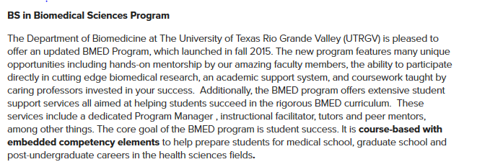
The Establishment

Slide 7
The Teacher Ed Opportunity

Slide 8
CBE Impact: New Models of Transcripts

Slide 9
CBE Impact: ‘Tuning’ of History and of Other Disciplines

Slide 10
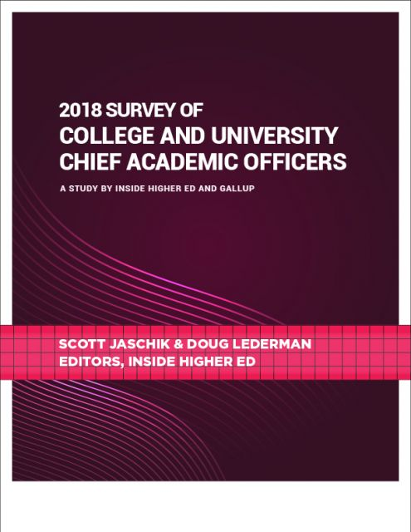
The Public-Private Gap and Why It Matters
Provosts in public higher education are more likely than private college counterparts to favor CBE (86 to 61 percent).
In public higher education, 26 percent fear CBE impact on general education. The figure is 47 percent in private higher ed.

Slide 11
The Irony on General Education

Slide 12
Direct Assessment
Accreditors
Education Department

Slide 13
The WGU Audit and the Faculty Role
Western Governors
Other colleges

Slide 14
Challenges / Opportunities
New models (beyond CBE) for master’s degrees and professional education
Public perceptions
Employers
Laws based on old models

Slide 15
Q&A
Your questions
Ideas for coverage

Slide 16
With Thanks …

