Slide 1
Access for All
How Cornell University Uses the Cloud to Reimagine Course Delivery
Presented by:
Rajesh Bhaskaran, Jeff Christen, and Sarah Christen
March 20, 2018

Slide 2
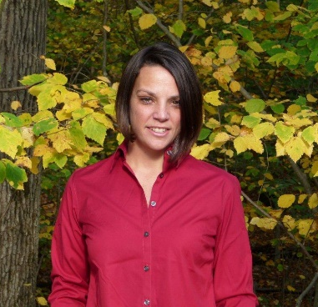
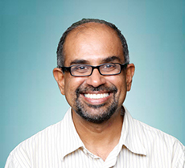
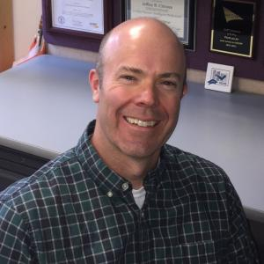
Today’s Presenters from Cornell University
Sarah Christen
Director, Community Platforms & Cloudification Services
sjc37@cornell.edu
Rajesh Bhaskaran
Sr. Lecturer and Swanson Director of Engineering Simulation
Bhaskaran@cornell.edu
Jeff Christen
Lecturer, Business Intelligence
jrc42@cornell.edu
Sponsored by:

Slide 3
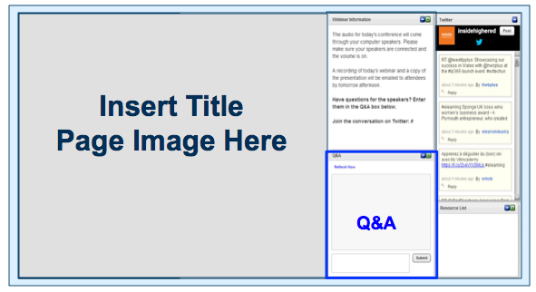
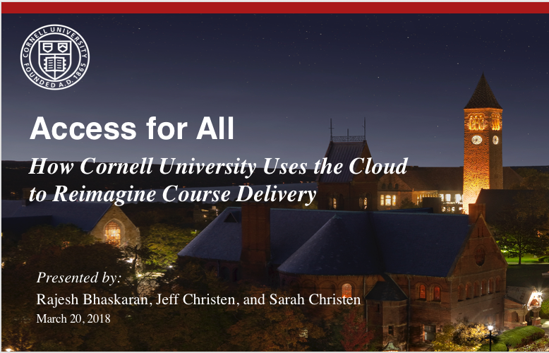
Before We Begin
We are using On24 for today’s webinar. Please enter questions in the text field at the bottom of the Q&A Window.
We are monitoring the discussion and will try to bring the Q&A comments into the conversation.
We are recording the webinar and will send a follow-up email tomorrow that provides the URL to access the presentation and the slides.
Enter Questions here

Slide 4
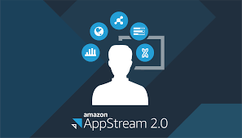
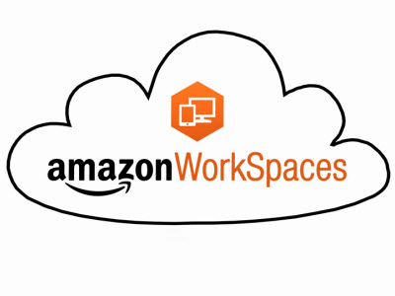
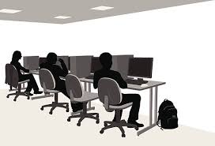
Our student lab journey

Slide 5
Traditional Computer Labs
Pros | Cons
In person support (computers and software) | Limited Lab Hours
Consistent install | No agility for software or configuration changes
All tools available like printers monitors | Limited time/space for instructor interaction with students/software
 | Maintenance and software updates
 | FTE for 7X24 support

Slide 6
Amazon WorkSpaces and Virtual Desktops
Pros | Cons
Access anywhere | Requires same maintenance as a full desktop
Any device | Need policy for student provided desktops
Consistent configuration | Students used it all the time, for purposes outside of class requirements.
Persistent environment | Cost
Any classroom becomes a lab
Easy roll out of software changes and updates

Slide 7
Amazon AppStream 2.0 and Application Streaming
Pros | Cons
Access anywhere, any device | Easy to over spend
Manage remotely, consistent configuration, agile updates | Persistent storage was a challenge (this is fixed now)
Non-persistent environment (resolves policy questions) | Iterative approach to what apps need to be in a stream
Auto scaling | Apps that need to work together
More control over environment. Just apps, not a desktop
Any classroom becomes a lab

Slide 8
Notes:
Next steps. We are creating a scalable service that our campus can use. We are running the service in a central VPC/account and are using a package once install many approach. We are developing a self service platform which will allow faculty, admins or tech support to select the applications they want to use (from a list of already packaged apps), size the instance and configure the scaling. They will also be able to view usage and cost information.
A note about auto-scaling. Streams auto scale but it take time. Around 30 minutes. To work around this AWS has created a new costing model for “sleeping” instances. For example if you know that 10pm is a high usage time for your class, you can have enough instances ready but sleeping to accommodate that usage. If an instance is sleeping, it takes about 1-2 minutes to come up. The scaling kicks in when you have run out of sleeping instances but takes closer to 30 minutes. Sleeping instances have a very small cost(?) but this saves you from having to run instances all the time to avoid the 30 minute wait.

Slide 9
Making Business Intelligence Courses Interactive

Slide 10
Goal of BI Systems Course
Blend of BI methodologies and technologies, with a focus on hands-on application of methodologies using leading industry technologies and real data.
Methodologies
BI requirements gathering
Dimensional Data Modeling
Data Analysis
ETL Design and Development
Data Visualization & Dashboard Development
Technologies
Oracle RDBMS
WhereScape RED
Tableau
SQL
Team Project to apply Methodologies and Technologies on a real BI Project for Cornell units

Slide 11
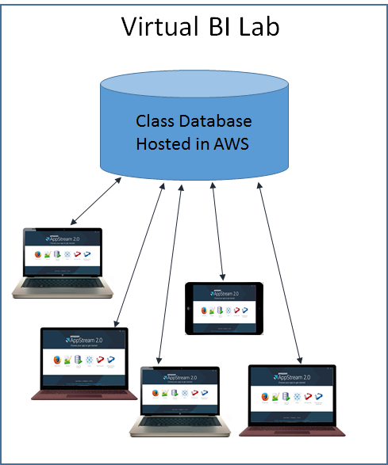
Virtual BI Lab
Lab Database
Each student has account
Contains many datasets for labs and projects
AppStream 2.0
Database driver
SQL Developer
WhereScape
Tableau

Slide 12
Why AppStream 2.0?
Ability to easily deliver Industry leading software to students
Configure once, then deploy
No need to support students installing software on their own devices
Data Security and Product license control
Data remains in AWS (not actually on students devices)
Donated software / TAs) access BI lab with any device from any location
Class demo easier to control (only lives on AppStream 2.0 images)
Students (and Instructor s and working sessions (brought Lab into Classroom)
Project team meetings held anywhere (not restricted to physical lab)
Office hours – can always access virtual lab
As instructor, easy to access to the virtual lab from home to answer student Piazza questions
Team project presentations to customers – live demos using AppStream 2.0

Slide 13
Democratizing Simulation Education
in Mechanical Engineering

Slide 14
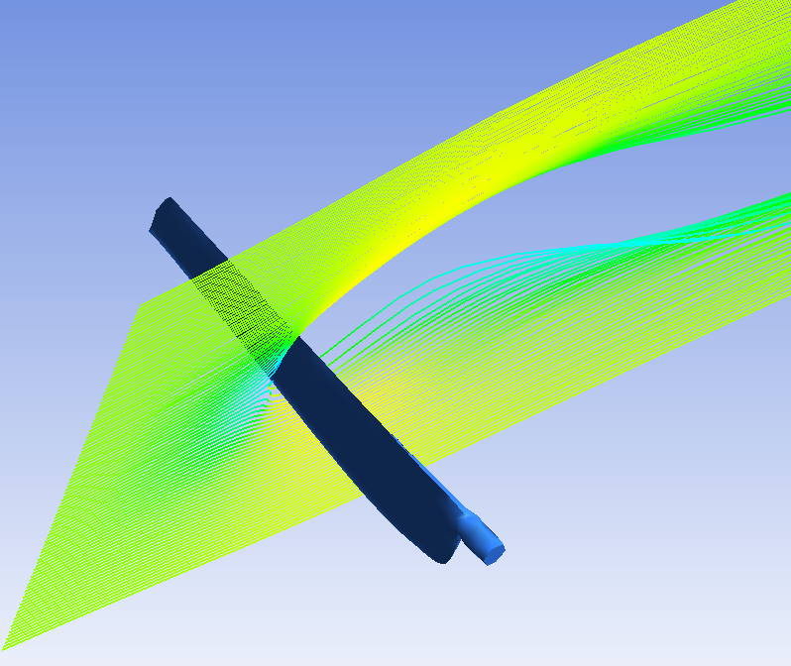
Demo Overview
Flow simulation for a wind turbine rotor from MAE 4020/5020 Wind Energy using ANSYS
Watch the demonstration video
https://youtu.be/gnFhziTWNjw

Slide 15
Introduction to Wind Turbine Simulations

Slide 16
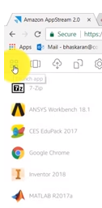
Access to ANSYS and other software in web browser with AppStream 2.0

Slide 17
Using software on remote machine similar experience to desktop

Slide 18
Annotate over software using tablet to support teaching

Slide 19
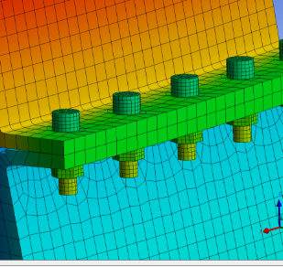
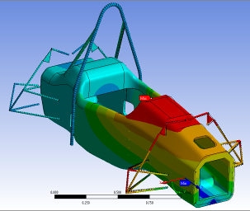
Why is this service important?
New technology
Each user gets own server on demand
Same solution works for 10, 100, or 100,000 students
New ways of teaching and learning
Democratizes simulations
Allows hands-on software instruction in MATLAB and CES during discussion sections
Solves MATLAB version mismatch problems
Students can use software for group problem solving
Gives software access for distance learning students and when computer labs are filled
Enables students to work on HW and projects when they are away for interviews, athletics
Engineering software often lacks Mac version. This solves by increasing cross platform access for students
Notes:
Discovery Live/Graphics instances
Removes resource barriers
Discussion section: CES in MAE 3270
Version mismatch:
-Teaching in Hollister during summer 2017 when ANSYS was still the old version
-Students have old versions of MATLAB on personal machines

Slide 20
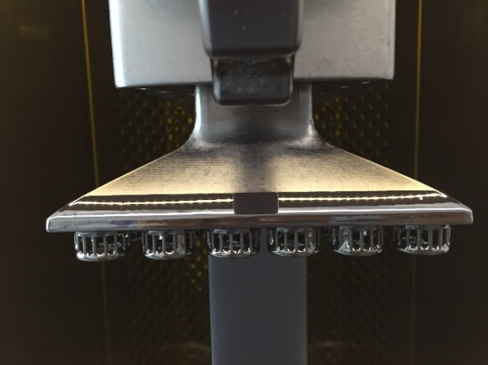
Feedback from students and faculty
MAE 3270 Mechanics for Engineering Materials mid-semester survey
Software: MATLAB and CES
57 used AppStream 2.0, 2 did not
3.9/5 rating (1 being "Terrible experience“ to 5 being "Great experience“)
MAE 4340/4341/5340 Innovative Product Design
Uses a new 3D printing tool that is 100X faster
Requires a lot of faces in the geometric representation that bogs down the computer
TA used AppStream 2.0 to process these files efficiently without making special trips to the lab
Students in this class will be able to build complex mechanical designs efficiently if they can use AppStream 2.0
Notes:
Attached is a picture of the printer with several parts attached to the inverted build tray
Using this to access programs like Solidworks made me more motivated to CAD because the program was accessible on my laptop. Solidworks on on-campus computers was faster for complicated geometries, but without buying a license or walking to a computer lab, I was unable to use this program at all. Overall, I really enjoyed using Appstream and can easily see it benefiting other students as well.

Slide 21
Resources
YouTube Video Demo: https://youtu.be/gnFhziTWNjw
Simulations MOOC on edX: http://bit.ly/2DEpniL
Amazon AppStream 2.0: https://aws.amazon.com/appstream2/
Amazon WorkSpaces: https://aws.amazon.com/education/workspaces-in-edu/

Slide 22
Questions?

Slide 23
Today’s Presenters from Cornell University
Sarah Christen
Director, Community Platforms & Cloudification Services
sjc37@cornell.edu
Rajesh Bhaskaran
Sr. Lecturer and Swanson Director of Engineering Simulation
Bhaskaran@cornell.edu
Jeff Christen
Lecturer, Business Intelligence
jrc42@cornell.edu
Sponsored by:

Slide 24
Thank You!

