Slide 1
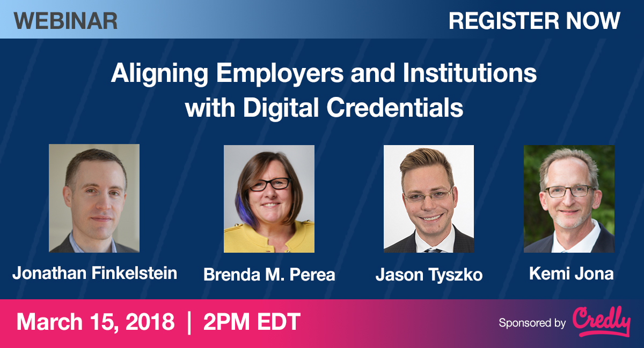

@JEFinkelstein
@Credly
@pereaink
@Credly
@jason_tyszko
@USCCFeducation
@KemiJona
@Northeastern
#WorkforceRelevant

Slide 2

Jonathan Finkelstein
Founder and Chief Executive Officer
Credly, Inc
#WorkforceRelevant

Slide 3
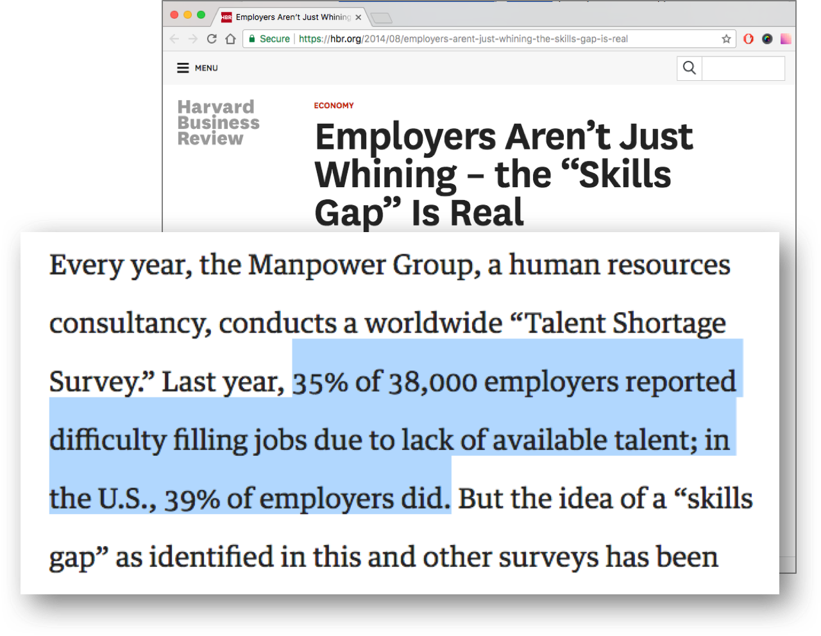
#WorkforceRelevant

Slide 4

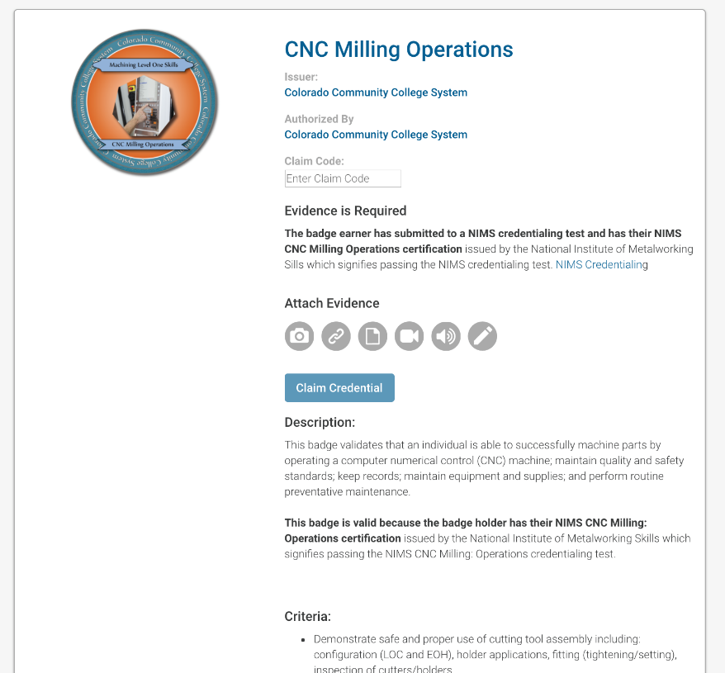
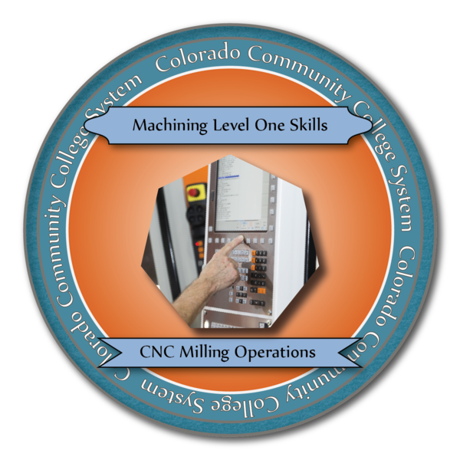
Connecting Verified Competencies to Jobs
Learner
15,000
Advanced
Manufacturing
Jobs Unfilled in CO
School
Employer
#WorkforceRelevant

Slide 5
POLL QUESTIONS
What perspective are you coming from today?
  Employer
  Academic Institution
  Individual
How strong are the relationships between the employers and/or institutions that are most relevant in your community?
  1-Very Weak 2 3 4 5-Very Strong

Slide 6

Jason Tyszko
Executive Director
U.S. Chamber of Commerce Foundation
#WorkforceRelevant

Slide 7
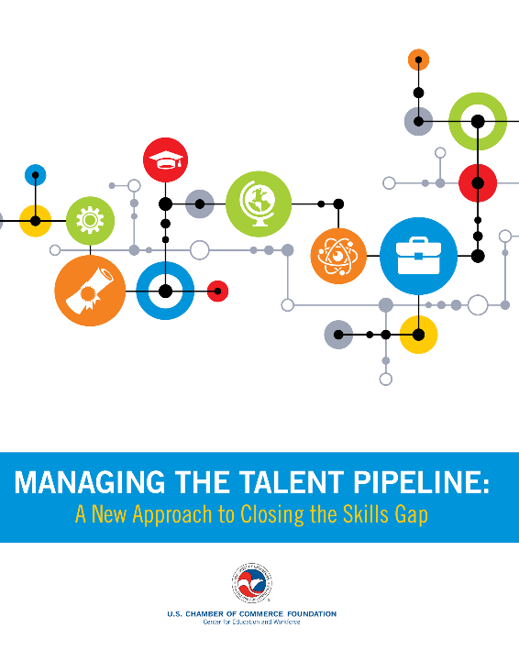
92% of executives believe there is a serious gap in workforce skills
Nearly 50% report that they are struggling to fill jobs
If left unaddressed, the skills gap could cause more than 5 million positions to go unfilled by 2020
Forgone revenue and profits can be as high as $23,000 per unfilled position
#WorkforceRelevant

Slide 8

Dr. Kemi Jona
Associate Dean, College of Professional Studies at Northeastern University
Founding Director, Lowell Institute School
#WorkforceRelevant

Slide 9

Brenda Perea
Director of Educational & Workforce Solutions
Credly, Inc
#WorkforceRelevant

Slide 10
Aligning Needs with
Skills and Capabilities
What changes for employers, institutions, and job-seekers as people increasingly move back and forth between academic and employment contexts?
#WorkforceRelevant

Slide 11
The Skills Gap and the Communications Gap
How do institutions, employers, and individuals evolve to have more meaningful conversations around their needs, skills, and capabilities?
#WorkforceRelevant

Slide 12
Workforce-Relevant Digital Credentials
What roles do digital credentials play in helping everyone speak the same language?
#WorkforceRelevant

Slide 13
Effective Institution-Employer Partnerships
What are the most important considerations when starting to develop partnerships to close the gaps?
What should each know about the other?
#WorkforceRelevant

Slide 14
Learner Impact
What changes for the learners, students, and employees as the skills and capabilities discussions become more granular and transparent?
#WorkforceRelevant

Slide 15
Q & A?
#WorkforceRelevant

Slide 16
For Additional Resources
Employer Engagement Field Guide
Managing the Talent Pipeline: A New Approach to Closing the Skills Gap
New Model for Earn and Learn: Quality Pathways: Employer Leadership in Earn and Learn Opportunities, a solution for the business community to increase employer investment in workforce training, outlines a five-step roadmap for employers to create and scale new earn and learn career pathways. Learn more at uschamberfoundation.org/QualityPathways.
Better Signaling: Learn more about challenges employers face communicating hiring requirements consistently in a rapidly changing economy and labor market in Clearer Signals, a report calling on the business community to transform how hiring requirements are organized and communicated.
Talent Supply Chains: Hope is not a strategy for closing the skills gap. 300+ employers across the country are using Talent Pipeline ManagementTM to close the skills gap for their industry and in some cases, state-wide. Learn more or join the movement at TheTalentSupplyChain.org.
Web 3.0 Technology Convergence & Interoperability.
#WorkforceRelevant

Slide 17
Thank You
Jonathan Finkelstein (@JEFinkelstein)
  Founder and CEO, Credly
Jason Tyszko (@jason_tyszko)
  Executive Director, U.S. Chamber of Commerce Foundation
Kemi Jona (@KemiJona)
  Associate Dean, College of Professional Studies at Northeastern University
Brenda Perea (@pereaink)
  Director of Educational & Workforce Solutions, Credly
#WorkforceRelevant

Slide 18




The “Communications Gap” is Real, Too
EDUCATORS & TRAINERS
EMPLOYEES
EMPLOYERS
Certificate
Resume
Job Description

Slide 19
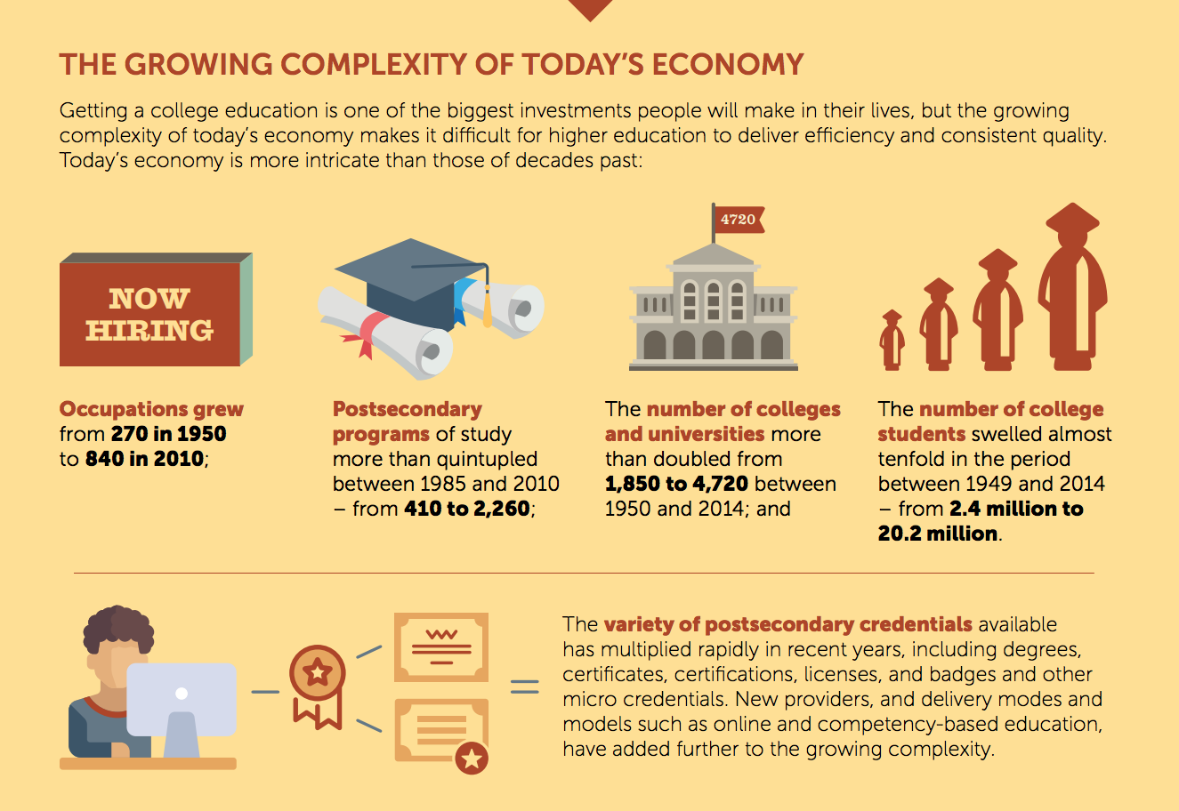
Source: Georgetown University Center on Education and the Workforce, Career Pathways: Five Ways to Connect College and Careers, 2017.

Slide 21
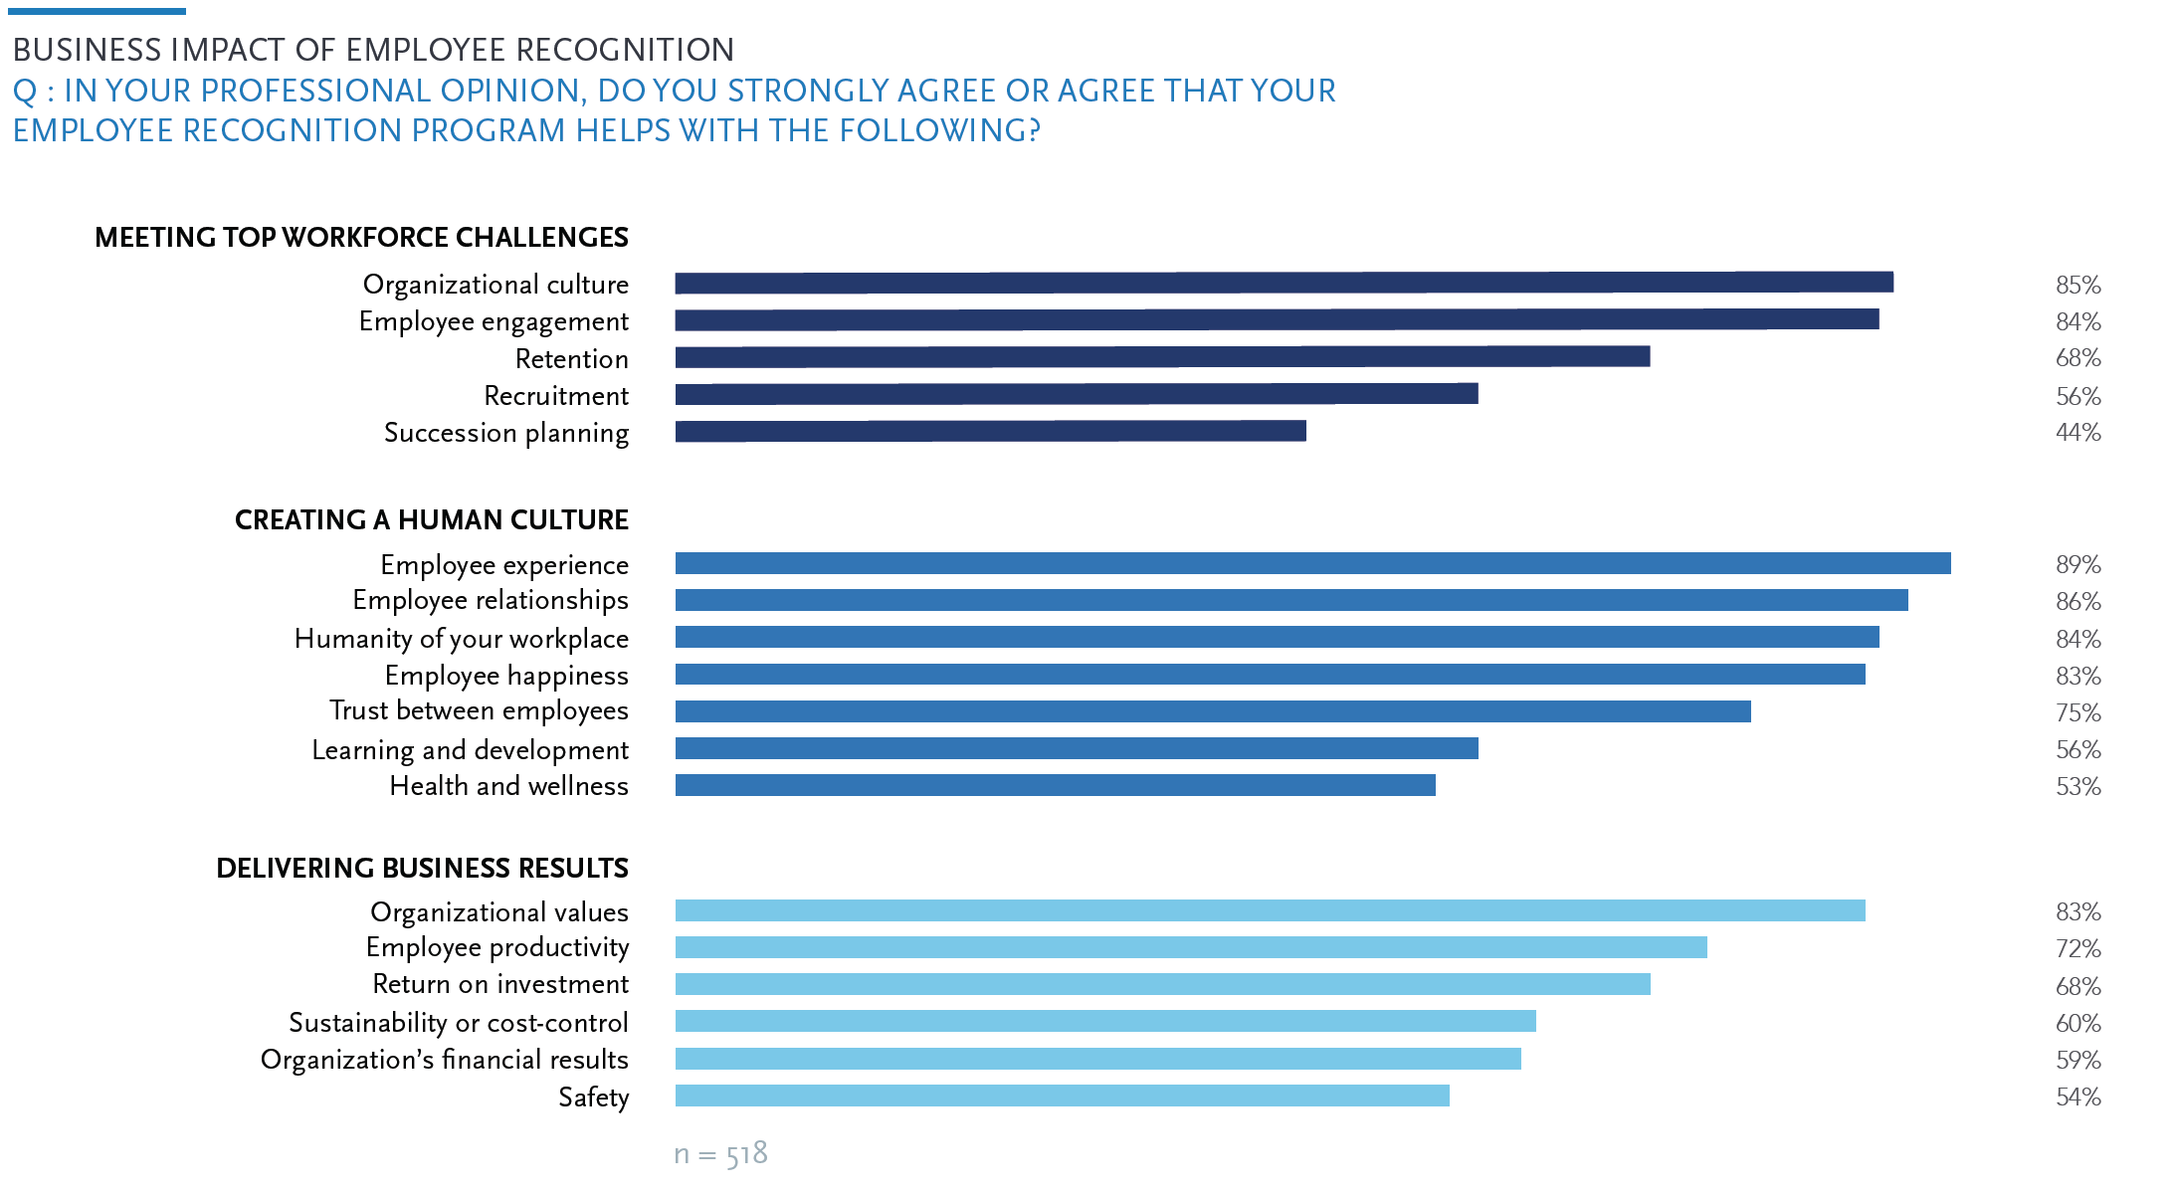
“A majority of HR
professionals say their
employee recognition program
helps with organizational
culture, employee engagement,
employee experience, employee
relationships, and organizational
values.
“As such, HR should treat
employee recognition as
not just a program, but a
management practice
that has very real
business impact.”
Source: THE 2018 SHRM/GLOBOFORCE
EMPLOYEE RECOGNITION REPORT:
Designing work cultures for the human era
Notes:
“A majority of HR professionals say their employee recognition program helps with organizational culture (85%), employee engagement (84%), employee experience (89%), employee relationships (86%), and organizational values (83%). As such, HR should treat employee recognition as not just a program, but a management practice that has very real business impact.”

Slide 22
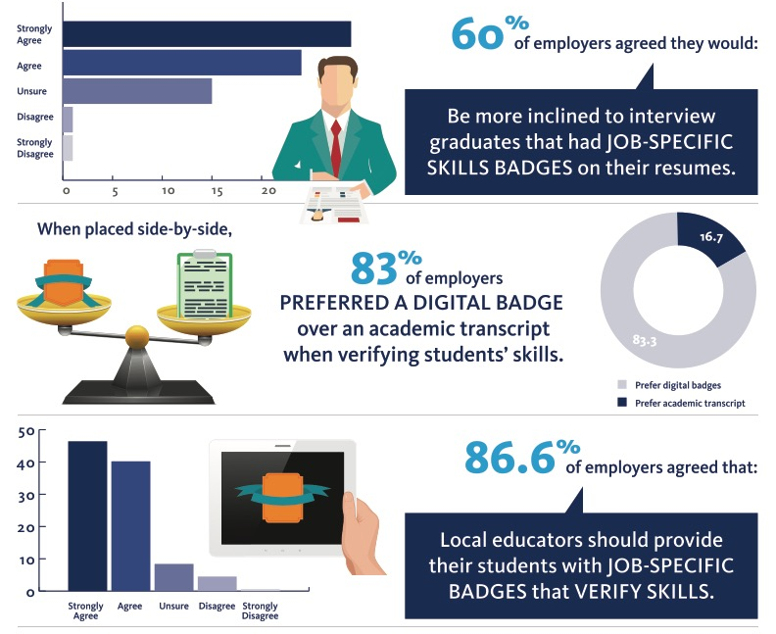
Employers Prefer Verified Skills & Digital Credentials
Source: Competency Matters / Wonderlic
https://www.competencymatters.org/soft-skills-infographics

Slide 23
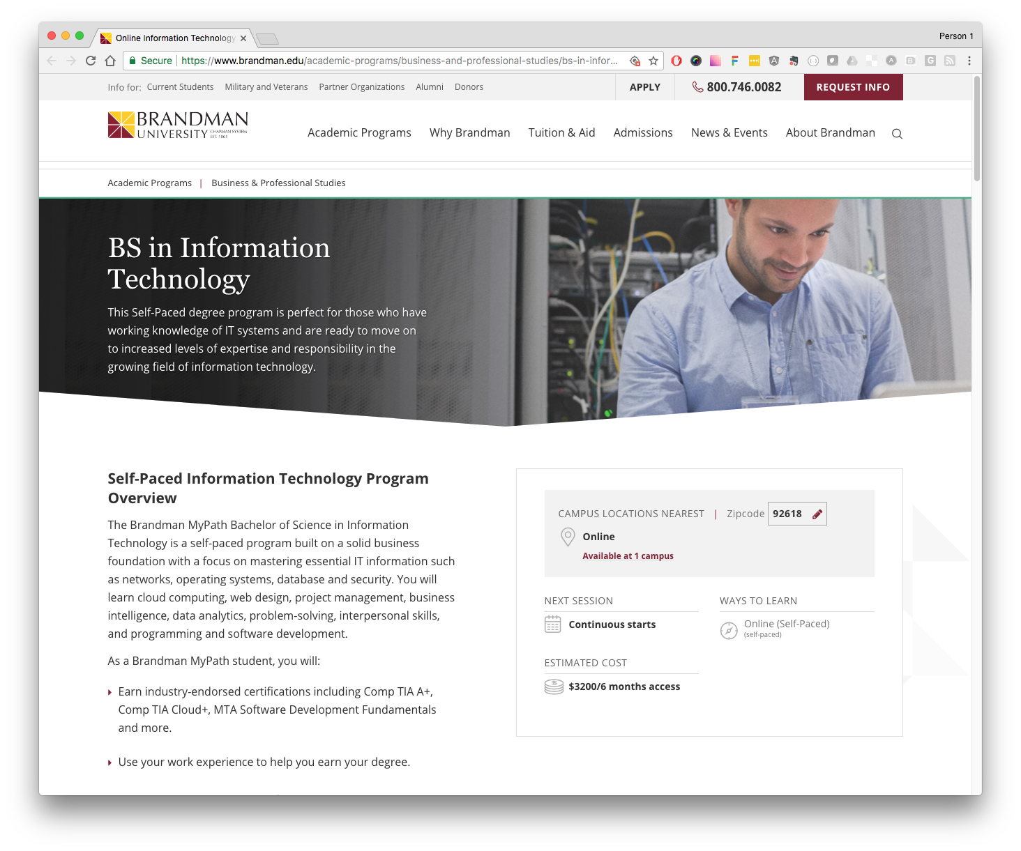
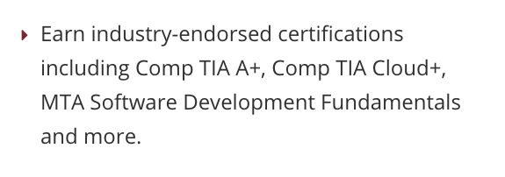

Slide 24
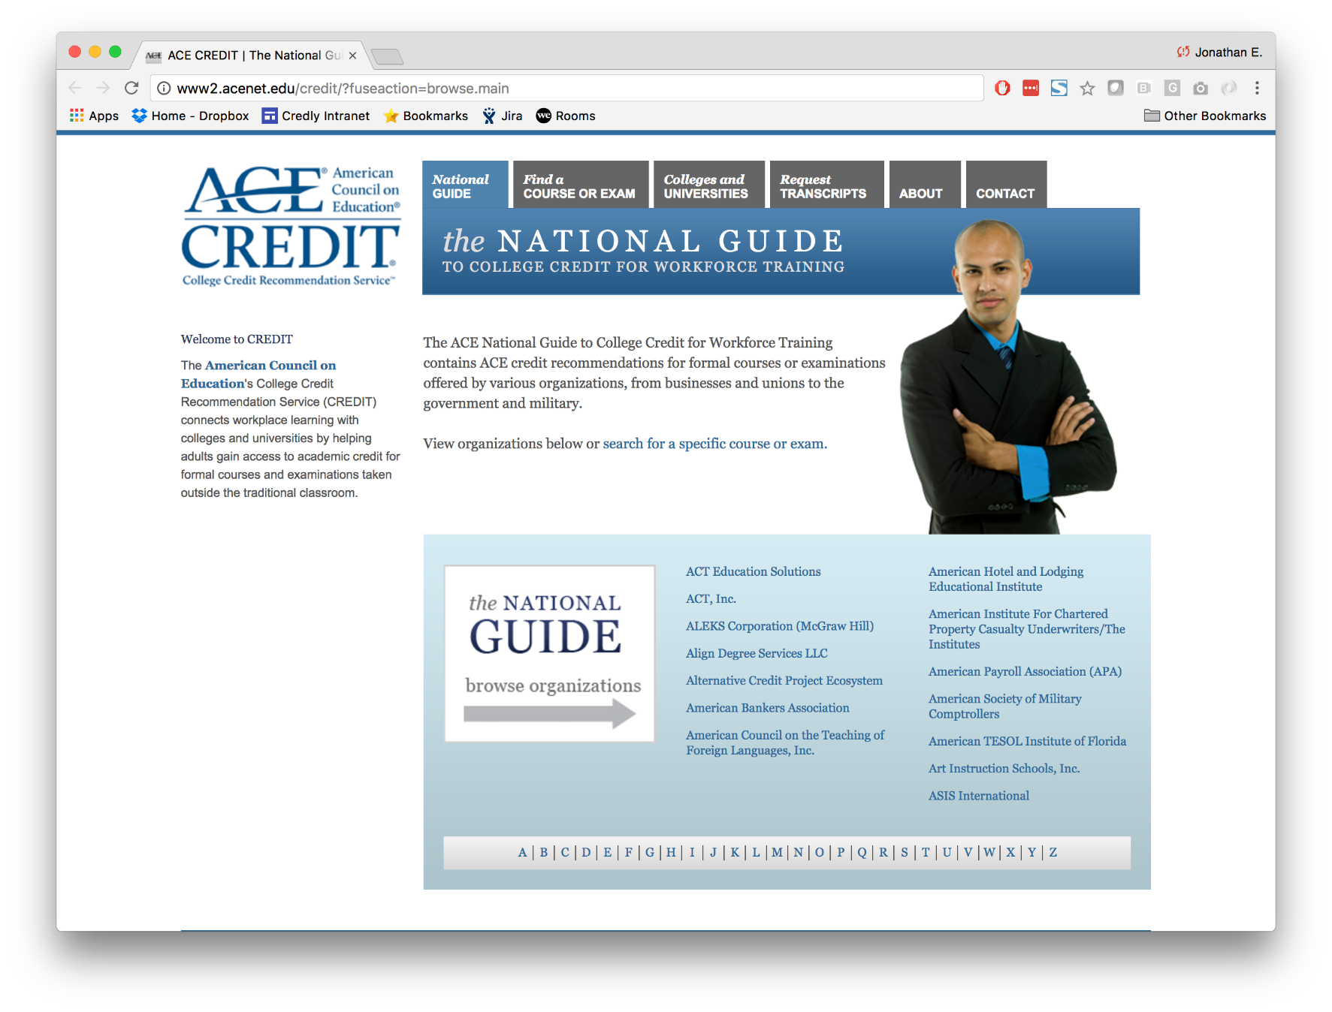
Digital Credentials drive innovation in
employers’ relationship with education
Notes:
On-the-job training courses recommended for college credit
CREDIT-recommended courses issue ACE CREDIT-endorsed digital credentials.
Employee engagement strategies center on continuous learning

Slide 25
