Slide 1
A Culture of Assessment
Wednesday, August 4
An Inside Higher Ed webcast
2 p.m. Eastern

Slide 2
Presenters
Scott Jaschik, editor, Inside Higher Ed, scott.jaschik@insidehighered.com
Doug Lederman, editor, Inside Higher Ed, doug.lederman@insidehighered.com

Slide 3
What Is the History of Assessment?
From doing things that are required (with a few believers).
To doing things that will genuinely improve an institution (and that may also satisfy those looking on).

Slide 4
What Is Assessment’s Purpose?
For students
For faculty members
For academic programs
For institutions
For accreditors
For state and federal officials

Slide 5

When Is a Learning Community
Not a Learning Community?

Slide 6

How Can State Financing Models
Promote Equity?
--University of Cincinnati

Slide 7

Student Evaluations of Faculty Members
--Wikimedia Commons

Slide 8

Who Needs Remediation?
--Brauns/E+/Getty Images

Slide 9
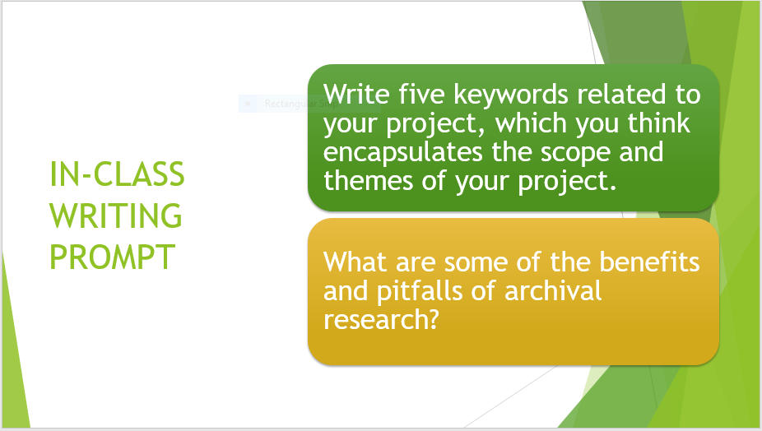
Assessing Student Participation

Slide 10
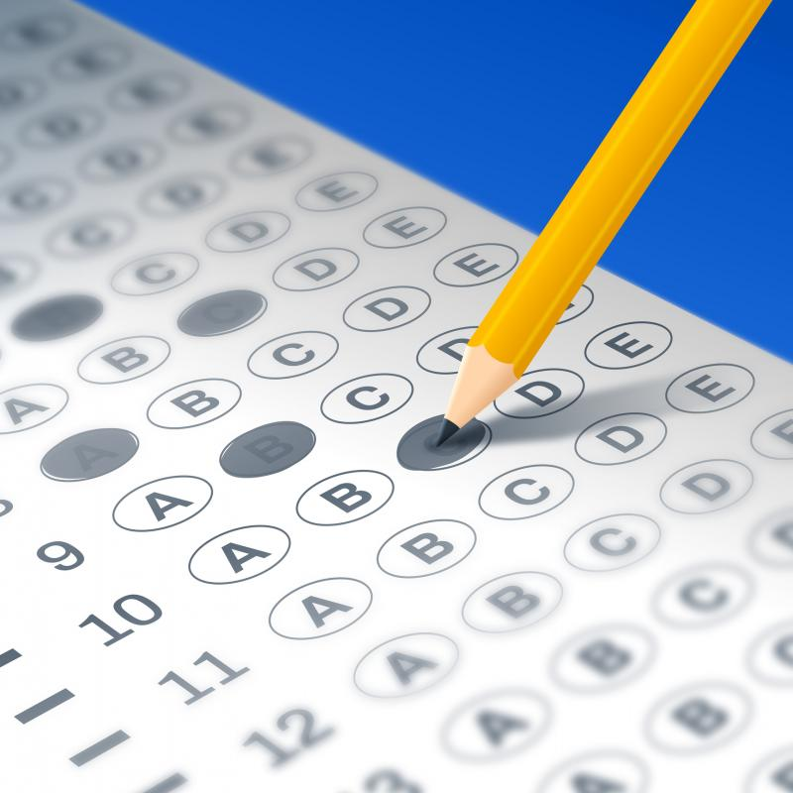
Higher Order
Multiple Choice Tests
--Filo/Getty Images

Slide 11
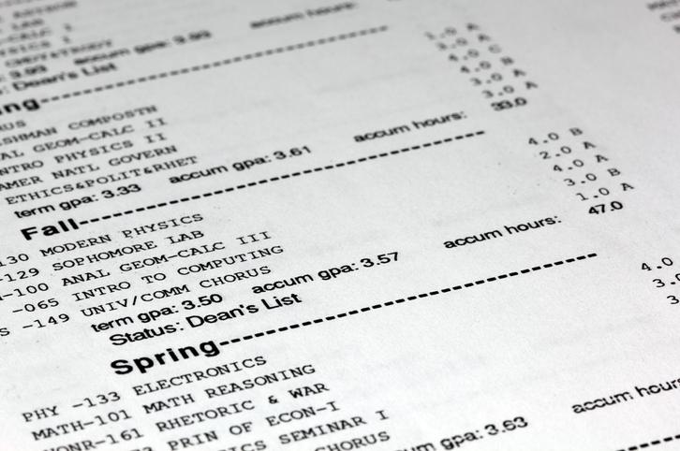
Transcripts for Careers
--Threespeed Jones/Getty Images

Slide 12

Self-Knowledge in a Changing
World of Work
--Imrsquid/Getty Images

Slide 13

Are We Creating a Culture of Assessment?
--Canan Turan/Getty Images

Slide 14
Q&A

Slide 15
With Thanks

