Slide 1
The New Accessibility:
Students With Disabilities and Access to Technology
An Inside Higher Ed webcast
Thursday, April 23, 2020
2 p.m. Eastern

Slide 2
Presenters
Scott Jaschik, editor, Inside Higher Ed, scott.jaschik@insidehighered.com
Doug Lederman, editor, Inside Higher Ed, doug.lederman@insidehighered.com

Slide 3

The Digital Courseware
Accessibility Problem
--iStock

Slide 4

Going Online
With a Learning Disability
Landmark College

Slide 5
Helping Institutions
Reach Accessibility Goals
The institution has a coordinated system for offering students what they need.
Students who require support receive it “in a timely way.”
Written guidelines outline procedures for students to seek support.
Accessibility efforts are supported by “sufficient fiscal, human and infrastructure resources.”

Slide 6
Dubious Faculty Members
The real problem
How to combat it

Slide 7
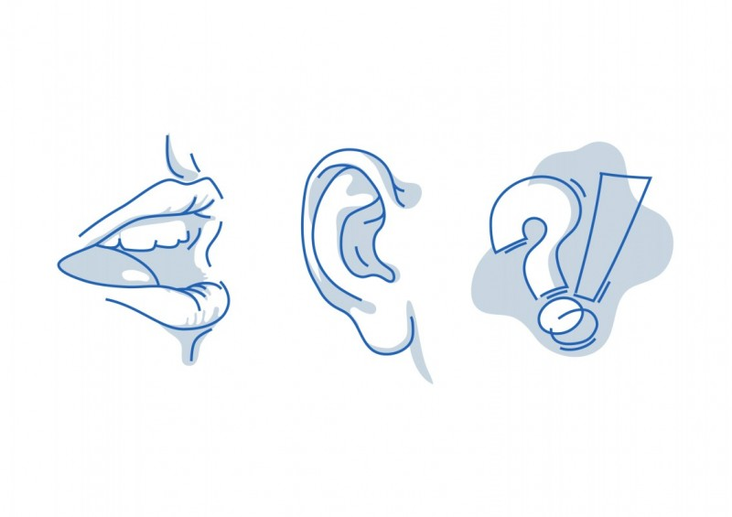
The Fight Over Captioning
--iStock

Slide 8
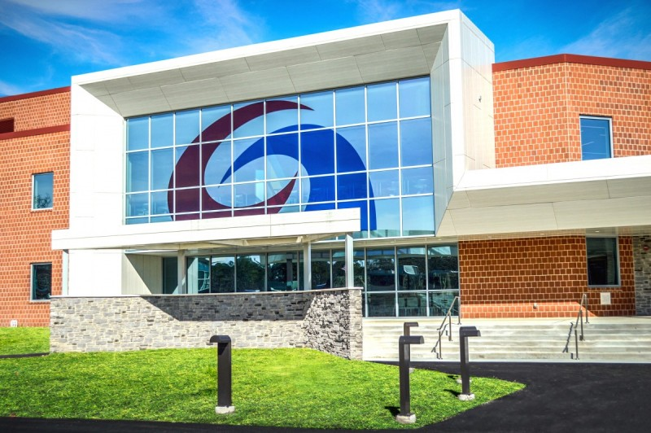
How a Lawsuit Prompted
One College to Change

Slide 9

What Technology Can
(and Can’t Do)

Slide 10
COVID-19
The rules are the same, but…
--The circumstances are different
--Courts may rule in different ways (right now)
--But if we are online in the fall …

Slide 11

With Thanks …

Slide 12
Your Questions

