Slide 1
A Brighter Future:
What to look for in a new learning management system Robert J. McCunney – University of the Sciences
Svetlana Lyutsko – University of the Sciences
Dr. Christopher Sessums – D2L
Notes:
Use these slides for prospects who DO NOT KNOW us

Slide 2
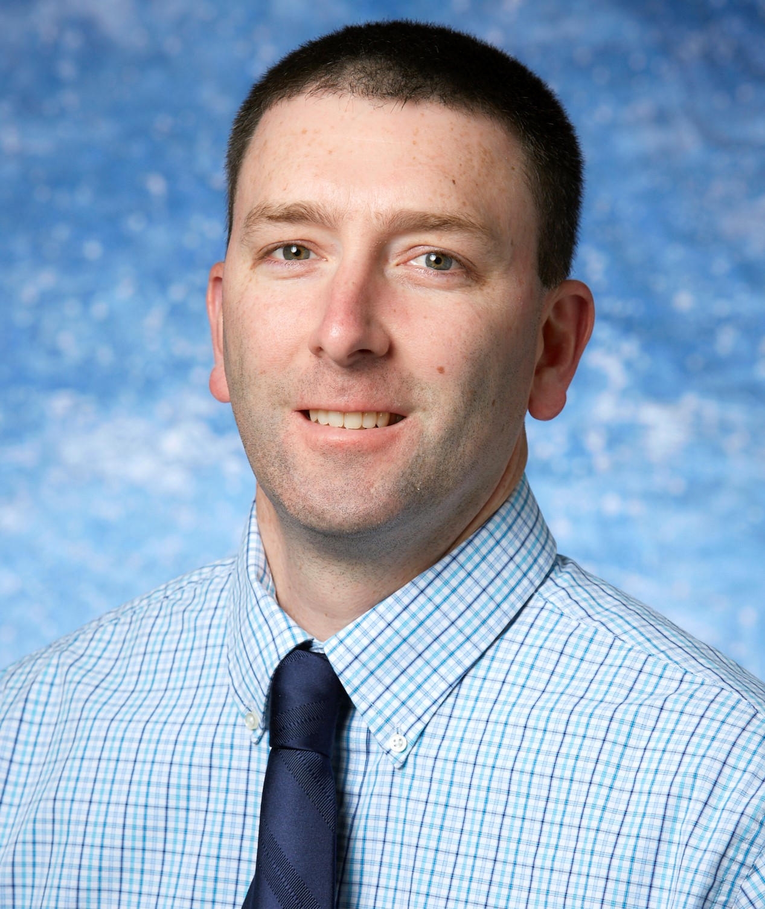
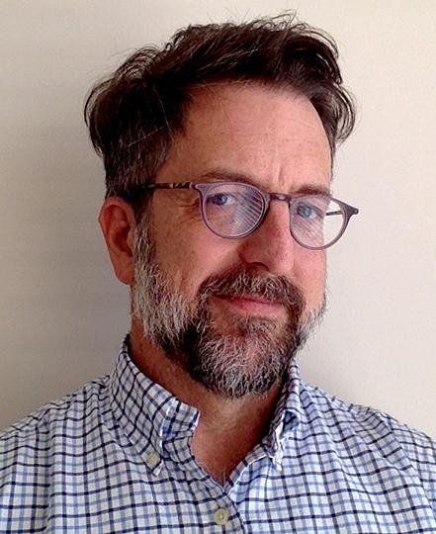
PRESENTERS
Sr Instructional Designer
University of the Sciences
Robert J. McCunney
r.mccunney@usciences.edu
Instructional Designer
University of the Sciences
Svetlana Lyutsko
s.lyutsko@usciences.edu
Director of Academic Affairs
D2L
Dr. Christopher Sessums
christopher.sessums@d2l.com
Notes:
Use these slides for prospects who DO NOT KNOW us

Slide 3
Essential Question
What are key factors
to consider when adopting
a new learning management
system?
https://www.leapclixx.com/hubfs/Blog_Images/key-factors-to-running-a-successful-inbound-marketing-campaign-part-3.jpg
Notes:
<sales executive to research in advance>
Sample Strategic Drivers:
Grow enrollment by launching new (or uplifting) online programs and courses
Improve retention by improving how we give feedback and spot at-risk learners
Improve student success by increasing engagement, satisfaction, and improving learning outcomes
Help me find efficiencies and a better ROI with insights from data
Futureproof my college or university and help me rise to the challenges of better preparing students for life and the workforce of today and the future (Future of Work)

Slide 4
Agenda
Setting the stage
Exploring solutions
Evaluating solutions
Selection process
Critical reflection
Final questions
> Q&A break every 5-7 minutes.

Slide 5
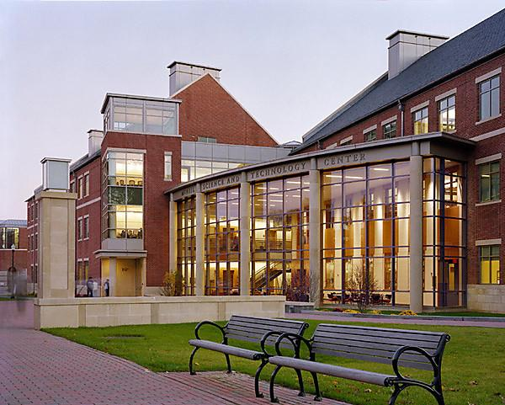
Background
Founded as Philadelphia College of Pharmacy in 1821.
First College of Pharmacy in North America.
Degrees in the health sciences, bench sciences, healthcare business and policy fields, and emerging related disciplines.
Sits on 36 acres in the heart of University City, just west of Center City, Philadelphia, PA.
Private institution with Undergraduate and Graduate Enrollment 2,300+
Consist of 4 Colleges and USciences Online Division
https://www.usciences.edu/
Notes:
<sales executive to research in advance>
Faculty pain points can be hot buttons:
‘I don’t have enough time in the day to do all the things I need to do.’
‘It’s not easy to use technology, and I struggle to make my content accessible and mobile friendly.’
‘It is hard to build learning experiences that keep my students engaged.’
‘I struggle to provide impactful feedback, quickly, and to all students.'
Leadership & Admin pains:
‘Dealing with faculty complaints. They need the system to just work and be more efficient – with the tedious tasks automated.’
‘I’m overwhelmed with too little good data, and struggle to gather the insights to drive the key actions to achieve our goals.’
‘I struggle with creating the infrastructure to support an increasingly diverse student population with varying means and abilities – including providing the right accommodations for students that are blind, deaf, or have other learning disabilities.’
‘I struggle to move the needle on retention’
‘I can’t scale effectively because I have too many things I need to do, and it takes too long to do them all. I need mindless tasks to be automated.’
‘I’m stuck without a partner – they are not listening to my requests, and keep missing expectations on new product delivery’
‘I’m struggling with reliability of the service, especially with large class sizes and the gradebook’
‘I’m spending a lot on people to support the system, and yet I’m still struggling to keep up with the latest upgrades and stay current. Plus, in a tight labor market I’m at risk of losing my technical resource’
‘My customizations are not making their way into the core product creating a maintenance headache’
‘I can’t easily and quickly integrate all of the systems and tools faculty and students use.’
‘My help desk is overwhelmed, and we don’t have time to handle all of the calls.’
Student pains:
‘I’m overwhelmed, and I need help managing my time, and help me build a clear expectation of what I need to do to be successful.’
‘I can’t easily reach my instructor or get feedback when I need or expect it.’
‘I need the system to be reliable.’
‘I really want the system to work on all my different mobile devices – so I can finish a learning activity, take the quiz or submit my assignment from anywhere.’

Slide 6
Setting the stage
What obstacles were you facing with your old learning management system?
How did you quantify and qualify a decision to switch?
https://www.incimages.com/uploaded_files/image/970x450/hurdles-track_1940x900_33807.jpg
Notes:
<sales executive to research in advance>
Sample Strategic Drivers:
Grow enrollment by launching new (or uplifting) online programs and courses
Improve retention by improving how we give feedback and spot at-risk learners
Improve student success by increasing engagement, satisfaction, and improving learning outcomes
Help me find efficiencies and a better ROI with insights from data
Futureproof my college or university and help me rise to the challenges of better preparing students for life and the workforce of today and the future (Future of Work)

Slide 7
Setting the stage
Obstacles:
Most recent upgrade to the existing LMS missed the mark
Significant resources and training still did not lead to positive outcomes
Faculty faith in existing LMS eroded
Notes:
<sales executive to research in advance>
Sample Strategic Drivers:
Grow enrollment by launching new (or uplifting) online programs and courses
Improve retention by improving how we give feedback and spot at-risk learners
Improve student success by increasing engagement, satisfaction, and improving learning outcomes
Help me find efficiencies and a better ROI with insights from data
Futureproof my college or university and help me rise to the challenges of better preparing students for life and the workforce of today and the future (Future of Work)

Slide 8
Setting the stage
Rationale for our decision to switch:
Timeline for contract renewal of current LMS
Budget concerns forced evaluations of all contracts
Launch of USciences Online in 2020
Change or go “all-in”. Longer term contract was most likely an outcome.
Notes:
<sales executive to research in advance>
Sample Strategic Drivers:
Grow enrollment by launching new (or uplifting) online programs and courses
Improve retention by improving how we give feedback and spot at-risk learners
Improve student success by increasing engagement, satisfaction, and improving learning outcomes
Help me find efficiencies and a better ROI with insights from data
Futureproof my college or university and help me rise to the challenges of better preparing students for life and the workforce of today and the future (Future of Work)

Slide 9
Exploring solutions
What was your process of investigating new solutions?
What steps did you take?
https://www.investigate.uk/wp-content/uploads/2016/09/sherlock-holmes.jpg
Notes:
<sales executive to research in advance>
Sample Strategic Drivers:
Grow enrollment by launching new (or uplifting) online programs and courses
Improve retention by improving how we give feedback and spot at-risk learners
Improve student success by increasing engagement, satisfaction, and improving learning outcomes
Help me find efficiencies and a better ROI with insights from data
Futureproof my college or university and help me rise to the challenges of better preparing students for life and the workforce of today and the future (Future of Work)

Slide 10
Evaluating solutions
Process
Compiled basic requirements for any LMS to be considered in RFP.
Focused live demos on specifics.
Categories included: Conversion, technical and course level requirements as well as grading and integrations.
Noted major differences or missing functionality.
Notes:
<sales executive to research in advance>
Sample Strategic Drivers:
Grow enrollment by launching new (or uplifting) online programs and courses
Improve retention by improving how we give feedback and spot at-risk learners
Improve student success by increasing engagement, satisfaction, and improving learning outcomes
Help me find efficiencies and a better ROI with insights from data
Futureproof my college or university and help me rise to the challenges of better preparing students for life and the workforce of today and the future (Future of Work)

Slide 11
Exploring solutions
Steps:
Created a committee that consisted of faculty representatives from all colleges, as well as IT and AT staff;
Met with vendors and created a scorecard for RFP evaluation;
Provided the vendors with courses of various complexity from our current LMS for course conversion;
Set up deadlines for making the decision;
Made the decision based on the committee’s findings instead of opening it up to all of the faculty.
Notes:
<sales executive to research in advance>
Sample Strategic Drivers:
Grow enrollment by launching new (or uplifting) online programs and courses
Improve retention by improving how we give feedback and spot at-risk learners
Improve student success by increasing engagement, satisfaction, and improving learning outcomes
Help me find efficiencies and a better ROI with insights from data
Futureproof my college or university and help me rise to the challenges of better preparing students for life and the workforce of today and the future (Future of Work)

Slide 12
QUESTIONS?
Notes:
<use these slides for prospects who KNOW US, but need to see the NEW D2L>
But we’re not the same LMS from decades ago. It’s time you took another look.

Slide 13
Evaluating solutions
What criteria did you use to evaluate platforms?
Who was involved in the evaluation process?
https://i.pinimg.com/originals/d8/41/fc/d841fc1ee5b147d9629b200eb9a4ff68.jpg
Notes:
<sales executive to research in advance>
Sample Strategic Drivers:
Grow enrollment by launching new (or uplifting) online programs and courses
Improve retention by improving how we give feedback and spot at-risk learners
Improve student success by increasing engagement, satisfaction, and improving learning outcomes
Help me find efficiencies and a better ROI with insights from data
Futureproof my college or university and help me rise to the challenges of better preparing students for life and the workforce of today and the future (Future of Work)

Slide 14
Exploring solutions
Criteria:
Conducted RFP review and live demos of leading LMS platforms, including the documentation from our current platform.
Main focus of the review:
robust gradebook;
comprehensive analytics package of both student and instructor use of the platform;
ability to convert courses from our current LMS;
compatibility with USciences Online vision;
financial aspect.
Notes:
<sales executive to research in advance>
Sample Strategic Drivers:
Grow enrollment by launching new (or uplifting) online programs and courses
Improve retention by improving how we give feedback and spot at-risk learners
Improve student success by increasing engagement, satisfaction, and improving learning outcomes
Help me find efficiencies and a better ROI with insights from data
Futureproof my college or university and help me rise to the challenges of better preparing students for life and the workforce of today and the future (Future of Work)

Slide 15
Evaluating solutions
Stakeholders:
Faculty from multiple schools/programs
PCP faculty: complicated gradebook, multiple sections, new curriculum
ID/LMS Administrators - staff of two
IT
USciences Online: need for a modern, easy to use platform suitable for fully online courses and programs
Notes:
<sales executive to research in advance>
Sample Strategic Drivers:
Grow enrollment by launching new (or uplifting) online programs and courses
Improve retention by improving how we give feedback and spot at-risk learners
Improve student success by increasing engagement, satisfaction, and improving learning outcomes
Help me find efficiencies and a better ROI with insights from data
Futureproof my college or university and help me rise to the challenges of better preparing students for life and the workforce of today and the future (Future of Work)

Slide 16
Selection process
What did you learn from the LMS selection process?
https://www.teachingenglish.org.uk/sites/teacheng/files/styles/large/public/images/light_bulb_RS4558_176430210-web_0.jpg?itok=1fxqPZNu
Notes:
<sales executive to research in advance>
Sample Strategic Drivers:
Grow enrollment by launching new (or uplifting) online programs and courses
Improve retention by improving how we give feedback and spot at-risk learners
Improve student success by increasing engagement, satisfaction, and improving learning outcomes
Help me find efficiencies and a better ROI with insights from data
Futureproof my college or university and help me rise to the challenges of better preparing students for life and the workforce of today and the future (Future of Work)

Slide 17
Selection process
Lessons Learned:
Limiting the number of people who participate in the discussion, provide more effective results and a faster decision making
Live demo is important; it’s easy to say “yes to all” on paper / in RFP document
Focused live demo. Not a commercial.
Hidden fees / additional costs, etc.
Notes:
<sales executive to research in advance>
Sample Strategic Drivers:
Grow enrollment by launching new (or uplifting) online programs and courses
Improve retention by improving how we give feedback and spot at-risk learners
Improve student success by increasing engagement, satisfaction, and improving learning outcomes
Help me find efficiencies and a better ROI with insights from data
Futureproof my college or university and help me rise to the challenges of better preparing students for life and the workforce of today and the future (Future of Work)

Slide 18
QUESTIONS?
Notes:
<use these slides for prospects who KNOW US, but need to see the NEW D2L>
But we’re not the same LMS from decades ago. It’s time you took another look.

Slide 19
Critical reflection
What were your key learnings / takeaways from selecting a new learning management system?
What advice do you have for others when evaluating an LMS?
https://images-na.ssl-images-amazon.com/images/I/613xhIZQXDL._SX466_.jpg
Notes:
<sales executive to research in advance>
Sample Strategic Drivers:
Grow enrollment by launching new (or uplifting) online programs and courses
Improve retention by improving how we give feedback and spot at-risk learners
Improve student success by increasing engagement, satisfaction, and improving learning outcomes
Help me find efficiencies and a better ROI with insights from data
Futureproof my college or university and help me rise to the challenges of better preparing students for life and the workforce of today and the future (Future of Work)

Slide 20
Critical reflection
USciences responses:
Don’t be afraid of the change, approach this process with an open mind, and don’t focus on current limitations or obstacles.
This is a good time to re-evaluate “how we’ve always done things”.
Switching to a new LMS might be a good time to introduce new online learning policies (for example, mandatory online training for the faculty, etc.)
Notes:
<sales executive to research in advance>
Sample Strategic Drivers:
Grow enrollment by launching new (or uplifting) online programs and courses
Improve retention by improving how we give feedback and spot at-risk learners
Improve student success by increasing engagement, satisfaction, and improving learning outcomes
Help me find efficiencies and a better ROI with insights from data
Futureproof my college or university and help me rise to the challenges of better preparing students for life and the workforce of today and the future (Future of Work)

Slide 21
Critical reflection
Advice:
Convene a diverse yet focused evaluation committee.
Provide specifics for live demos for efficient use of meetings. bypass the “fluff”.
Ask questions about unique use cases
Be open about your process and your timeline with vendors.
Be realistic about timeline and faculty availability.
Notes:
<sales executive to research in advance>
Sample Strategic Drivers:
Grow enrollment by launching new (or uplifting) online programs and courses
Improve retention by improving how we give feedback and spot at-risk learners
Improve student success by increasing engagement, satisfaction, and improving learning outcomes
Help me find efficiencies and a better ROI with insights from data
Futureproof my college or university and help me rise to the challenges of better preparing students for life and the workforce of today and the future (Future of Work)

Slide 22
QUESTIONS?
Notes:
<use these slides for prospects who KNOW US, but need to see the NEW D2L>
But we’re not the same LMS from decades ago. It’s time you took another look.

