Slide 1
Key Issues on Student Debt
An Inside Higher Ed webcast
Tuesday, July 10
2 p.m. Eastern

Slide 2
Presenters
Scott Jaschik, editor, Inside Higher Ed scott.jaschik@insidehighered.com
Doug Lederman, editor, Inside Higher Ed doug.lederman@insidehighered.com

Slide 3
Some Key Distinctions
Current borrowing vs. debt levels
Sector trends
Federally backed loans vs. private loans
Federal, state and institutional policies
The very worst kind of debt

Slide 4
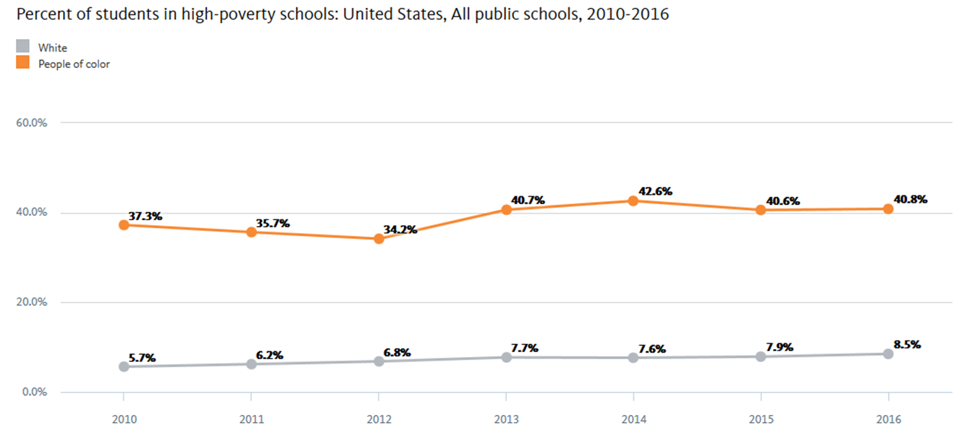
Poverty And Would-Be Students
--National Equity Atlas, University of Southern California

Slide 5
Borrowing Is Going Down
38% of undergraduates borrowed in 2015-16, down from 42% four years earlier.
Borrowing rates were down for every sector, but especially for students in for-profit higher education.
And yet the issue has not gone away.

Slide 6
Debt Fears Impact Colleges
Per 2017 Inside Higher Ed survey of admissions directors, 71 percent in public higher education and 89 percent in private higher education believe they are losing applicants due to concerns over debt.

Slide 7
Disconnect Between Colleges and Potential Students
Admissions Directors on Reasonable Debt Levels for Four-Year Degree
 | Public | Private
No Debt at All | 6% | 0%
<$5,000 | 7% | 1%
$5,000 - <$10,000 | 17% | 2%
$10,000 - <$20,000 | 31% | 19%
$20,000 - <$30,000 | 28% | 42%
$30,000 - <$40,000 | 9% | 23%
$40,000 - <$50,000 | 1% | 8%
$50,000 or more | 0% | 5%

Slide 8
The Risks of Risk Sharing
--iStock

Slide 9
The Conservative Approach
--Getty Images

Slide 10
The Liberal Approach

Slide 11
Race, Borrowing and Debt
Who borrows?
Who repays?
Who is to blame?

Slide 12
PLUS Loans and Race

Slide 13
Geography and Student Debt

Slide 14
The Longterm Impact of Debt:
Having children
Buying homes
Retirement

Slide 15
Indiana Push Against Defaults

Slide 16
The Push to Meet Full Need

Slide 17
Q&A
Your questions
Ideas for coverage

Slide 18
With Thanks …

