Slide 1
Diversifying Graduate Schools and the Faculty
An Inside Higher Ed webcast
Tuesday, March 19, 2019
2 p.m. Eastern

Slide 2
Presenter
Scott Jaschik, editor, Inside Higher Ed, scott.jaschik@insidehighered.com

Slide 3
What Do We Mean by Diversity?
Race / ethnicity
Gender
Class
Disability status
Veteran status
Geography
Politics / ideology

Slide 4
Context of Diversity
Within a college or university
Within a department or discipline
Within a state or geographic region
Within a group of colleges (by mission, faith or other factors)
Within the power structure

Slide 5
Inclusivity
The Association of American Colleges and Universities describes inclusivity as the “active, intentional and ongoing engagement with diversity -- in the curriculum, in the co-curriculum and in communities (intellectual, social, cultural, geographical) with which individuals might connect -- in ways that increase awareness, content knowledge, cognitive sophistication and empathic understanding of the complex ways individuals interact within systems and institutions.”

Slide 6
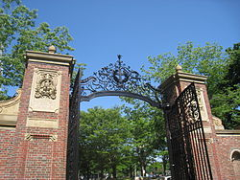
Current Context
Leaders in academe continue to back efforts to diversify graduate and faculty populations.
Political leaders have decidedly mixed views.
Legal challenge to Harvard’s admissions policies could have major impact.

Slide 7
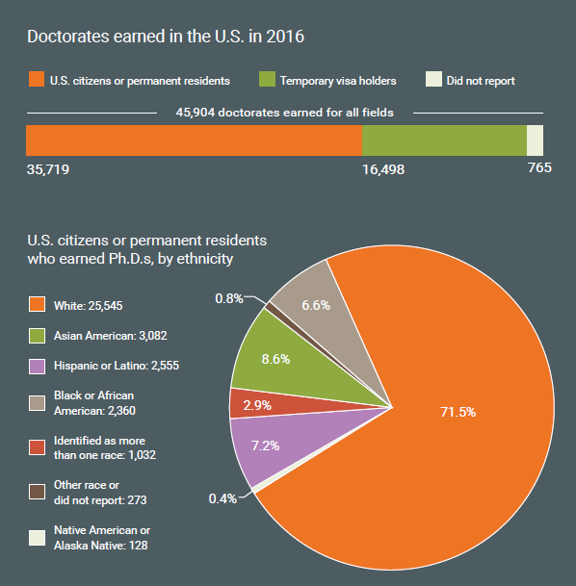
Data on New Ph.D.s
--National Science Foundation

Slide 8
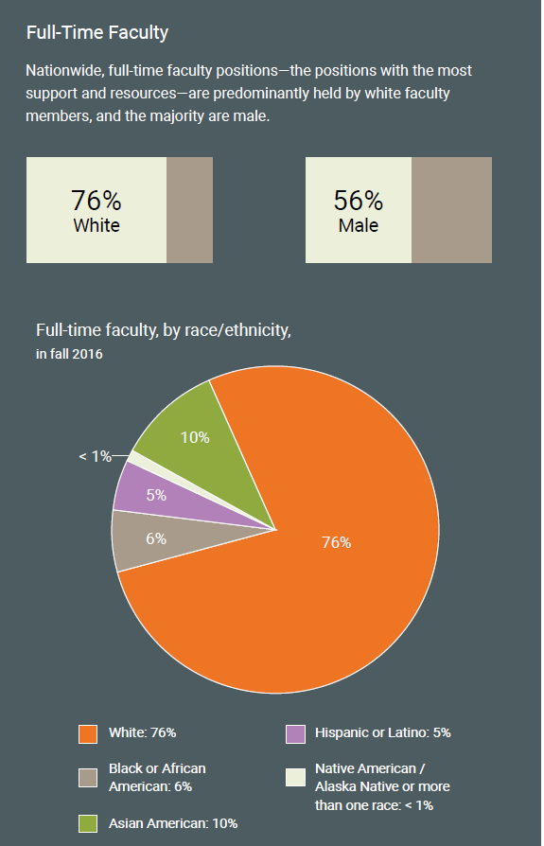
Data on the Faculty
--National Center for Education Statistics

Slide 9
The Adjunct Track
More diversity
Lower compensation levels
Minimal job security

Slide 10

Graduate School I: Getting In

Slide 11

Graduate School II: Paying for It
--iStock

Slide 12

Graduate School III: Mentors
--iStock

Slide 13
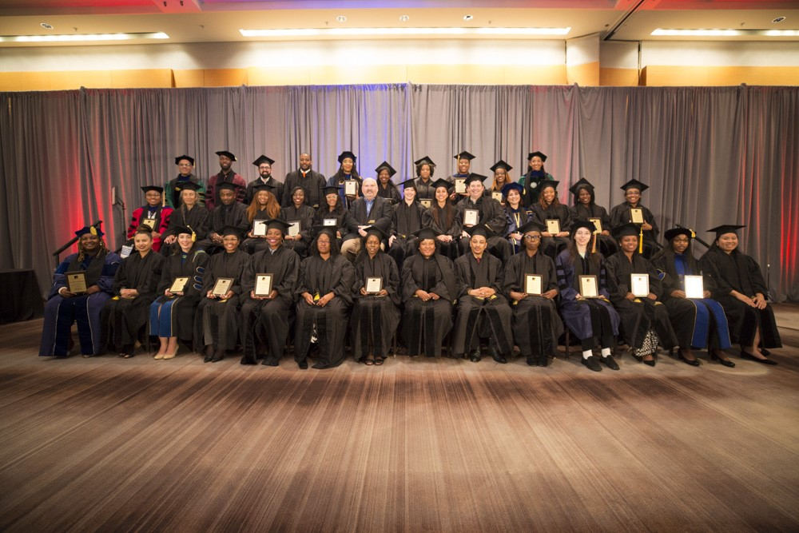
Case Study:
Institute on Teaching and Mentoring

Slide 14
The Faculty I: Hiring
Confronting bias
Cluster hiring
Open searches
Diversity statements

Slide 15
The Faculty II: Tenure
Preparing
Mentoring
Particular challenges for minority scholars

Slide 16
The Faculty III: Retention
Competition for talent
When the wealthiest colleges poach
Critical mass

Slide 17
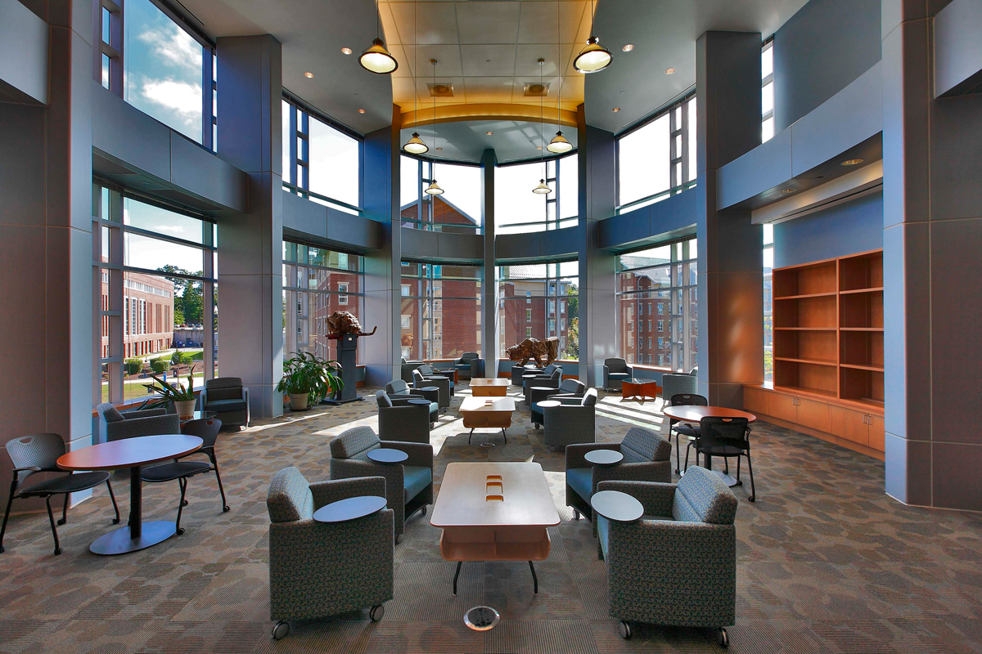
Case Study: Eastern Connecticut State University

Slide 18
Q&A
Your questions
Your ideas for future coverage

Slide 19

With Thanks ….

