Slide 1
Curriculum and Assessment Amid COVID-19 and Beyond
An Inside Higher Ed webcast
Wednesday, August 12, 2020
2 p.m. Eastern

Slide 2
Presenters
Scott Jaschik, editor, Inside Higher Ed, scott.jaschik@insidehighered.com
Doug Lederman, editor, Inside Higher Ed, doug.lederman@insidehighered.com

Slide 3
Uncertain Times….

Slide 4
What Do We Know About Student Learning in the Spring?
--iStock

Slide 5
Less Tolerance for Inadequacy
In the spring, classes were shifted within days.
Most people (emphasis on most) accepted that good online education takes time to prepare.
Educators don’t expect the same tolerance this semester.

Slide 6
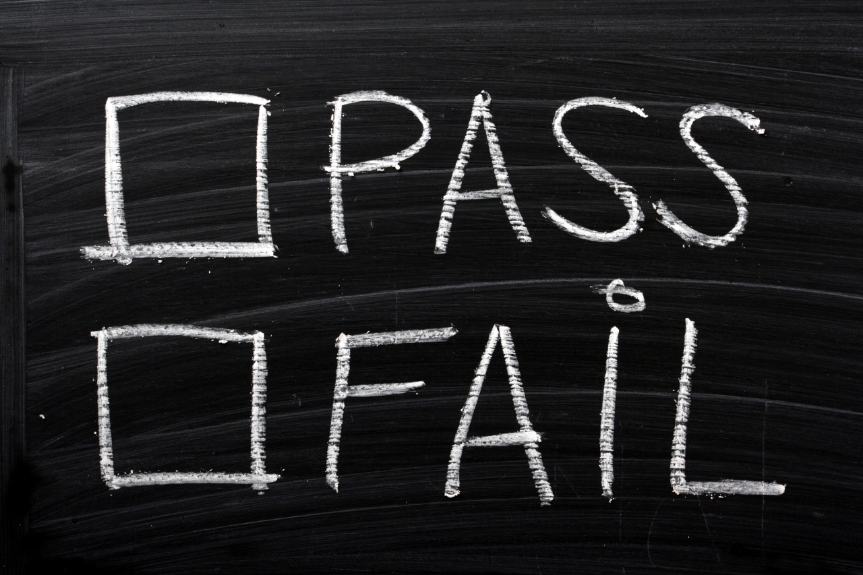
Pass / Fail
--iStock

Slide 7
What College Students Liked and Didn’t Like in the Spring
--iStock

Slide 8
Faculty Development
Never has faculty development been more essential.
Many colleges have added programs, focused on teaching online.
Many of those doing faculty development (on all issues) report that they reach a fraction of those who could benefit.

Slide 9
Faculty Views
“In a pandemic, everyone gets an Asterisk.”
“Return to learn.”
“Values-centered learning.”
“Equitable exams during COVID-19.”

Slide 10
Assessment
The push for assessment in American higher education (from the class to the campus, and beyond) isn’t going away.
But flexibility is needed.

Slide 11
With Thanks …

Slide 12
Your Questions

