Slide 1
Recruiting International Graduate Students in Challenging Environment
An Inside Higher Ed webcast
July 18, 2019
2 p.m. Eastern

Slide 2
Presenters
Scott Jaschik, editor, Inside Higher Ed, scott.jaschik@insidehighered.com
Doug Lederman, editor, Inside Higher Ed, doug.lederman@insidehighered.com

Slide 3
The Trends
Confusion
Depression
Lots of questions
But there are better answers.

Slide 4
Council of Graduate Schools Survey of International Students
Change in First-Year Enrollment
Asia 0%
Europe -3%
Latin America +5%
Middle East -12%

Slide 5
Council of Graduate Schools Survey of International Students
Change in First-Year Enrollment
Engineering -10%
Physical and earth sciences -13%
Health sciences +3%
Business +1%

Slide 6
Chinese Students Love the U.K.

Slide 7
Warnings From Chinese Officials
Was the warning fair?
Will students listen?

Slide 8
Science and Security
Actions by government
Actions by universities

Slide 9
Other Countries
Approaches
Limitations of approaches

Slide 10
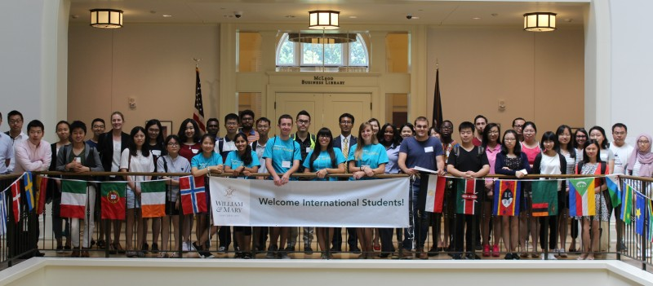
Strategies That Work

Slide 11
Q&A
Your questions
Your ideas for future coverage

Slide 12
With Thanks ….

