Slide 1
New Models for Educational Materials
An Inside Higher Ed webcast
Wednesday, April 18
2 p.m. Eastern

Slide 2
Presenters
Scott Jaschik, editor, Inside Higher Ed, scott.jaschik@insidehighered.com
Doug Lederman, editor, Inside Higher Ed, doug.lederman@insidehighered.com

Slide 3
Why Now?
Costs of traditional materials
Frustrations over students who don’t buy/rent/borrow materials
New technology
Changes in publishers’ business models

Slide 4
Where Issue Is Most Urgent
Institutions with many low-income students (community colleges, other publics)
Institutions that aren’t wealthy

Slide 5

Why Issue Has Always Mattered

Slide 6
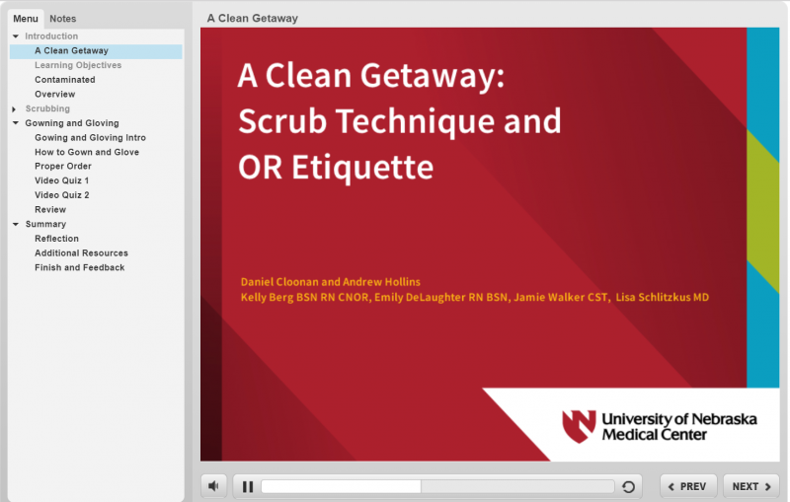
Use Case: Online Modules in Health Professions

Slide 7
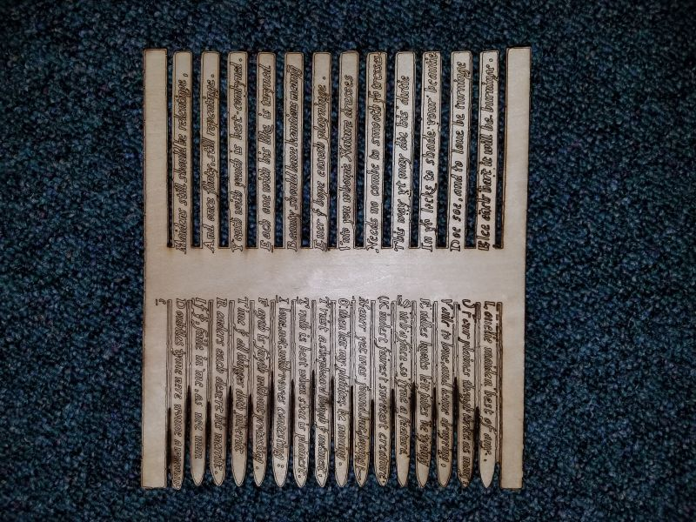
Use Case:
Literature Classrooms

Slide 8
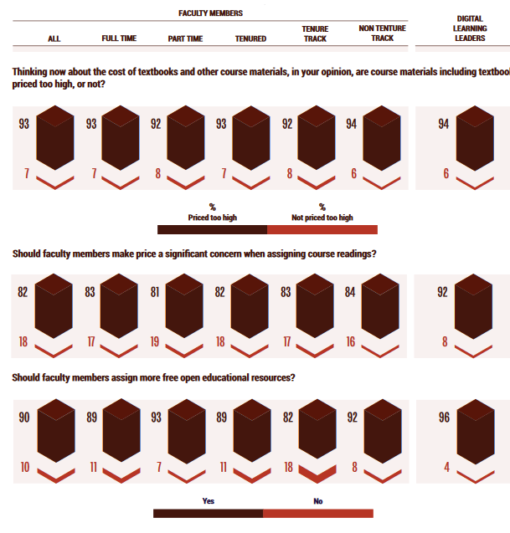
Faculty Members’
(Conflicted) Attitudes

Slide 9

Slashing Prices

Slide 10
OER I: Definitions
What it is
How it works
Who likes it
Who is dubious

Slide 11

OER II: Stewardship

Slide 12
OER III: The Publishers and OER
Shift in attitudes
Business models

Slide 13
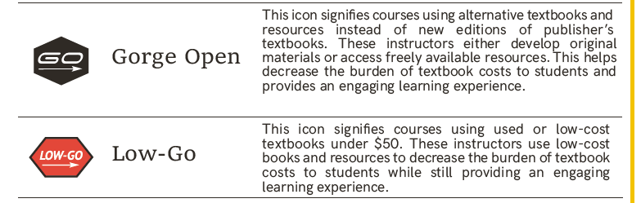
OER IV: Labels

Slide 14

Inclusive Access

Slide 15
Q&A
Your questions
Your ideas for future coverage

Slide 16

With Thanks

