Slide 1
Meeting the Challenges of Today’s Endowment Strategies
An Inside Higher Ed webcast
Monday, December 10
2 p.m. Eastern

Slide 2
Presenters
Scott Jaschik, editor, Inside Higher Ed scott.jaschik@insidehighered.com
Rick Seltzer, reporter, Inside Higher Ed rick.seltzer@insidehighered.com

Slide 3
The Broader Economic Context
Most public colleges and universities face limited growth (if any) in state appropriations.
Most private colleges have difficulty attracting students who have ability/will to pay full costs.
Demographic shifts will decrease number of potential students for most colleges

Slide 4
The Broader Endowment Context
Wide variation among colleges (from under $100,000 to nearly $40 billion)
Wide variation in importance to budget
Wide variation in risk tolerance

Slide 5
Trends in Average Returns

Slide 6
The Wealthy Get Wealthier
--NACUBO / CommonFund
 | Endowment over $1B | $501M-$1B | $101M- $500M | $51M-$100M | $25M-$50M | Under $25M
1-year return | 12.9% | 12.7% | 12.5% | 11.9% | 11.7% | 11.6%
3-year return | 5.0% | 4.2% | 5.1% | 3.9% | 4.0% | 4.7%
5-year return | 8.6% | 8.1% | 7.8% | 7.7% | 7.7% | 8.1%
10-year return | 5.0% | 4.6% | 4.4% | 4.4% | 4.5% | 5.0%

Slide 7
At the Top
--NACUBO / CommonFund
University | End of 2017 Value | 1-Year Change
Harvard | $36,021,516,000 | 4.3%
Yale | $27,176,100,000 | 7.0%
U of Texas System | $26,535,095,000 | 9.6%
Stanford | $24,784,943,000 | 10.7%
Princeton | $23,812,241,000 | 7.5%

Slide 8
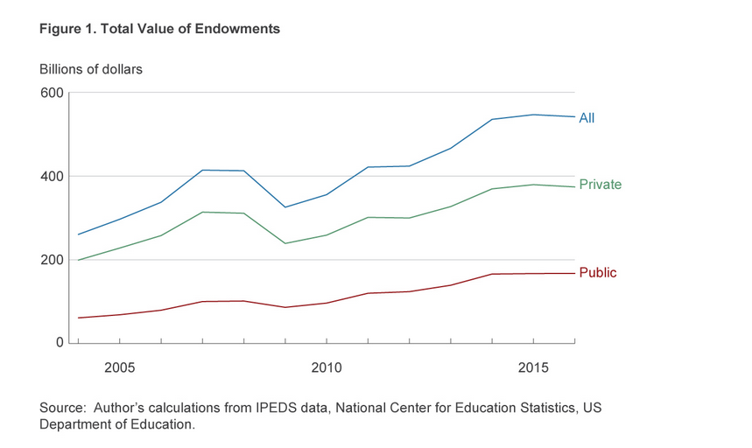
Total Value
--Federal Reserve of Cleveland

Slide 9
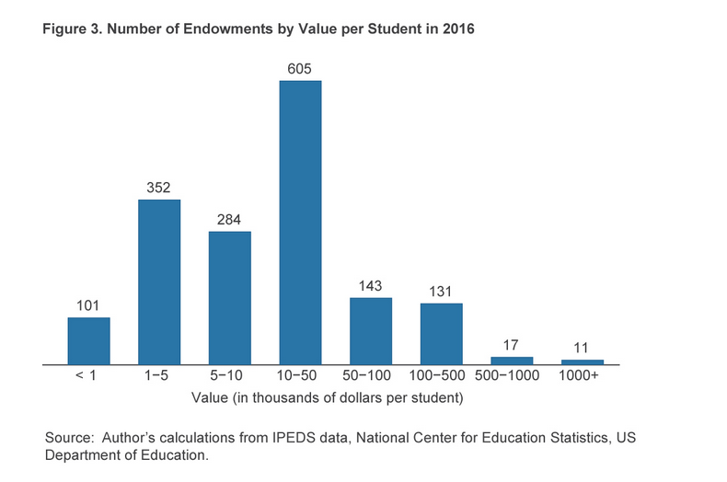
Endowment Per Student
--Federal Reserve of Cleveland

Slide 10
Yale’s Wins and Harvard’s Losses (Small Gains = Losses)

Slide 11
How Small Endowments Sometimes Outperform the Big Names

Slide 12
Going for Gold
--Getty Images

Slide 13
Reasons for Worry
--Getty Images

Slide 14
Spending Rates
--iStock

Slide 15
The Contrarian Argument Against Building Up Endowments

Slide 16
New Ethical Debates

Slide 17
Pundits Eye Endowments

Slide 18
The Endowment Tax: The Grassley Questions and Impact
Some of the wealthiest colleges and universities upped spending on student aid.
Stock market crash hit wealthy universities hard and shifted discussion.

Slide 19
The Reed Proposals
Require colleges with endowments > $1 billion to using at least 25 percent of gains "to reduce the costs of attendance for students from middle- and working-class families." Those that fail to do so would face taxes on earnings.
Require colleges to report more information -- and make it easier to find -- about benefits provided to senior officials.
Require colleges to submit plans to assure that tuition increases at less than the rate of inflation. Rewards and penalties would be established for those that succeed or fail at their plans.

Slide 20
Lazy Rivers, Relevant or Not

Slide 21
Final Version of Tax Bill
1.4 percent excise tax on net investment income at an estimated several dozen private colleges and universities.
The tax will apply to institutions with at least 500 students and net assets of $500,000 per student.
Waiting for regulations.

Slide 22
What’s Ahead, If Law Stands

Slide 23
The Idea Spreads

Slide 24
Q&A
Your questions
Ideas for coverage

Slide 25
With Thanks …

