Slide 1
The Endowment Tax:
How It Happened and Why It Matters to Higher Ed
An Inside Higher Ed webcast
January 30, 2018
2 p.m. Eastern

Slide 2
Presenters
Scott Jaschik, editor, Inside Higher Ed, scott.jaschik@insidehighered.com
Doug Lederman, editor, Inside Higher Ed, doug.lederman@insidehighered.com

Slide 3
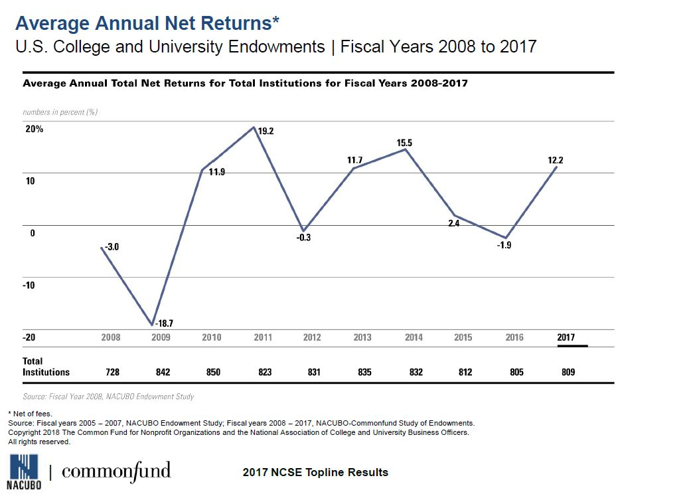
Endowments: Current Trends

Slide 4
Endowments: The Wealthiest
Institution | 2017 Value
Harvard University | $36,021,516,000
Yale University | $27,176,100,000
University of Texas System | $26,535,095,000
Stanford University | $24,784,943,000
Princeton University | $23,812,241,000

Slide 5
Endowments: Perspective
The combined values of the endowments of Cornell, Dartmouth, Duke, Rice, the University of Southern California and Vanderbilt are less than the value of Harvard’s endowment.
The median endowment in NACUBO’s endowment survey was $127.8 million.

Slide 6

Senator Grassley’s Questions

Slide 7
Impact of Grassley
Some of the wealthiest colleges and universities upped spending on student aid.
Stock market crash hit wealthy universities hard and shifted discussion.

Slide 8
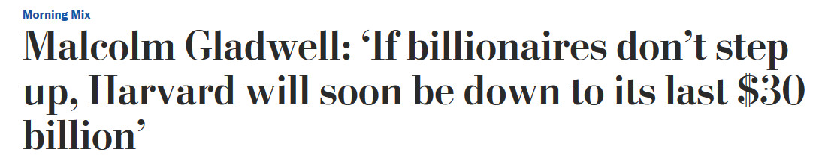
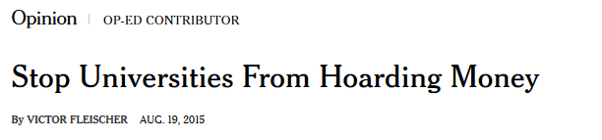
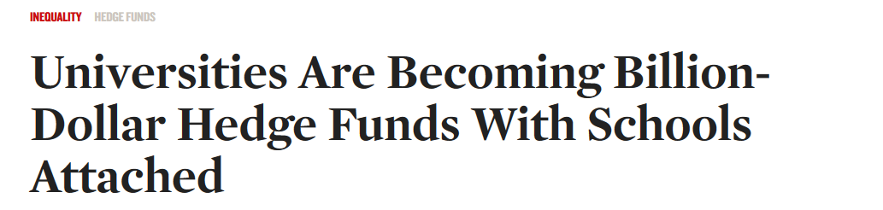
Pundits and Public Opinion

Slide 9
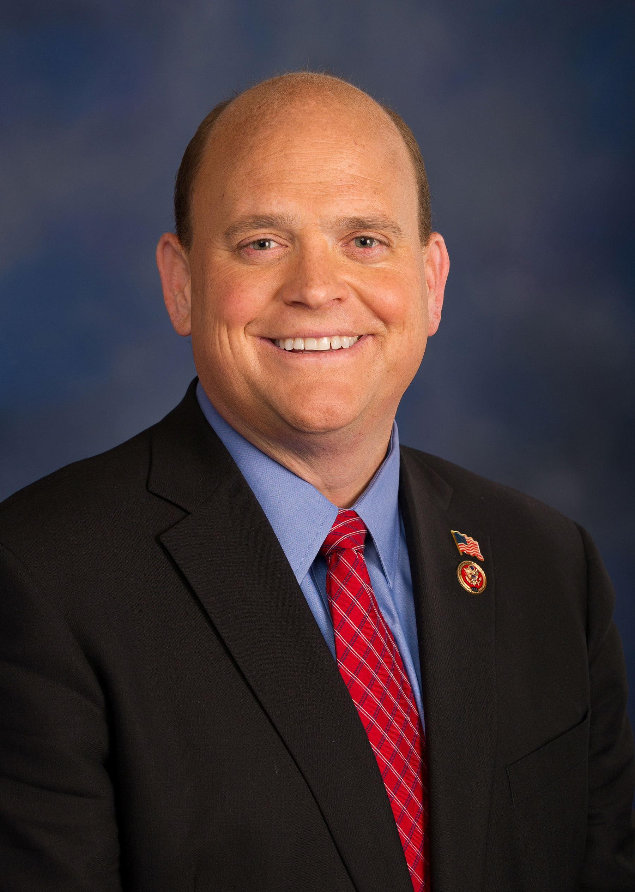
Representative Reed’s Proposals
Require colleges with endowments > $1 billion to using at least 25 percent of gains "to reduce the costs of attendance for students from middle- and working-class families." Those that fail to do so would face taxes on earnings.
Require colleges to report more information -- and make it easier to find -- about benefits provided to senior officials.
Require colleges to submit plans to assure that tuition increases at less than the rate of inflation. Rewards and penalties would be established for those that succeed or fail at their plans.

Slide 10

Trump’s Campaign Rhetoric

Slide 11
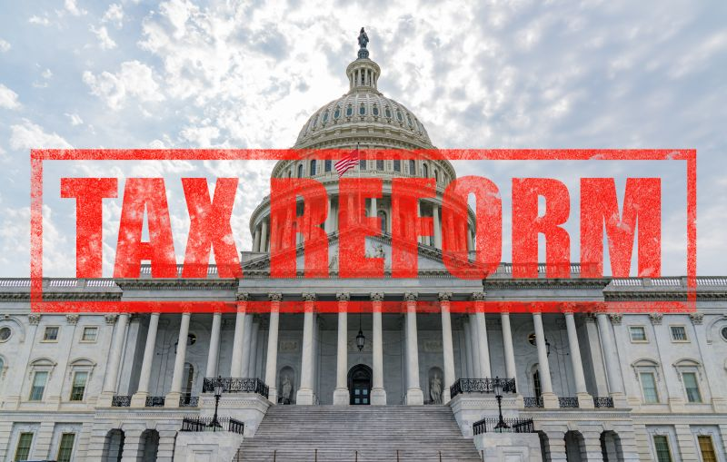
The 2017 Tax Bill
Pressure for revenue to offset revenue losses
Politics of going after wealthy colleges
Erosion of bipartisan support for higher education

Slide 12

Lazy Rivers, Relevant or Not

Slide 13
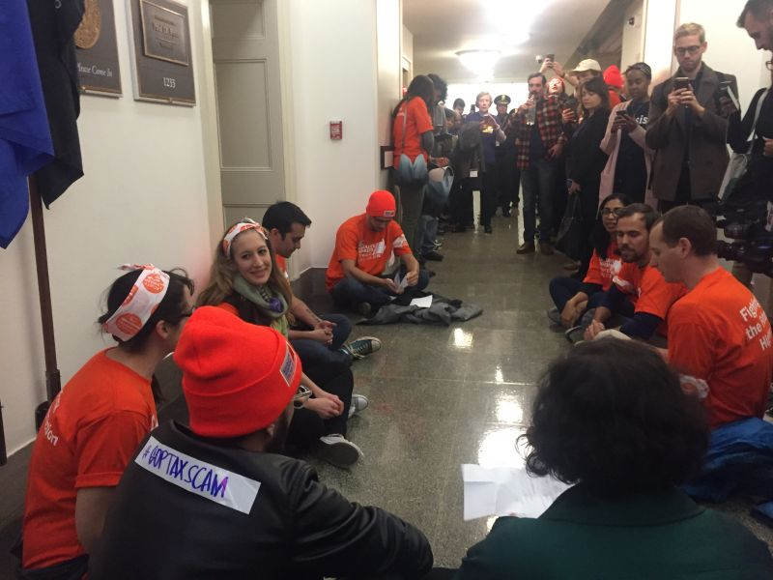
The Tax Battles Higher Ed Won

Slide 14
The Final Version of the Bill
1.4 percent excise tax on net investment income at an estimated several dozen private colleges and universities.
The tax will apply to institutions with at least 500 students and net assets of $500,000 per student.

Slide 15

Major Uncertainties on New Law
--iStock

Slide 16

Why Berea Matters

Slide 17

Carrots or Sticks?
--iStock

Slide 18
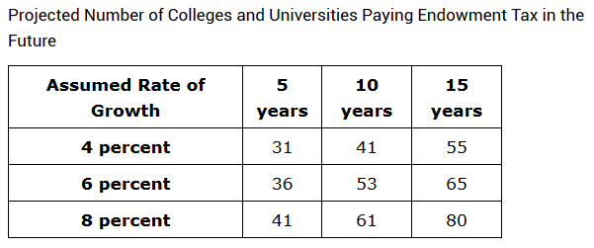
What’s Ahead (if Law Stands)
--Estimates by Phillip B. Levine

Slide 19
What Could Be Ahead (Federal)
Changes in the ratio
Changes in the size of the tax
Return to carrots and sticks
Additional scrutiny and reporting (also on pay and perks)
Including public institutions

Slide 20
What Could Be Ahead (Broadly)
PILOT debates
Tax-exempt debates
More questions about big gifts and wealthy vs. non-wealthy colleges

Slide 21
Q&A
Your questions
Your ideas for future coverage

Slide 22

With Thanks ….

