Slide 1
In Their Own Words
Student Challenges in the Pandemic
Strada Public Viewpoint: COVID-19 Work and Education Survey
November 16, 2020

Slide 2
Self-doubt is a major barrier for half of Americans when it comes to pursuing education and training
How challenging would each of the following be for you personally in pursuing education and training?
Extremely/very challenging
Strada Center for Consumer Insights Public Viewpoint surveys, May 20-June 25. Base: Americans ages 18-64, n=3,241.

Slide 3
Education-to-career connections have been disrupted
Career exploration, mentoring, and work opportunities all have
suffered because of COVID-19.
66%
55%
57%
Opportunities for
career exploration
are worse
Faculty less available for
academic and professional
development advice
Had internship or
job plans canceled
or changed
Strada-College Pulse survey, Sept. 10-25. Base: current college students enrolled at four-year institutions, n=3,887.

Slide 4
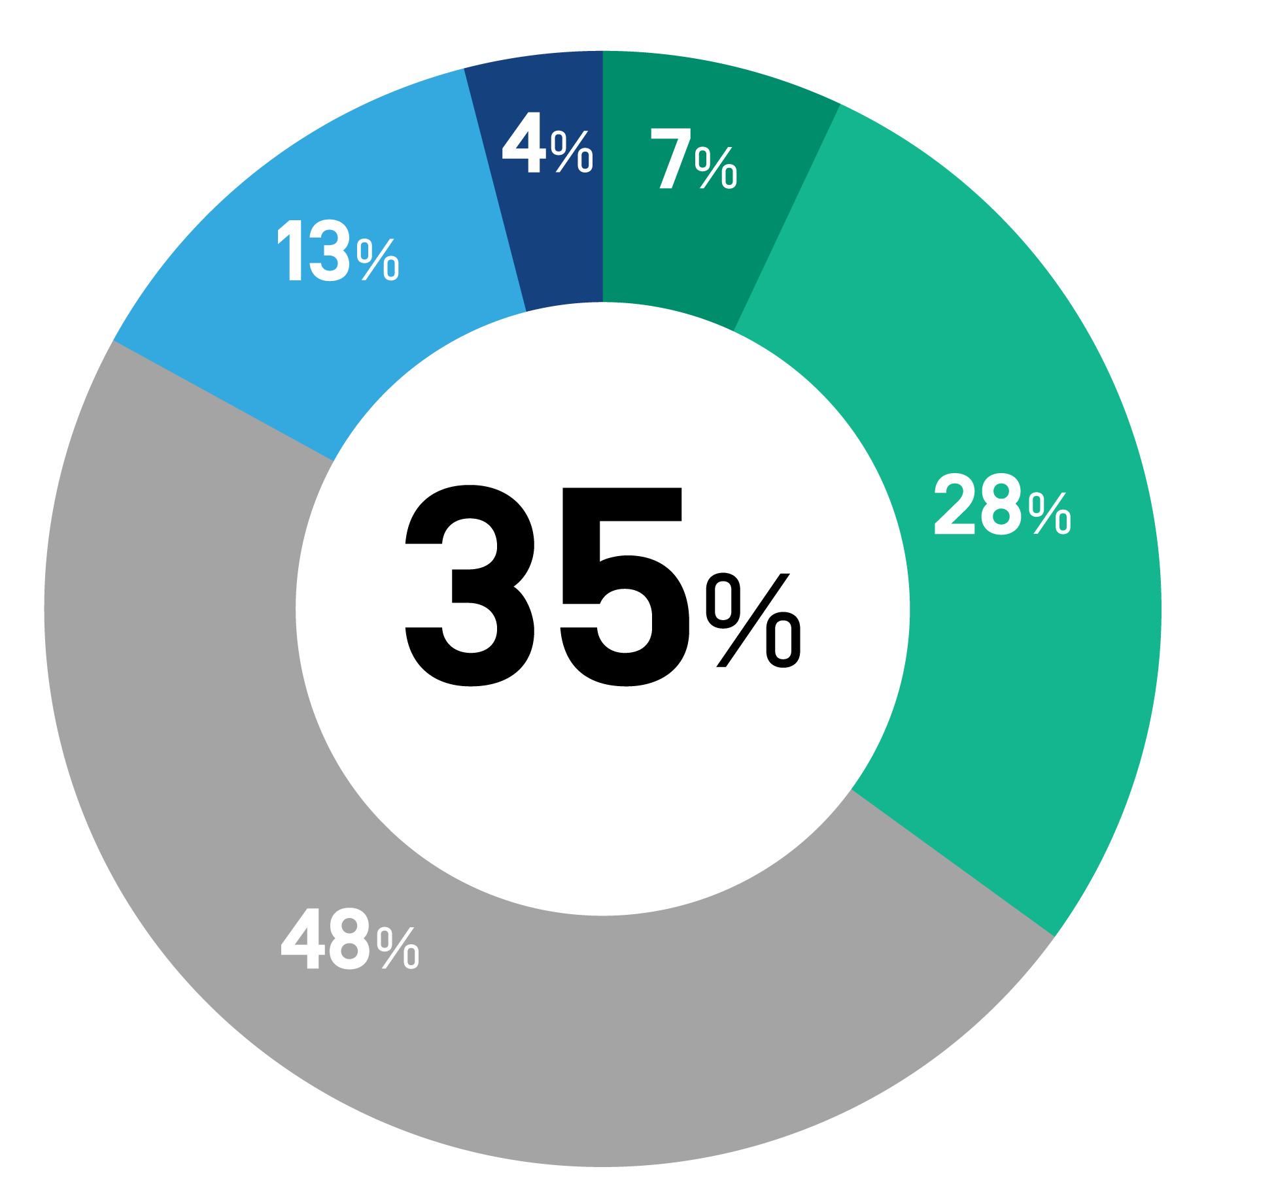
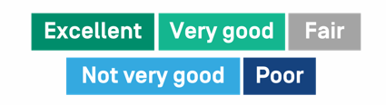
About one-third of students rate their school as “excellent” or “very good” at connecting education to meaningful careers
How would you rate your college or university’s support for helping students
connect their education to a meaningful career?
Strada-College Pulse survey, Sept. 10-25. Base: current college students enrolled at four-year institutions, n=3,887.

Slide 5
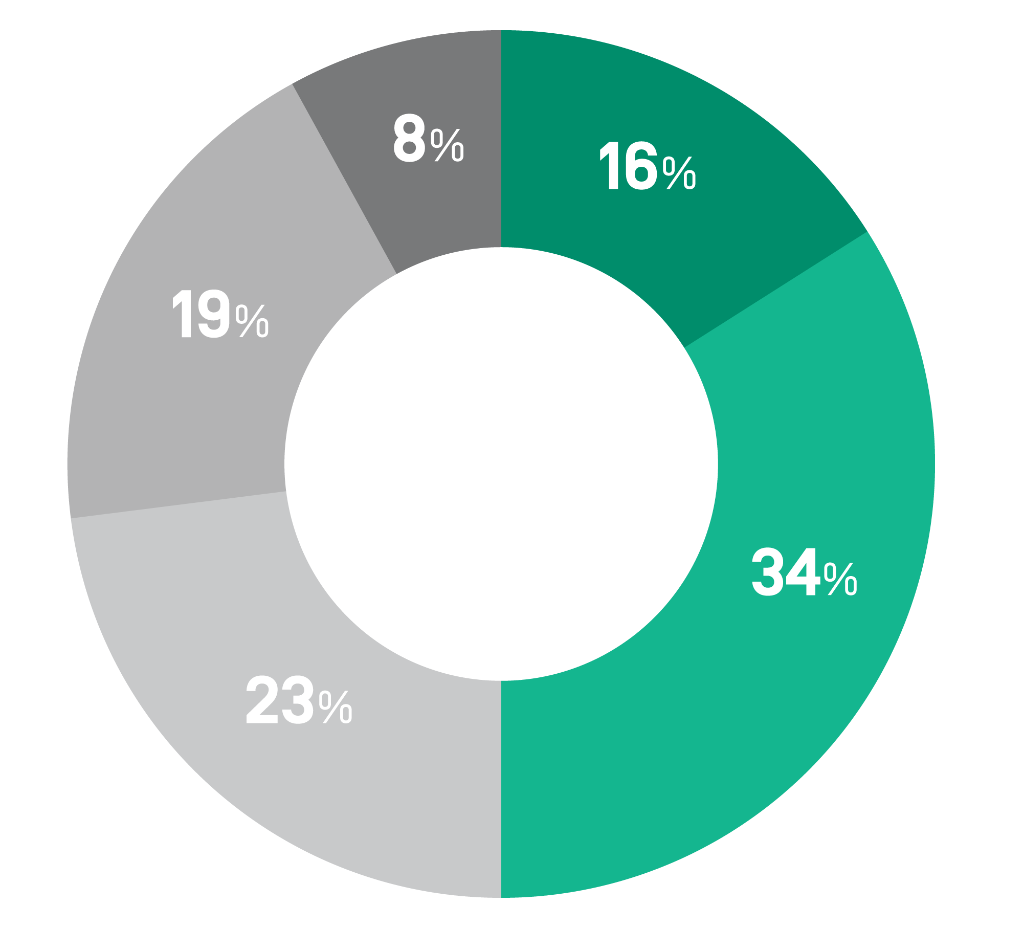

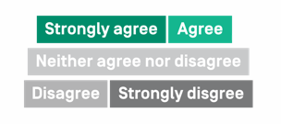
Fewer than 1 in 5 current college students strongly agree their education will be worth the cost
My education will be worth the cost.
8%
16%
19%
34%
23%
Strada-College Pulse survey, Sept. 10-25. Base: current college students enrolled at four-year institutions, n=3,887.
Notes:
Only 16% strongly agree their education will be worth the cost

Slide 6
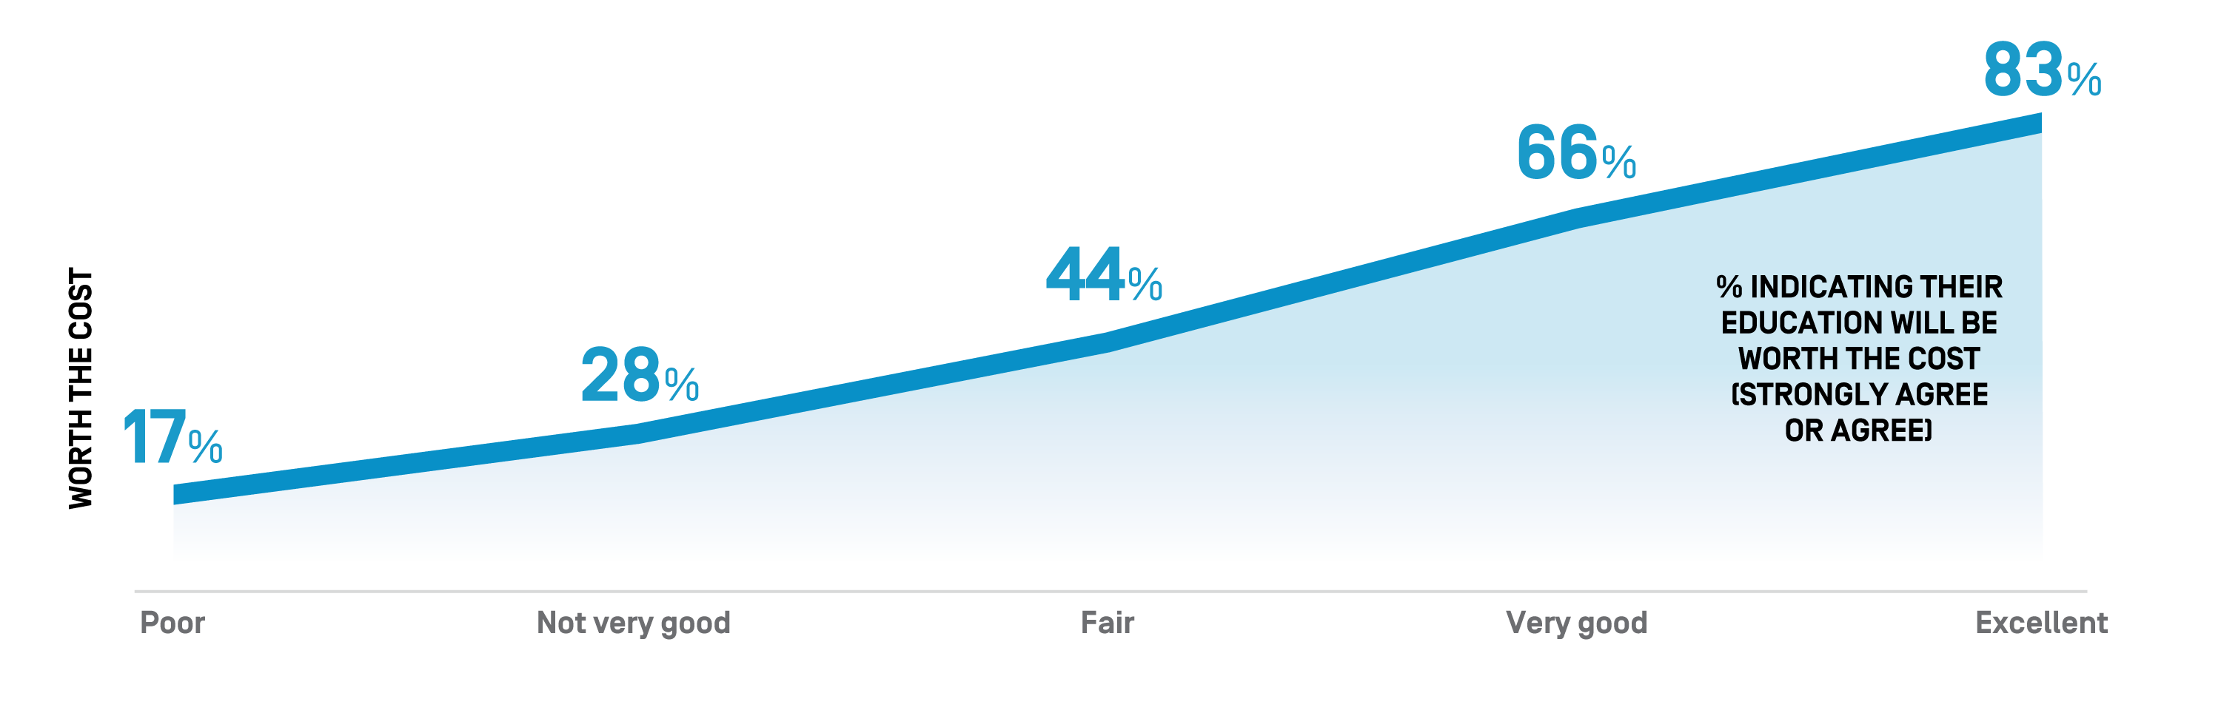
When students have the support to connect their education to a career, they are more likely to say their education will be worth the cost
How would you rate your college or university’s support for helping students
connect their education to a meaningful career?
Strada-College Pulse survey, Sept. 10-25. Base: current college students enrolled at four-year institutions, n=3,887.
Notes:
Break out or only strongly agree

Slide 7
Learn more at
StradaEducation.org/PublicViewpoint or email consumervoice@stradaeducation.org

Slide 8
Methodology
Public Viewpoint is a regular tracking survey of education consumers’ perceptions of COVID-19’s impact on postsecondary education and work in the United States, completed by Heart+Mind Strategies on behalf of Strada Center for Education Consumer Insights.
  Online survey of Americans ages 18 and older.
  Representative of the general population in age, gender, geographic region, educational attainment, and race/ethnicity.
  Current database size from March 25 to Oct. 29, n = 21,137.
  Retirees are excluded from this analysis.
  A theoretical margin of error based on a probability sample of size 1,000 would be +/- 3.1 percent at 95 percent confidence. This is not a probability-based sample, and a margin of error cannot be estimated. Based on experience, we believe the sampling error would be at least this number.
The Strada Student Viewpoint survey was fielded by College Pulse from Sept. 10 to 25 as an online survey from a panel of students enrolled at four-year institutions. Data are weighted based on the Current Population Survey on the basis of age, race/ethnicity, and gender; n=4,007. Theoretical margin of error +/- 1.7%.
Please contact Center for Education Consumer Insights with questions or information requests at consumervoice@stradaeducation.org or learn more at StradaEducation.org/PublicViewpoint.

