Slide 1
Graduate and Professional Education: An Ever-Changing Environment
An Inside Higher Ed webcast
Wednesday November 14
2 p.m. Eastern

Slide 2
Presenters
Scott Jaschik, editor, Inside Higher Ed, scott.jaschik@insidehighered.com
Doug Lederman, editor, Inside Higher Ed, doug.lederman@insidehighered.com

Slide 3
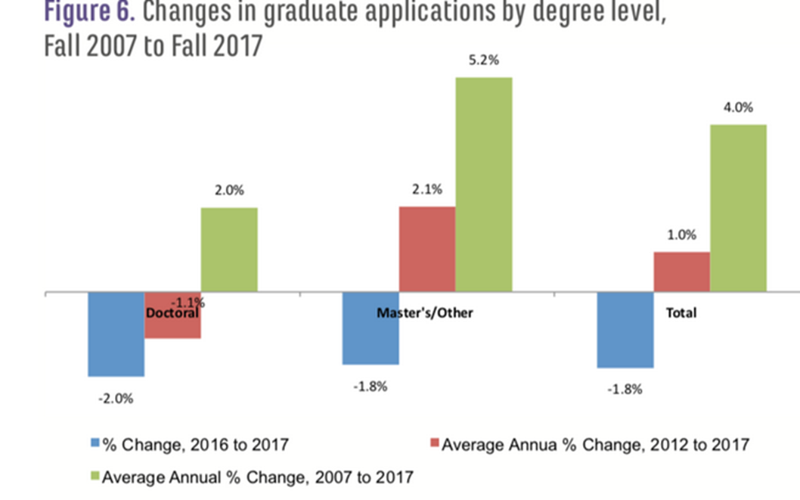
Application Pressures
--Council of Graduate Schools

Slide 4
International Pressures
Open Doors: % Change in Graduate Enrollments, Top 5 Countries of Origin, 2016/17-2017/18
Country | Percent Change
China | +2.0%
India | -8.8%
South Korea | -5.5%
Saudi Arabia | -10.2%
Canada | -5.9%

Slide 5
Diversity Pressures: The Harvard Case and Its Potential Impact

Slide 6
Withering Humanities Jobs

Slide 7
Ph.D. Training Mismatch
Percentage of MLA Jobs Seeking Alt-Ac Skills
 | English Jobs | Foreign Language Jobs
Advising | 24% | 22%
Administration | 23% | 25%
Curriculum development | 23% | 22%
Working with diverse populations | 20% | 16%
Public engagement | 17% | 12%
Digital writing / media | 15% | 5%
Digital scholarship | 14% | 6%

Slide 8
The Impact of Female Peers

Slide 9
The Trade-Off Myth on Graduate Training

Slide 10
Falling M.B.A. Applications

Slide 11
Push to Reform STEM Graduate Education
Curriculum
Careers
Data

Slide 12
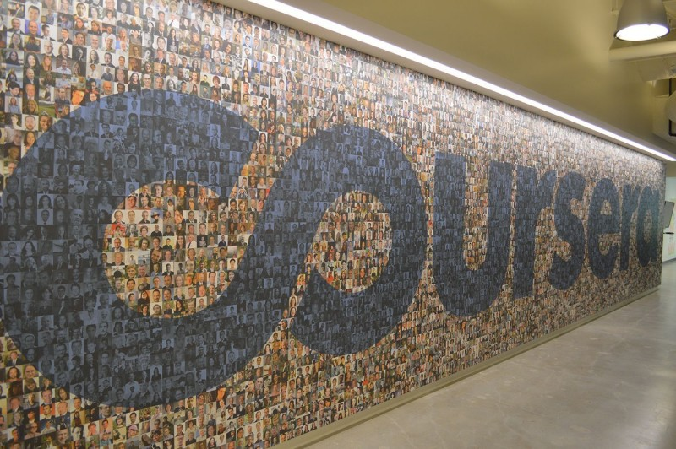
Online in New Formats
Continued growth of micromasters
Penn’s Coursera master’s

Slide 13
What Do Women Want … in a Professional School?

Slide 14
Stanford’s Shift on M.B.A. Aid

Slide 15
The Temple Rankings Scandal

Slide 16
Law School Ups and Downs

Slide 17
Can Med School Be Free?

Slide 18
Q&A
Your questions
Suggestions for future coverage

Slide 19
With Thanks….

