Slide 1
High-Impact Practices for Student Success
An Inside Higher Ed webcast
Tuesday, March 5, 2019
2 p.m. Eastern

Slide 2
Presenters
Scott Jaschik, editor, Inside Higher Ed, scott.jaschik@insidehighered.com
Doug Lederman, editor, Inside Higher Ed, doug.lederman@insidehighered.com

Slide 3

Missing Pieces of Information
-iStock

Slide 4
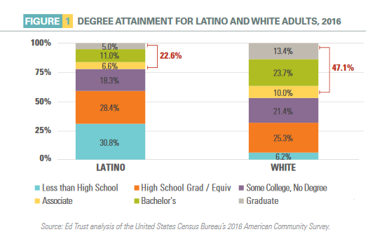
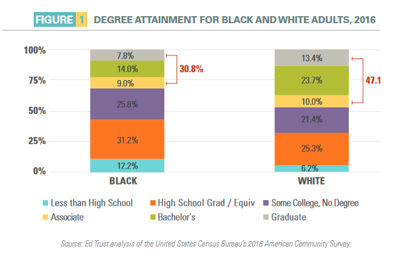
Confronting Key Equity Issues
--Education Trust

Slide 5

The Degree Rules … for Now
--iStock

Slide 6

Strategy: Embrace the New

Slide 7
Strategy: Use High-Impact Practices in Online Teaching
Writing-intensive assignments
Collaborative projects
Community-based learning
Capstone projects

Slide 8
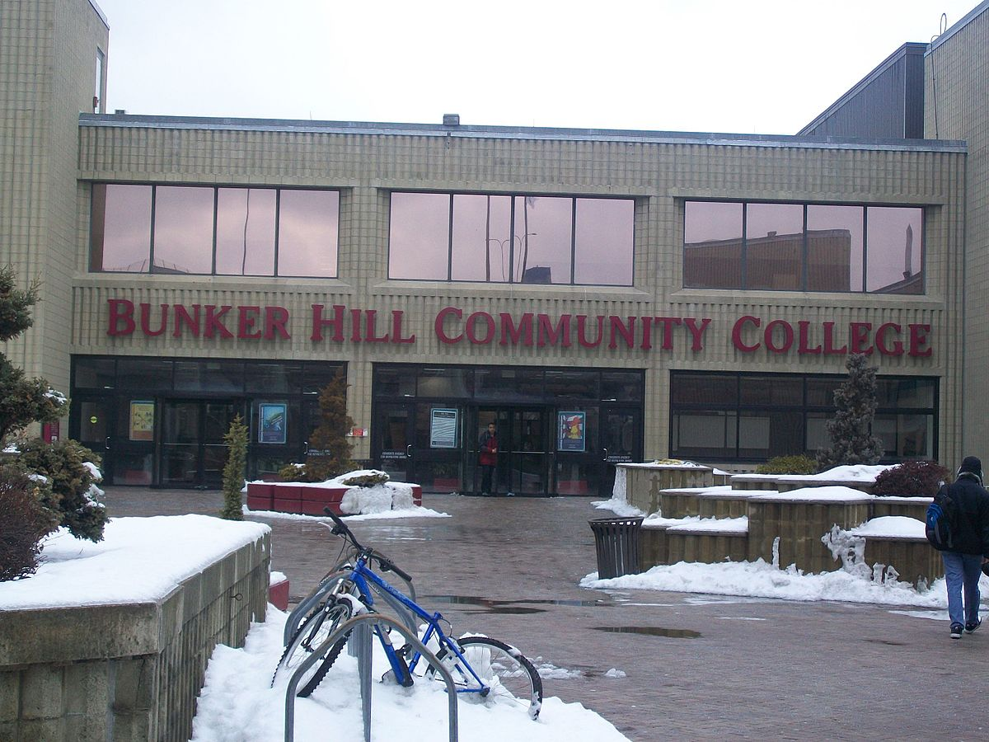
Strategy: Don’t Write Off
Part-Timers

Slide 9

Strategy: ePortfolios
--LaGuardia Community College, CUNY

Slide 10
Strategy: Meaningful Assessment
Faculty role (throughout)
Mission of the college and goals of students
Alignment between classroom objectives and institutional objectives
Adjust, adjust, adjust

Slide 11

Strategy: Employment Matters

Slide 12
Strategy: Focus on the First Year
Placement
Orientation
Early patterns
Learning communities
Academic advising

Slide 13

Strategy: No Sophomore Slumps
-iStock

Slide 14
Strategy: Leadership at the Top
Why it matters
Why many presidents aren’t ready
The career path
On the job training
How presidents are evaluated

Slide 15
Q&A
Your questions
Your ideas for future coverage

Slide 16

With Thanks ….

