Slide 1
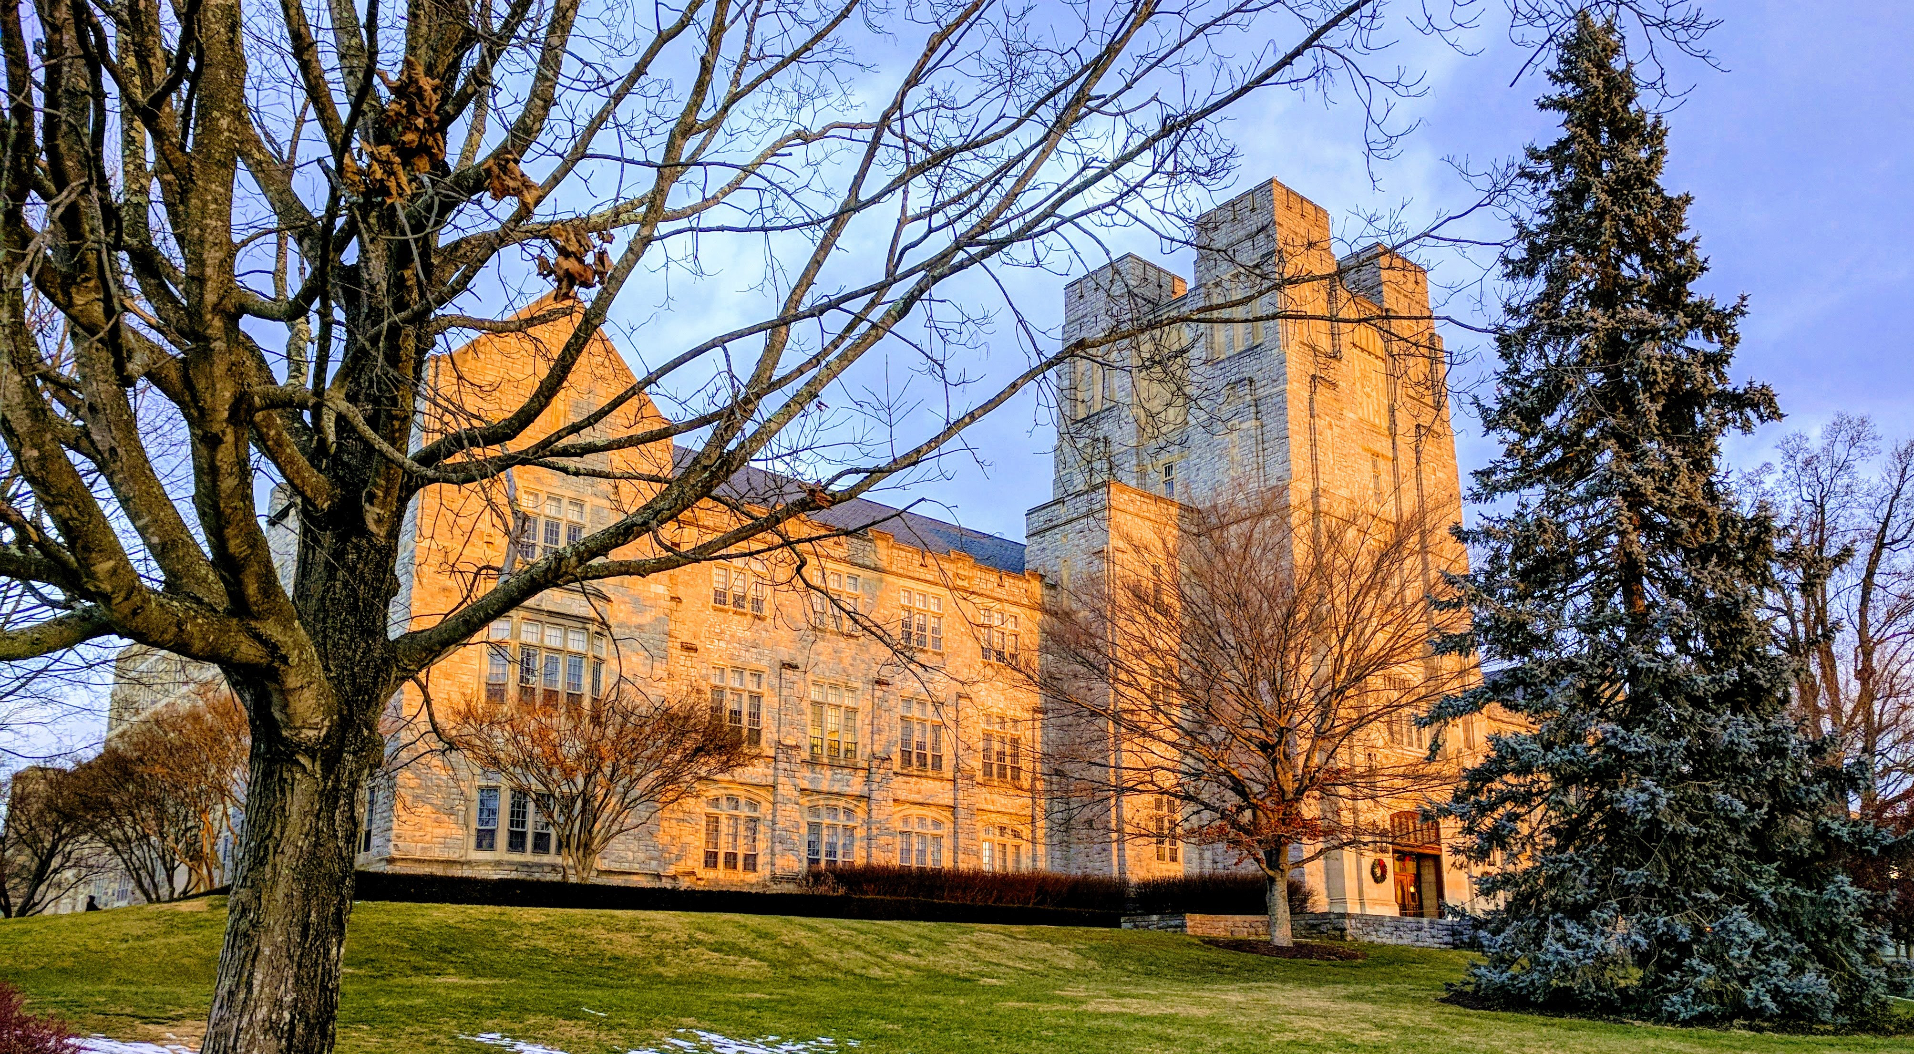
Securing Data in the Cloud:
Virginia Tech’s Take
December 18, 2018

Slide 2
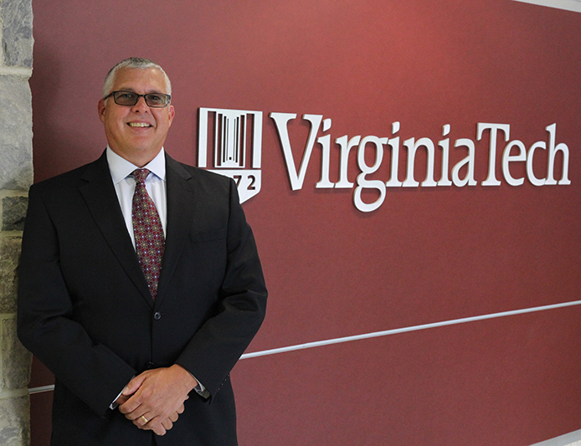



Today’s Speakers
Carl Harris
Chief Technology
Architect
Randy Marchany
University Information
Technology Security
Officer
Scott Midkiff
Vice President for
Information Technology
and CIO
Sandra Schiavo
Lead Courseware
Coordinator,
Virginia Cyber Range

Slide 3
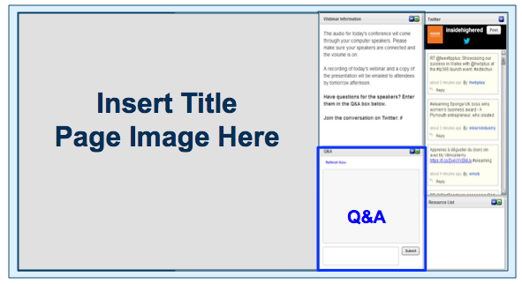
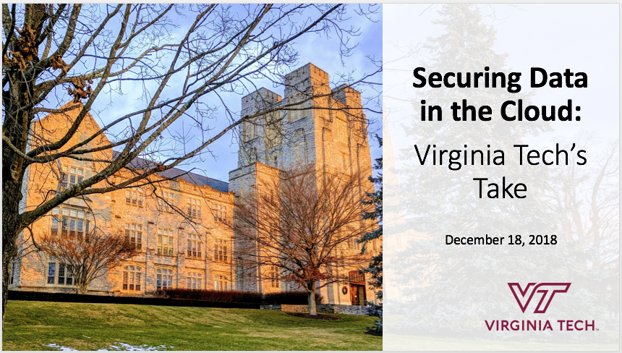
Before We Begin
We are using On24 for today’s webinar. Please enter questions in the text field at the bottom of the Q&A Window. We are monitoring the discussion and will try to bring the Q&A comments into the conversation.
We are recording the webinar; the webinar archive and slides will be available later today.

Slide 4
Introduction
Scott Midkiff
Vice President for IT and CIO
midkiff@vt.edu
https://it.vt.edu

Slide 5

What to Expect:
Introduction
Scott Midkiff
Virginia Tech’s approach to IT security
Randy Marchany
Securing Summit on AWS
Carl Harris
The Virginia Cyber Range: Cloud-based resources for cybersecurity education
Sandra Schiavo
Notes:
Photo source: https://vt.edu/admissions/undergraduate/visit/campus-photo-tour.html

Slide 6
Overview of Virginia Tech
Some numbers…
  32,304 students on campus; 34,440 on and off campus
  110+ bachelor’s degree programs and 170+ master’s and doctoral degrees
  1,520 faculty members
  43rd overall in the National Science Foundation’s annual survey of higher-ed research expenditures, 24th among public research universities
Locations…
  Blacksburg
  Roanoke
  Northern Virginia
  Across the Commonwealth
IT at Virginia Tech...
  Hybrid enterprise/local IT model
  About 360 employees in the Division of IT
  (enterprise IT)
  Comprehensive portfolio
Arlington, VA
Alexandria, VA
Falls Church, VA
Leesburg, VA
Roanoke, VA
Blacksburg, VA

Slide 7

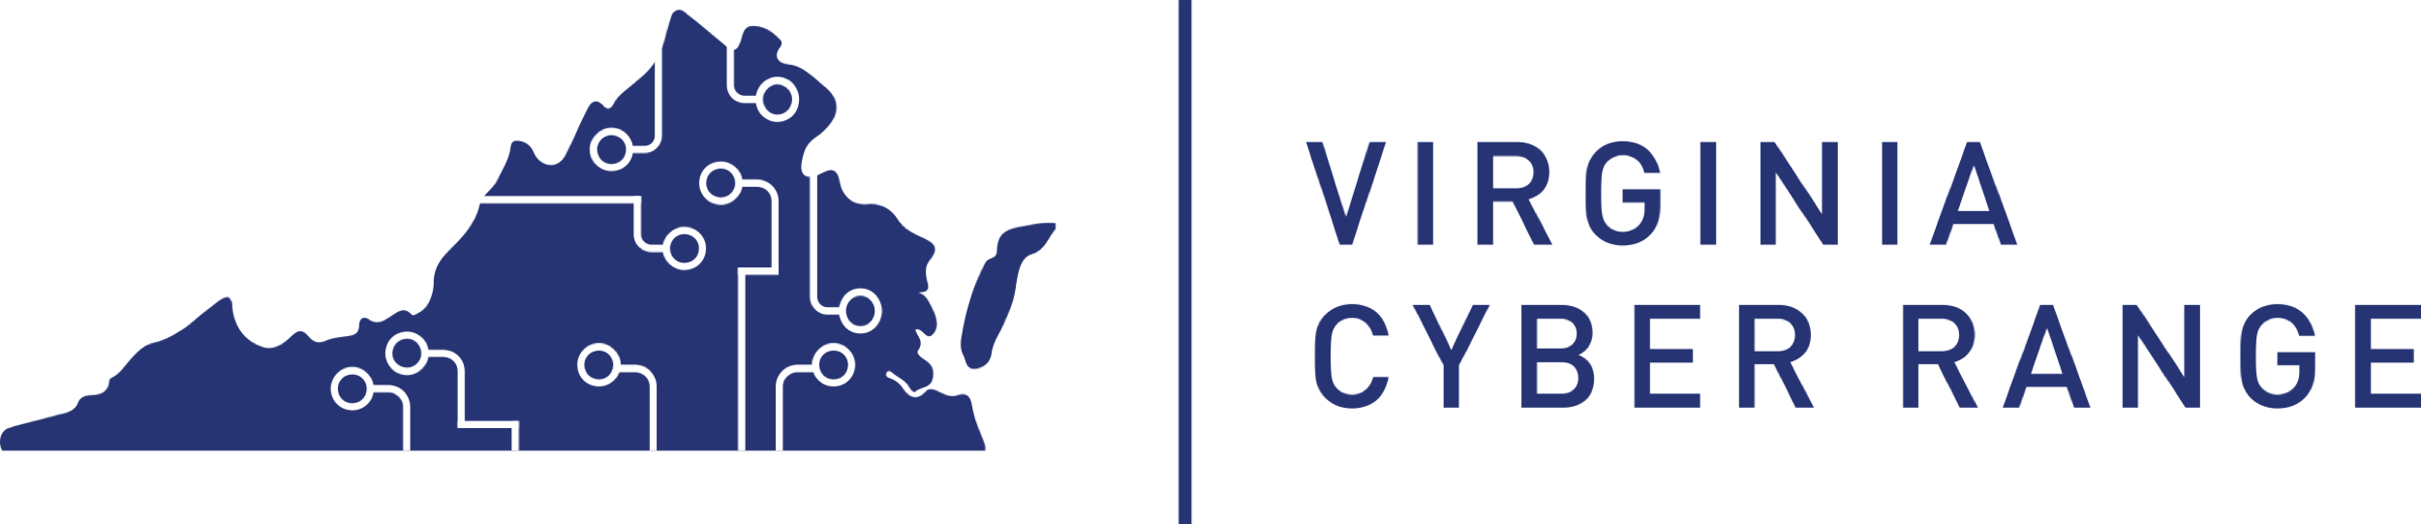
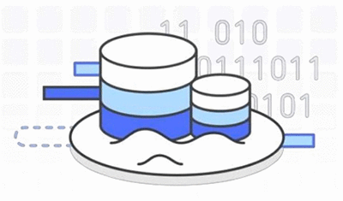
Virginia Tech’s Cloud Journey to Date
Virginia Tech has focused on deploying new services and capabilities to the cloud rather than wholesale migration
Example deployments in the cloud
  Summit research administration application
  The Virginia Cyber Range
  Ongoing data lake pilot
  Several account, group, and certificate management services
  Some development, integration, test,
  and QA environments

Slide 8
Virginia Tech and the Cloud
Virginia Tech is realizing multiple benefits from building applications in the cloud
  Ease of innovation and exploring
  Flexibility in deployment and ease
  Rapid initial deployment and continued scaling
  Cost-effective deployment and operation
  Synergy with DevOps and CI/CD approaches
Security is always a concern
  We worry about privacy, compliance, and reputation
  Our concerns are fundamentally the same whether an application is on premises or in the cloud

Slide 9
Virginia Tech’s Approach to IT Security
Randy Marchany
University IT Security Officer
marchany@vt.edu
https://security.it.vt.edu

Slide 10
The Mobile Internet
Evolution of the Internet
  Internet 1.0 – static servers, endpoints
  Internet 2.0 – static servers, mobile endpoints
  Internet 3.0 – mobile servers (containers, serverless, cloud), mobile endpoints (laptops, phones, tablets, IoT, ICS)
Current security architectures are somewhere between Internet 1.0 and Internet 2.0
We need to adapt to Internet 3.0 now

Slide 11
Data are the New Border
Easier said than done
All data must be secured regardless of location. Encryption at rest or in transit
User identities must be confirmed. Access to data strictly enforced. Default of minimum privileges
All network traffic should be logged and analyzed.
  “Trust but verify” → “Verify and never trust”
Eliminates distinction between trusted-inside-perimeter and untrusted activity that crossed the perimeter

Slide 12
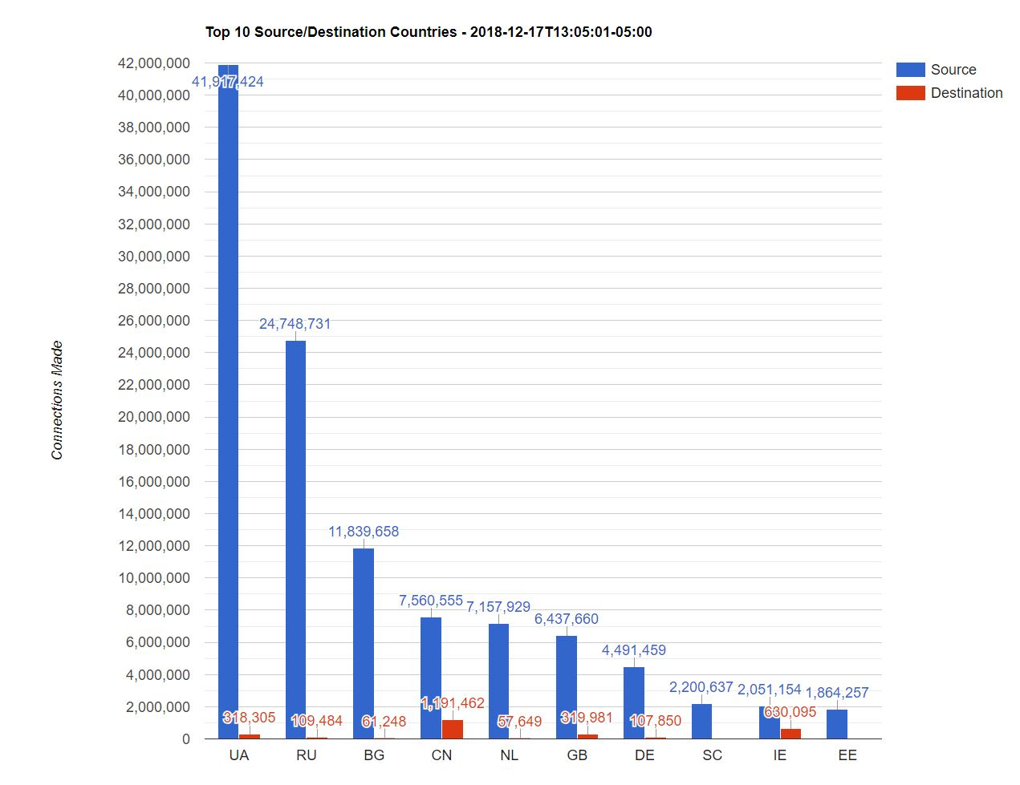
Hacker Attack Goals
Hacker attack goals are 1 or more of the following:
  DATA theft/disclosure a.k.a. data breaches
  ATTACK other sites using hacked assets
  DESTRUCTION of company data (deletion or ransomware)
DEFEND accordingly

Slide 13
Corporate Structure → EDU Model, The Future
Administrative – the process that runs the institution (“Corporate”)
  Payroll, HR, Purchasing, Facilities, Legal, etc.
  Security model closest to corporate model
Academic and instructional – the process that supports teaching and learning (“ISP”)
  Learning management systems such as CANVAS, Blackboard, Moodle
  Course Delivery systems – Zoom, Webex, etc.
  Heavily BYOD – all flavors and types
  Security model closest to an Internet service provider

Slide 14




Corporate Structure → EDU Model, The Future
Research – hybrid of administrative and academic/instructional
  Intellectual property protection
  High risk, visibility
  Security model is a hybrid of corporate and ISP

Slide 15
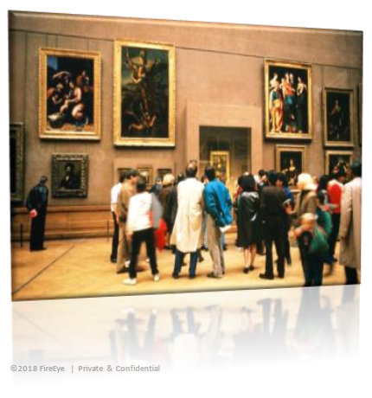
Museum Defense in Depth
Control access points
  Limited but free flowing access points
  Additional barriers around high risk assets
Pervasive Monitoring tools
  Cameras, motion sensors, etc.
Active Response
  Guards, on-demand barriers, fire suppression
Recovery Measures
  Insurance
  Tracking devices
Assume hostiles are inside
Used with permission of Christian Schreiber

Slide 16
Zero Trust Networks(ZTN) Characteristics*
Network and user traffic patterns have change dramatically in the past 20 years.
Pillar 1: The network is always assumed to be hostile
Pillar 2: Assume the hostiles are already inside your network
Pillar 3: Network locality (segmentation) is not sufficient for deciding trust in a network
Pillar 4: Every device, user and network flow is authenticated and authorized
Pillar 5: Policies must be dynamic and calculated from as many sources of data as possible
* “Zero Trust Networks: Building Secure Systems in Untrusted Networks,” Evan Gilman, Doug Barth

Slide 17
The Future: The Mobile Internet
Positioning IT Security for the future
Pillar 6: The device is no longer the border. A user’s identity is the new border. Data is the new border.
Pillar 7: Containers, serverless and cloud computing are the new disruptors of traditional security architectures.
Pillar 8: Mobile users, mobile apps, mobile storage
Notes:
Karen Herrington first suggested the user’s identity is the new border.

Slide 18
Another View of ZTN
“As we move our data outside of the firewall, we have to adopt a zero-trust type model,” [Chris] Townshend said. “We are shifting our security enforcement out to the data itself, and you have to have a security policy that follows that user no matter where that user is or what device they are using to access the data.”
In other words, data becomes the border.
“The new cyber landscape,” Patrick Marshall, GCN Magazine, vol. 37, no. 1.

Slide 19
Securing Summit on AWS
Carl Harris
Chief Technology Architect
ceharris@vt.edu

Slide 20
Summit: The Backstory
Build a workflow management tool to support sponsored research administration
  Existing business process supported mostly by long e-mail reply chains and attachments
  Several previous attempts to acquire/integrate a tool were unsuccessful
  Agile development approach; responsive, iterative
  Original plan was to build and run on our own infrastructure
  Instead used it as an opportunity to leverage the cloud (via AWS)
  Became our first enterprise-scale application in the cloud in Summer 2016

Slide 21












AWS Cloud
summit.demo.org
*.summit.demo.org
Summit
Users
https://summit.demo.org
Download distribution
Notes:
Serverless. Just storage for static assets and configuration.

Slide 22



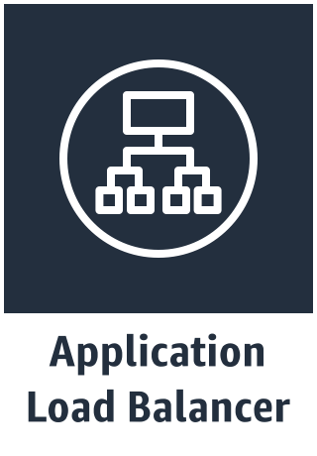




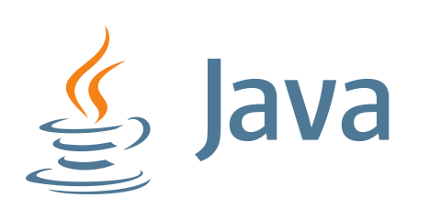




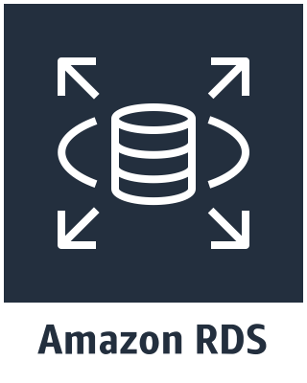
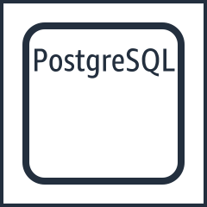


AWS Cloud
VPC
Public Subnet
Internet gateway
Front-End App
Registry
Private Subnet
Auto Scaling group
EC2 Container Instances
Docker Container Images
SQL Database
VPN Gateway
VT-Local Databases
Notes:
Full stack Java EE 7 deployed as Docker container images using EC2 Container Service, Application Load Balancing, and a RDS database

Slide 23
Security Advantages of Containers in the Back-End
“Immutable” and inaccessible server hosts
  Minimal attack surface… nothing installed but Docker engine and ECS agent
  ECS-optimized AMI is regularly updated by AWS
  No application data on server
  Application logs forwarded to CloudWatch
  No SSH access
Application container images include all dependencies
  Know full manifest… every dependency, with required versions effectively pinned
  Vulnerability scanning can happen before deployment, in the CI/CD pipeline
Disposable host instances
  Nothing to install, backup, or maintain… i.e. nothing to administer
  Don't patch… replace instead

Slide 24
Other Considerations for the Web Front-End
Use Sub-Resource Integrity (SRI) checks
  reduce risk of getting compromised library code
  for any/all code fetched from a CDN
  specified via <script> tags
Use a Content Security Policy (CSP)
  dramatically reduce risk that our front-end will execute malicious code (even from a trusted origin; e.g. various XSS vectors)
  specified via headers added using Lambda@Edge
Use Cross-Origin Resource Sharing (CORS) constraints
  prevent code from a third-party origin from accessing data in our back-end
  via HTTP headers added by the back-end service

Slide 25
Protecting the Data
Relational Database Service (RDS)
  use security groups to minimize exposed scope of database server ports
  use TLS to protect connections to the database
  use encrypted storage volumes to protect data at rest
  regularly rotate access passwords used by applications
  scheduled snapshots for backups
  automatic patching of database server during scheduled maintenance windows
Simple Storage Service (S3)
  IAM role-based access policies to ensure authorized access to the data, e.g. using ECS task roles
  use encrypted storage for objects
  use lifecycle policies and versioning
  new console features make it easier to specify a "safe" policy

Slide 26
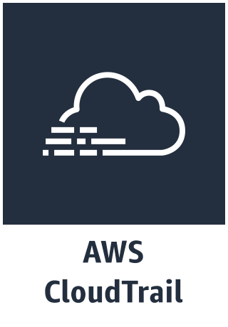

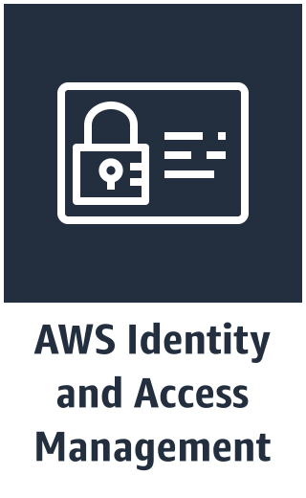
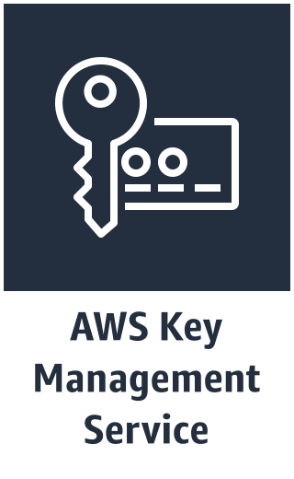

Honorable Mentions

Slide 27
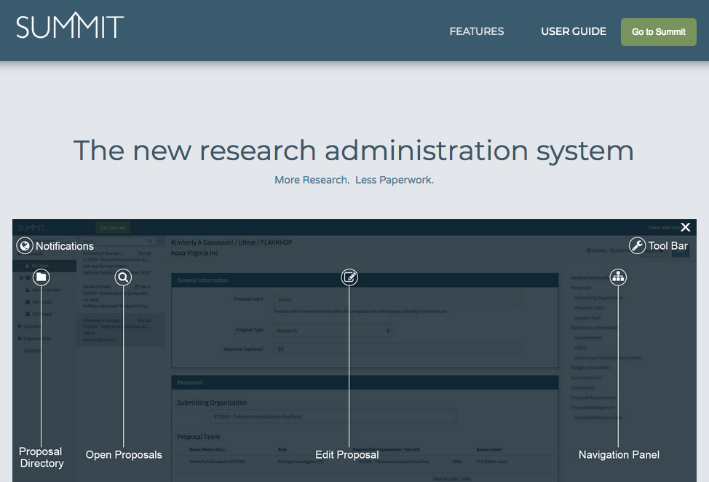
Outcomes
Responsive, iterative
process really satisfies our stakeholders
Used this effort to set the stage for additional cloud deployment efforts
  Leverage major application upgrades as window of opportunity
  Several smaller applications running in AWS now
  Also helped prepare us for
  much more significant
  challenge in building the
  Virginia Cyber Range
Notes:
say some words here about the similarities and contrasts of Summit vs Cyber Range

Slide 28
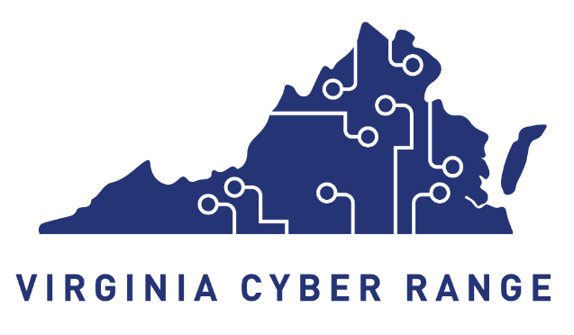
The Virginia Cyber Range:
Cloud-based resources for cybersecurity education
Sandra Schiavo
Lead Courseware Coordinator, Virginia Cyber Range
sandra@virginiacyberrange.org
https://virginiacyberrange.org

Slide 29
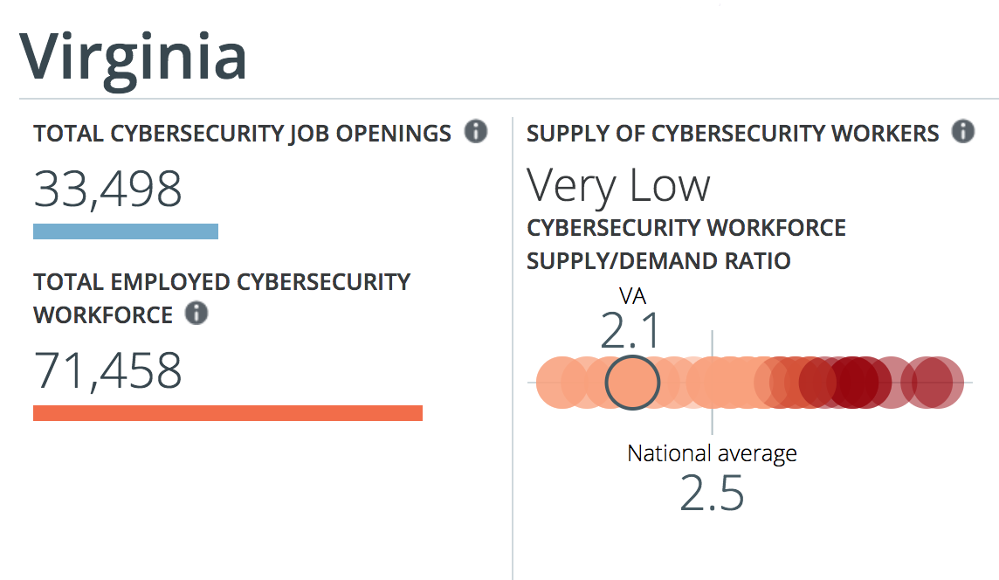
Cybersecurity Talent Shortfalls

Slide 30



Courseware Repository
Exercise Area
Community of Purpose
Courses, modules, and exercises for use in HS, CC, and university cybersecurity curricula
  Instructors/professors can select course content in full or a la carte
Grants offered for courseware development
Menu of per-student exercise environments for use in cybersecurity courses
Working towards team-based offensive and defensive, scenario-based environments
Capture-the-Flag infrastructure for cybersecurity competitions
Consortium governance
Convene workshops and conferences to “teach the teachers” and share best practices
Helping to expand NSA/DHS CAE certification among Virginia colleges and universities

Slide 31



Leveraging the Public Cloud
Design Requirements:
  Difficult to predict resource requirements
  Completely automatable
  Cost effective
  Short-term surge capacity
  Available anywhere
  Web portal for access to content
  Role-based access
  Login to see user-specific content
  Students just need a web browser and internet connection!
Why the Cloud?
Unlimited scalability!
Quick start-up phase
Low capital investment
Rapid scalability
Surge capacity
Location independent
Highly automated
Pay as you use

Slide 32

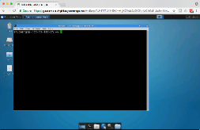
Virginia Cyber Range
Internet
TCP:80;443
Proxy
TCP:80;443
www.
something.
com
Internal IP
10.10.x.y
External IP
TCP:3389
TCP:22
TCP:443
Student
School network

Slide 33
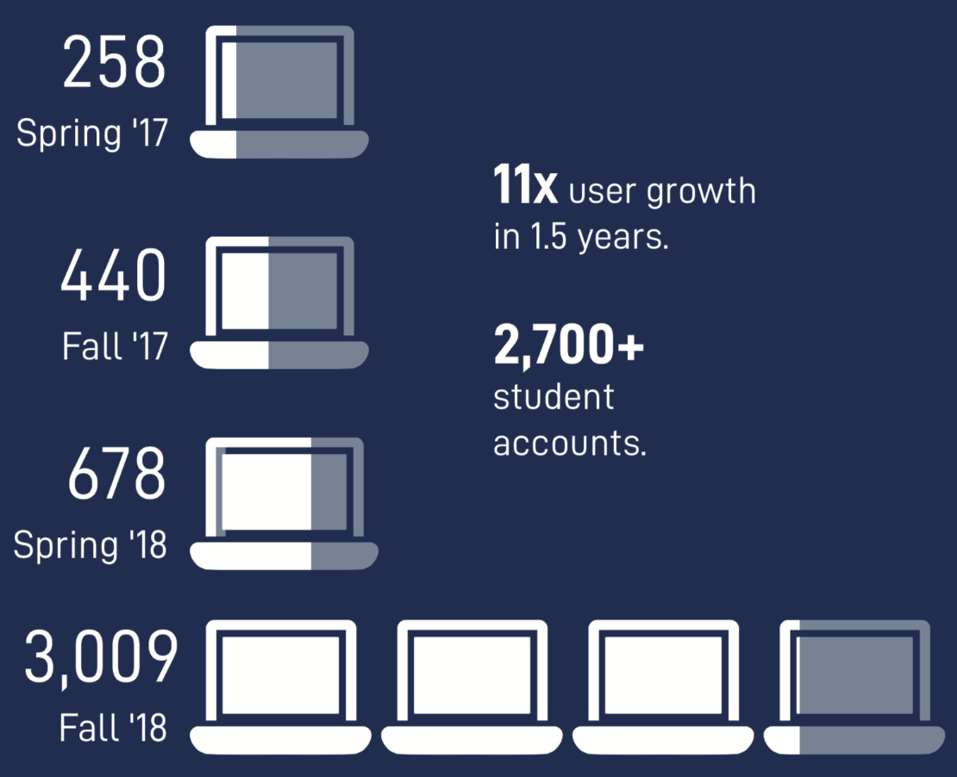
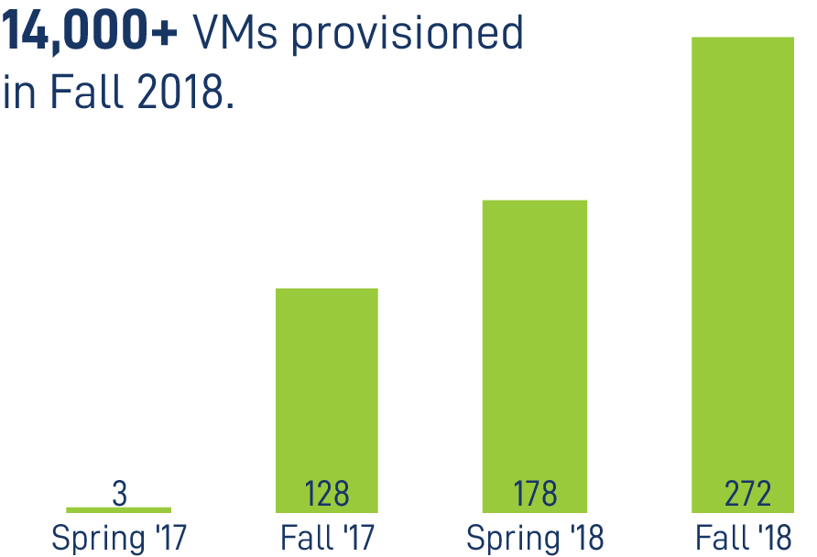
Exercise Area User Stats
Courses Supported
Users Supported

Slide 34
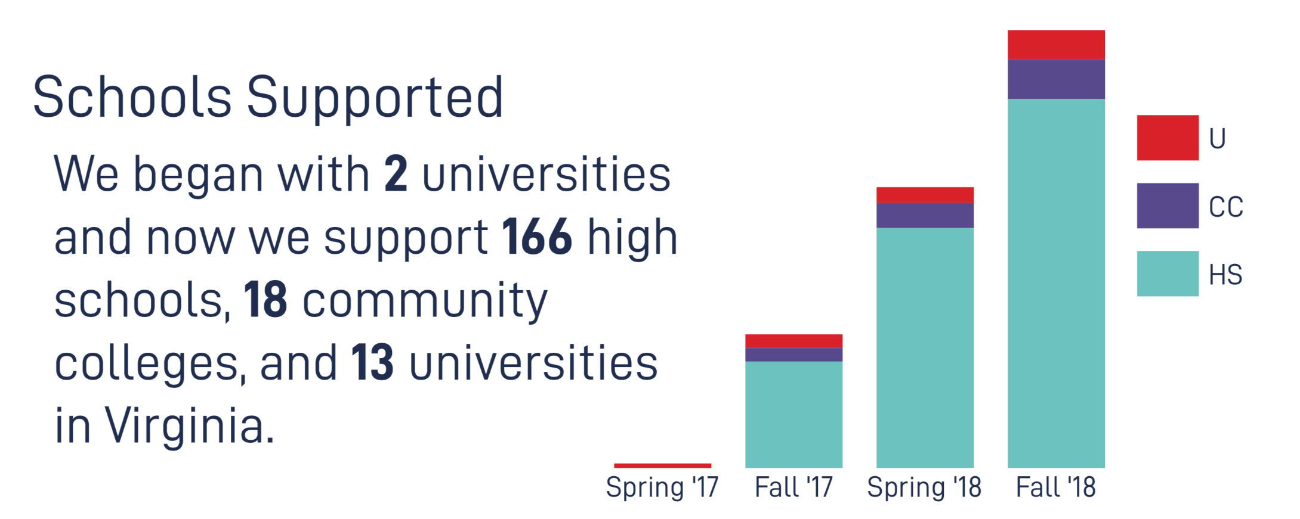
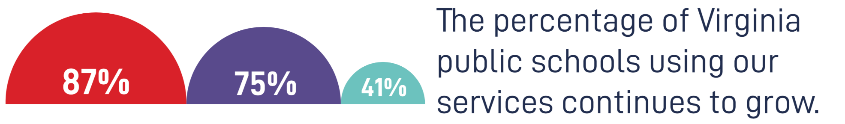
Schools Supported
Notes:
2-yr Public Colleges Missing:
Eastern Shore Community College
Patrick Henry Community College
Richard Bland College
Southside Virginia Community College
Virginia Highlands Community College
Wytheville Community College
Users:
Blue Ridge Community College
Central Virginia Community College
Dabney S. Lancaster Community College
Danville Community College
Germanna Community College
J. Sargeant Reynolds Community College
John Tyler Community College
Lord Fairfax Community College
Mountain Empire Community College
New River Community College
Northern Virginia Community College
Paul D. Camp Community College
Piedmont Virginia Community College
Rappahannock Community College
Southwest Virginia Community College
Thomas Nelson Community College
Tidewater Community College
Virginia Western Community College

Slide 35
Reasons for Growth
Demand
  Emphasis on cybersecurity
  Virginia Department of Education’s development of Cybersecurity Career Pathway Courses
Outreach
  Presentations at various local and national academic conferences
  On-site visits to various colleges and universities
  Our annual Virginia cybersecurity education conference
Technical
  Cloud-enabled scaling
  Designed platform/program to scale
  Negates need for special hardware and eliminates associated overhead with on-premise solutions

Slide 36
Resources and References
Virginia Cyber Range (https://virginiacyberrange.org/)
Virginia Tech Information Technology (https://it.vt.edu/)
Virginia Tech IT Security Office (https://security.vt.edu/)
Summit (https://summit.cloud.vt.edu/)
AWS Security and Compliance Quick Reference Guide: Education Edition
(https://d1.awsstatic.com/whitepapers/compliance/AWS_Compliance_Quick_Reference_Education.pdf)
Center for Digital Education Security Whitepaper (Featuring Virginia Tech)
(https://pages.awscloud.com/NAMER_WWPS_CS_cde-whitepaper_20180919.html)

Slide 37
Questions?

Slide 38
Thanks to Today’s Speakers
Carl Harris
Chief Technology
Architect
ceharris@vt.edu
Randy Marchany
University Information
Technology Security
Officer
marchany@vt.edu
Scott Midkiff
Vice President for
Information Technology
and CIO
midkiff@vt.edu
Sandra Schiavo
Lead Courseware
Coordinator,
Virginia Cyber Range
sandra@virginiacyberrange.org

