Slide 1

The smarter video platform for education.
Improving Student Success with
Video & Active Learning
Thursday, December 6 at 2 p.m. Eastern

Slide 2
Moderator:
Dr. Perry Samson
Arthur F. Thorneau Professor at University of Michigan and Senior VP of Teaching Innovations at Echo360

Slide 3
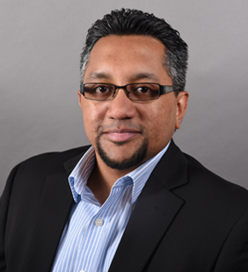
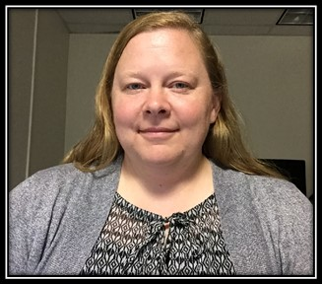
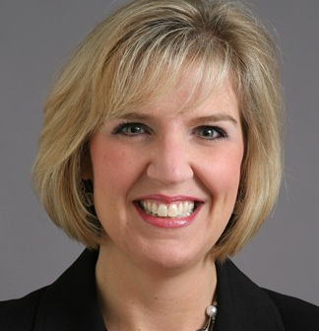
Andrew Perumal
Associate Professor, Department of Economics
University of Massachusetts at Boston
Tina Meagher
Manager of Video & Digital Media Strategy, Sr. Video Strategist
University of Cincinnati
Angela Paprocki
Assistant Provost for Curriculum and Instruction, Director, University Teaching Center
University of Toledo

Slide 4
Driving Student Metacognition:
Echo360 in the Classroom
Andrew Perumal
Economics Department
UMass Boston

Slide 5
Metacognition
“thinking about your thinking”
My ability to know what I know and what I do not know; how do I think; and, what helps me learn.
For example, I am engaging in metacognition if I notice that I am having more trouble learning A than B; if it strikes me that I should double check C before accepting it as fact.
-Flavell, 1979, Metacognition and cognitive monitoring: a new area of psychological inquiry. Am Psychol 34, 906–911.

Slide 6
The course
Introduction to Microeconomics/Macroeconomics (ECON 101 & 102):
  Since Spring 2015: 8 courses, 700 students
  Lecture heavy
  Weekly online homework: multiple attempts, real-time feedback/explanations
  4 exams: MCQ, short answer, graphing, simple algebra
  Participation points are earned by answering in-class questions using Echo 360
  (10% of grade)

Slide 7
Echo360 Active Learning Platform
Features:
  Active learning to increase engagement in class
  Q&As allow students to clarify doubts as they arise
  Students take notes that are tied to specific slides
  Students may bookmark slides, or mark them as confusing
  Recorded lectures support student learning outside the classroom
  LMS integration / single sign-on

Slide 8
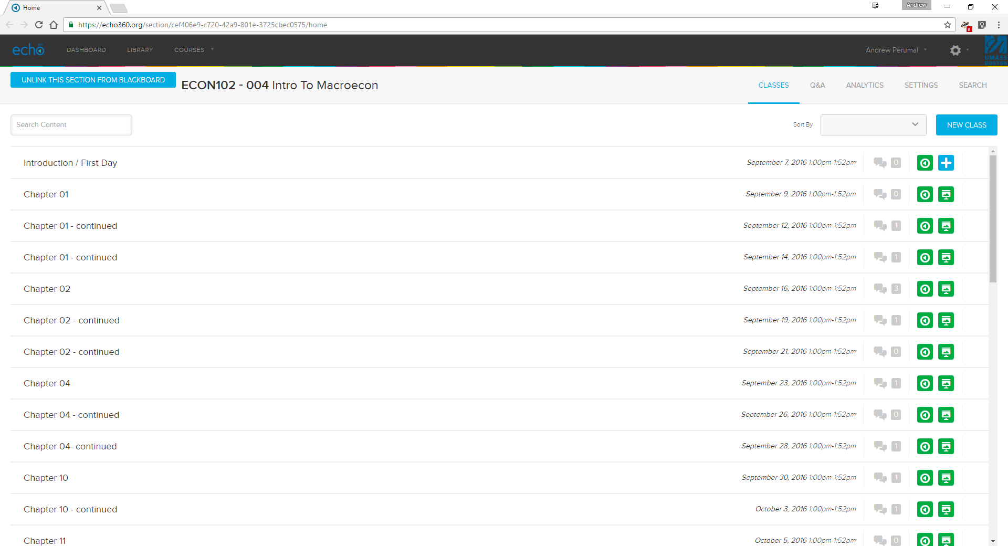
Library
Student questions
Recordings of lectures populate automatically
Course homepage

Slide 9
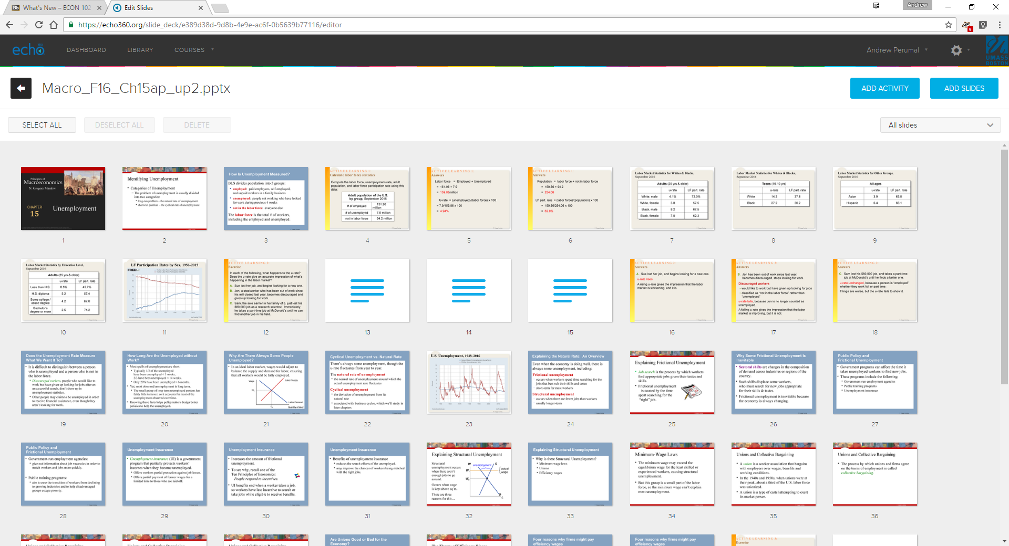
Slide editing: rearranging, adding questions, media

Slide 10
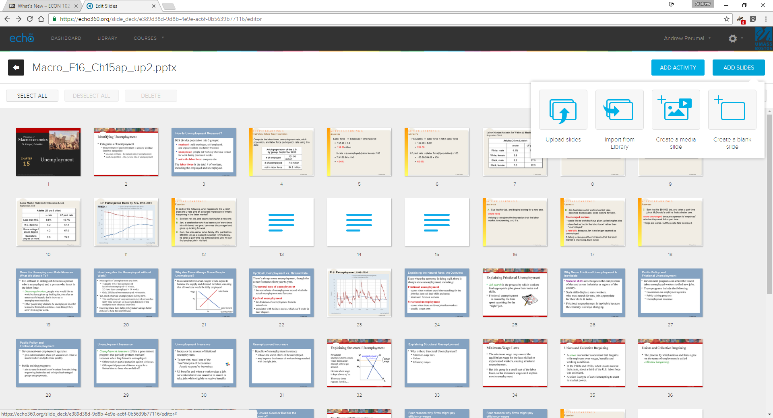
Add Slides: additional slides, or videos and images

Slide 11
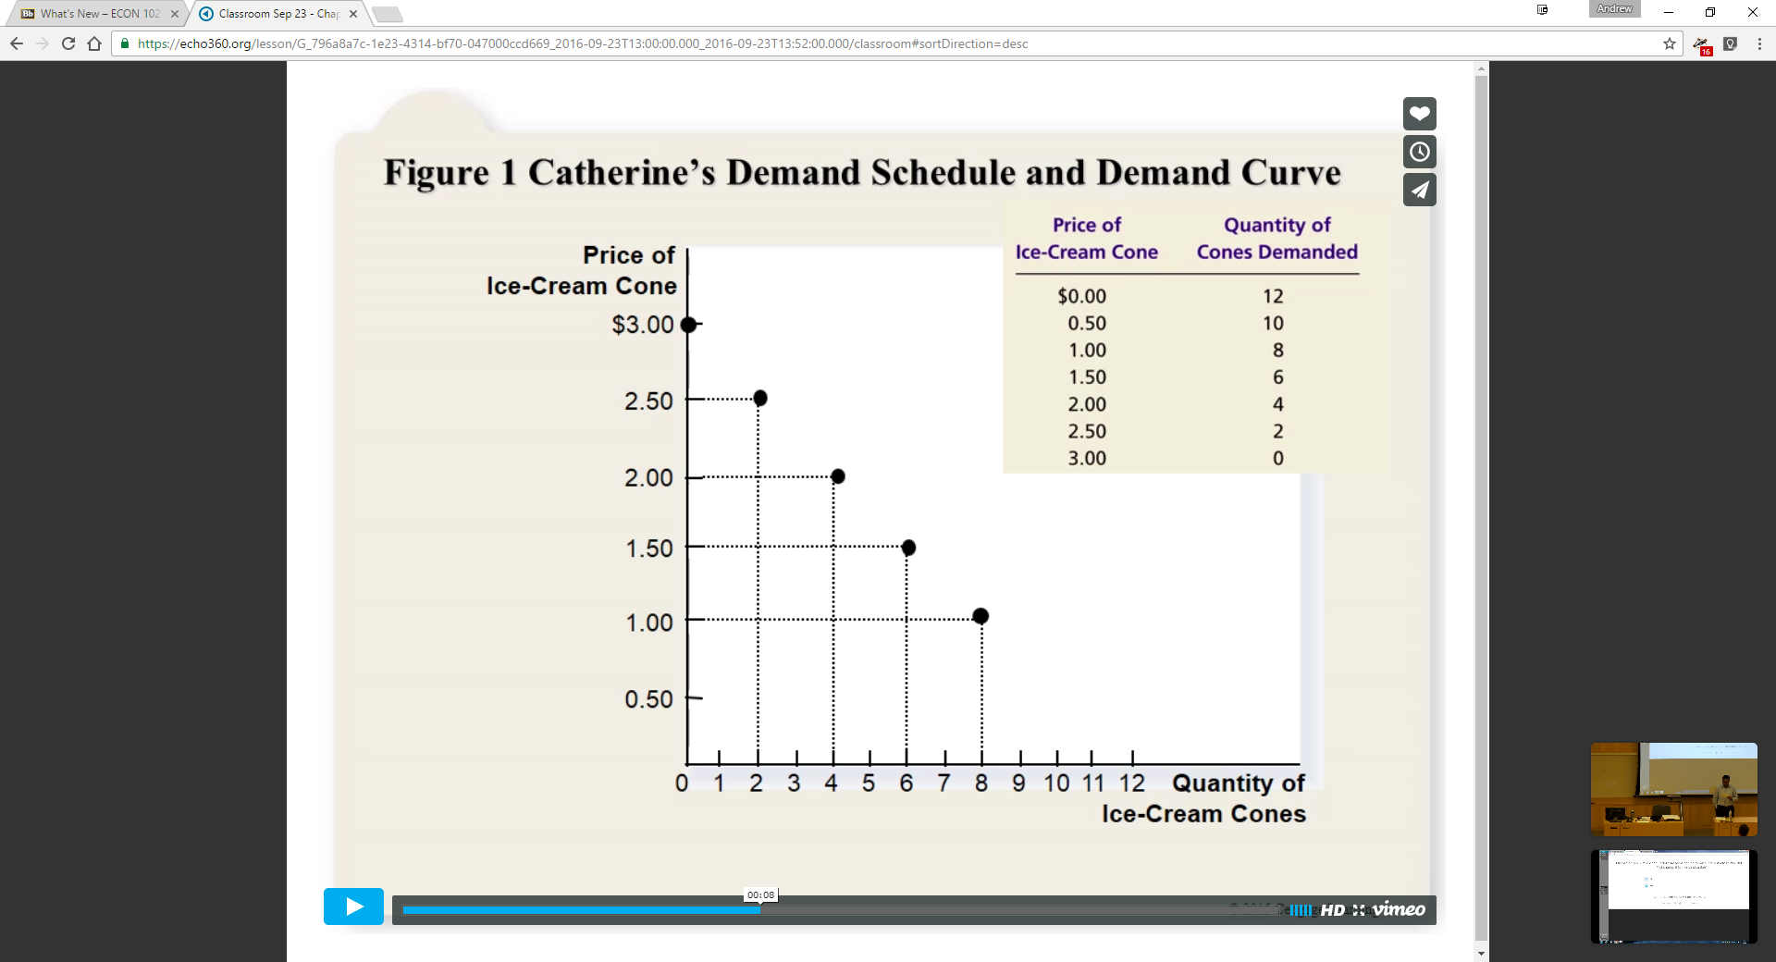

Media slides: Video, uploaded to vimeo

Slide 12
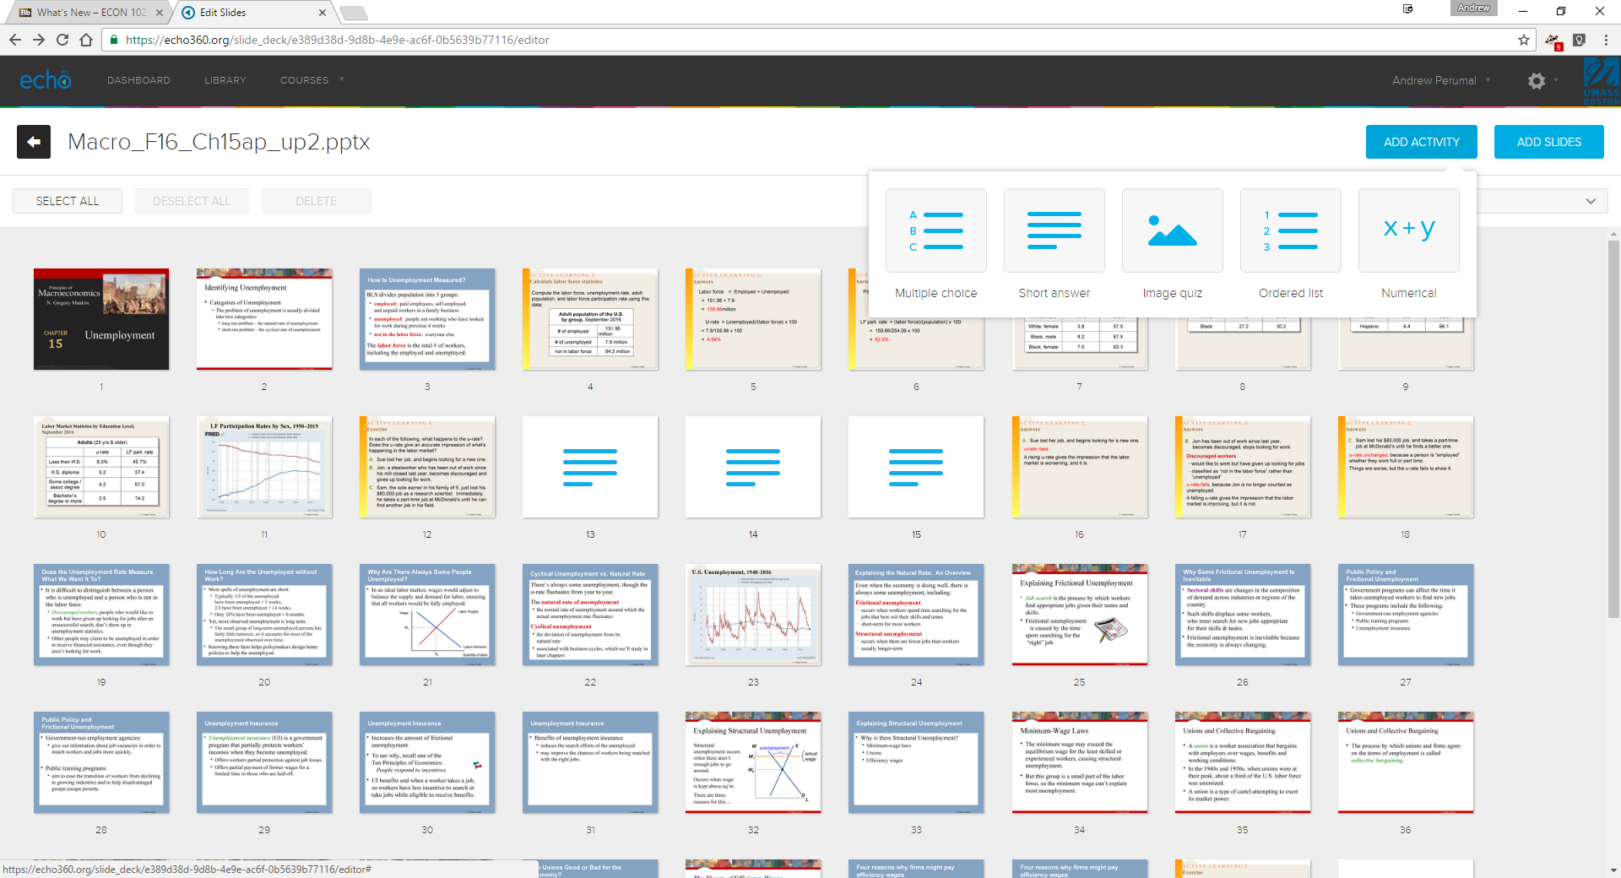
Add Activity: Multiple Choice, Short answer, etc.

Slide 13
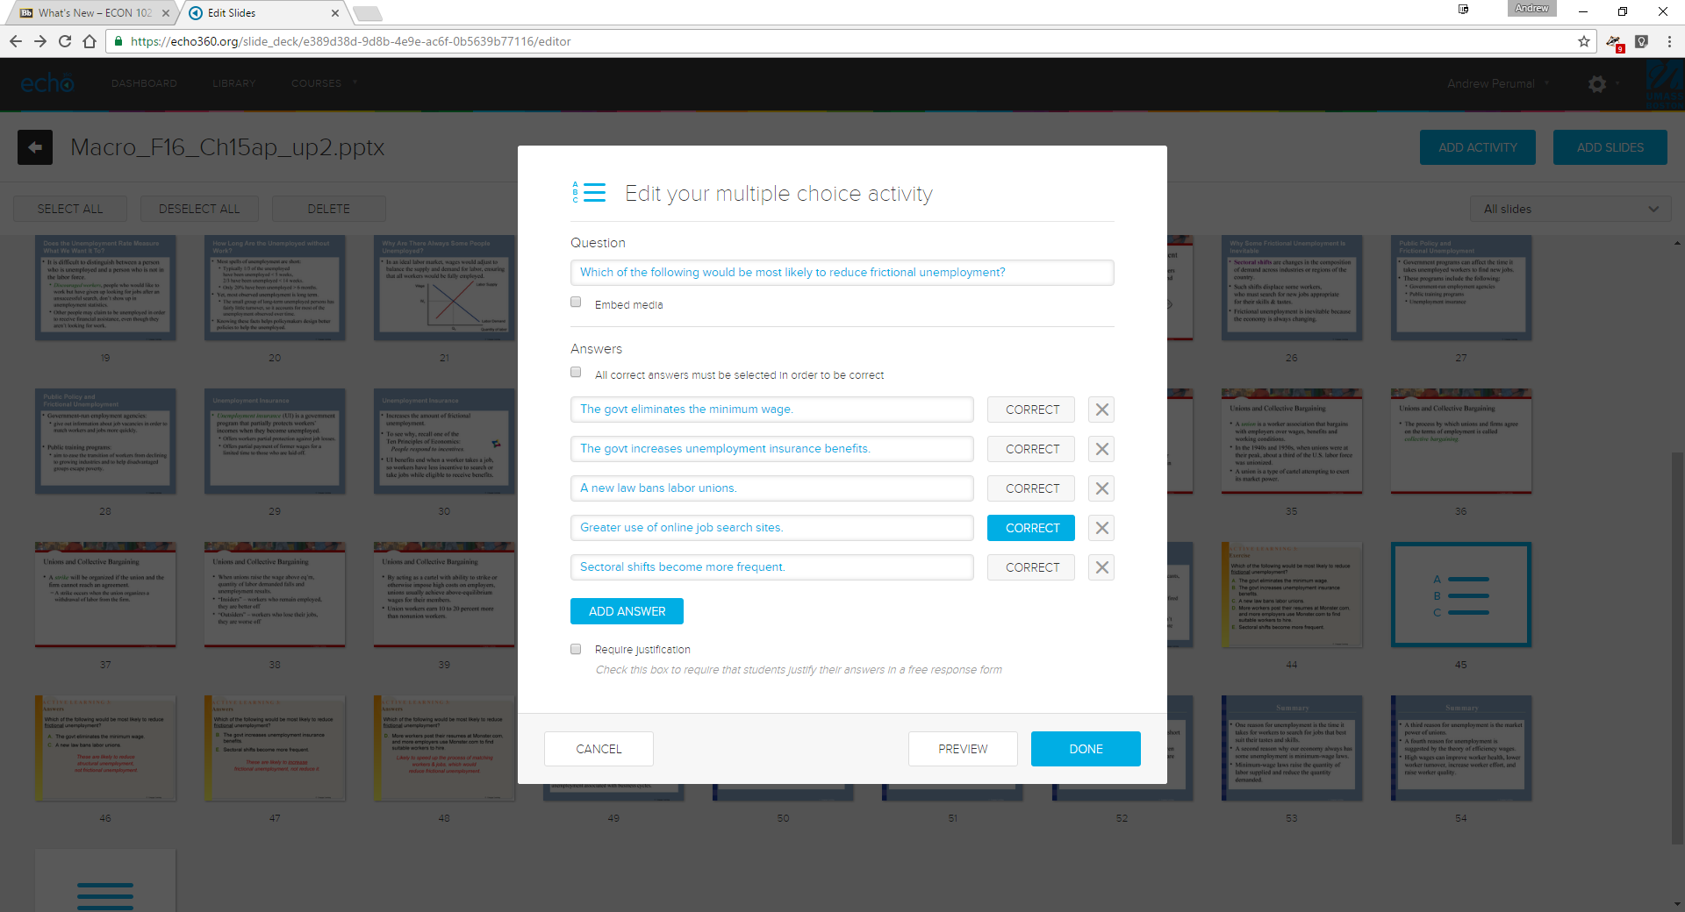
Question types: Multiple choice, creating a question

Slide 14
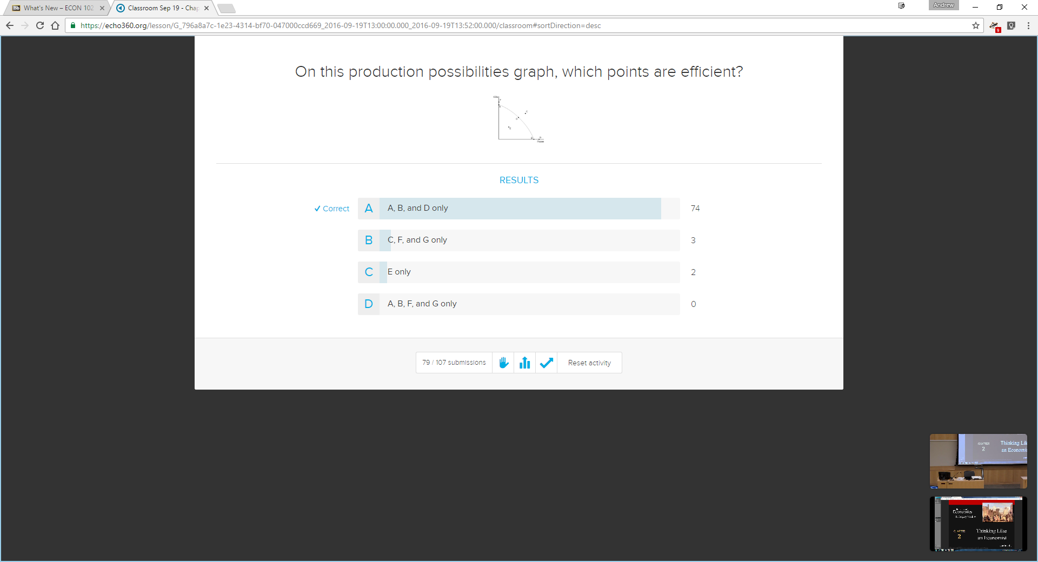
End participation
Show student responses
Show correct answer
Question types: Multiple choice questions, student responses

Slide 15
Do students know what they know?
  Active Learning & real-time feedback:
  Encourage engagement before content coverage
  Identify student depth of content comprehension
  In-class activities for problem solving & use of formulae
  Obtaining student feedback (daily) becomes effortless
  1-minute paper at the end of every class
  Prime students for metacognition
  Current limits of their knowledge
  Convey high expectations
  Reflect on class content

Slide 16
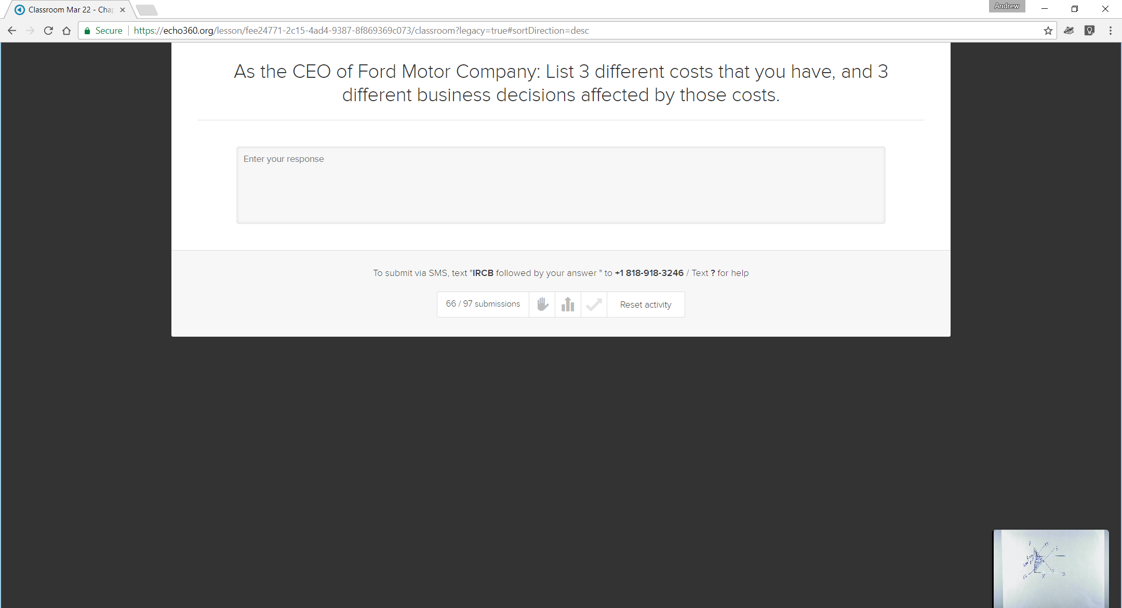
Engage Students: Encourage engagement before content coverage

Slide 17
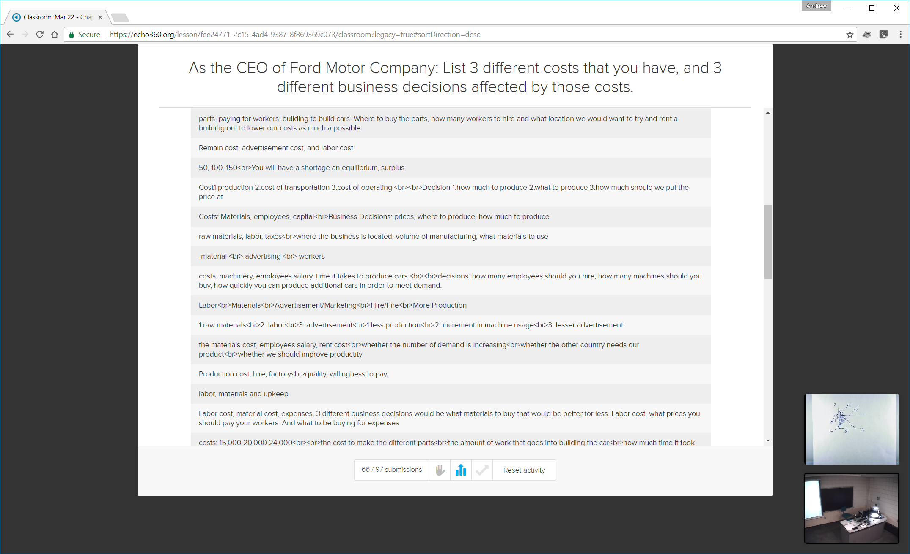
Engage Students: Encourage engagement before content coverage

Slide 18
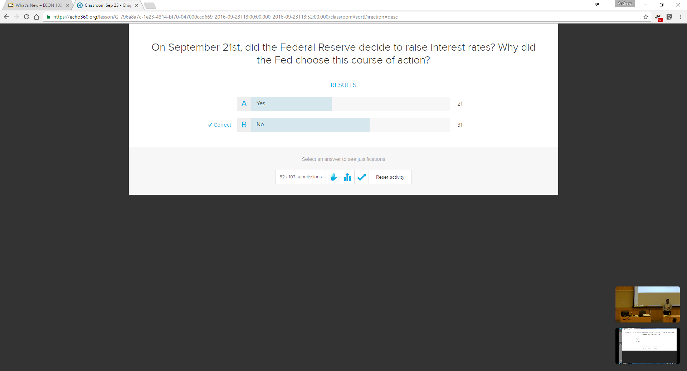
Engage Students: Identify depth of content comprehension

Slide 19
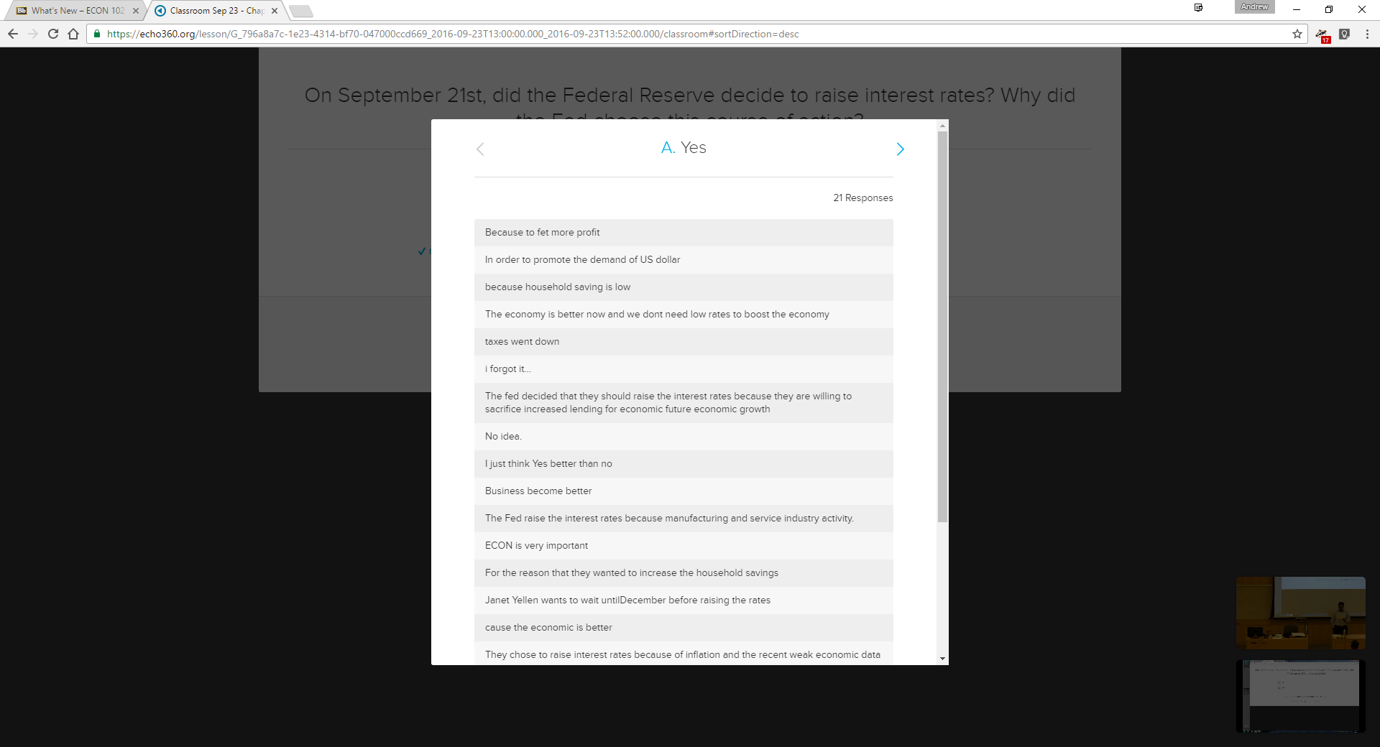

Engage Students: Identify depth of content comprehension

Slide 20
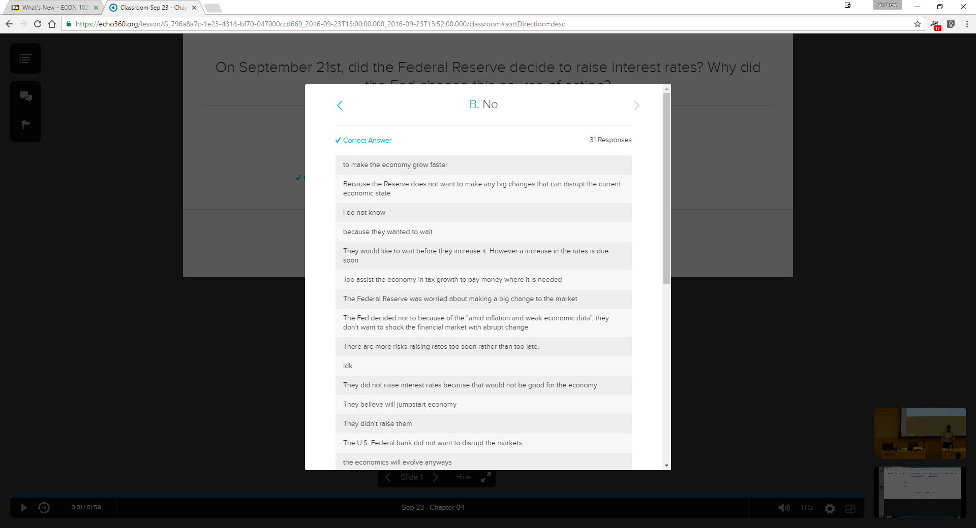
Engage Students: Identify depth of content comprehension

Slide 21
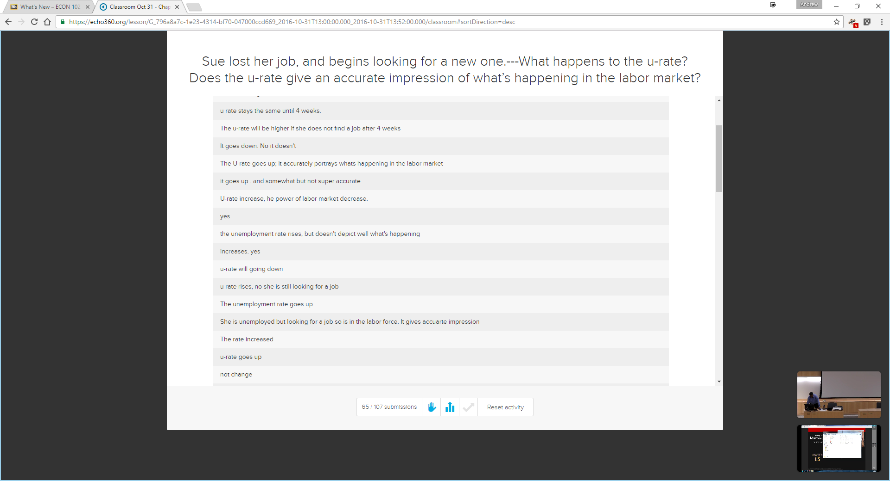
Engage Students: Identify depth of content comprehension

Slide 22
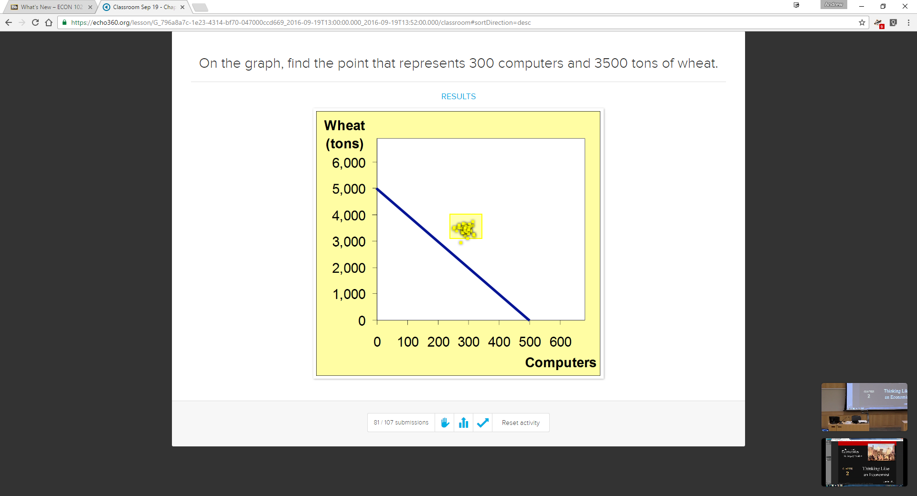
Engage Students: Simple image questions

Slide 23
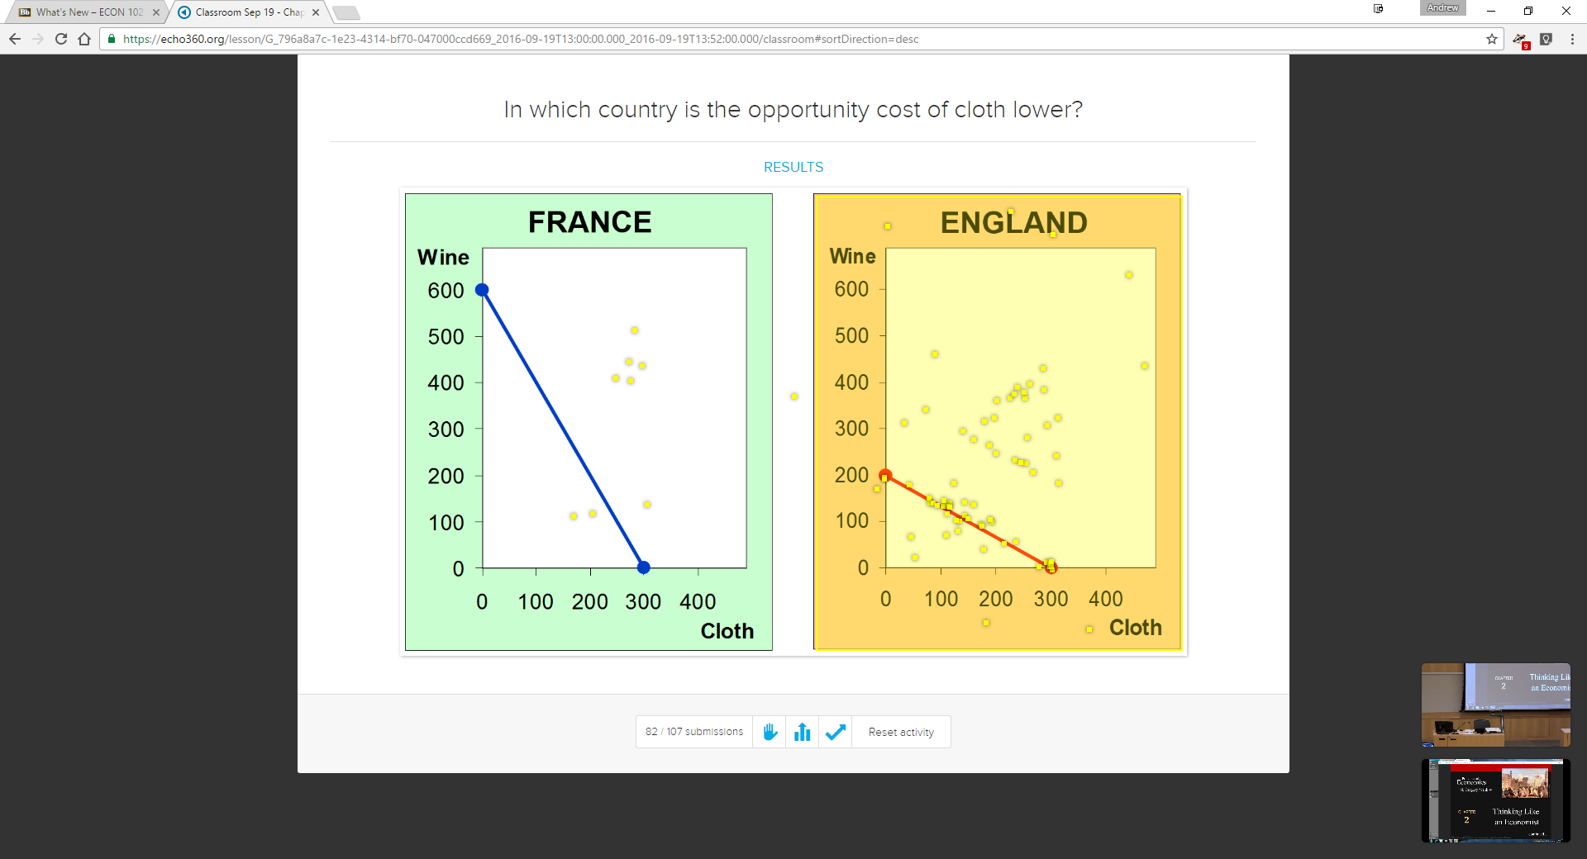
Engage Students: More complex image question

Slide 24
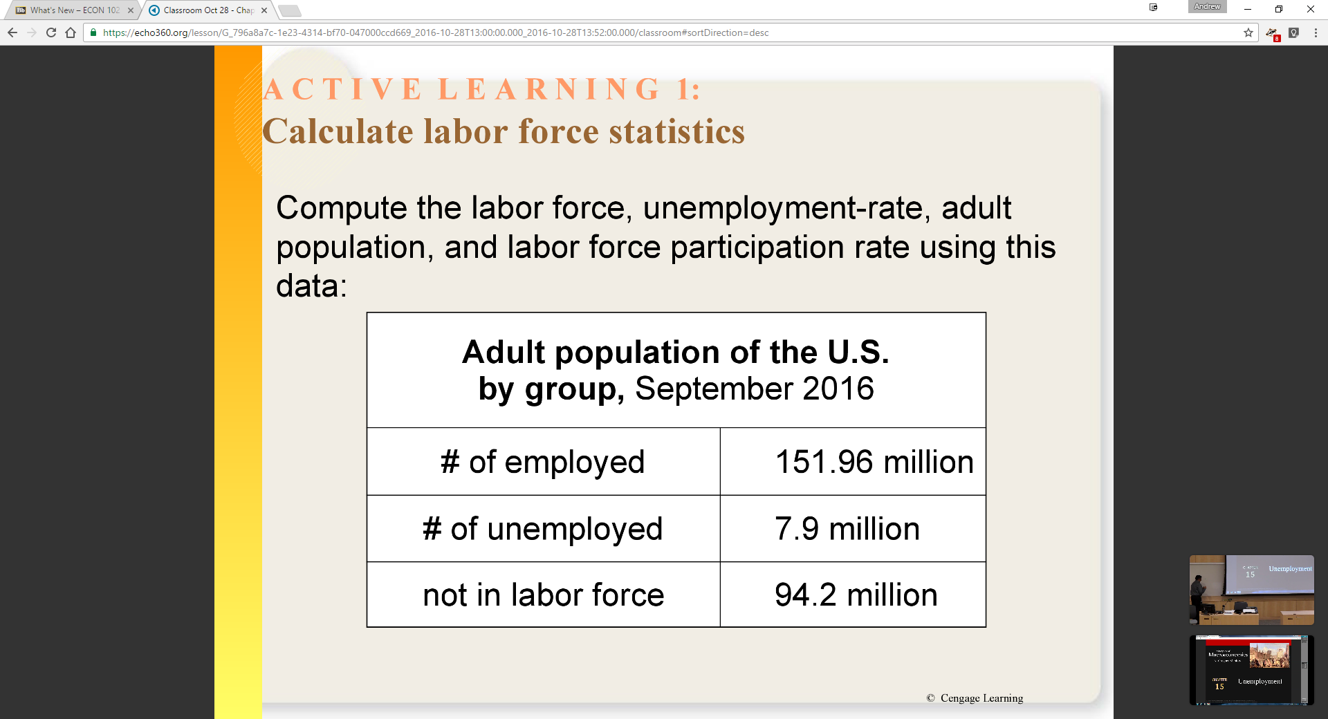
Engage Students: Require students to attempt calculations in class

Slide 25
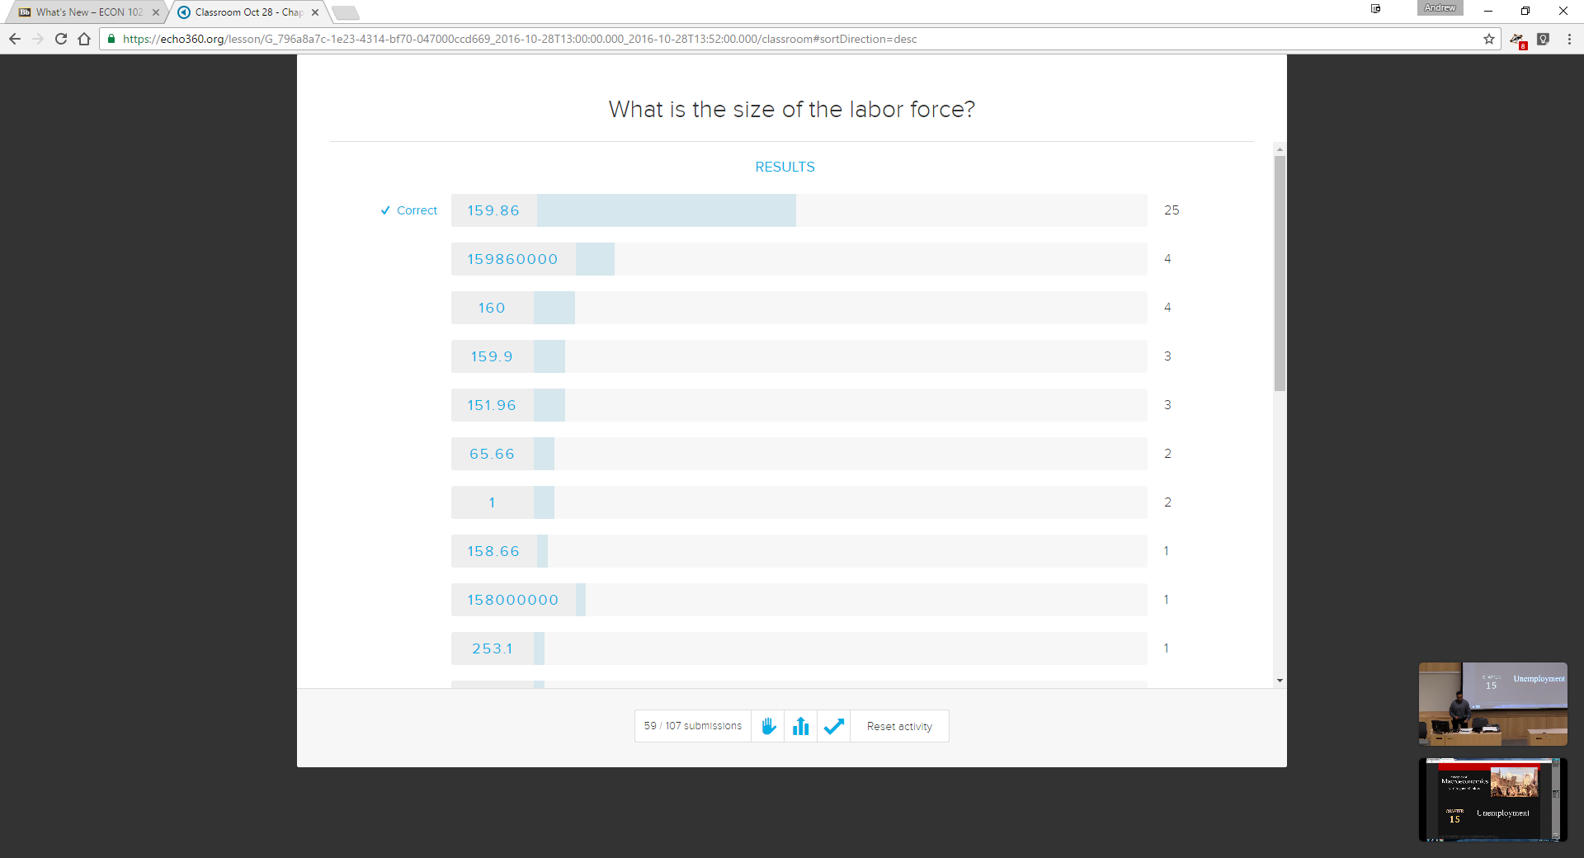
Engage Students: Require students to attempt calculations in class

Slide 26
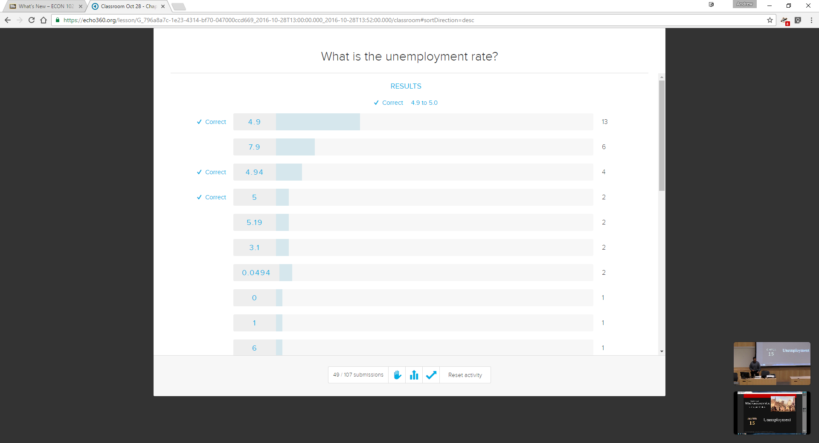
Engage Students: Require students to attempt calculations in class

Slide 27
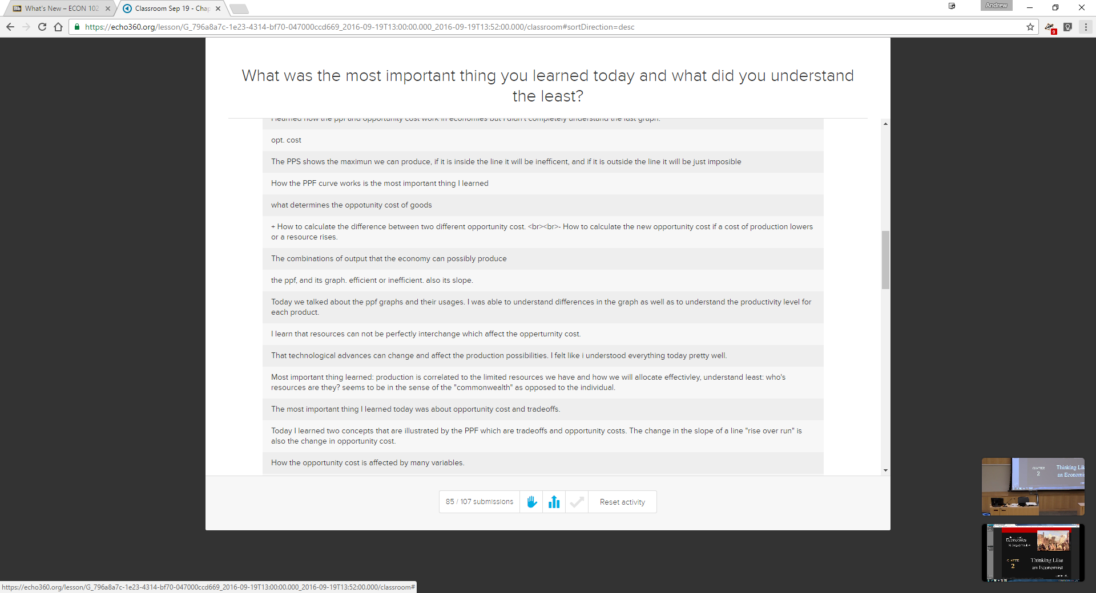
Engage Students: Obtain daily feedback (1-min paper, end of class)

Slide 28
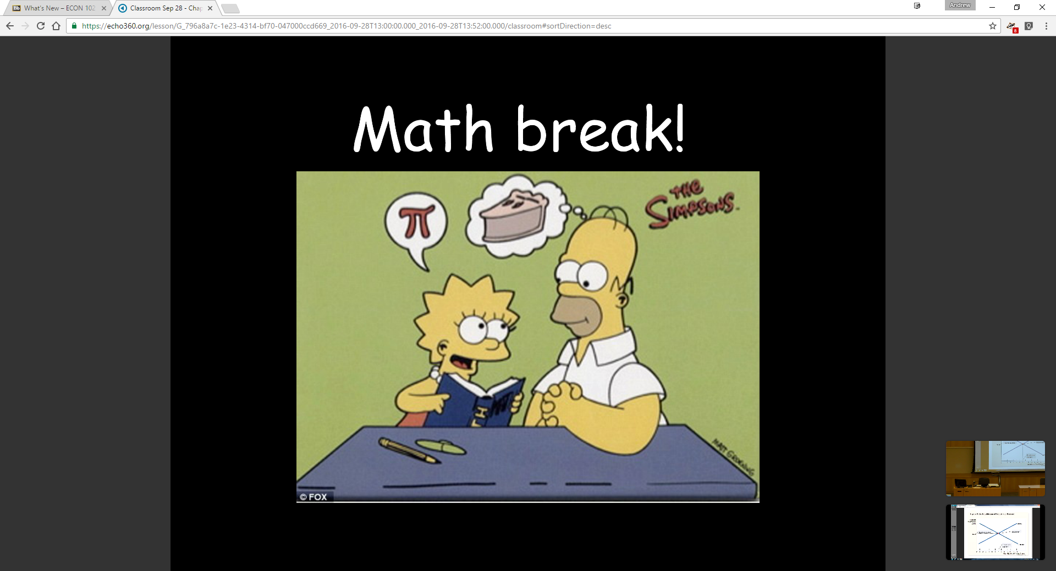
Ease of breaking up a long series of concepts

Slide 29
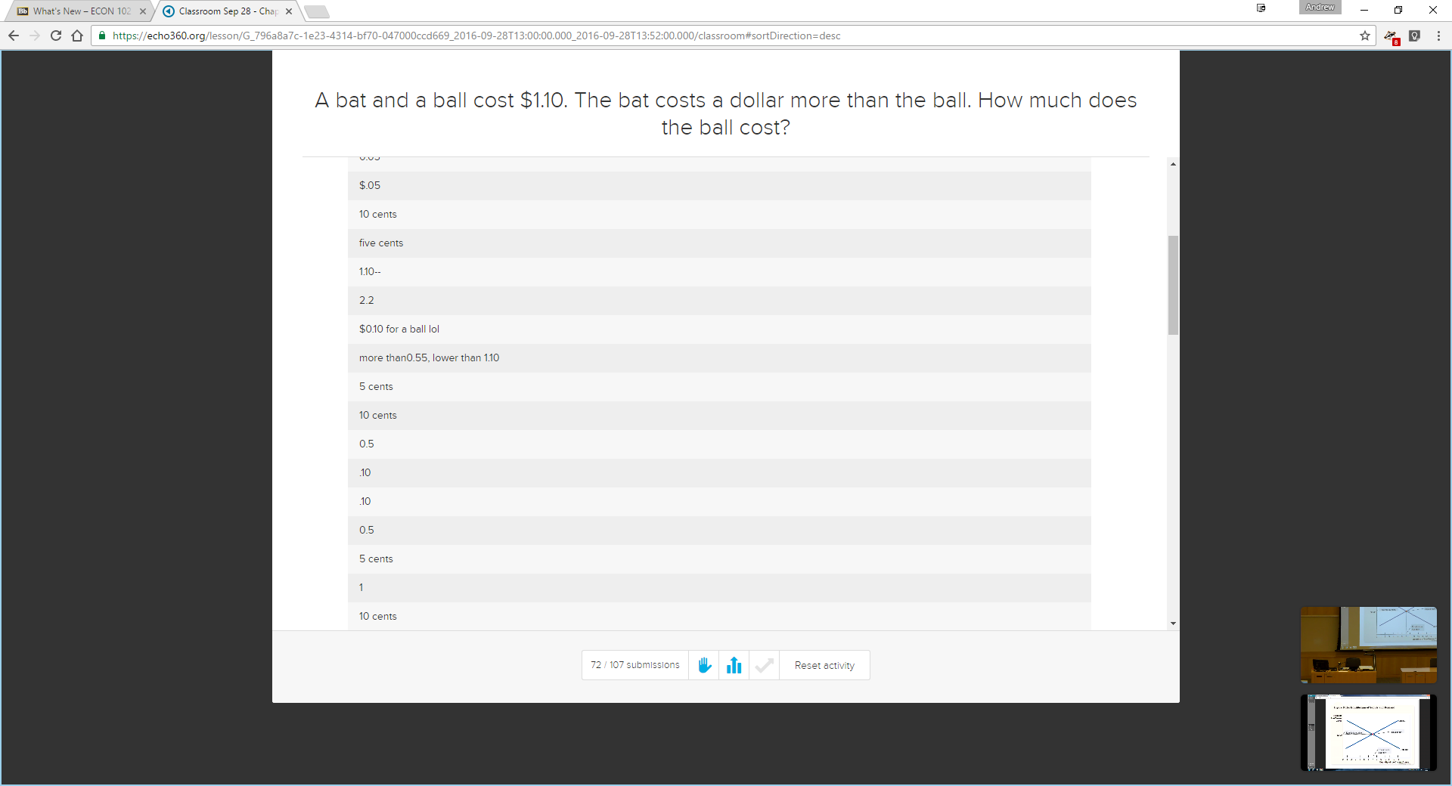
Ease of breaking up a long series of concepts

Slide 31
Do students use the platform?
View and answer questions from students
Track student engagement
  Do students watch the recorded lectures?
  Are they participating in all activities?
  Do students take notes?

Slide 32
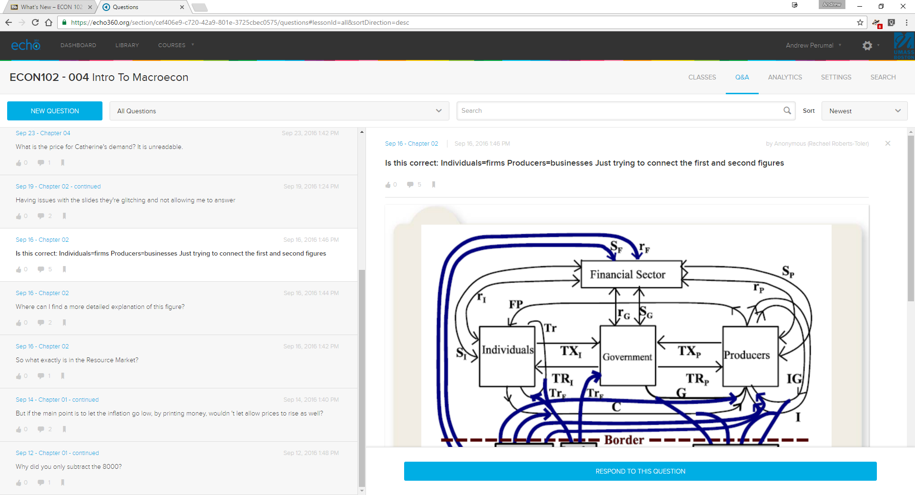
Q&A Section: During, or after class, students can ask questions.
May be answered by anyone.

Slide 33
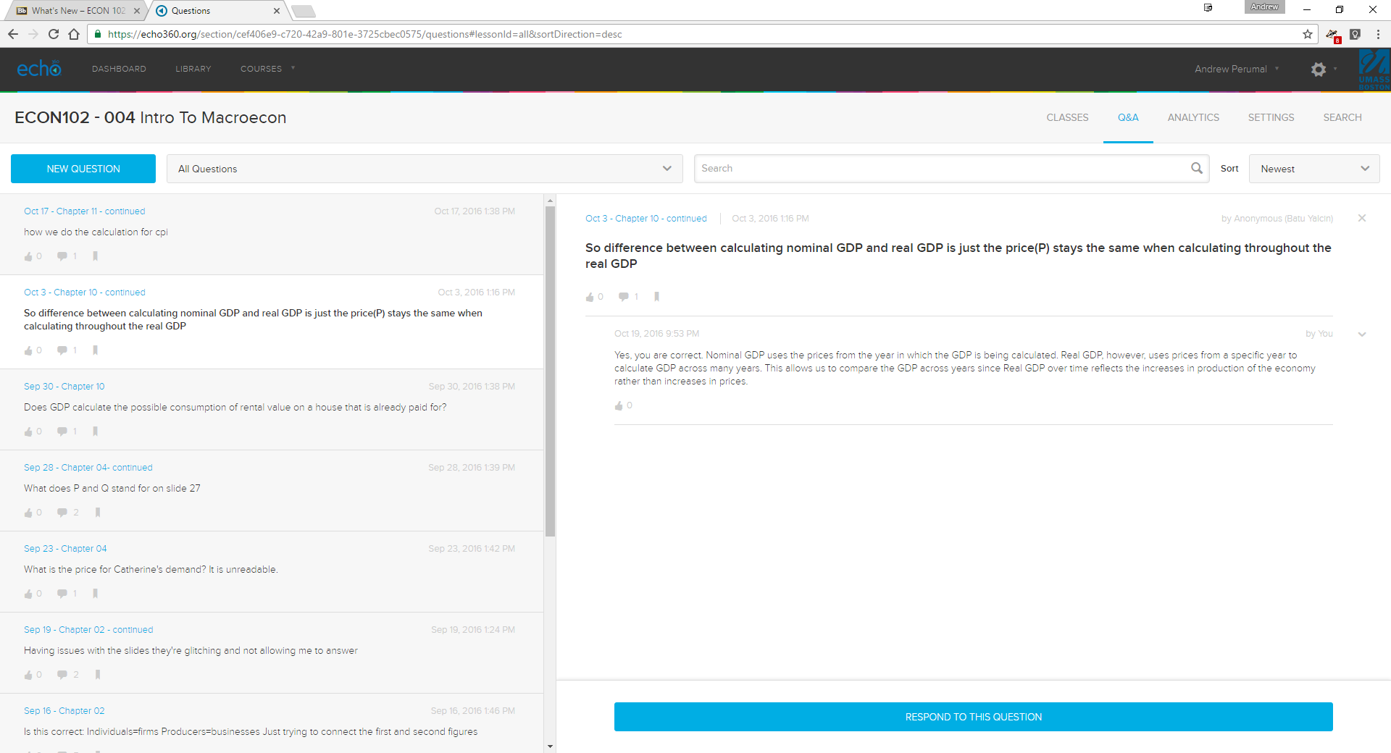
Q&A Section: Question answered by me after class.
Typically, TA answers all questions during class.

Slide 34
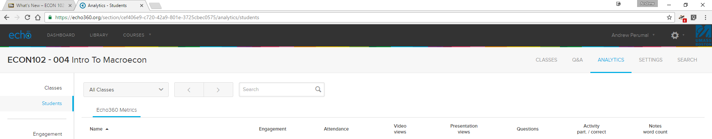
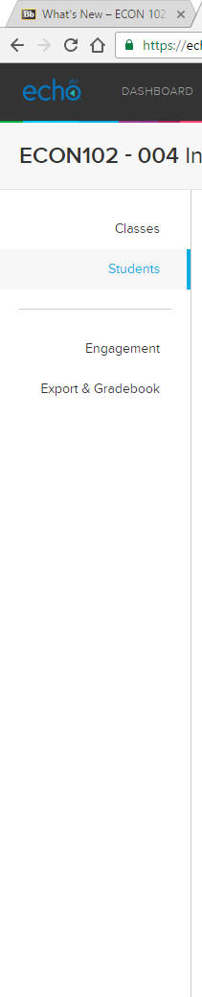
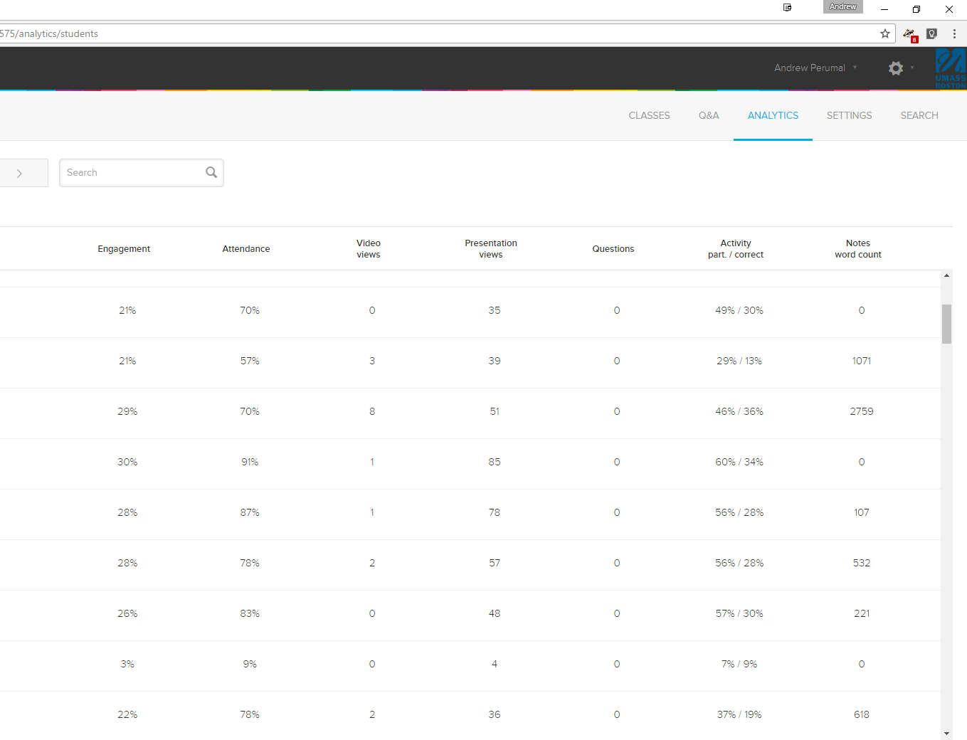
Analytics section: can explore student specific metrics, by date

Slide 35
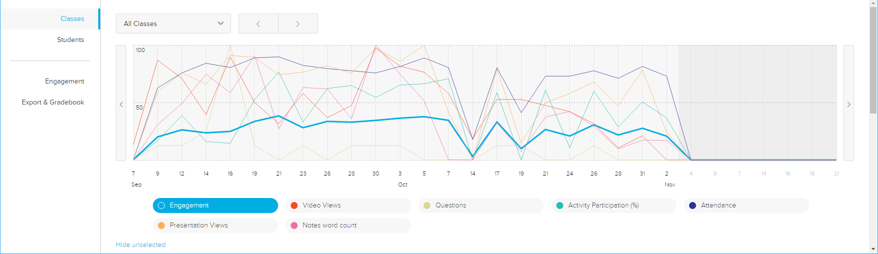
Analytics section: can explore overall class metrics, by date
Examining student engagement

Slide 36
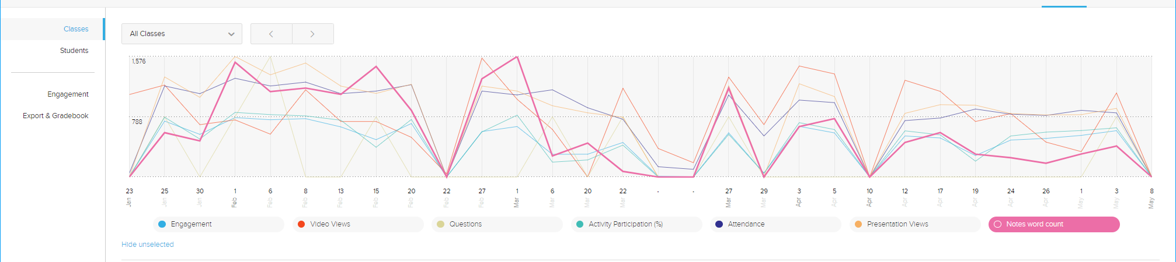
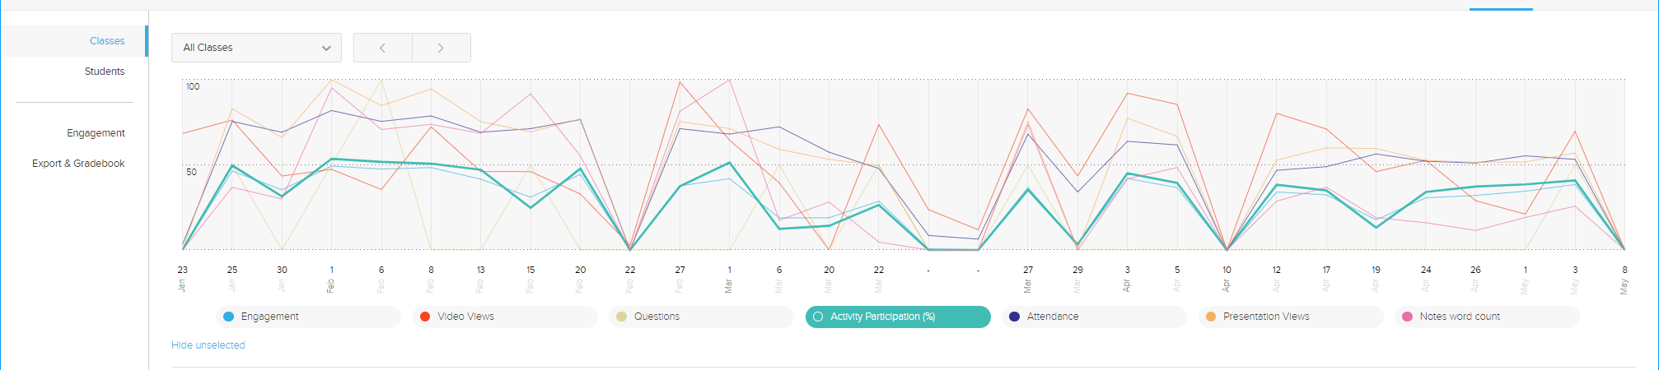
Notes word count:
Activity Participation (%):
Analytics section: deep dive by component, by class

Slide 37
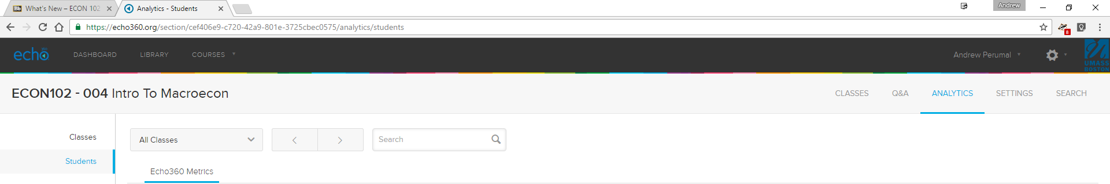
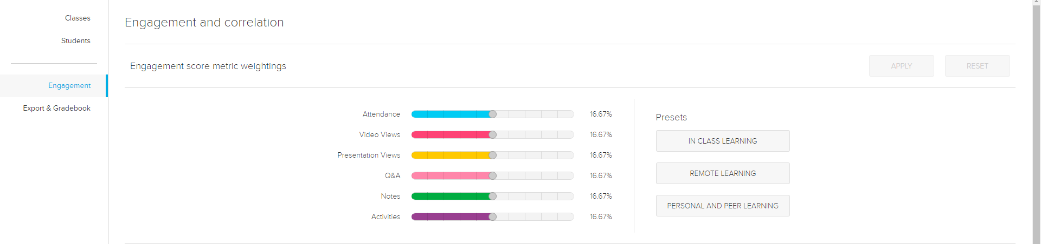
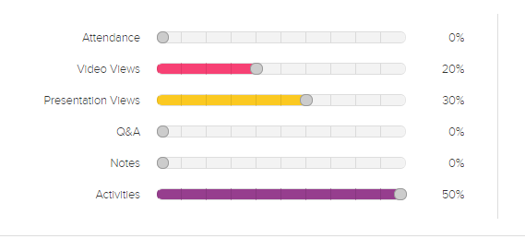
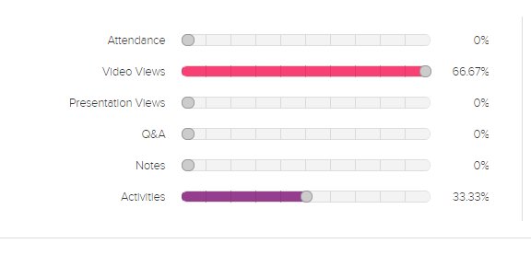
Blended class,
active learning focus
Online class,
content coverage
+ active learning
Analytics section: can explore overall class metrics, by date
Examining student engagement: flexible weighting of components

Slide 38
Echo360 in, and outside, the classroom
Characterized by ease of use for instructors and students
Easy to have all activities visible before class, but restrict answering questions
  If students work on an activity before you want them to, click “Reset Activity”
  Or, use the “End participation” button to “start” the activity
“Hide” slides that you don’t want students to see
  Such as the solution to exercises, which are easily revealed in class as needed.

Slide 39
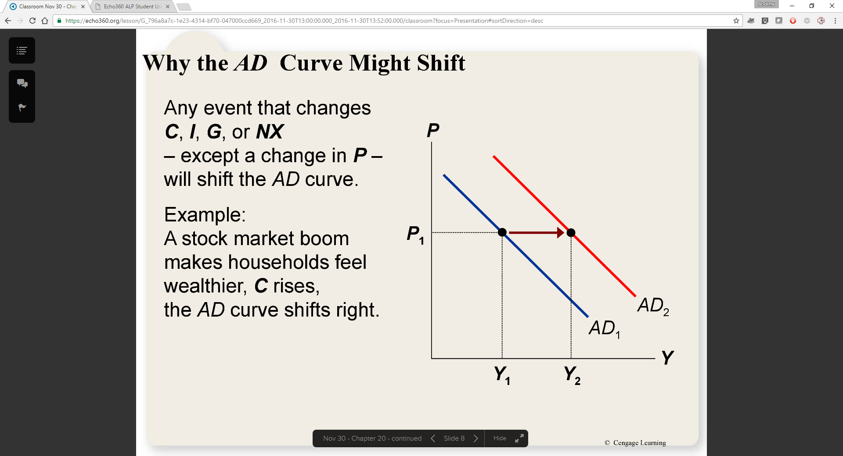
Instructor view during class

Slide 40
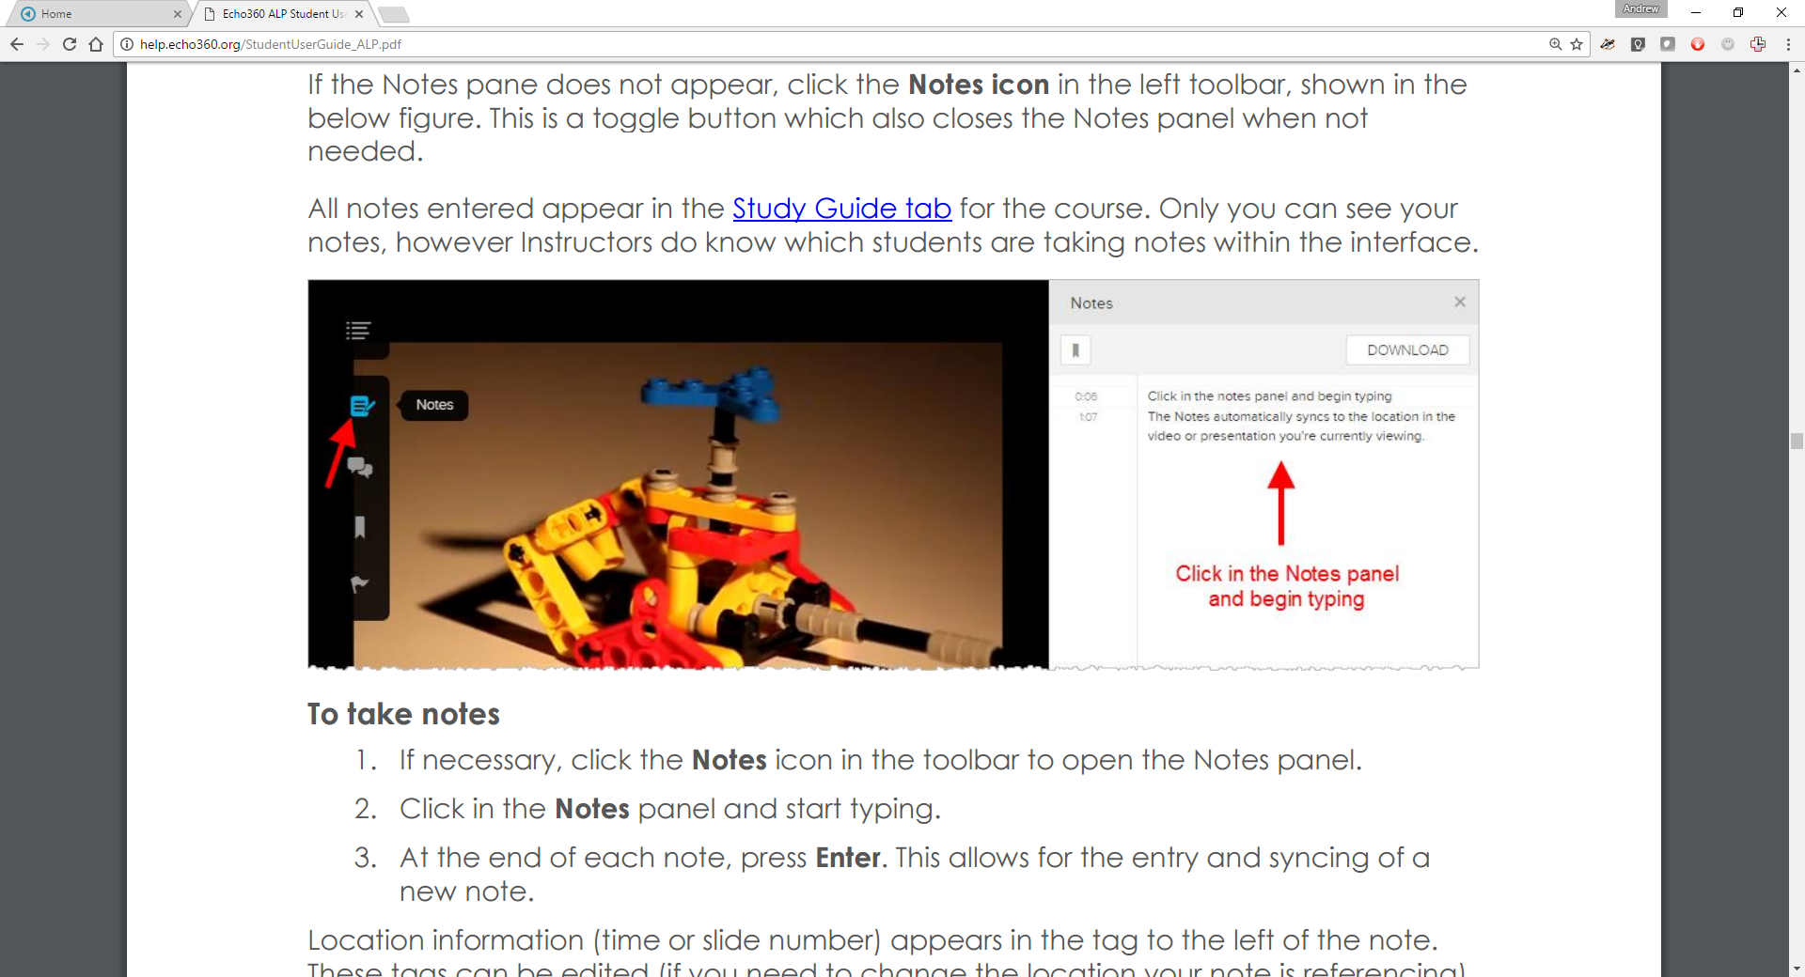
Student view: Taking notes

Slide 41
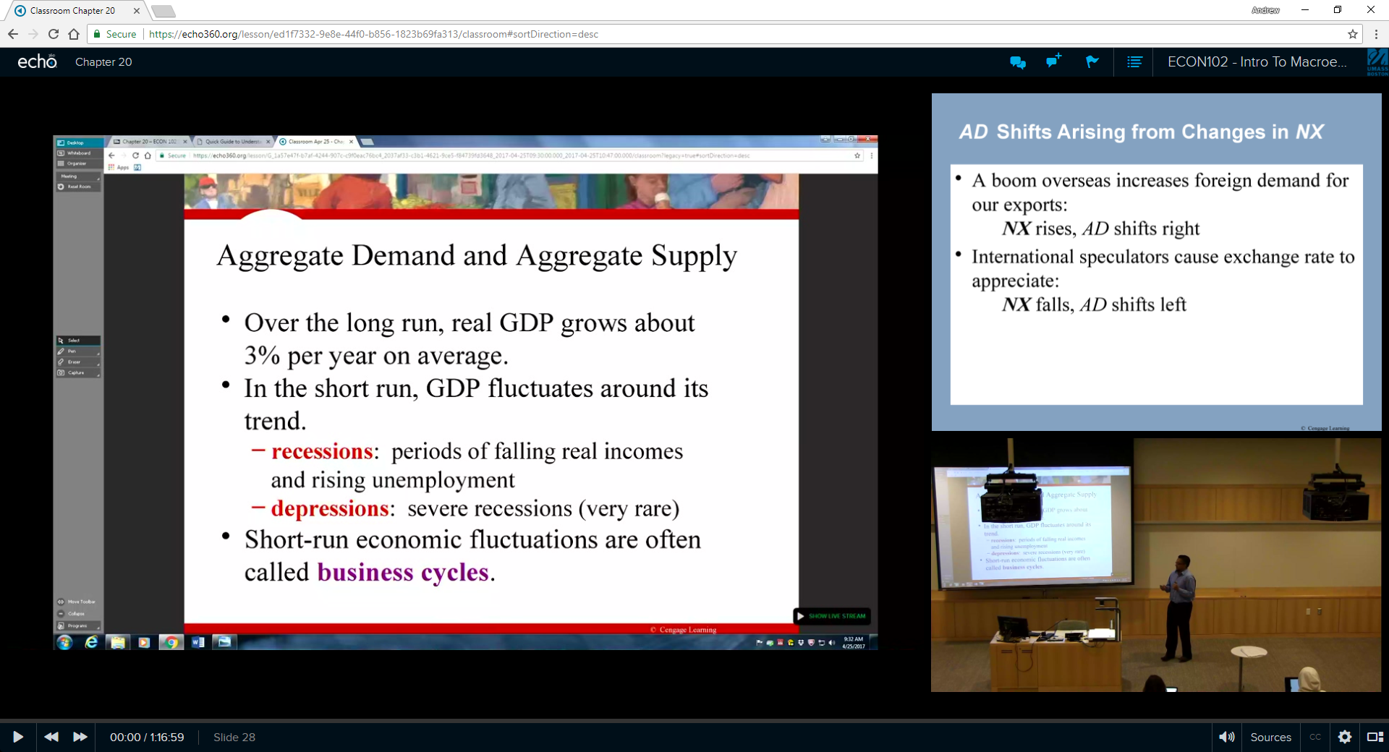
Recorded lecture view

Slide 42
HINTS
Make all activities visible before class
  If students work on an activity before you want them to, click “Reset Activity”
  Or, use the “End participation” button to “start” the activity
“Hide” slides that you don’t want students to see
  Such as the solution to exercises.
  These slides are easily revealed in class as needed.
Help section for instructors and students is exceptionally informative.

Slide 43
Thank you
Q&A at the end of the session
Feel free to reach out to me: andrew.perumal@umb.edu

Slide 44
The History of Classroom Capture and the Video Strategy at the University of Cincinnati
Tina Meagher
Manager of Video and Digital Media, Senior Video Strategist
University of Cincinnati

Slide 45

The University of Cincinnati
Established since 1819
46,000 students
4 campuses
14 colleges
The bearcat

Slide 46

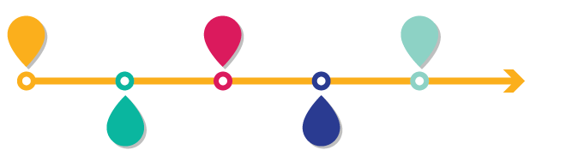
Classroom Capture at UC
2016 Summer Move all colleges to Active Learning Platform
2009 UC starts recording lectures
2014 Launch Echo360 ESS (Enterprise Solution)
2013 Lecture Capture Taskforce
2016 Spring Early Launch of Active Learning Platform

Slide 47
The need for a video strategy
The Wild West
Phone
GoPro
Video Conferencing
ScreenCast-O-Matic
Avid
Adobe Connect
Classroom Capture
Web Camera
Kaltura
Personal Capture
Video Camera
WebEx
Echo360
iMovie
CaptureSpace
iPad
Screen recorder
Jing
Adobe After Effects
Adobe Premiere Elements
Podcast Producer
Camtasia
QuickTime
Explain Everything
MovieMaker
Final Cut Pro
MediaSite
Adobe Premiere Pro
PowerPoint
Storyline

Slide 48
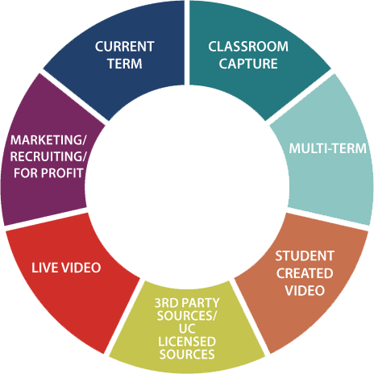
The Types of Video Content

Slide 49

The Seven Circles
Faculty/Student Created Content

Slide 50
The Seven Circles
Lecture Capture
Guest Speakers
Student presentations
Student speeches
Labs/Simulations
Rehearsals
Critiques
Evaluation
Current Term
Notes:
Classroom capture is used to document what happens in the classroom. Lecture capture is an easy way to document what happens in the classroom.

Slide 51

By the Numbers
Classroom Capture
86
14k+
20
Hardware Devices
Total Captures
Fall 2017 – Spring 2018
Software-based Capture

Slide 52
  Echo360 Engagement

Slide 53
The Engagement
Full Court Press
  Visibility of the Engagement Tools
  Great Gateway Courses
  The White Glove Treatment
Notes:
Push for visibility of the engagement tools
Great Gateway Courses
Larger courses
Most impact
Foundation for other courses and programs
Having faculty like Ivan Ivanoff & Joe Gallagher who have started to analyze the data
The White Glove Treatment
Transition from other tools
One-on-one consultation
In class support

Slide 54
By the Numbers
Was the Echo360 Engagement a Success?
92
17
27
Faculty Engagement
New Faculty Usage
Fall 2017 – Spring 2018
Course Usage
Notes:
So what does success look like—
We were shooting for 10-12 new faculty using Echo360.
We contact via email and personally 92 faculty who showed interest or were Great Gateways faculty—they were trained and had 1 on 1 consultations
17 faculty (new to the engagement tools in Echo360) used the tool in Fall semester 2017 and Spring semester 2018
There were 27 courses that used the engagement tools for the first time in class
We had in increase in student users of over 2000

Slide 55
Next Steps…
Continue with Echo360 Engagement
Increase classroom capture footprint
Integrate ASR into the video strategy
Implement analytics for usage data

Slide 56

Primary Responsibilities
  Curricular Compliance with State
  Course/Program Design
  Oversight of the University Teaching Center
    Explore and propose new classroom technologies
    Develop and facilitate faculty development
    Course/Program Design Institutes
Technology Implemented Under APCI Direction:
  Echo360
  Virtual Assistive Lab for Student with disabilities
  Virtual Orientation (INXPO)
  iPad Kiosks
  ZenDesk (knowledge base)
  Ideascale (social innovation platform)
  SchoolsApp (Uversity formerly Inigral)
Angela Paprocki, Ph.D.
Assistant Provost for Curriculum and Instruction
The University of Toledo

Slide 57

WHO WE ARE
UT is one of 16 state institutions in the Ohio
Land-grant, public, open-enrollment, research intensive university
  14 Colleges (300+ programs) including a College of Medicine and College of Law
    2 Campuses
      Main Campus
      Health Science
Number of Students: 20,381
Known as “The Rockets”
  Mascot: Rocky the Rocket
  Colors: Rocket Gold and Tower Blue

Slide 58

What we know about learning
Practice is essential to learning new facts, but not all practice is equivalent
Information must be taught using an Interleave (i.e., alternate) practice method. For example, if students are learning four mathematical operations, it’s more effective to interleave practice of different problem types, rather than practice just one type of problem, then another type of problem, and so on.
Effective feedback is often essential to acquiring new knowledge and skills
Good feedback is:
  Specific and clear;
  Focused on the task rather than the student; and
  Explanatory
New ideas are understood through the use of examples, but it can be difficult to see the unifying underlying concepts in different examples
Identifying and labeling sub-steps required for solving a problem or completing a process will assist students with recognizing the underlying structure of the problem and/or process and allow them to apply these problem/process-solving steps to other tasks (transference).
Notes:
For example, if students are learning four mathematical operations, it’s more effective to interleave practice of different problem types, rather than practice just one type of problem, then another type of problem, and so on.

Slide 59
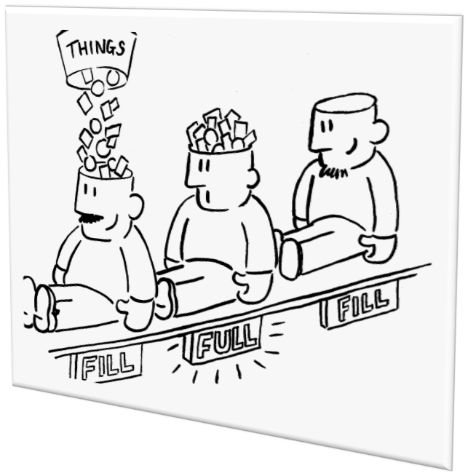
What we know about learning
Beliefs about intelligence are important predictors of student behavior in school.
Students are more motivated when they believe that ability and intelligence can be improved through hard work
Faculty can contribute to students’ beliefs about their ability to improve their intelligence by providing appropriate and timely feedback
The ability to monitor one’s own thinking can help a student identify what s/he does
and does not know
Faculty can engage students to monitor their own learning; however, if students don’t, they are likely to make judgments about their own knowledge based on how familiar their situation feels and whether they have partial or related information and unfortunately, these cues are often misleading.
Notes:
For example, if students are learning four mathematical operations, it’s more effective to interleave practice of different problem types, rather than practice just one type of problem, then another type of problem, and so on.

Slide 60


RATIONAL FOR CHOOSING ECHO360
Blackboard
Echo360
Flipped Learning
STUDENT SUCCESS
Faculty want Options-
BUT not too many options
Multiple solutions may seem like a good idea but it can be difficult to manage for both faculty and students
Easy integration
with LMS
and other technologies used on campus; easy to use; platform functionality

Slide 61
LEVERAGING Technology Tools
TO Increase Engagement and Success IN UNIQUE WAYS
Students at risk of dropping a course stop contributing, miss class and assignments.
Digital learning tools, such as Echo360, can be used to track progress indicators during and between classes.
Dashboard
Polling
There are a plethora of technology tools to leverage pedagogically that allow faculty opportunities to connect with students in unique ways.
Faculty should think out of the box when leveraging Echo360 to engage students, i.e., instead of flipping the class, flip the assignment/strategy.
Lecture
Capture
Personal Capture
Notes:
Tracking courses using the software and comparing them to courses not using it; Institutional Research has been able to develop control groups for other studies we hope to use this same algorithm to determine the efficacy of using the technology and leverage the data to increase usage on campus
Dashboard/Polling
Quick and easy way to survey students during class
Assess students’ understanding
Allows instructor to adjust pace and content (adaptive teaching/learning
Lecture Capture Personal Capture Tools
NOTE: Studies show that posting recorded lectures does not diminish attendance and students really appreciate the opportunity to review lectures at their own pace.

Slide 62
IMPLEMENTING ECHO360 In FACe-TO-FACE CourseS
WHY: To improve course completion/success and decrease DFW rates
HOW: Faculty Stipends
FOCUS: Courses with high DFW rates and General Education Courses
AWARDS: Course Design Institute (CDI) and Innovations in Teaching Awards (ITA)
  Summer 2015: CDI and ITAs
    CDI focused on backward design strategies and the implementation of technology
    ITAs focused on incorporating technology into their course redesign
  Summer 2016: CDI and ITAs focused on integration of technology, including the expanded use of Echo360, to improve student learning, success, and retention
  Summer 2017/2018: Continue to offer programs and support to faculty integrating technology in their courses to improve student learning, success and retention

Slide 63

RESULTS, NEXT STEPS, & QUESTIONS
RESULTS
Significant course redesigns integrating Echo360 and focusing on active learning has improved DFW rates in targeted courses
NEXT STEPS
Plan to expand into other courses
Research project also planned
ANY
QUESTIONS

Slide 64
Dr. Perry Samson
University of Michigan
Moderator
Andrew Perumal
Associate Professor, Department of Economics
University of Massachusetts at Boston
andrew.perumal@umb.edu
Tina Meagher
Manager of Video & Digital Media Strategy, Sr. Video Strategist
University of Cincinnati
meaghecm@ucmail.uc.edu
Panelists
Dr. Perry Samson
Arthur F. Thorneau Professor at University of Michigan and Senior VP of Teaching Innovations at Echo360
samson@umich.edu
Angela Paprocki
Assistant Provost for Curriculum and Instruction, Director, University Teaching Center
University of Toledo
Angela.Paprocki@utoledo.edu

