Slide 1
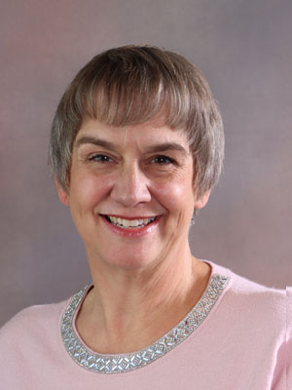
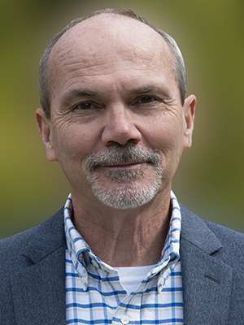
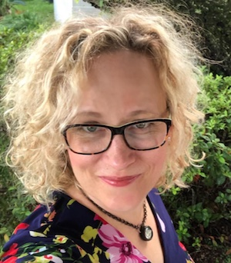
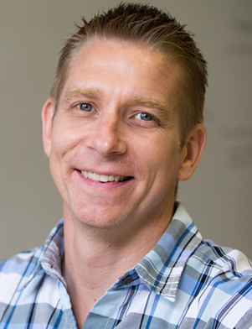
Karen Acree, PhD. Director, Online Services San Juan College
Bill Knapp
Executive Director: Distance Learning & Instructional Technology Grand Rapids Community College
Janet Lee
Instructional Designer Hillsborough Community College
Shane Lovellette
Education Strategy Lead TechSmith Corporation
Moderator
Tuesday October 13, 2 PM ET

Slide 2
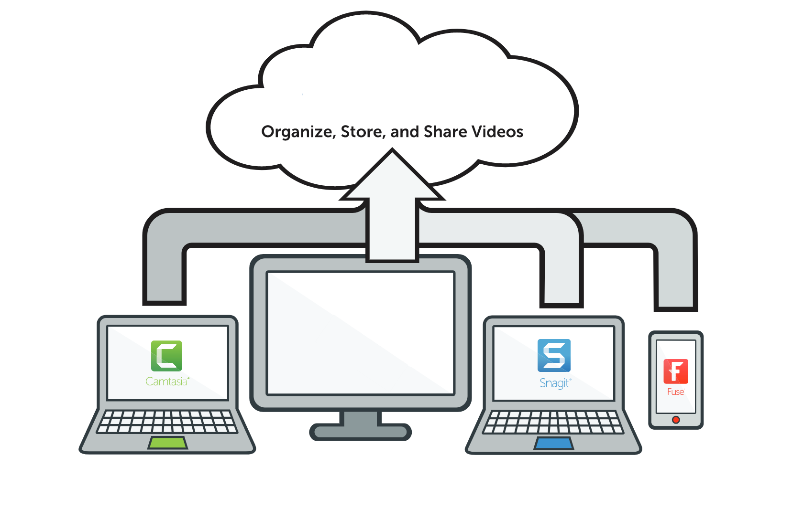
TechSmith can help with every step of the process
Knowmia for easily recording videos
Fuse for capturing on-the-go content
Camtasia for advanced video editing
Snagit for screen capture and image editing needs
Learn More: techsmith.com/education

Slide 3
Karen Acree, PhD. Director, Online Services San Juan College
Bill Knapp
Executive Director: Distance Learning & Instructional Technology Grand Rapids Community College
Janet Lee
Instructional Designer Hillsborough Community College
Shane Lovellette
Education Strategy Lead TechSmith Corporation
Moderator
Tuesday October 13, 2 PM ET

Slide 4
A Little About Me I’ve been involved in higher education for 20 years, the last 13 at San Juan College I love working with our faculty and students to ensure they have everything they need for a quality online experience Instructional design with faculty is the fun part of my day
Karen Acree
Director, Online Services
San Juan College

Slide 5
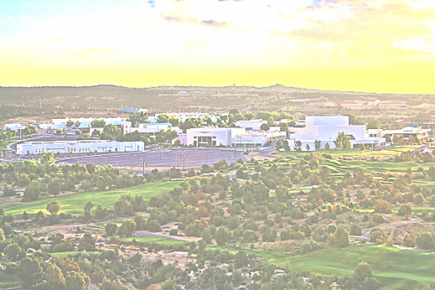
Who are we?
Native Serving Institution ​
​
32% Native American​
18% Hispanic​
​
4,300 FTE ​
Located in​ Farmington, New Mexico

Slide 6
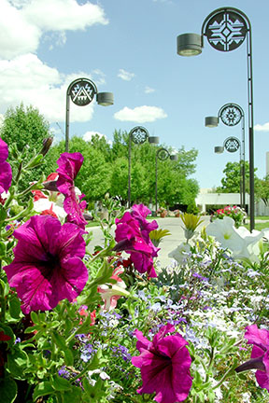
Who are we?
AACC Pathways 2.0 participant ​
​
HLC Accredited (Formerly AQIP, now Open Pathway)
​
Faculty-led Quality Assurance Team
Strong strategic plan

Slide 7
At San Juan College…
What worked well in supporting faculty to shift online in the spring?
Faculty approved process for professional development
Faculty-led revamped course development process
Zoom office hours with instructional designers
Loaner laptops
Simple Syllabus implementation
Challenges encountered
Underestimated the lack of internet in faculty homes
Updating security software for remote access
Communicating with faculty about supported instructional technology software

Slide 8
Bill Knapp serves as Executive Director of Distance Learning and Instructional Technologies at Grand Rapids Community College in Grand Rapids Michigan. For more than twenty years, Bill has been supporting faculty in the selection, use, and application of technology for teaching and learning. His passions include quality online learning design and student success.

Slide 9
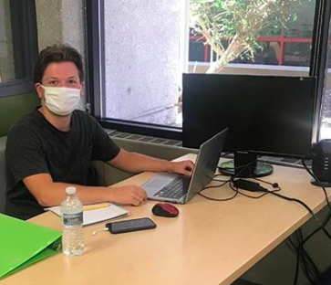
What worked @ GRCC?
Introduction to Distance Learning (IDL)
CAP Pilot: Synchronous & Streaming Media
Distance Learning Standards (Quality Matters)

Slide 10
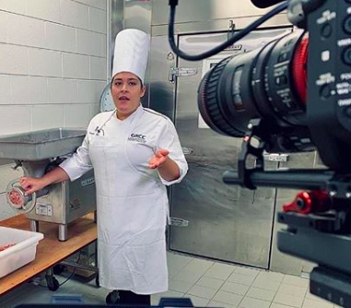
Not so much…
SWD & Dev Ed courses not typically offered online
Instructional Design support understaffed
Labs
Testing Center offline

Slide 11
Janet Lee,
Instructional Designer,
Hillsborough Community College
Janet Lee specializes in practical professional development strategies for face-to-face to online live transitions. Her international K-12/higher education experience includes curriculum development publications, virtual in-service coordination, media literacy, and micro-learning film production.

Slide 12
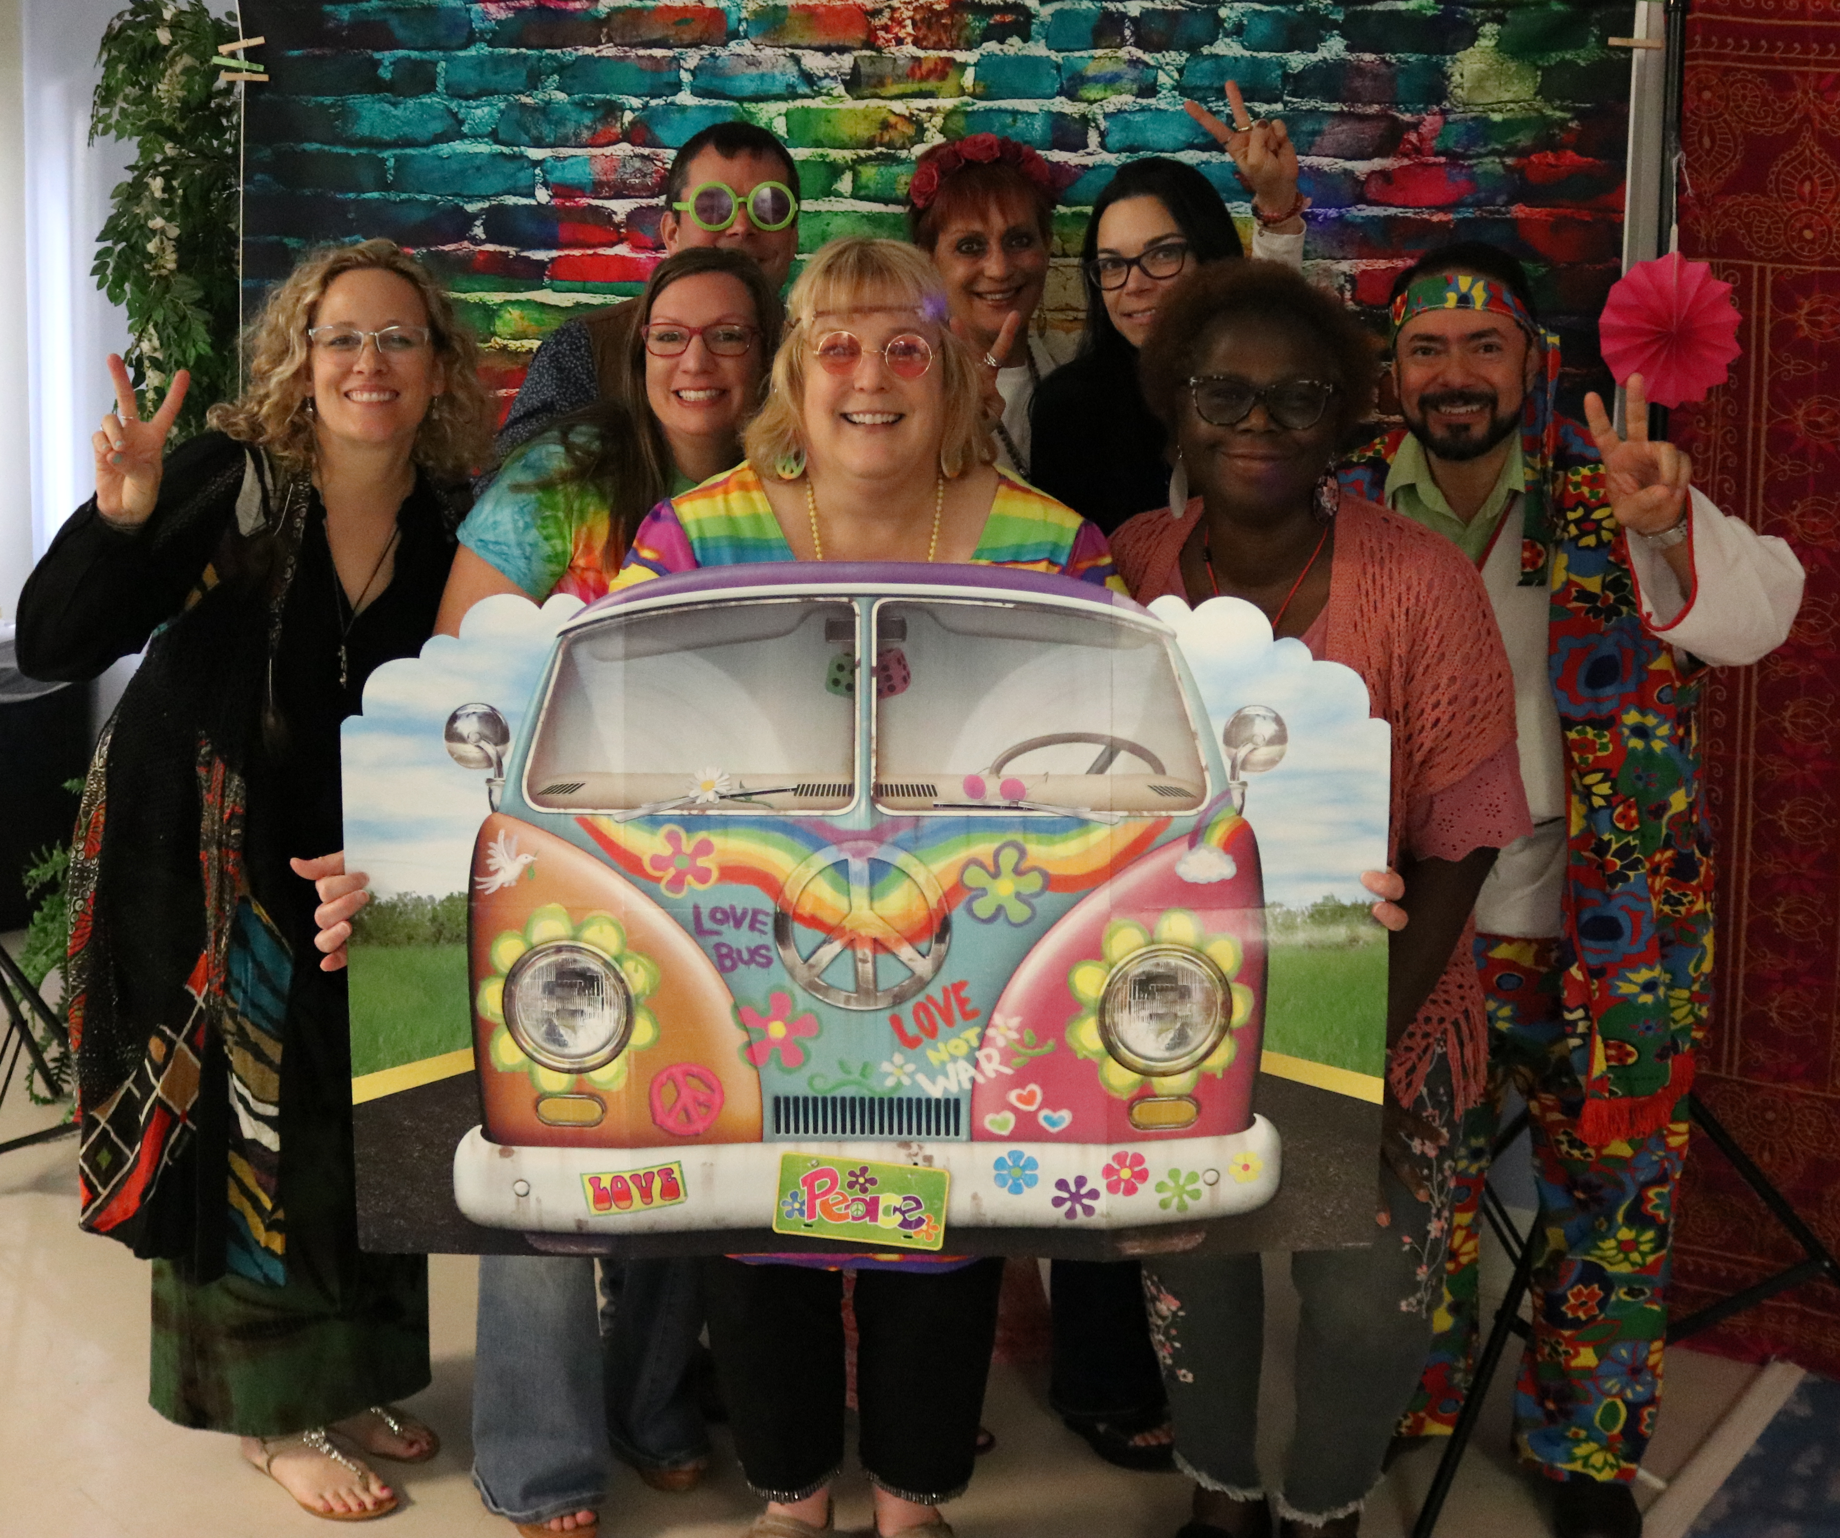
Hillsborough Community College
Notes:
Speaker - Janet Lee
Question – Introduction and What worked what didn’t

Slide 13
Karen Acree, PhD. Director, Online Services San Juan College
Bill Knapp
Executive Director: Distance Learning & Instructional Technology Grand Rapids Community College
Janet Lee
Instructional Designer Hillsborough Community College
Shane Lovellette
Education Strategy Lead TechSmith Corporation
Moderator
Tuesday October 13, 2 PM ET

Slide 14
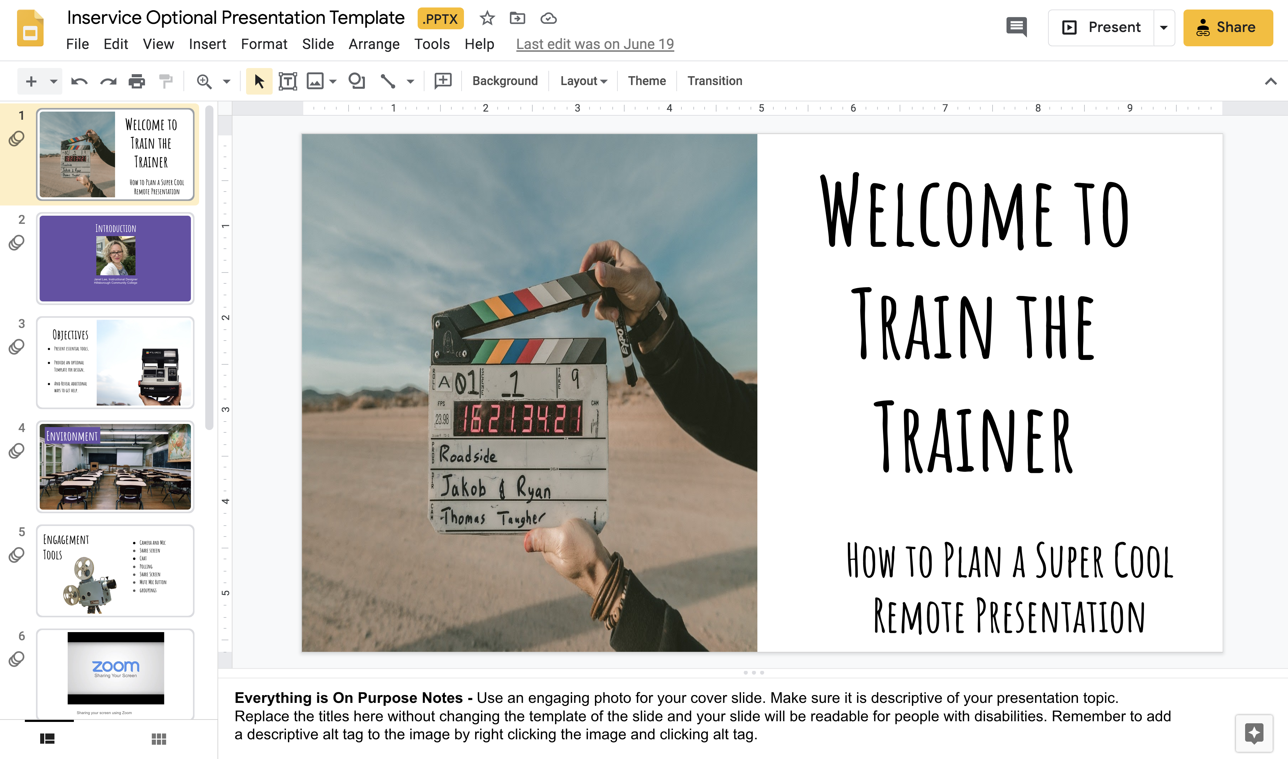
Notes:
Speaker - Janet Lee
Question - How, if at all, has your strategy for online courses, student engagement, and faculty training changed based on the pandemic experience?

Slide 15
Notes:
Speaker - Janet Lee
Question - How, if at all, has your strategy for online courses, student engagement, and faculty training changed based on the pandemic experience?

Slide 16
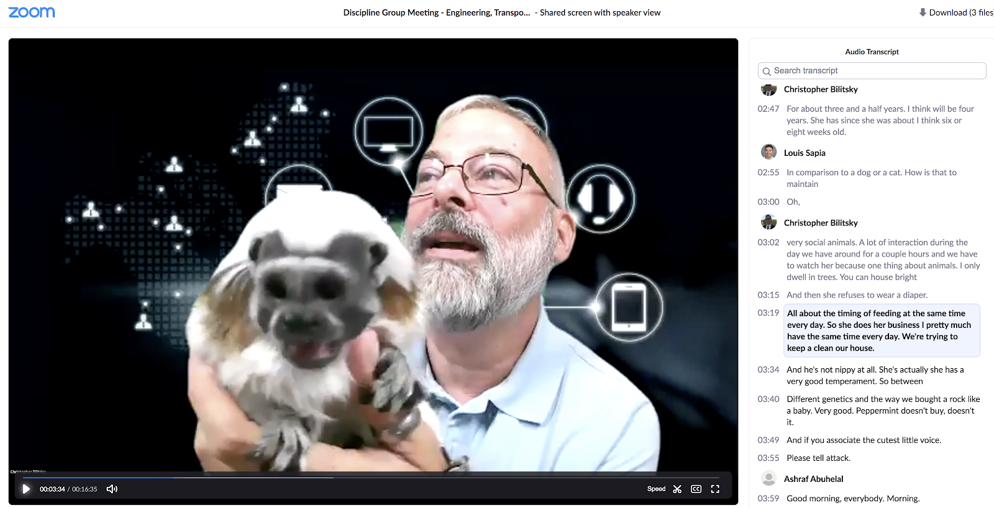
Online Engagement Repository
Notes:
Speaker - Janet Lee
Question - How, if at all, has your strategy for online courses, student engagement, and faculty training changed based on the pandemic experience?

Slide 17
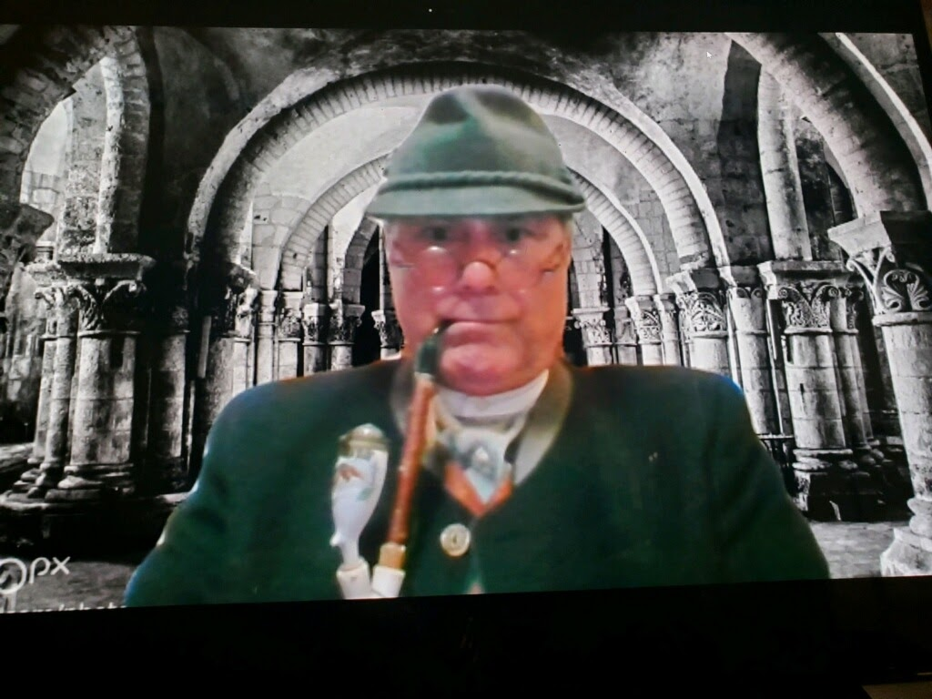
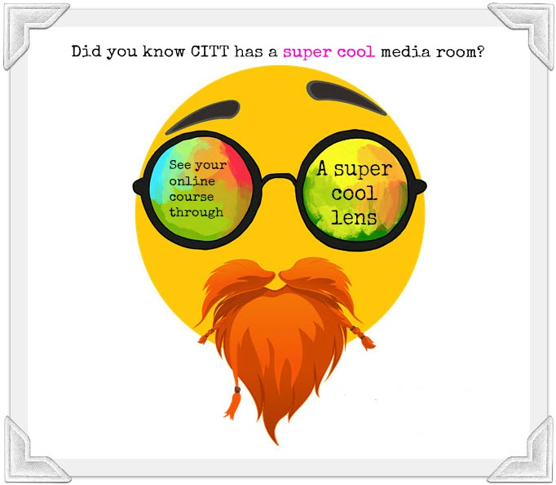
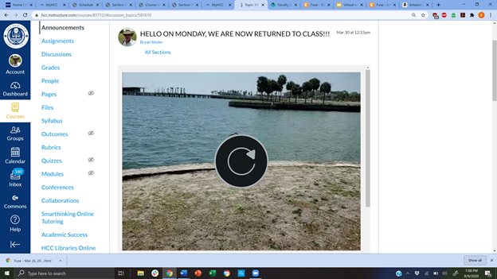
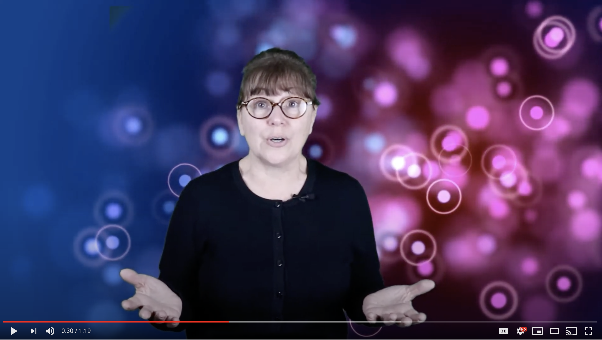
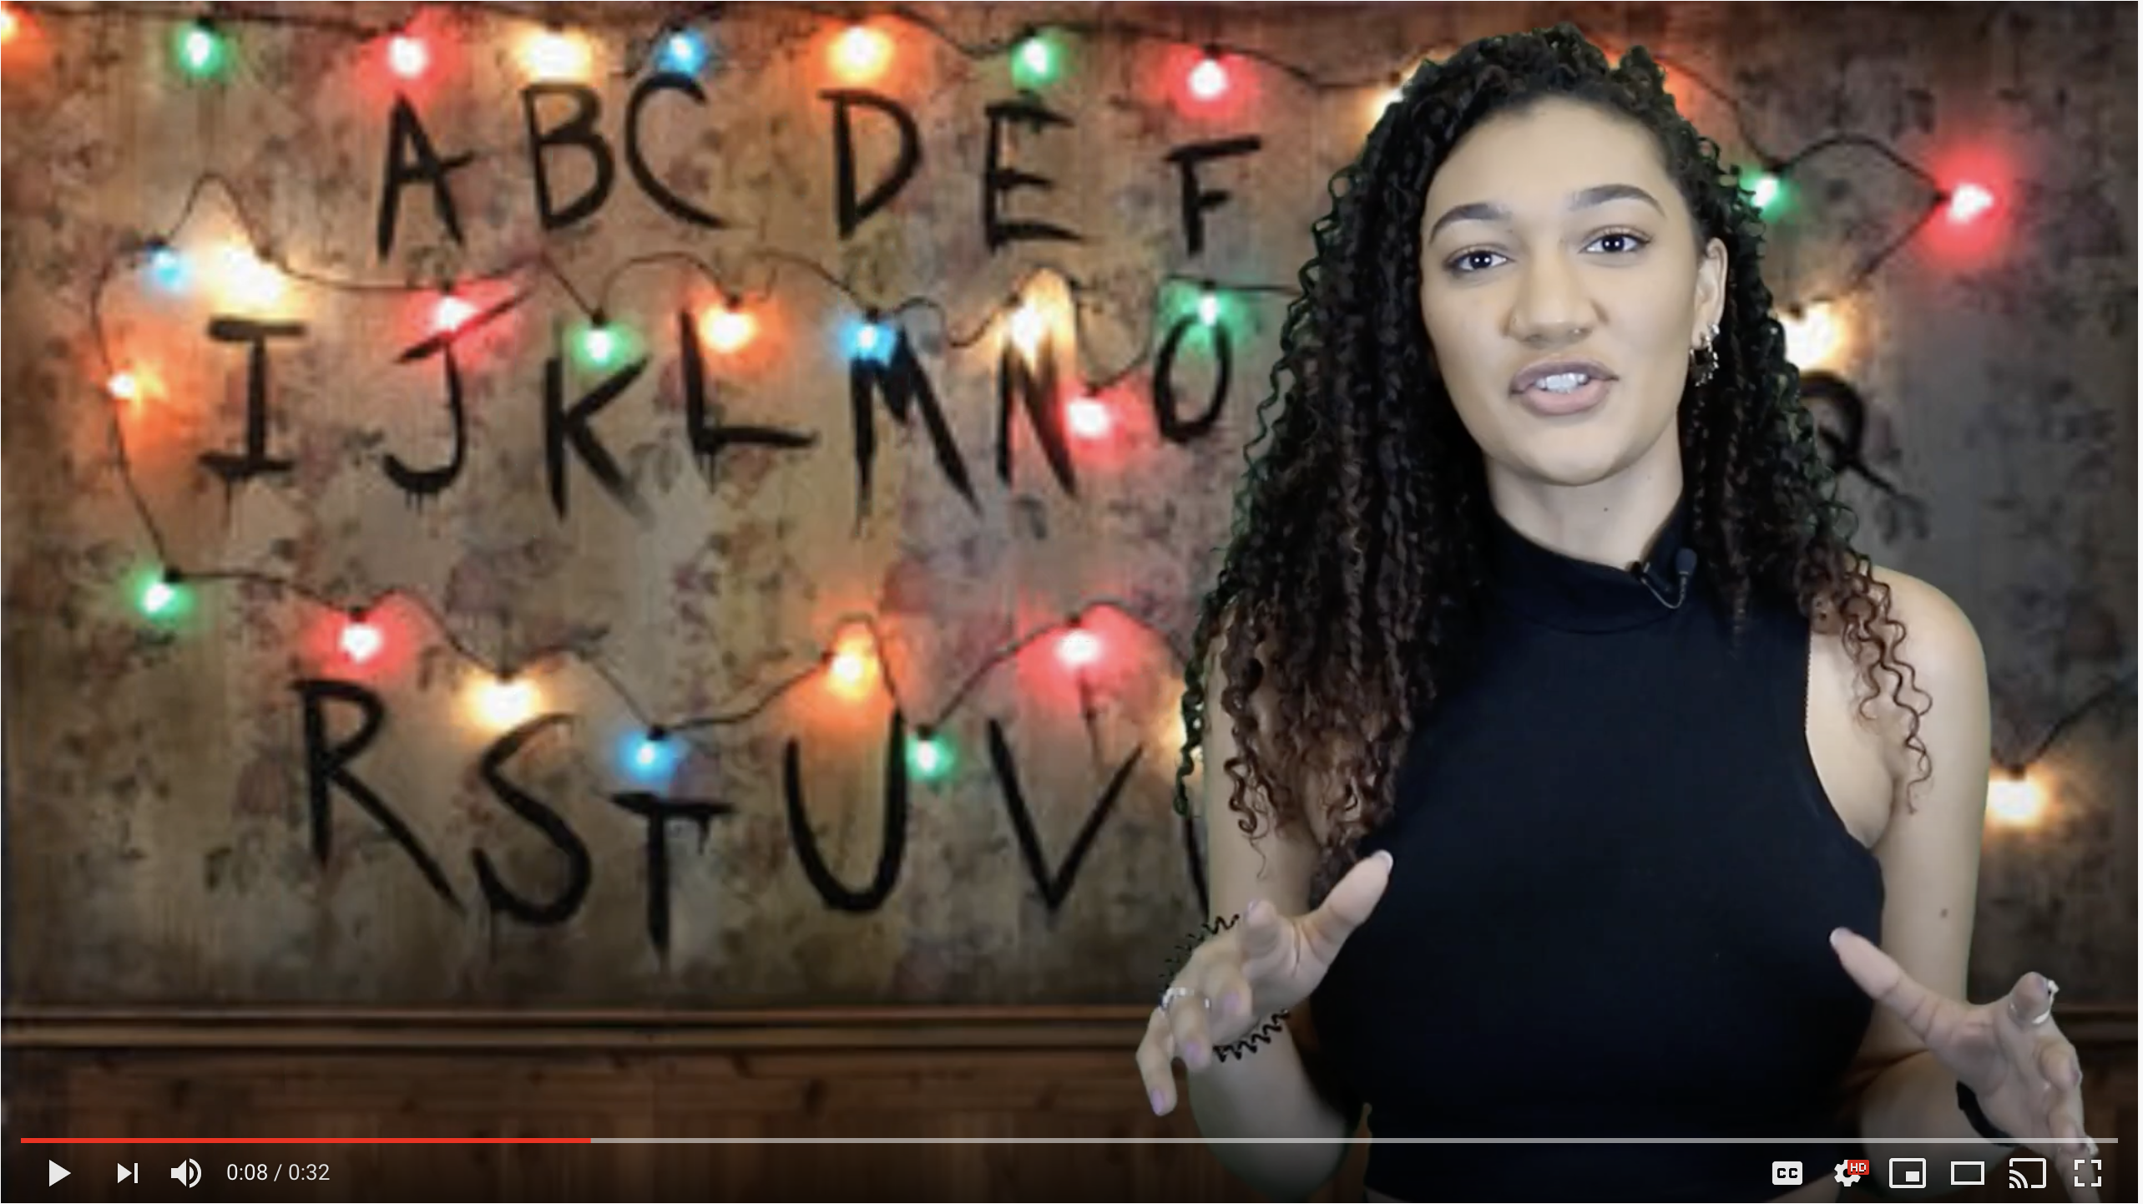
Role of Video at HCC
Notes:
Speaker - Janet Lee
Question - How has the role of video and its importance changed?

Slide 18
Karen Acree, PhD. Director, Online Services San Juan College
Bill Knapp
Executive Director: Distance Learning & Instructional Technology Grand Rapids Community College
Janet Lee
Instructional Designer Hillsborough Community College
Shane Lovellette
Education Strategy Lead TechSmith Corporation
Moderator
Tuesday October 13, 2 PM ET

Slide 19
Karen Acree, PhD. Director, Online Services San Juan College
Q&A
Bill Knapp
Executive Director: Distance Learning & Instructional Technology Grand Rapids Community College
Janet Lee
Instructional Designer Hillsborough Community College
Shane Lovellette
Education Strategy Lead TechSmith Corporation
Moderator

