Slide 1
Transforming Higher Ed by Listening to Consumers
June 28 2 p.m. Eastern
Carol D’Amico Executive Vice President, Mission Advancement & Philanthropy Strada Education Network | Brandon Busteed Executive Director, Education and Workforce Development Gallup
1

Slide 2
Strada Education Network is a national nonprofit dedicated to improving lives by catalyzing more direct and promising pathways between education and employment.
2

Slide 3
United to Strengthen America’s Pathways Between Education and Employment
Research & Insights | Philanthropy | National Engagement | Mission-Aligned Investments | Mission-Aligned Affiliates
3

Slide 4
We believe in elevating and empowering the consumer voice to measure value and inform solutions.

Slide 5

Consumer Insights Drive Industry Transformation
Health Care
Hospitality & Service Industries
Manufacturing
Transportation
Retail

Slide 6
  Creating the largest dataset of education
  consumer insights in the nation:
  Education Consumer Survey
    350 daily | 10,000 monthly | 122,500 annually
    All demographics | All states & DC | Top metro regions
  Alumni Survey
  Current College Student Survey
  Employer Survey

Slide 7
Postsecondary
Education Consumers
95 Million Americans Without a Degree Post High School
20 Million Current College Students
4.6 Million Disconnected Youth
Neither Working Nor in School
3.6 Million H.S. Graduates Annually
U.S. Census Bureau's Current Population Survey, 2017 and American Community Survey, 2016

Slide 8
There are Major Disconnects
Between Education & Employment

Slide 9
Is Higher Education Preparing Students for Work?
of Americans strongly agree that college graduates in this country are well‐prepared for success in the workplace
of trustees strongly agree that colleges and universities have a good understanding of what employers are looking for in a job candidate
13%
11%
6%
of business leaders strongly agree that graduating students have the skills and competencies their businesses need
Sources: Lumina Foundation/Gallup Poll 2013, The 2013 Inside Higher Ed Survey of College & University Chief Academic Officers Report

Slide 10
The Academy Thinks So…
95%
  of Chief Academic Officers rate their institution as very/somewhat effective at preparing students for the world of work
Sources: Gallup/Lumina poll, UCLA CIRP, Gallup/IHE poll

Slide 11
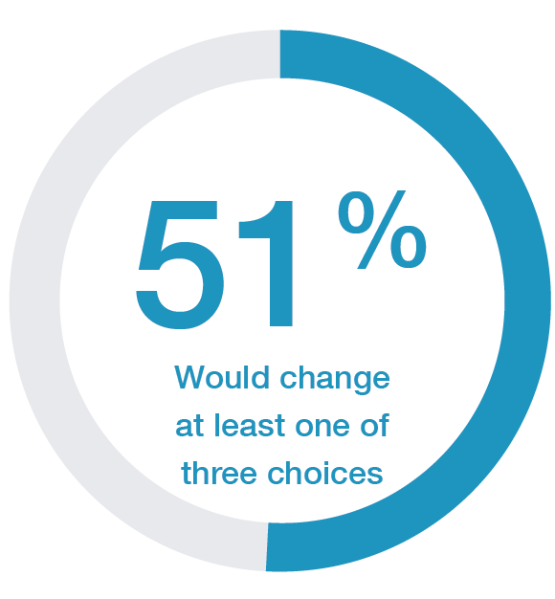
Majority of U.S. Adults Would Do Their Education Differently
Disconnects on Education Decisions
Source: Strada-Gallup On Second Thought: U.S. Adults Reflect on Their Education Decisions Report
Copyright © 2018 Gallup, Inc. All rights reserved.
Notes:
Disconnects on Education Decisions

Slide 12
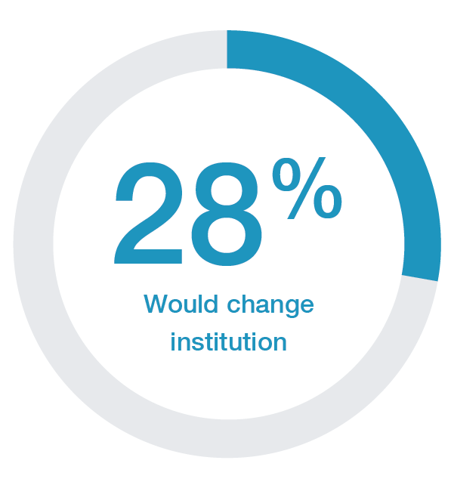
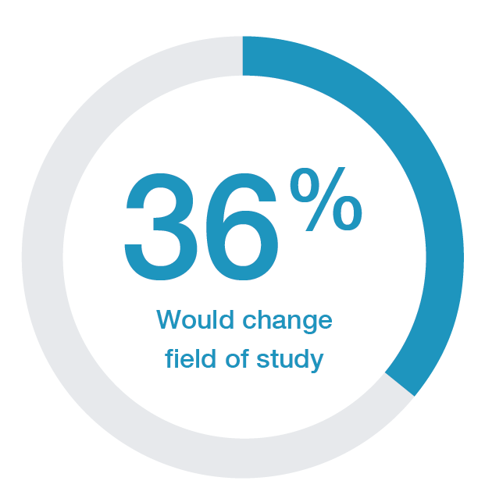
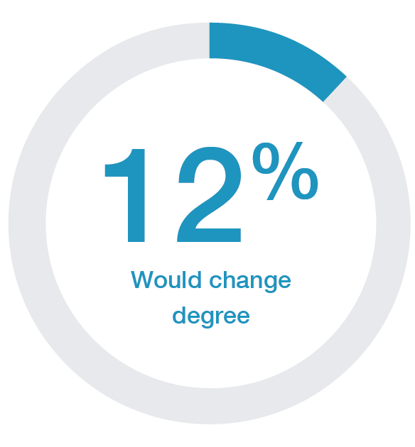
Second Thoughts by Degree, Institution and Major
Source: Strada-Gallup On Second Thought: U.S. Adults Reflect on Their Education Decisions Report
Copyright © 2018 Gallup, Inc. All rights reserved.
Notes:
A third would change their major and institution.

Slide 13
Disconnects Between Student Motivations & Outcomes
85%
27%
  of freshmen say “to be able to get a better job” is a very important reason to go to college
  report having a good job upon graduation
Sources: 2016 UCLA HERI Survey of College Freshmen; Strada-Gallup Alumni Survey
Copyright © 2018 Gallup, Inc. All rights reserved.

Slide 14
Higher Ed is Valued and Almost Half of
Employed Americans Say They Need More
97%
  say it is important to have a certificate or degree beyond high school
46%
say they need more education to advance in their current career
Source: Strada-Gallup Education Consumer Survey

Slide 15
Top Motivation for Enrolling: Work Outcomes
60%
  of degree holders identify work outcomes as main reason for enrolling
Source: Strada-Gallup Education Consumer Survey

Slide 16
Motivations for Enrolling Matter for Completion
Work Outcomes
Work Outcomes
60%
47%
WITH DEGREE
NO DEGREE
report work outcomes as the main reason while 23% report general learning interests
report work outcomes as the main reason while 31% report general learning interests
Source: Strada-Gallup Education Consumer Survey
Copyright © 2018 Gallup, Inc. All rights reserved.
Notes:
Of this universe of education consumers, what do we know about their motivation to enroll?

Slide 17
Confidence in Preparation for Work Declines During College
38%
36%
37%
Successful in workplace
34%
First-year
Sophomore
Junior
Senior
Source: Strada-Gallup 2017 Current College Student Survey
Notes:
One of the most actionable insights we’ve learned to date is the impact of work-related exposure and experiences on achieving career relevance.

Slide 18
Student Confidence in Workforce Preparation Differs Across Majors
I am confident I will graduate with the knowledge and skills I need to be successful in the workplace.
Source: Strada-Gallup 2017 Current College Student Survey

Slide 19

Gallup-Strada 2017 College Student Survey focuses on current college students
Administered Spring of 2017
Nationally representative sample of currently enrolled U.S. college students
  32,585 currently enrolled colleges students
Random sample of colleges and universities via IPEDS
  Stratified by size and control of institutions
  Recruited 43 schools who students were randomly selected to participate in survey
Weighted to institution size and control (based on IPEDS)
Key focus on preparation for the workforce
REPORT FINDINGS
Source: Strada-Gallup 2017 Current College Student Survey

Slide 20
The Key to Bridging Disconnects: Career Relevance

Slide 21
Relevance Is the Strongest Predictor of Consumers’ Perceptions of Quality and Value
Copyright © 2018 Gallup, Inc. All rights reserved.
Notes:
Relevance predicts quality and value more than other public data used to create college rankings. Relevance scores are more powerful predictors of consumer satisfaction than average SAT/ACT math scores, student loan default rates, average cost of attendance, a measure of alumni income earnings and graduation rates.

Slide 22
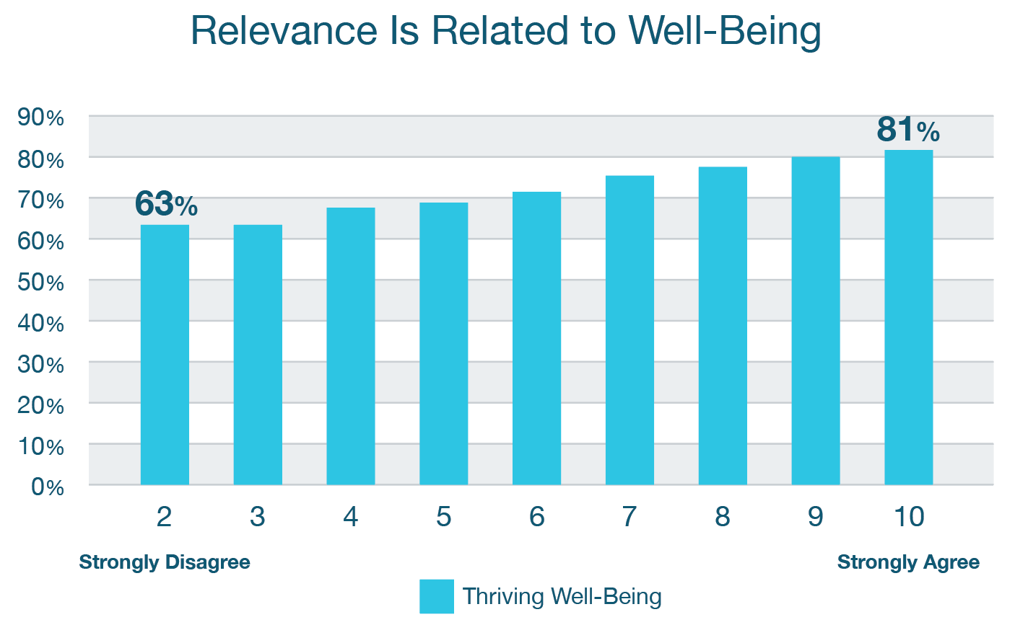
Source: Strada-Gallup Education Consumer Survey
Notes:
Relevance is related to well-being. Consumers who strongly agree their courses are relevant to their current careers and lives are 18 percentage points more likely to be “thriving” in their overall sense of well-being.

Slide 23
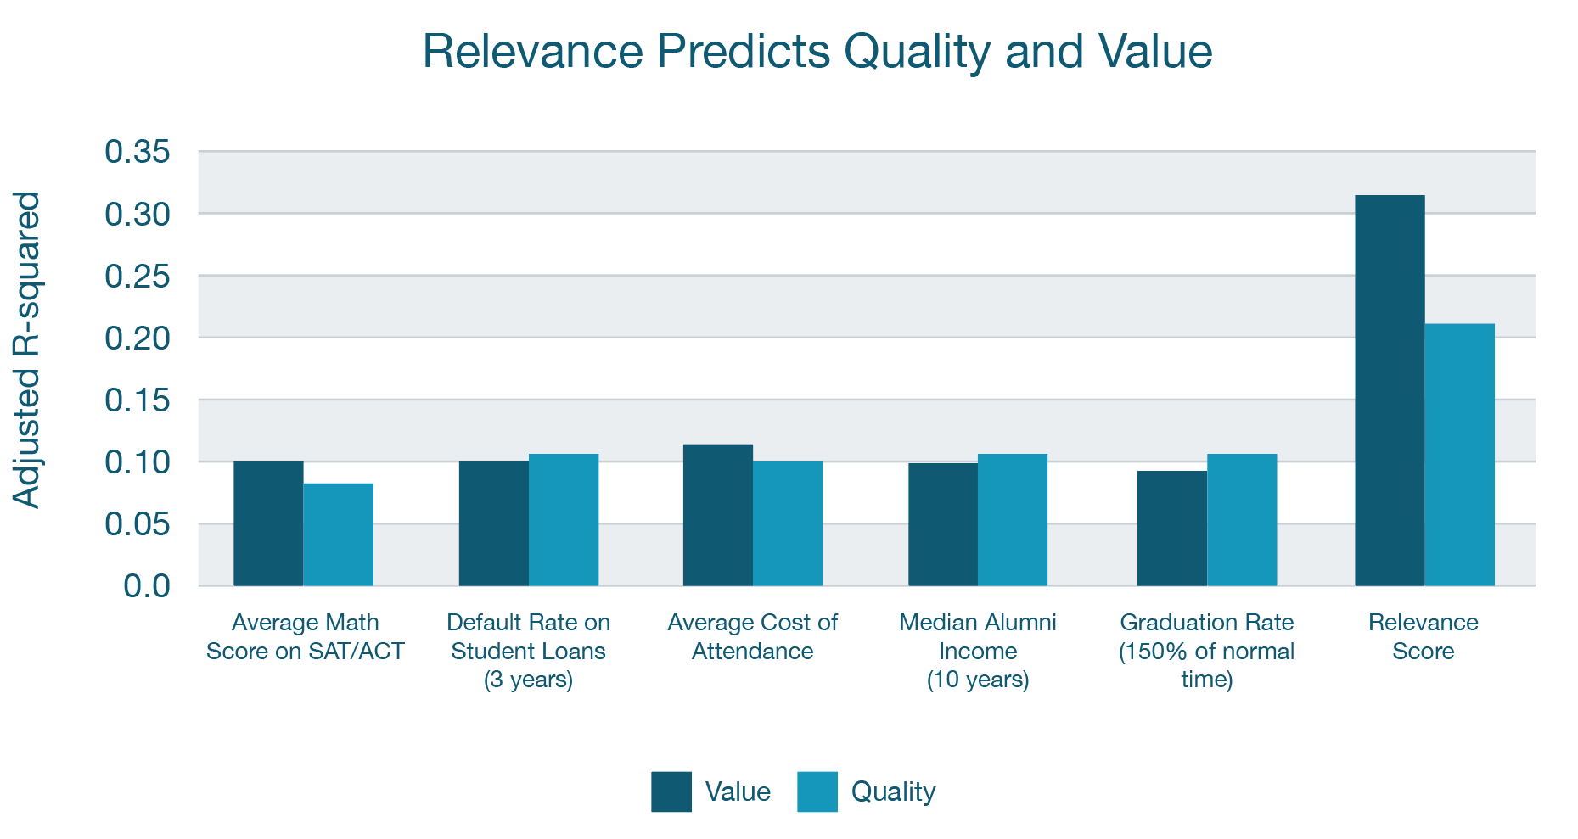
Source: Strada-Gallup Education Consumer Survey
Notes:
Relevance predicts quality and value more than other public data used to create college rankings. Relevance scores are more powerful predictors of consumer satisfaction than average SAT/ACT math scores, student loan default rates, average cost of attendance, a measure of alumni income earnings and graduation rates.

Slide 24
Only 26% of those who went to college and are employed strongly agree that their higher education is relevant to both work and daily life.
Source: Strada-Gallup Education Consumer Survey

Slide 25
Relevance Is Not Evenly Distributed
Source: Strada-Gallup Education Consumer Survey

Slide 26
California: Top 5 and Bottom 5 Institutions on Work Relevance
–––
Percent of Alumni who Strongly Agree Their Courses are Relevant to their Career,
for Top and Bottom Scoring 4-year Schools in California
TOP 5 SCHOOLS
4-year, Private non-profit | 60%
4-year, Private non-profit | 57%
4-year, Private non-profit | 56%
4-year, Public | 54%
4-year, Private non-profit | 53%
BOTTOM 5 SCHOOLS
4-year, Public | 23%
4-year, Public | 23%
4-year, Public | 22%
4-year, Public | 20%
4-year, Private non-profit | 8%
Source: Strada-Gallup Education Consumer Survey
Copyright © 2018 Gallup, Inc. All rights reserved.

Slide 27
Texas: Top 5 and Bottom 5 Institutions on Work Relevance
–––
Percent of Alumni who Strongly Agree Their Courses are Relevant to their Career,
for Top and Bottom Scoring 4-year Schools in Texas
TOP 5 SCHOOLS
4-year, Public | 81%
4-year, Public | 79%
4-year, Public | 69%
4-year, Private non-profit | 54%
4-year, Private non-profit | 53%
BOTTOM 5 SCHOOLS
4-year, Private non-profit | 23%
4-year, Private non-profit | 22%
4-year, Public | 21%
4-year, Public | 21%
4-year, Private non-profit | 18%
Source: Strada-Gallup Education Consumer Survey
Copyright © 2018 Gallup, Inc. All rights reserved.

Slide 28
Consumers Point to Scalable Solutions

Slide 29
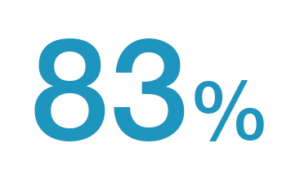
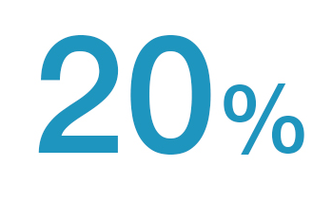
Work-based Advice Is Most Valued But Least Used
Value
Received
Source: Strada-Gallup Major Influence: Where Students Get Valued Advice on What to Study in College Report

Slide 30
Workforce Looks to Employers Over the Academy
    If your job was lost due to Artificial Intelligence,
    to where would you look for education?
    49% On-the-job training offered by an employer
    21% In-person enrollment at college or university
    16% Online enrollment
    10% Self-guided training through free online courses
    5% Accelerated skills boot camp or course
Source: Northeastern University-Gallup, Optimism & Anxiety: Views on the Impact of AI and Higher Education’s Response

Slide 31
Current students who have these experiences at their institution are significantly more confident about their preparation for the workforce:
Speak often with faculty or staff about their career options
Have at least one university official initiate a conversation with them about their career options
Believe their school is committed to helping their students find a rewarding career
Source: Strada-Gallup 2017 Current College Student Survey

Slide 32
Alumni: The Big Six Success Factors
64%
“At least one professor who made me excited about learning”
“Professors cared about me as a person”
“A mentor who encouraged my goals and dreams”
32%
“Long-term project taking a semester or more to complete”
“Internship or job where applied learning”
“Extremely involved in extracurricular activities and organizations”
27%
30%
22%
20%
14% of all alumni experienced all three
6% of all alumni experienced all three
Results from the Gallup-Purdue Index, survey of college and university alumni

Slide 33
  85% of graduates who strongly agree that they had all six experiences as an undergraduate also strongly agree their school prepared them well for life outside of college.
Results from the Gallup-Purdue Index, survey of college and university alumni

Slide 34
Transforming Higher Ed by Listening to Consumers:
A FUSION OF LEARNING AND WORK

Slide 35
Thank You
Download reports at stradaeducation.gallup.com

