Slide 1
Why Admissions Teams Need an International School Strategy

Slide 2
An introduction to today’s webinar
Participation and discussion options
Please use the Q&A feature if you have any questions, group shares, or comments for the group
Today’s session will be recorded and the slides will be made available in follow-up
Zoom controls

Slide 3
Today’s agenda
CALIBRATE | Understanding the transformation in the international schools landscape and what it means for universities
LEARN | Current perspectives on the US admissions process from international schools
ASK | What does best practice look like in an innovative US enrollment shop?
OPERATIONALIZE | How to apply this expertise for a powerful ‘22 cycle

Slide 4
Poll 1*
*responses anonymous (even to us!)

Slide 5
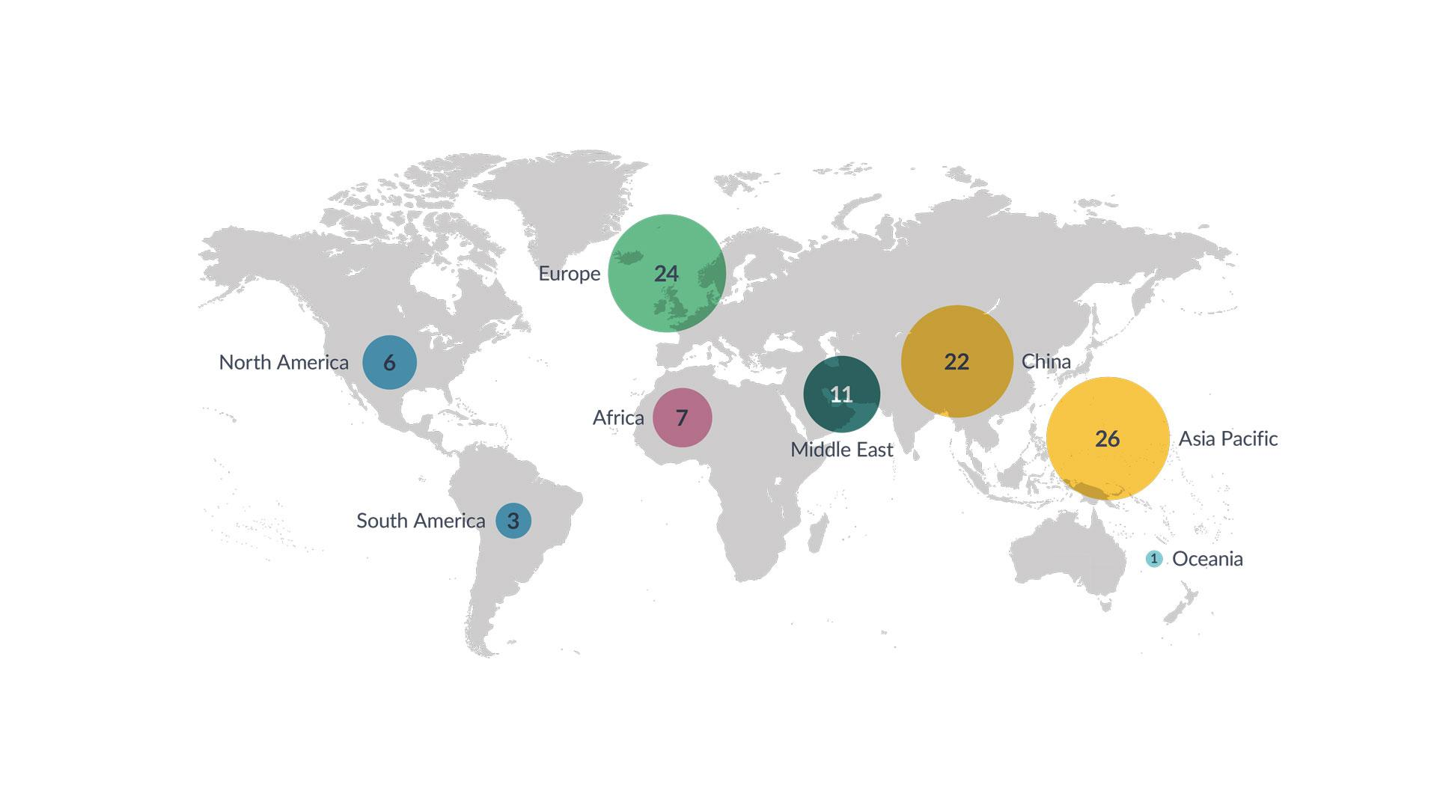
BridgeU is the leading expert in international schools guidance
Technology-enabled careers and university guidance provision
Engaging international schools counselors and students in 120+ countries

Slide 6
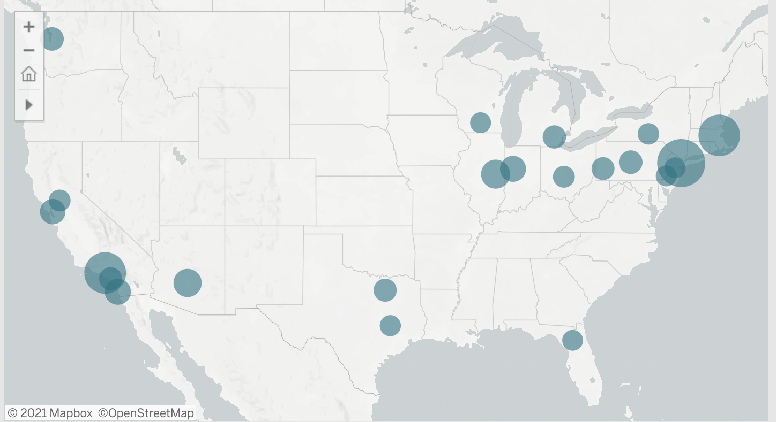
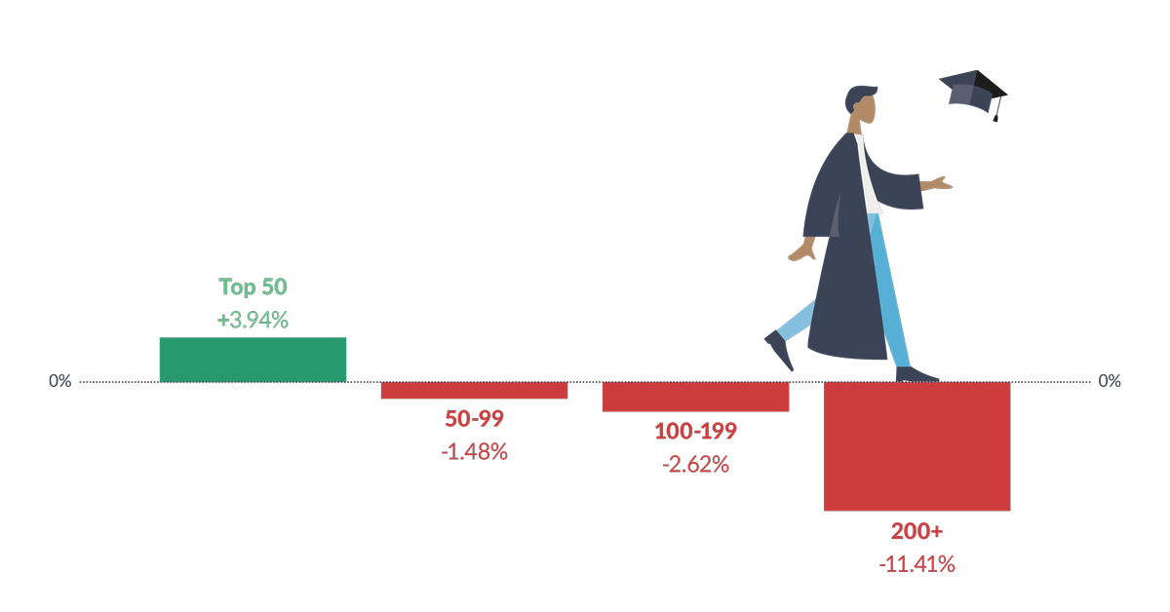
International secondary education is more dynamic than ever
Growing number of students and schools...
with more diverse backgrounds...
applying to the same universities,
which are ever more selective.
Notes:
Last year, during the peak of the COVID-19 crisis, we surveyed 2020 high school students using BridgeU. Our survey told us that, when international students did switch countries due to the pandemic, the USA saw a 67% reduction in enrollments.
While the USA was still the most popular destinations for our 2021 cohort, we were still eager to learn if the pandemic would, in turn, affect their application decisions.
We’ve analysed US international student applicants throughout the current cycle, culminating in our latest report, looking at how 2021 students’ application habits have changed in the last year.

Slide 7
Case in point: Comparing two international schools

Slide 8
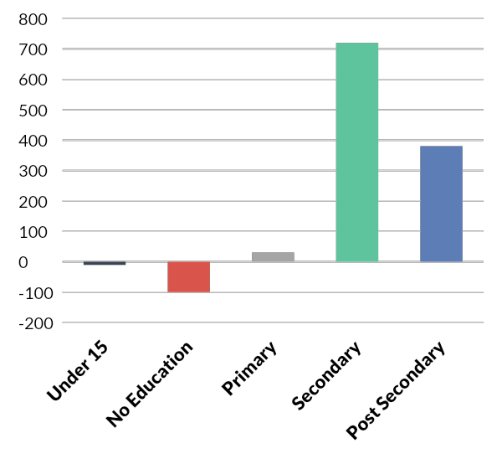
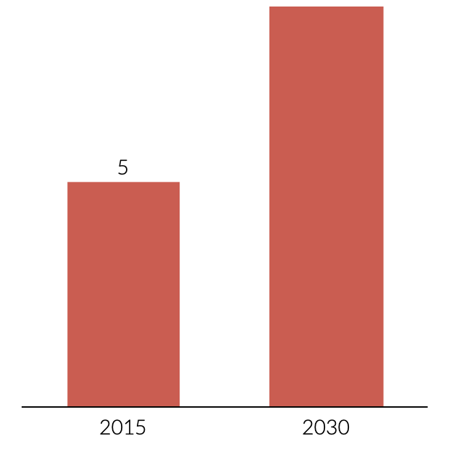
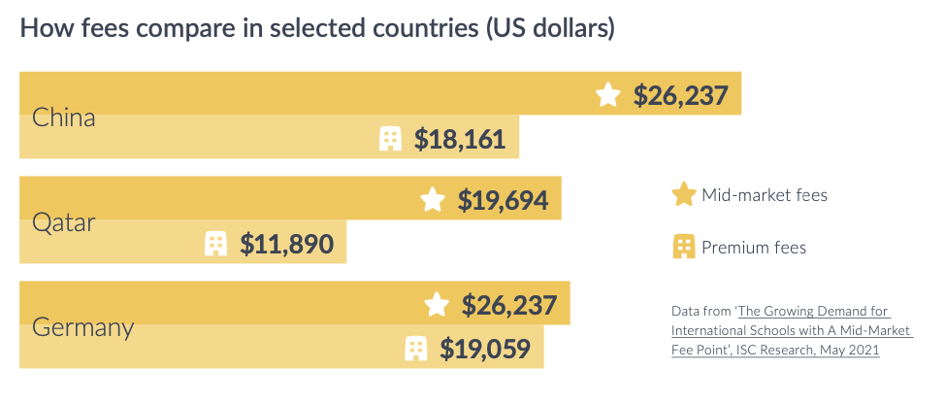
Global demographics are a funhouse mirror of domestic trends
The next decade will see an additional 350m post-secondary graduates. Emerging markets are the driving force behind this expansion
Emerging middle classes are fueling demand for quality global education resulting in 16.4k international schools by 2026, educating 10.6m students.
Increasing competition among international schools and new types of students has led to new definitions of affordability
Notes:
Ranking or reputation

Slide 9
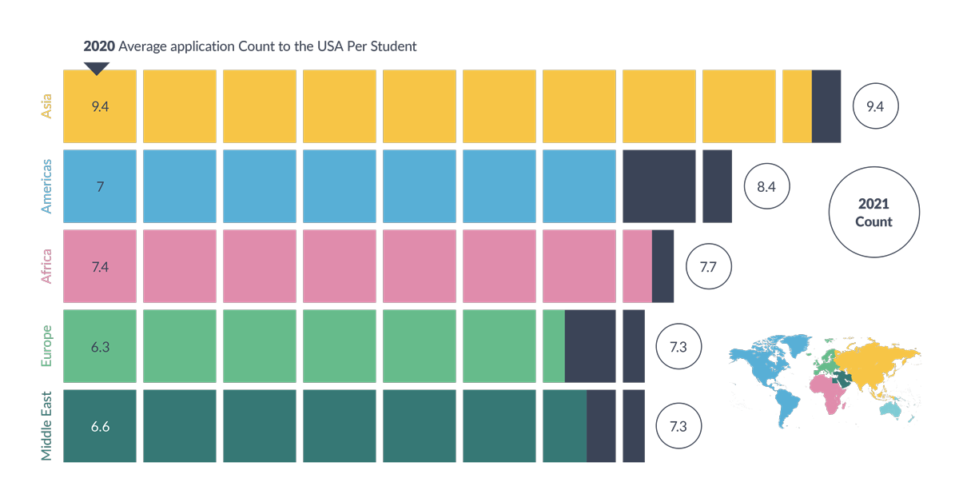
Why the opportunity for US universities is now
Signals from 2021
3 Principles to a Best Practice Strategy
distinct from overall international admissions strategy
recognizes the complexity among international schools
accounts for the growth curve in international
BridgeU student applications to the United States, 2020-2021 admissions cycles

Slide 10
Poll 2*
*responses anonymous (even to us!)

Slide 11
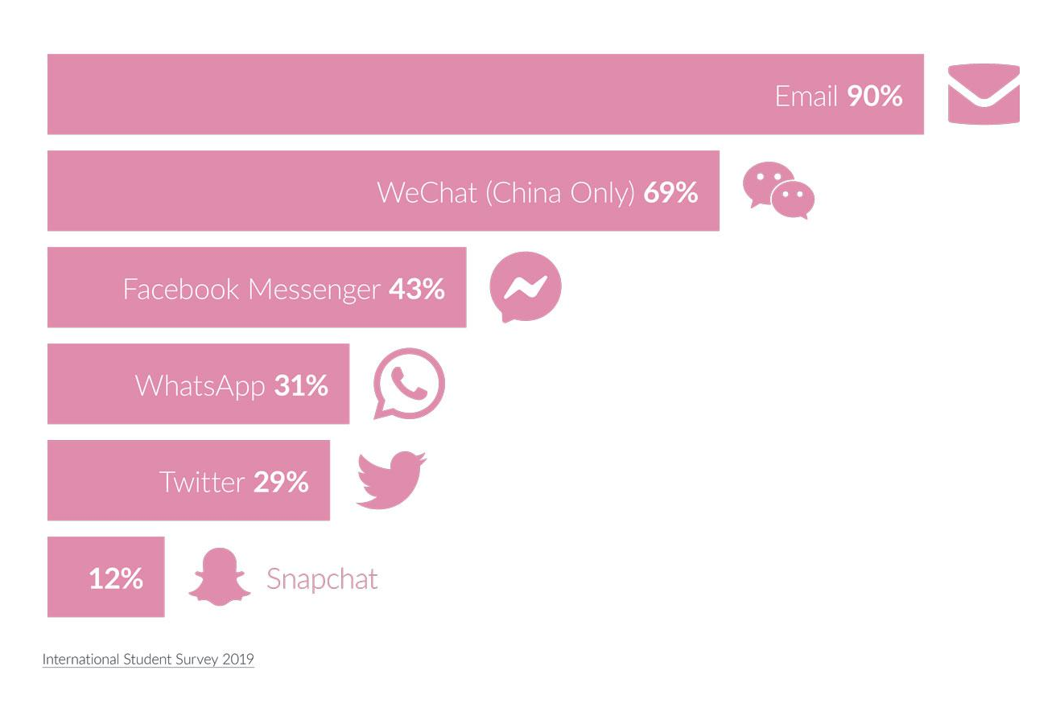
Adapting to changing student communications preferences
Social is crucial (but fragmented)
And email may be too crucial (and not fragmented enough)

Slide 12
How to get started with your international schools strategy
Step-by-step
Step one: Review your budget and resources
Step two: Conduct an analysis of your relevant recruitment markets
Step three: Research your target schools and school groups
Step four: Start your outreach

Slide 13
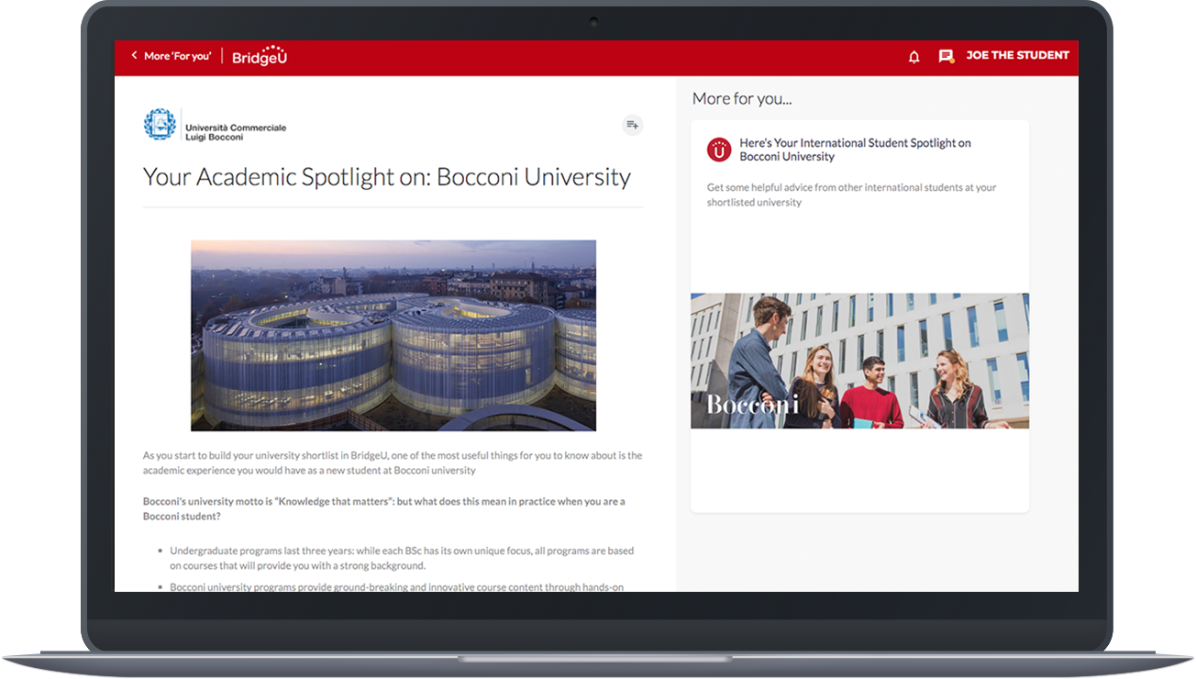
Adopt a scalable strategy with BridgeU for Universities
End-to-end support to identify, engage, and admit best-fit, qualified international school candidates
Shortlist
Applications
Offers
Enrollees
406
113
83
21
*Average results from QS Top 50 BridgeU universities

Slide 14
Thank you!
Follow-up options
I’d like to receive a digital copy of today’s presentation
I’d like to receive a digital copy of BridgeU’s The Essential International Schools Strategy Guide
I’d like to schedule a consultation with a BridgeU expert
Other, please contact me
Continue the conversation:
BridgeU
LinkedIn
Twitter

Slide 15
Poll 3:
Follow-up

