Slide 1
Public Viewpoint: COVID-19 Work and Education Survey
Balanced Learning: Meeting Students Needs During COVID-19
Oct. 27, 2020

Slide 2
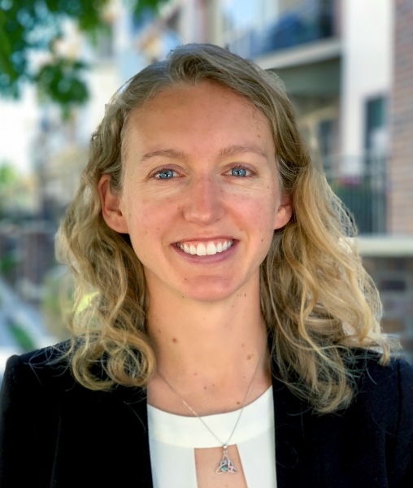
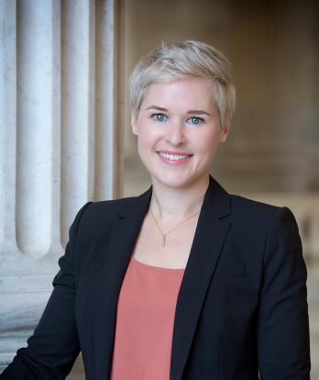
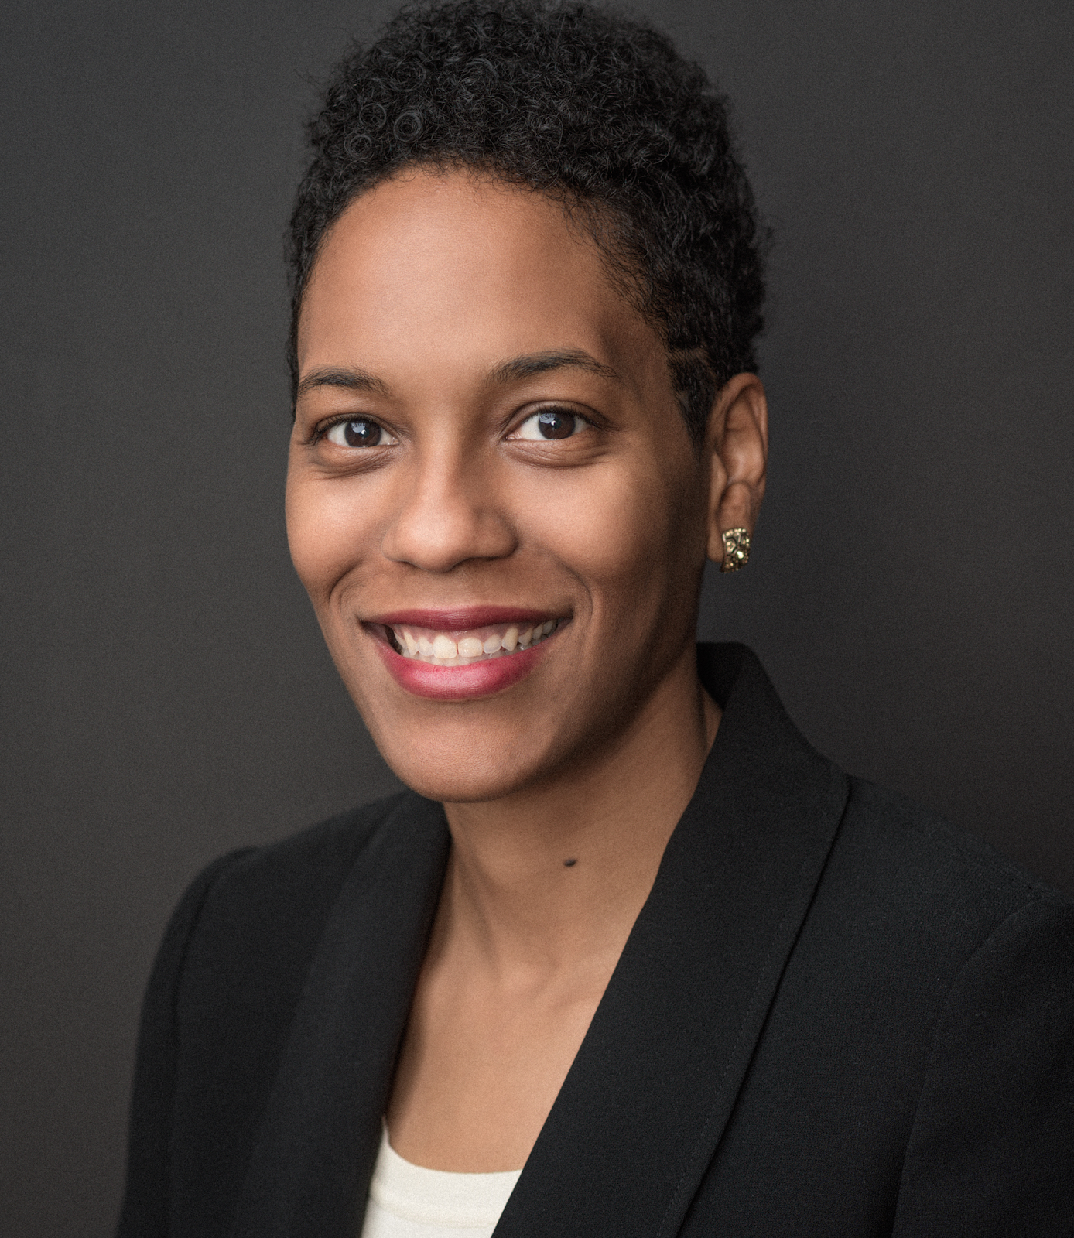
Public Viewpoint Webinar Series
COVID-19 Work & Education Survey
Oct. 27, 2020
Nichole Torpey-Saboe, PhD Director of research,
Strada Center for
Consumer Insights
Beth Akers, PhD Senior Fellow,
Manhattan Institute
Andrew Jones, EdD
CEO and Founder,
Creating Futures LLC
Amelia Parnell, PhD VP for Research and Policy,
NASPA

Slide 3
Emotional well-being is students' biggest challenge this fall
Which of the following has been the biggest challenge or struggle for you this fall?
Strada-College Pulse survey, Sept. 10-25. Base: current college students enrolled at four-year institutions, n=3,389.

Slide 4
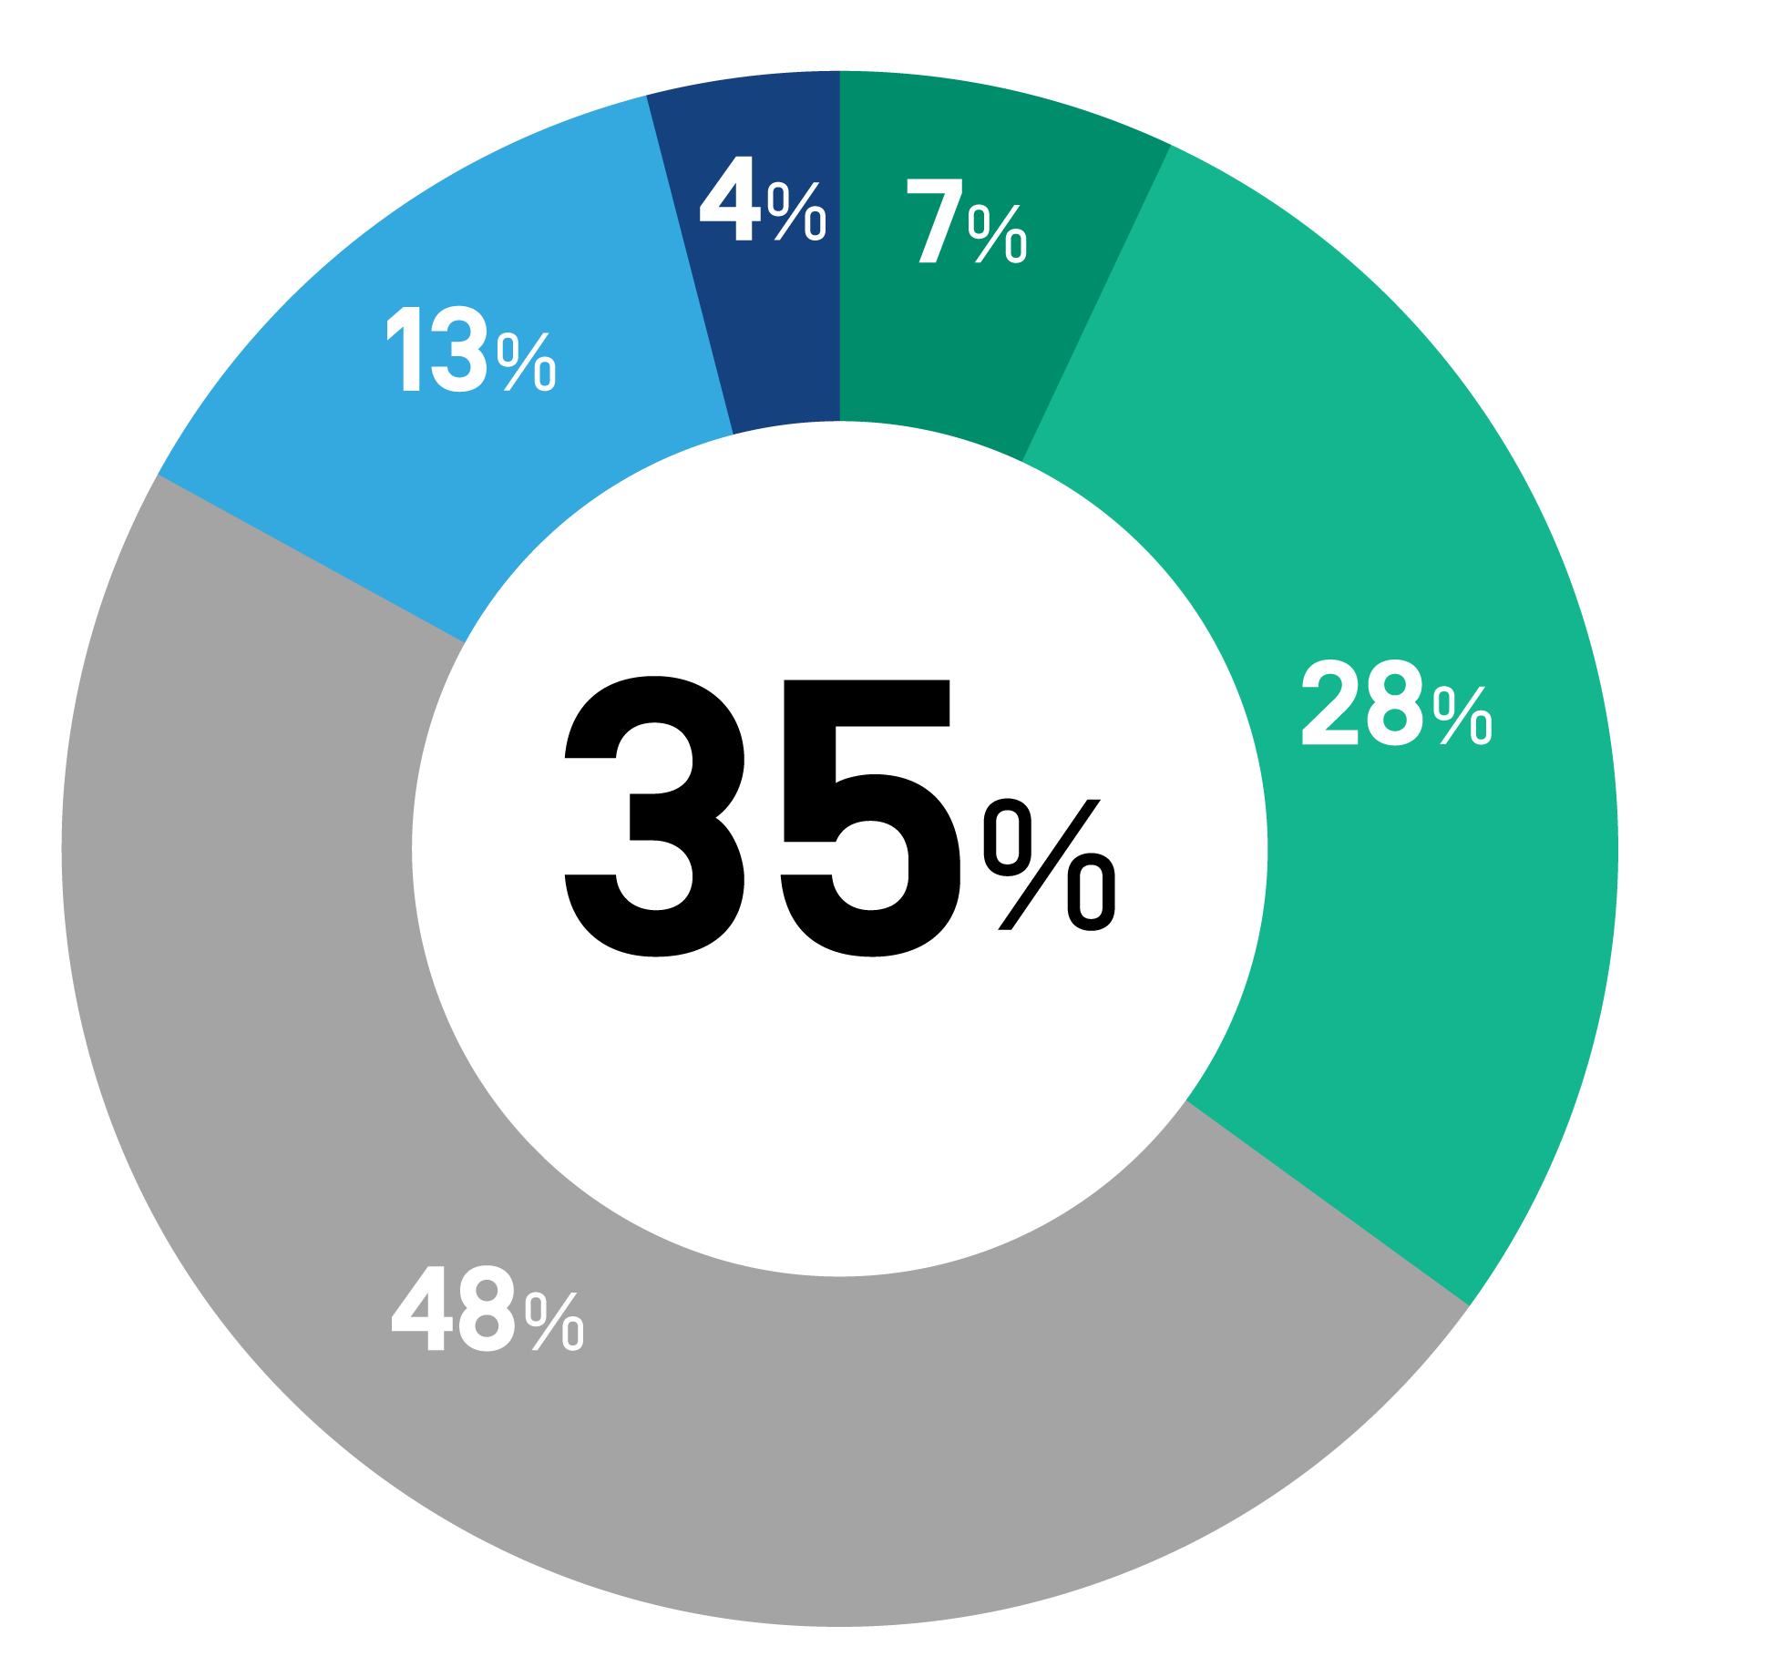
About one-third of students rate their school as “excellent” or “very good” at connecting education to meaningful careers
How would you rate your college or university’s support for helping students connect their education to a meaningful career?
Strada-College Pulse survey, Sept. 10-25. Base: current college students enrolled at four-year institutions, n=3,887.

Slide 5
1 in 5 students say COVID-19 has made their opportunities for career exploration much worse
How has COVID-19 impacted your opportunities for career exploration?
Strada-College Pulse survey, Sept. 10-25. Base: current college students enrolled at four-year institutions, n=3,886.

Slide 6
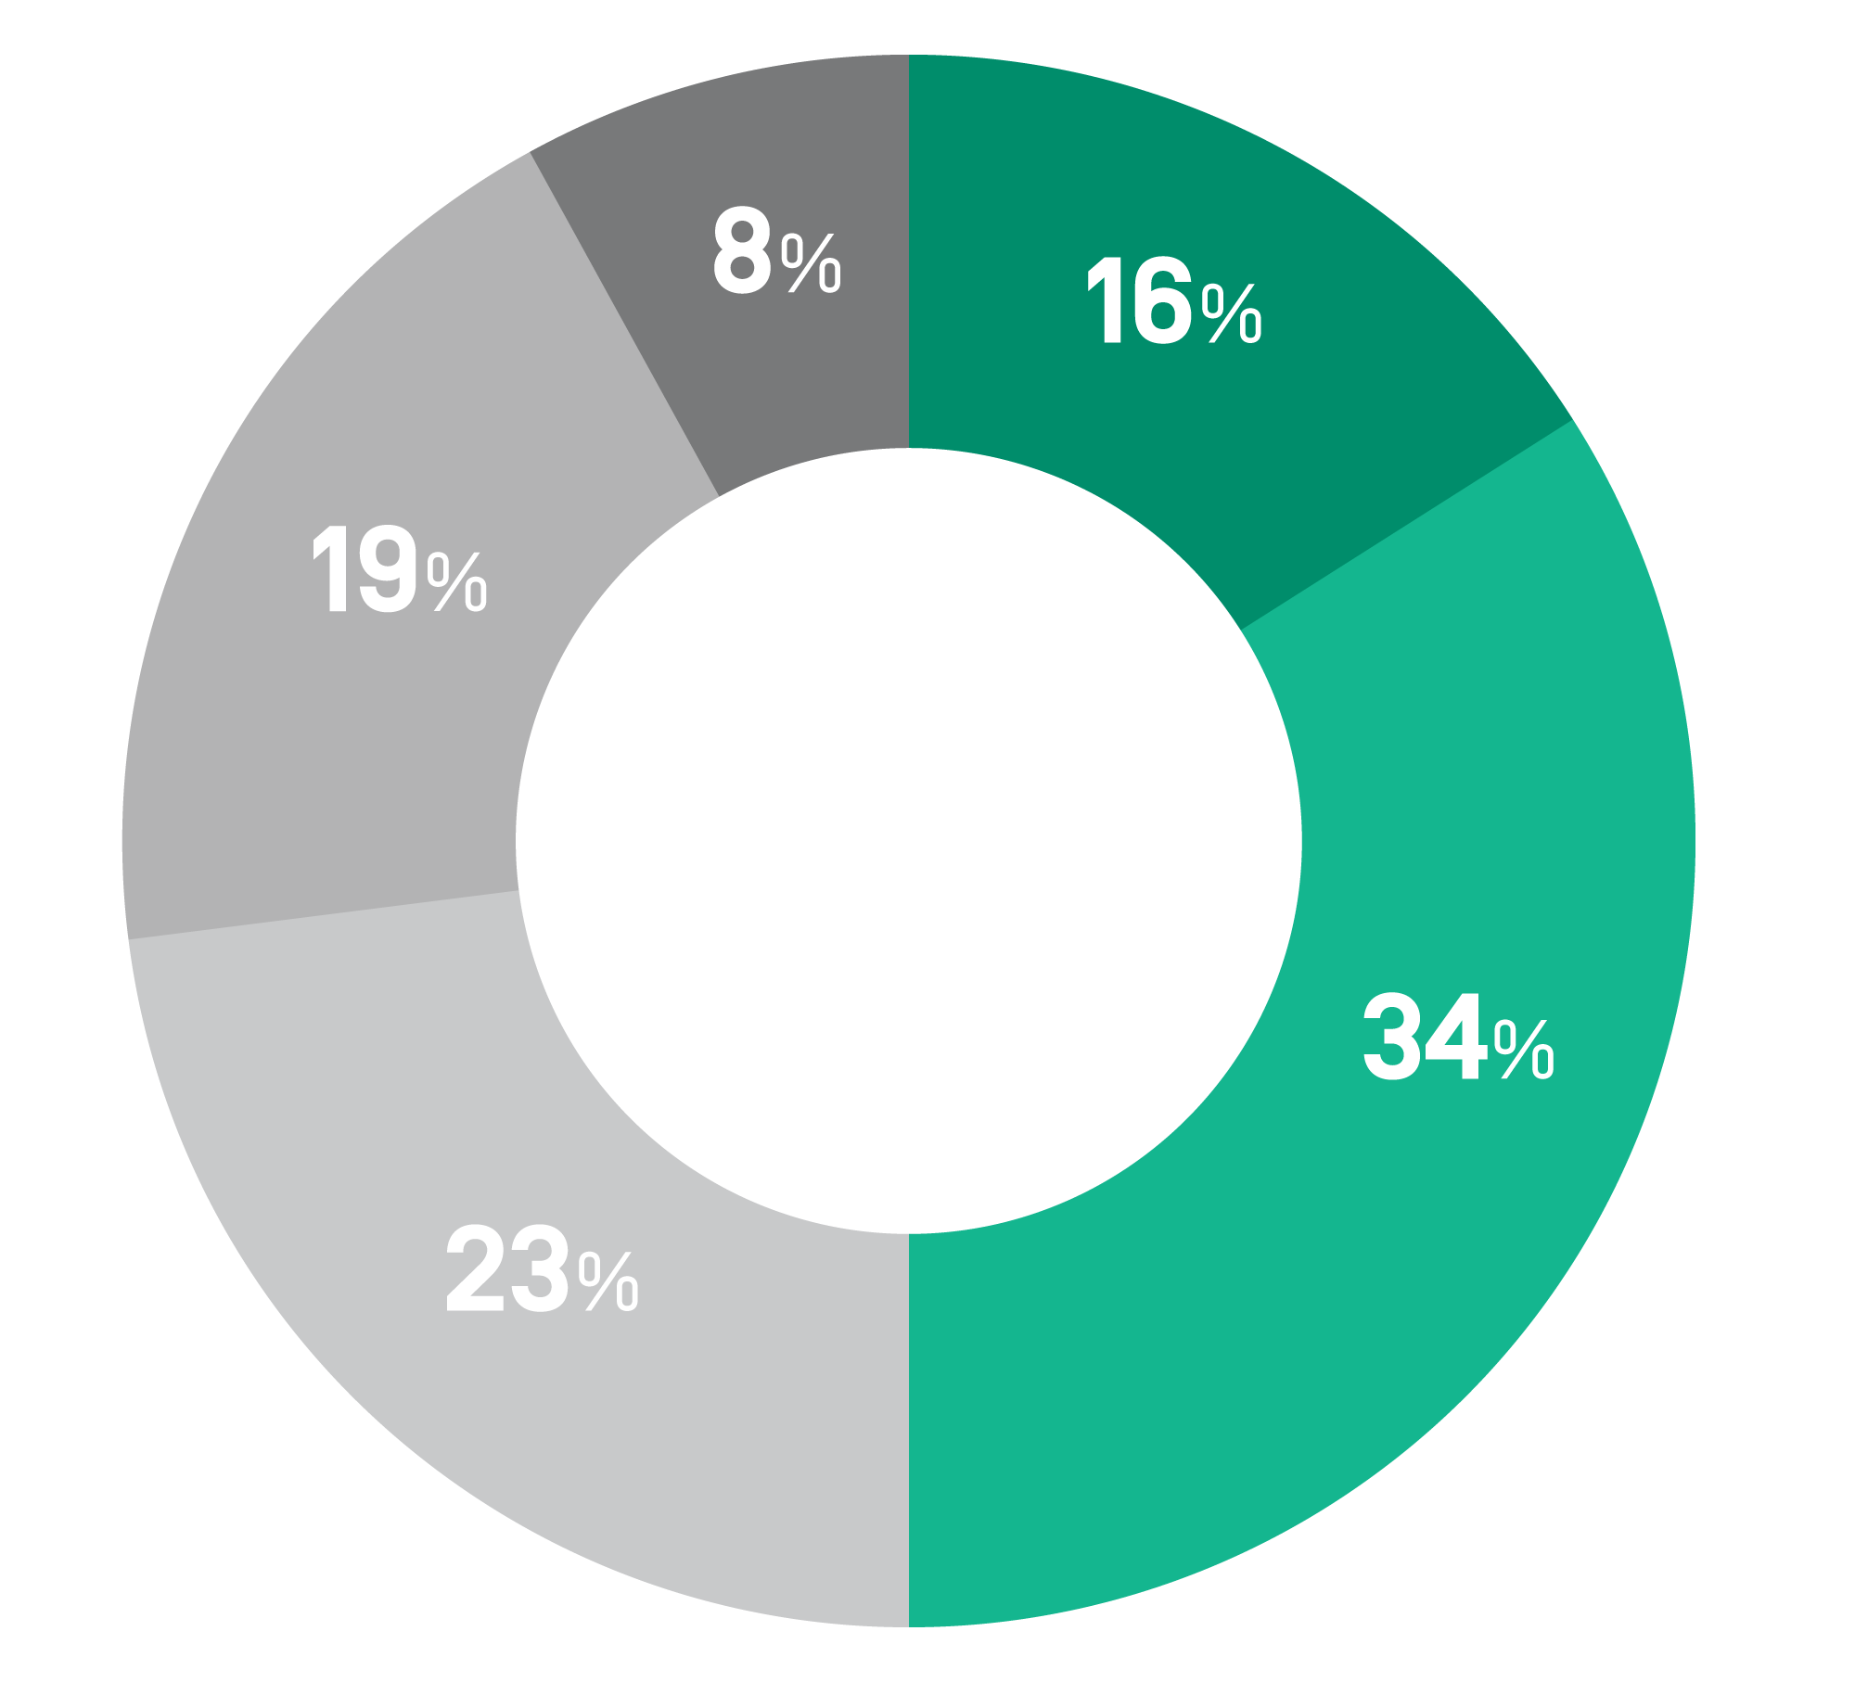
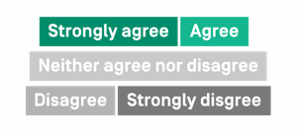
Fewer than 1 in 5 current college students strongly agree their education will be worth the cost
My education will be worth the cost.
8%
16%
19%
34%
23%
Strada-College Pulse survey, Sept. 10-25. Base: current college students enrolled at four-year institutions, n=3,887.
Notes:
Only 16% strongly agree their education will be worth the cost

Slide 7
When students have the support to connect their education to a career, they are more likely to say their education will be worth the cost
How would you rate your college or university’s support for helping students connect their education to a meaningful career?
Strada-College Pulse survey, Sept. 10-25. Base: current college students enrolled at four-year institutions, n=3,887.
Notes:
Break out or only strongly agree

Slide 8
Learn more at StradaEducation.org/PublicViewpoint or email consumervoice@stradaeducation.org

Slide 9
Methodology
The Strada Student Viewpoint survey was fielded by College Pulse from Sept. 10 to 25 as an online survey from a panel of students enrolled at four-year institutions. Data are weighted based on the Current Population Survey on the basis of age, race/ethnicity, and gender; n=4,007. Theoretical margin of error +/- 1.7%.
Please contact Strada Center for Consumer Insights with questions or information requests at consumervoice@stradaeducation.org or learn more at StradaEducation.org/PublicViewpoint.

