Slide 1
The 2017 Survey of CHIEF ACADEMIC OFFICERS
Webinar on the Inside Higher Ed / Gallup survey of provosts
Wednesday, February 15 at 2 p.m. Eastern

Slide 2
Presenters
Scott Jaschik, editor, Inside Higher Ed, scott.jaschik@insidehighered.com
Doug Lederman, editor, Inside Higher Ed, doug.lederman@insidehighered.com

Slide 3
Methodology
Questions prepared by Inside Higher Ed, in collaboration with Gallup.
Polling conducted by Gallup.
Results from 654 provosts or chief academic officers.
Complete anonymity for respondents, but answers coded to allow for breakdown by tenure status, demographics, etc.

Slide 4
Demands for Diversity in Faculty and Curriculum

Slide 5
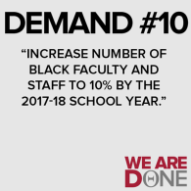
Mixed Feelings on Faculty Hiring Goals
31% of provosts say their institutions can meet hiring goals focused on diversity; 31% of provosts disagree.
Provosts are more likely to think that their targets are unrealistic (35%) than that they are realistic (29%).
62% of provosts agree or strongly agree that “my college will need to make hiring decisions in new ways in order to achieve meaningful increases in the number of minority faculty members.”

Slide 6
Diversifying the Curriculum
Statement | % Agree -- Private | % Disagree -- Private | % Agree -- Public | % Disagree -- Public
Curriculum at my college should be revised to add emphasis on diversity. | 45% | 23% | 40% | 26%
Undergraduates should be required to take one course on diversity. | 80% | 8% | 69% | 17%
Colleges should add support for departments that focus on study of minority groups. | 32% | 27% | 25% | 38%
Demands of student groups related to curriculum should be turned over to faculty bodies for action. | 56% | 20% | 58% | 27%

Slide 7
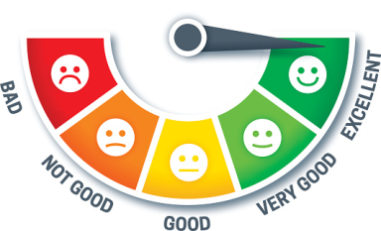
Bias in Student Reviews of Professors
Provosts report that such reviews matter.
Provosts report that they are aware of the increasing consensus about bias in the reviews.
32% of provosts at public institutions and 53% at private institutions are reconsidering their use of these reviews.

Slide 8
Predicting the Status Quo on Adjuncts
 | Private | All Public | Community Colleges
Expect less reliance on adjuncts | 6% | 14% | 4%
Expect no change | 60% | 63% | 61%
Expect greater reliance on adjuncts | 33% | 23% | 35%

Slide 9
Provosts on Whether Institutions Are ‘Very Effective’
Area | Private | All Public | Community Colleges
Providing a quality undergrad education | 69% | 66% | 68%
Preparing students for the world of work | 49% | 45% | 49%
Offering undergraduate support services | 47% | 47% | 45%
Controlling rising prices | 19% | 44% | 44%
Assessing learning outcomes | 32% | 29% | 31%
Preparing students for engaged citizenship | 34% | 20% | 15%
Using data effectively | 20% | 31% | 30%

Slide 10
Assessment: Provosts vs. Professors
Statement | % Private Provosts Agreeing | % Public Provosts Agreeing | % Community College Provosts Agreeing | % Faculty Members Agreeing
Assessment has improved quality of teaching and learning at my college. | 56% | 46% | 50% | 27%
Assessment is more about keeping accreditors/politicians happy than about teaching and learning. | 20% | 35% | 37% | 65%

Slide 11
The Liberal Arts
90% of provosts agree or strongly agree (65% strongly agree) that liberal arts education “is central to undergraduate education -- even in professional programs.”
54% agree or strongly agree with the statement “I expect to see the number of liberal arts colleges decline significantly over the next five years.”
60% believe that “politicians, presidents and boards are increasingly unsympathetic to liberal arts education.”
33% of provosts agree or strongly agree that liberal arts education “has become too divorced from the career needs of students and graduates.”
33% agree that “liberal arts faculty members are not sufficiently interested in the desire of parents and students for career preparation.”

Slide 12
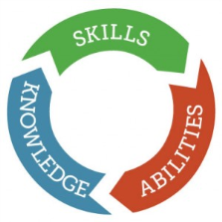
Competency-Based Education
Growth across the board is evident in interest – and in institutions offering some instruction through CBE.
Concerns about impact on general education appear to be declining.
Public-private gap continues and is unlikely to narrow.

Slide 13
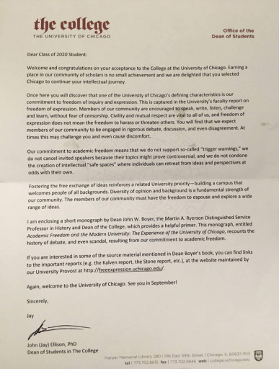
Trigger Warnings … After Chicago Letter
Let professors decide.
Institutional policies rare.
Some concerns on impact.

Slide 14
Q&A
Your questions.
Suggestions for future coverage.

Slide 15
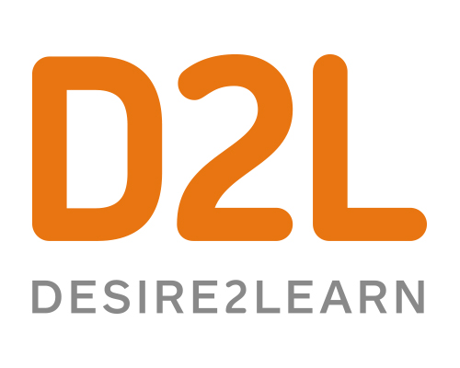
With Thanks …

