Slide 1
Higher Ed’s Responsive Strategies To COVID Bring About Faculty Confidence and Optimism
Jeff Seaman, Director, Bay View Analytics
Nicole Johnson, Research Director,
Canadian Digital Learning Research Association
Jennifer Mathes, CEO, Online Learning Consortium
Ryan Tipton, Provost, University of the Southwest

Slide 2

Dr. Jeff Seaman
Director
Bay View Analytics
http://onlinelearningsurvey.com/

Slide 3
Project Goals
One survey for multiple partners so respondents are not bombarded with questions from those who are trying to help
Collaboration
Identify which functions and services faculty and institutions think are working (or not)
What Works?
Guidance for institutions – and for policy makers and support organizations
Next Steps

Slide 4
Survey Overview
Design
Quick survey, can be completed in under 5 minutes
A single survey for administrators and faculty, flexibly designed to show only the relevant questions for each respondent
Privacy guaranteed
Process:
Two weeks of data collection: August 4 to August 14, 2020
Completed online
Results:
887 U.S. Higher Education faculty and administrator respondents
Represent 597 different institutions
Merged with the Integrated Postsecondary Education Data System (IPEDS) for institutional characteristics

Slide 5
Resources
A full report is in production – all webinar registrants will receive the download link.
Visit cengage.com/digital-learning-pulse-survey to access a resource hub for this quarterly survey with administrators and faculty from across the US. You'll find infographics, webinar archives, slides and links to the full research reports.
Webinar on Canadian results “Ready or not, the fall semester is here”:
Sep 24, 2020 12:00 PM in Eastern Time
https://ecampusontario.zoom.us/webinar/register/WN_JGpnou0XR-Ws66qDeMjgFw

Slide 6






Project Partners:
WICHE Cooperative for Educational Technologies
University Professional and Continuing Education Association

Slide 7
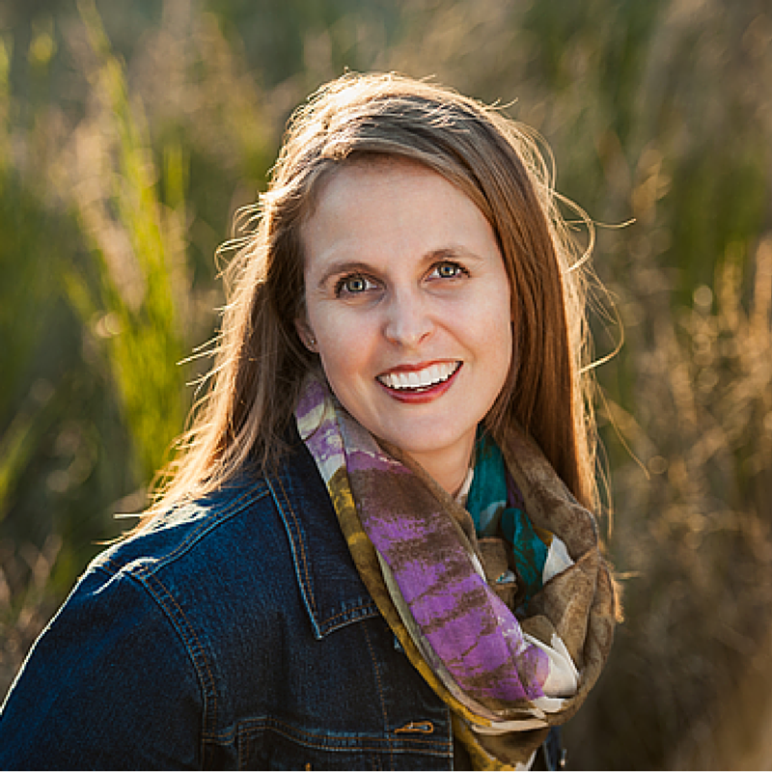
Survey Results
Nicole Johnson
Research Director
Canadian Digital Learning Research Association

Slide 8
Faculty: Ready to teach online

Slide 9
Administrators: Institutions are ready for online

Slide 10
Faculty: Multiple PD options

Slide 11
Faculty: PD was effective
Notes:
This is the % among those where it was offered who attended AND found it useful. In other words about 1/3 of faculty either did not take advantage of the offered PD, or did not find it useful when they did.

Slide 12
Faculty: Student engagement is key

Slide 13
Faculty: Optimism-Pessimism

Slide 14
Faculty: Post-pandemic
"The online learning genie is out of the bottle."
"Will make people seriously question the need for higher ed. Will become a transaction more than a relationship."
"We may have to offer simultaneous zooming from class all the time now."
"It will show people that some classes are well suited for remote learning, and take away the stigma that some people still have regarding remote learning."
"I think it will be the end of face to face classes."
"Higher education will increasingly use flipped classrooms and online resources to enhance the classroom experience."
"The biggest impact will be that online learning will transform from a choice to a requirement."

Slide 15
Administrator: Post-pandemic
“Some institutions will close. Some will emerge as a shadow of what they were previously. Others, with effective leadership will make difficult choices and come out stronger.”
“Higher education will increasingly move online and it will become the predominant delivery method.”
“Students will recognize that sitting in a lecture hall being talked at isn't an effective way for them to learn.”
“Increased value for the campus experience — students who now have done both understand what is lost when campus is closed.”
“It may force faculty who were resistant to using technology to be more engaged.”
“The pandemic has made us leaner, more responsive, and more creative.”

Slide 16
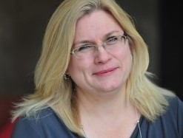
Jennifer Mathes, Ph.D.
Chief Executive Officer
Online Learning Consortium
https://onlinelearningconsortium.org/

Slide 17
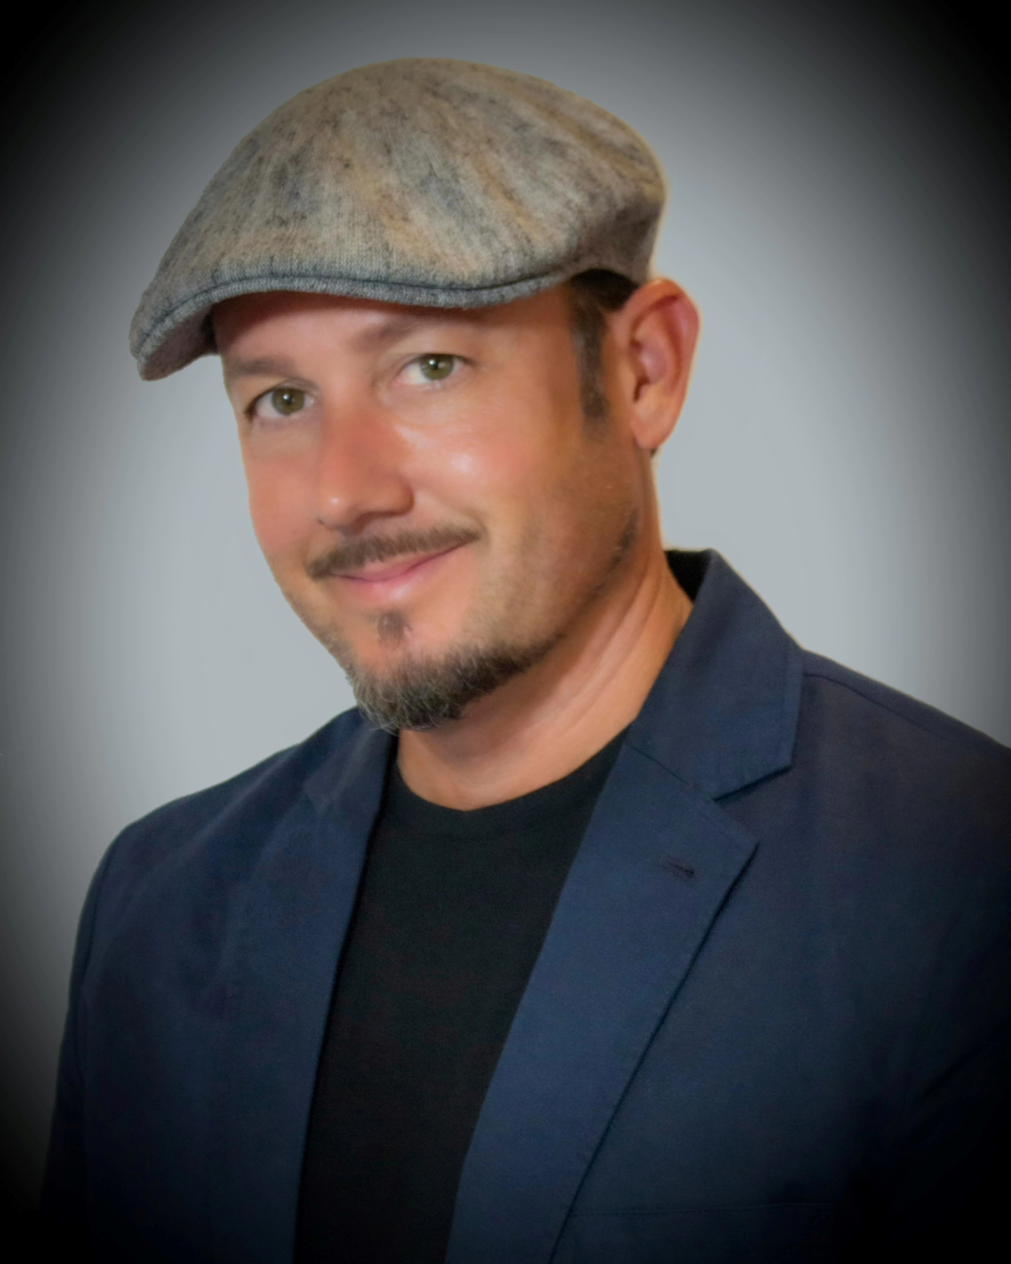
Ryan Tipton
Provost
University of the Southwest
https://www.usw.edu/

Slide 18
Questions and Answers

Slide 19

With Support From

Slide 20
Resources
A full report is in production – all webinar registrants will receive the download link.
Visit cengage.com/digital-learning-pulse-survey to access a resource hub for this quarterly survey with administrators and faculty from across the US. You'll find infographics, webinar archives, slides and links to the full research reports.
Webinar on Canadian results “Ready or not, the fall semester is here”:
Sep 24, 2020 12:00 PM in Eastern Time
https://ecampusontario.zoom.us/webinar/register/WN_JGpnou0XR-Ws66qDeMjgFw

