Slide 1
New Strategies to Navigate International Enrollments
An Inside Higher Ed webcast
Thursday, May 10
2 p.m. Eastern

Slide 2
Presenters
Scott Jaschik, editor, Inside Higher Ed scott.jaschik@insidehighered.com
Doug Lederman, editor, Inside Higher Ed doug.lederman@insidehighered.com

Slide 3
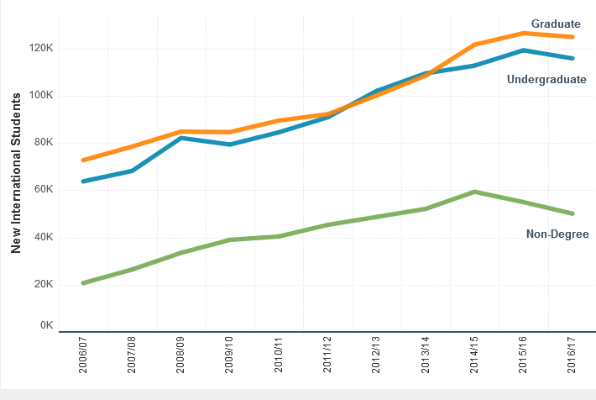
The Numbers: I
--Institute of International Education

Slide 4
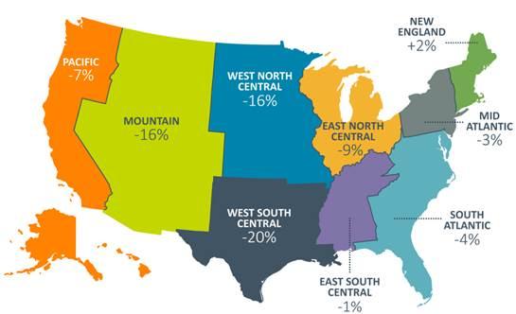
The Numbers: II
--Institute of International Education

Slide 5
The Numbers: III
Top Countries of Origin
--Institute of International Education
Country | Students, 2016-17 | % Change in Year
China | 350,755 | +6.8%
India | 186,267 | +12.3%
South Korea | 58,663 | -3.8%
Saudi Arabia | 52,611 | -14.2%
Canada | 27,065 | +.03%

Slide 6
The Travel Ban

Slide 7
The Latest Data From SEVIS

Slide 8
O Canada!

Slide 9
Boom and Bust in Indian Enrollments

Slide 10
#YouAreWelcomeHere

Slide 11
Distancing College From Trump

Slide 12
Diversification of Countries

Slide 13
New Models for Joint Degrees

Slide 14
Offering Merit Aid

Slide 15
Recruiting
Presidential visits
Agents

Slide 16
Classifying Econ as STEM

Slide 17
Q&A
Your questions
Ideas for coverage

Slide 18
With Thanks …

