Slide 1
Case Study: How Montana State University Streamlined Budgeting
Megan Lasso, Montana State University
Stewart Clark, Kaufman Hall

Slide 2
MEGAN LASSO
Budget and Fiscal Manager, Montana State University
Main fiscal support for the Provost; engages with Deans, VPs, and various committees
14 years at Montana State University
STEWART CLARK
Senior Solutions Engineer, Kaufman Hall
Senior Associate Director of Financial Operations, MIT Sloan School of Management
Senior Financial Analyst, Harvard University
Notes:
Christy

Slide 3
AGENDA
Background
Challenges
Solutions & Efficiencies Gained
Driving User Adoption
What’s Next?
Notes:
Stewart

Slide 4
Background

Slide 5
SOMEWHAT UNPREPARED FOR THE FUTURE
82%
66%
Acknowledge higher education is behind most other industries in terms of adopting modern financial planning practices and tools
Say they are not prepared to respond quickly to change, or were unsure if they could use existing tools and processes to do so
Source: Kaufman, Hall & Associates: 2019 CFO Outlook: Performance Management Trends and Priorities in Higher Education, Dec. 2018.
Notes:
Stewart

Slide 6
BUDGETING PROCESSES ARE INEFFICIENT
18%
82%
From initial roll out to board presentation, how long does your budgeting process take?
Under
3 Months
Over
3 months
Source: Kaufman, Hall & Associates: 2019 CFO Outlook: Performance Management Trends and Priorities in Higher Education, Dec. 2018.
Notes:
Stewart

Slide 7
HIGHEST PRIORITIES FOR 2019
Which of the following financial planning & analysis initiatives is your organization looking to improve?
Operational budgeting and forecasting
75%
Reporting and analysis to support decision making
56%
Long-range financial planning
56%
Source: Kaufman, Hall & Associates: 2019 CFO Outlook: Performance Management Trends and Priorities in Higher Education, Dec. 2018.
Notes:
Stewart

Slide 8
Case Study: Montana State University
Notes:
Stewart turns over to Megan

Slide 9
ABOUT MONTANA STATE UNIVERSITY
Located in Bozeman, MT
Largest of four campuses in the Montana State University System
Ranks top 3% for research expenditures; more than $100 million annually
16,902
602
460
Total students
Full-time faculty
Part-time faculty
Notes:
Megan

Slide 10
Challenges
Notes:
Megan

Slide 11
INEFFICIENT, TIME-CONSUMING PROCESSES
1
Limited integration with ERP system
2
Spreadsheet-based budgeting
3
Manual budget adjustment process
4
Manual, time-consuming reporting
5
Labor planning complexities across four campuses
Notes:
Megan

Slide 12
Challenge #1: Limited integration with ERP system
Time intensive to aggregate data from disparate sources both within and outside of Ellucian Banner
Lack of data transparency across university
Difficulty aligning budget and enrollment data with ERP data

Slide 13
Challenge #2: spreadsheet-based budgeting
Lack of standardized budgeting process across institutions
Budget Office built Excel-based budget spreadsheets and distributed them to each unit for investment requests
Manual workflows between individual units and the Budget Office
Time intensive and cumbersome

Slide 14
PREVIOUS BUDGET REQUEST TEMPLATE

Slide 15
Challenge #3: Manual budget adjustment process
Necessitated multiple points of communication around a single adjustment
Lacked automated workflow
Duplication of effort in department and Budget Office
Paper-based process made it difficult to find reason for changes

Slide 16
Challenge #4: Manual, time-consuming reporting
Budget Office manually collected data and aggregated data from several sources
No time left for analyzing the data
Time-intensive reporting processes that could be subject to error

Slide 17
Challenge #5: Labor planning complexities across four campuses
Each of four campuses has differences in labor planning
Could not view HR and payroll data from Banner alongside budget data
Separate spreadsheets to manage budgets for different employee types

Slide 18
Solutions & Efficiencies Gained
Notes:
Megan

Slide 19
PERFORMANCE MANAGEMENT SOLUTIONS
1
Integration with Ellucian Banner
2
Axiom Budgeting and Forecasting
3
Axiom Reporting and Analytics
4
Axiom Labor Planning
Notes:
Megan

Slide 20
SOLUTION #1: Integration with ERP
Provides single view of finance data
MSU selected a Kaufman Hall Axiom Higher Education, which:
Integrated with MSU’s Ellucian Banner finance, HR, and student information systems
Understood existing Banner systems and processes that could complement them
Efficiencies gained:
Single view of finance, HR, and student data from disparate sources
Data transparency across institution
Alignment of budget and enrollment data with Ellucian data to inform key decisions
Notes:
Megan

Slide 21
Solution #2: Budgeting & forecasting
Shortens budget process and eliminates disparate spreadsheets
Standardized budget process across Bozeman and affiliates
Replaced multiple spreadsheets with a single system
Automated workflows between individual units and Budget Office
Notes:
Megan

Slide 22
BUDGET REQUEST – STRATEGIC ALIGNMENT & ASSESSMENT

Slide 23
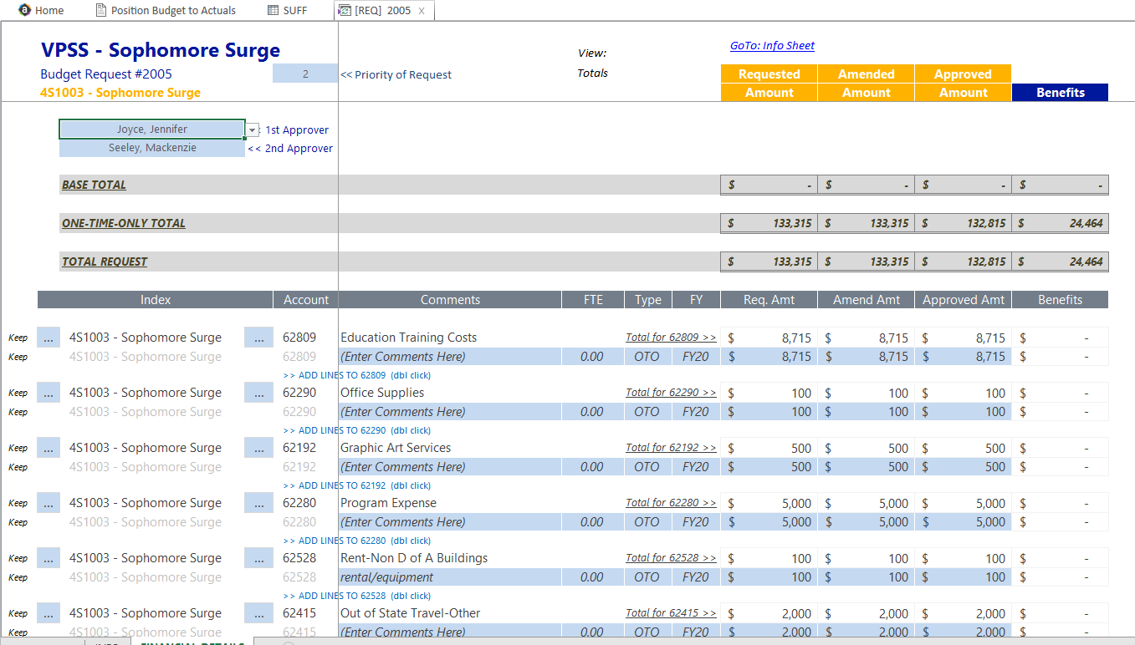
BUDGET REQUEST – FINANCIAL INFORMATION & PROCESSING

Slide 24
BUDGETING WORKFLOW
Budget Request submitted with modifications by Executive
Budget Request approved as requested, approved with modifications, or denied
Approved amounts flow into Budget Allocation
Allocation appears in Budget Files for reconciliation
Reports produced on strategic plan alignment, final outcomes, and assessments in the future

Slide 25
Solution #3: Budgeting & forecasting
Transforms budget process into on-demand, electronic process
On-demand budget adjustment process
Notification of balance across fund types
Includes both position and non-position adjustments
Automated workflow that:
Routes approvals to the appropriate parties
Notifies the Budget Office
Easily posts finalized adjustments to Banner Finance
Notes:
Megan

Slide 26
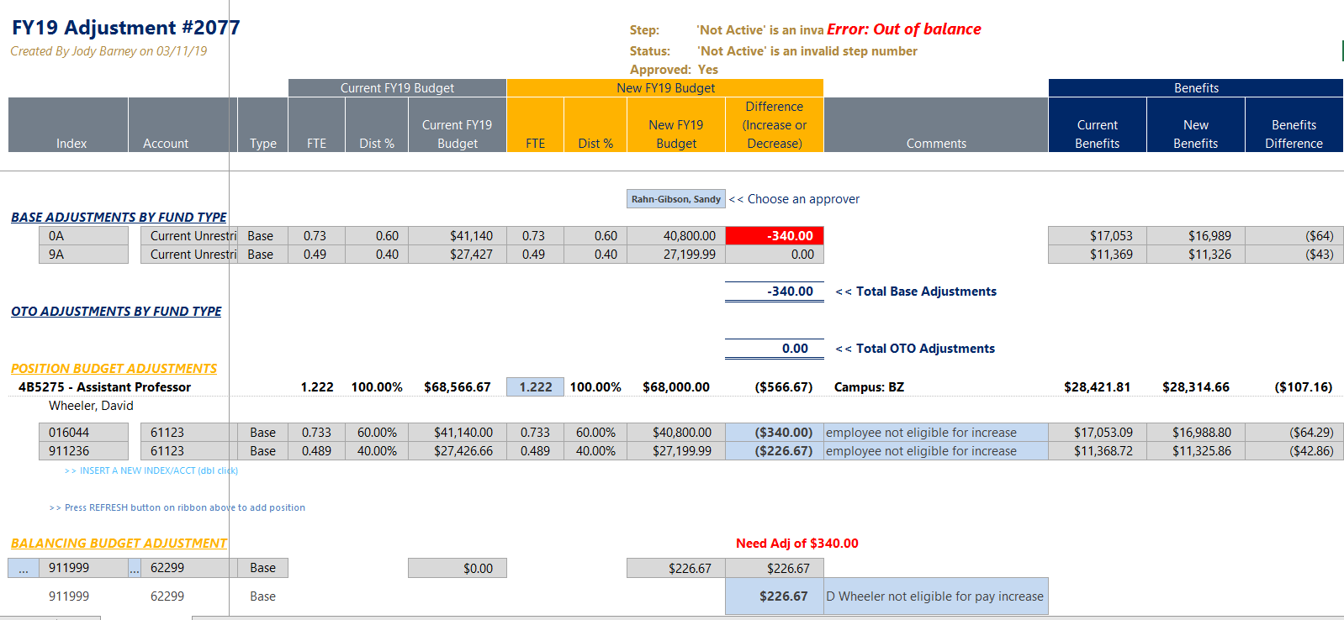

Slide 27
Solution #4: Reporting & analytics
Saves time and increases transparency
Ability to write ad hoc reports, saving significant time
Access finance, HR, and student data within budget system
Drill down into transactional levels of detail in variance reports
Increased transparency and data confidence across institution
Ability to make informed, data-driven decisions
Notes:
Megan

Slide 28
COMBINATION REPORT WITH BUDGET AND PAYROLL DATA

Slide 29
Solution #5: Labor planning
Standardizes complex labor planning process across four campuses
Users can view and analyze HR and payroll data side-by-side with budget data, including:
Payroll Labor Distribution
Stipend vs Base Payroll and Budget
Position Management reports
Labor Increases
Labor budgets for all employee types reside in a single system
System logic calculates budgets for multiple employee types
Notes:
Megan

Slide 30
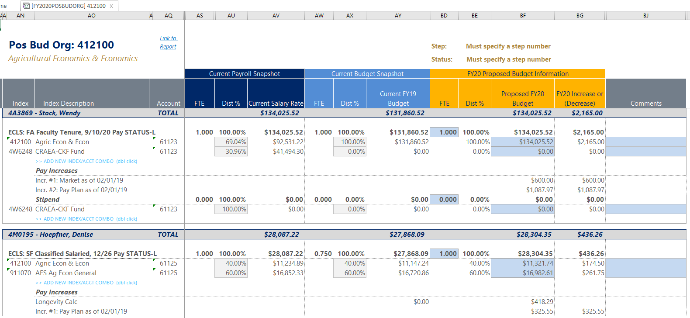
LABOR PLANNING

Slide 31
Driving User Adoption
Notes:
Megan

Slide 32
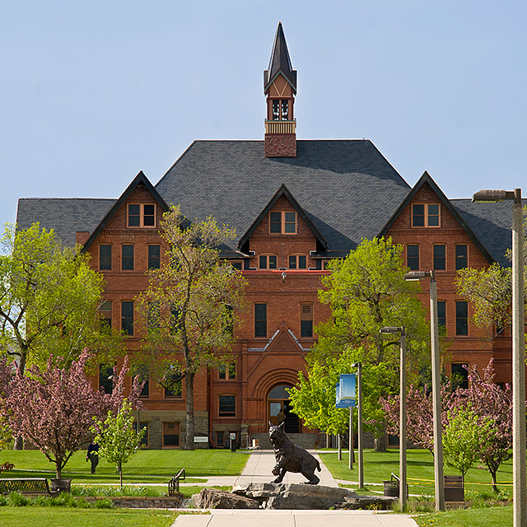
Tips for driving user adoption
Maximizes value in investment
Involve users through all phases of selection process:
Vendor selection
System design
Training
Ongoing communication
Familiar interface to avoid steep learning curve
Streamline processes to save time
Notes:
Megan

Slide 33
What’s Next?
Notes:
Megan

Slide 34
Looking to the future
Tuition Planning
Update tuition models due to factors affecting higher education
Planning by cohort
Incorporating changing discounting strategies
Including fund balance data to improve budget planning
Leverage dashboarding to increase administrator engagement
Notes:
Megan

Slide 35
Wrap Up
Notes:
Stewart

Slide 36
Guiding strategy and enabling outcomes with comprehensive and integrated financial consulting and performance management software tools.
30
5
475+
Years
Consecutive Years
Professionals
Helping senior leaders realize success amid a changing market
As a highly rated software platform by Gartner
in offices throughout the United States
Notes:
Stewart

Slide 37
Questions? More information: www.kaufmanhall.com
Notes:
Megan and Stewart

