Slide 1
Student Success:
Everyone’s Responsibility
An Inside Higher Ed webcast
Tuesday, April 21, 2020
2 p.m. Eastern

Slide 2
Presenters
Scott Jaschik, editor, Inside Higher Ed, scott.jaschik@insidehighered.com
Doug Lederman, editor, Inside Higher Ed, doug.lederman@insidehighered.com

Slide 3

The Downside of Reduced
Student Borrowing
--Getty Images

Slide 4

A Second Chance in Detroit
--Wayne State University

Slide 5

The Crucial Role of the Library
--iStock

Slide 6

Is Students’ Early Career Success a Faculty Responsibility?

Slide 7
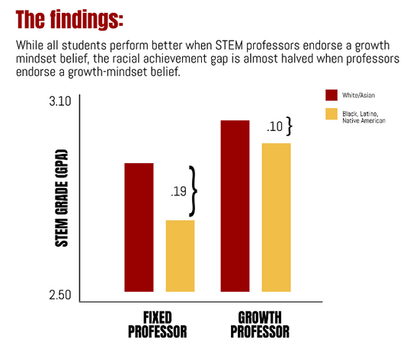
The Impact of Faculty Attitudes
About Intelligence

Slide 8

Faculty Members’ Role in Retention
--iStock

Slide 9
Cutting ‘Programmitis’
--With Thanks to Adrianna Kezar
Interventions that support student success
Sustained interventions over the long run
Culture change

Slide 10

Rethinking Remedial Education

Slide 11

Houston Collaborates

Slide 12
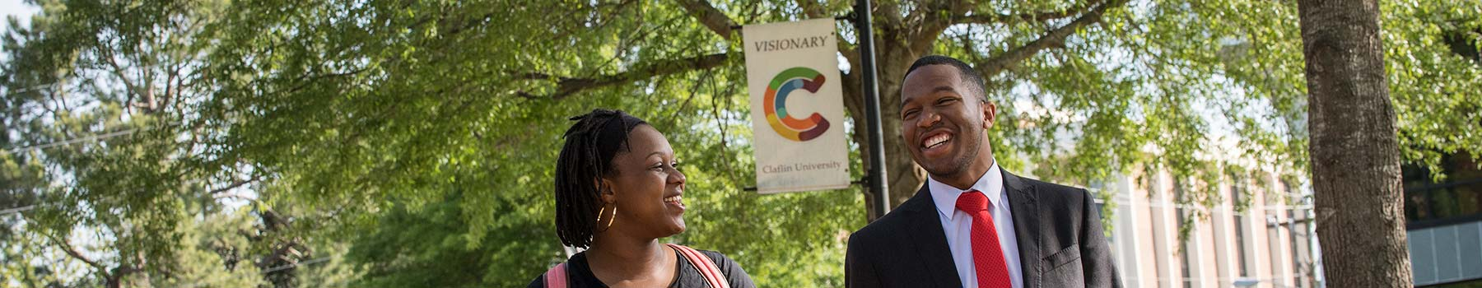
One College’s Tactics

Slide 13
Coronavirus Challenges and Opportunities
For faculty
For administrators
For all of us

Slide 14

With Thanks …

Slide 15
Your Questions

