Slide 1
College Leadership in an Era of Unpredictability
An Inside Higher Ed webcast
Wednesday, October 7, 2019
2 p.m. Eastern

Slide 2
Presenter
Rick Seltzer, rick.seltzer@insidehighered.com
Projects editor, Inside Higher Ed
Author of special report

Slide 3
The report
Examines three pandemics converging in this moment:
Health
Economic
Racism
Explores six forces driving those three pandemics
Lays out components of a vision for colleges or universities to consider for the future
Examines leadership traits expected to be important going forward

Slide 4
So much happened since publication
Fall semester started
Sharper picture of how the COVID-19 pandemic is unfolding
Additional economic data
Widening racial disparities

Slide 5
Our agenda today
Examine latest key indicators and trends
COVID-19
Economy
Racial disparities and systemic racism
Major issues for higher ed
Leadership in this uncertain time

Slide 6
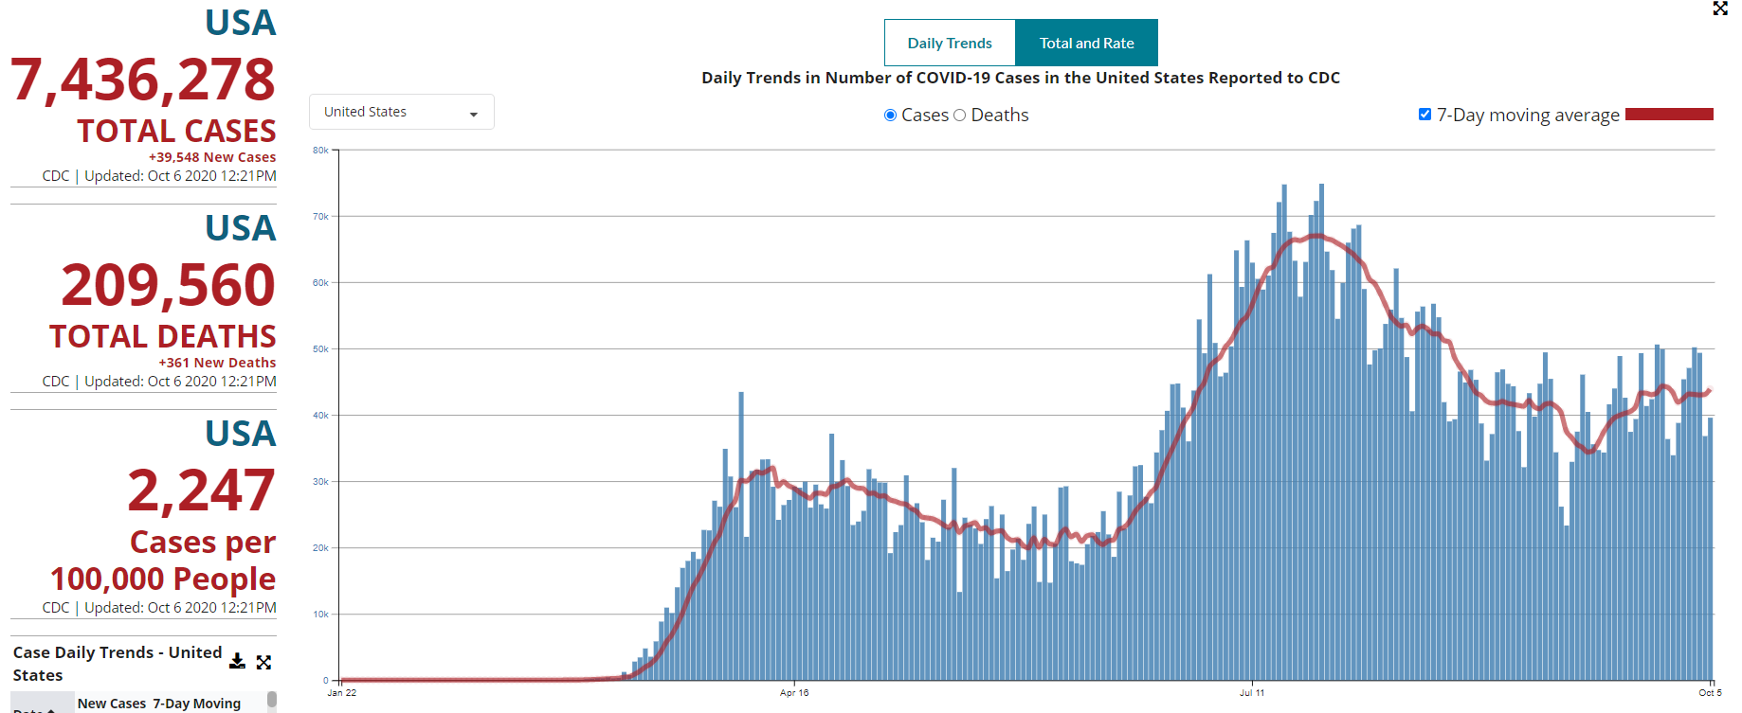
COVID-19 across the country
Source: CDC

Slide 7
Colleges with counties vs. without
Data source: Johns Hopkins Coronavirus Resource Center

Slide 8
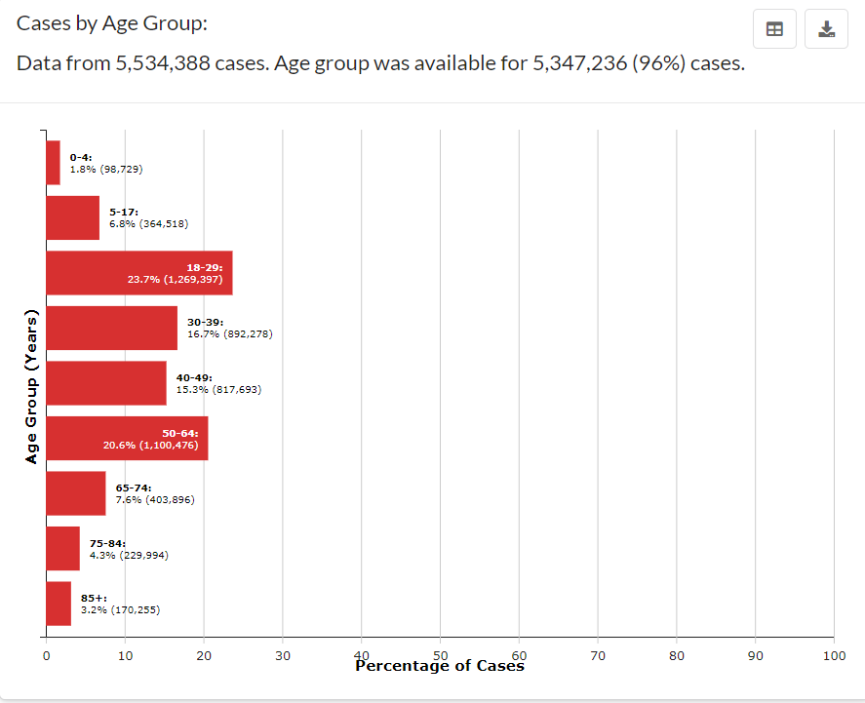
Latest picture across the country
Source: CDC

Slide 9
Aug. 2-Sept. 5, 2020
Weekly COVID-19 cases among those 18-22:
55 percent nationally
“Increases in cases were not solely attributable to increased testing.”
Source: CDC MMWR. https://www.cdc.gov/mmwr/volumes/69/wr/mm6939e4.htm?s_cid=mm6939e4_w

Slide 10
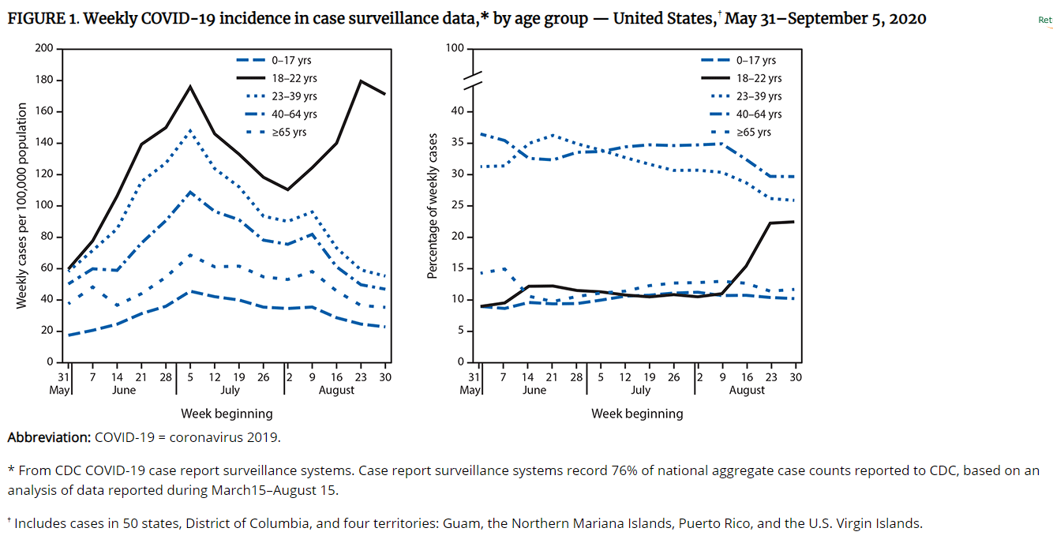
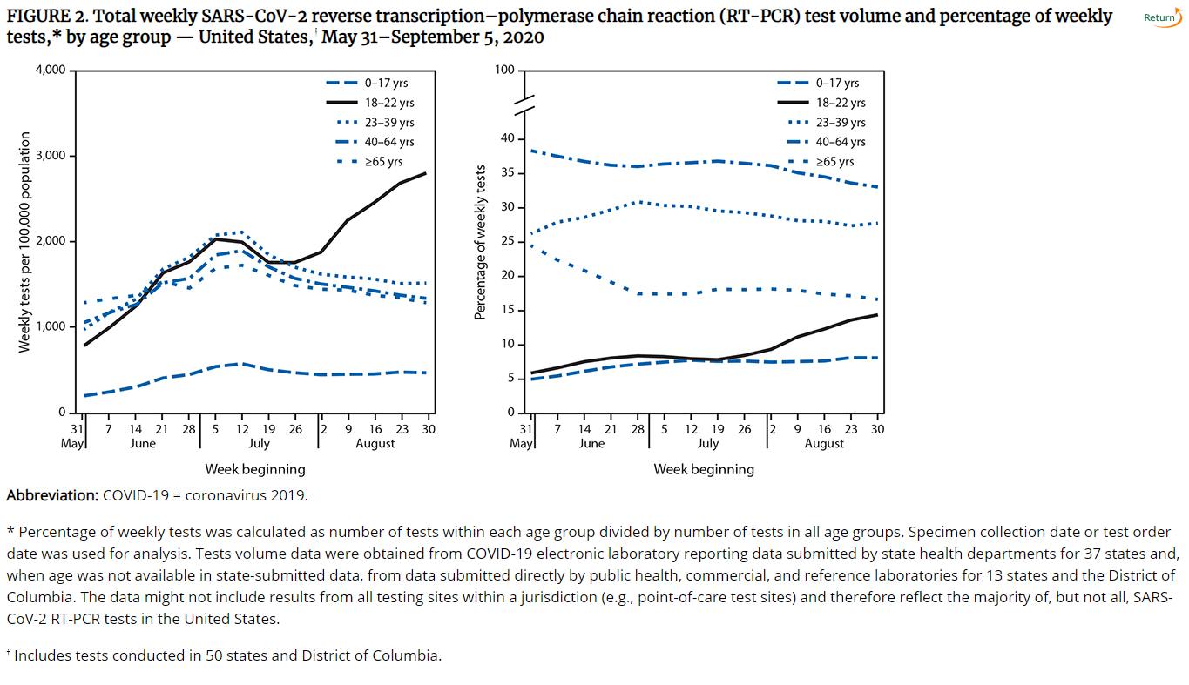
May 31-Sept. 5, 2020
Source: CDC MMWR. https://www.cdc.gov/mmwr/volumes/69/wr/mm6939e4.htm?s_cid=mm6939e4_w

Slide 11
“University A”
Source: CDC MMWR. https://www.cdc.gov/mmwr/volumes/69/wr/mm6939e3.htm?s_cid=mm6939e3_w

Slide 12
Student deaths
“If it can happen to a super healthy 19-year-old boy who doesn’t smoke, vape or do drugs, it can happen to anyone.”
— Statement attributed to the mother of Chad Dorrill, Appalachian State student who died after experiencing COVID-19 complications

Slide 13
Latest forecast across the country
Source: CDC

Slide 14
What role will colleges play?
"I am deeply concerned about the fact that Thanksgiving may roll around and we may be sending all sorts of ticking time bombs home.”
—David Paltiel, a public health expert at Yale University and co-author of a study on frequent testing being important, to NPR
Source: https://www.npr.org/2020/10/06/919159473/even-in-covid-hot-spots-many-colleges-arent-aggressively-testing-students

Slide 15
Why should you care?
What you do in a public health situation like this, when you can muddy the water and avoid responsibility for your decisions, is a direct reflection of who you are as a leader.

Slide 16
Leadership, COVID-19 and trust
Photo Credit: Chip Somodevilla via Getty Images

Slide 17
Leadership, COVID-19 and trust

Slide 18
Leadership, COVID-19 and trust
Photo Credit: Le Moyne College

Slide 19
Questions?

Slide 20
Economy
Friday jobs report:
Total nonfarm payroll employment increased 661,000 in September
Number of unemployed persons fell by 1 million to 12.6 million
Source: https://www.bls.gov/news.release/empsit.nr0.htm

Slide 21
Unemployment rate

Slide 22
Key data
The labor force is smaller today than it was in February — 2.3 million more people are not in the labor force but want a job (total 7.2 million).
You’re looking at a higher unemployment rate on a smaller labor participation rate across the board.
Source: BLS (https://www.bls.gov/news.release/empsit.t04.htm)

Slide 23
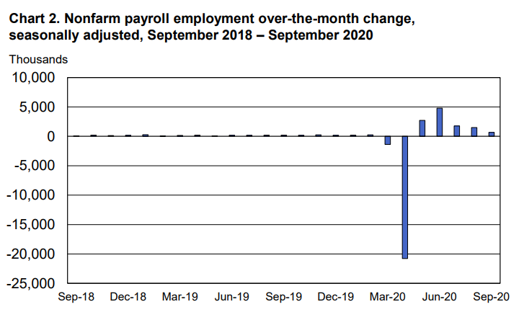
A recovery losing steam?
Source: BLS

Slide 24
How was higher education hit?
Employees on nonfarm payrolls by selected industry sector
Seasonally adjusted, in 1,000s | September 2019 | July 2020 | August 2020 | September 2020 | Change, Aug. 2020 to Sept. 2020
Educational services (private) | 3,791.6 | 3,471.5 | 3,542.2 | 3,473.7 | -68.5
State gov. education | 2,483.2 | 2,269.8 | 2,288.9 | 2,239.5 | -49.4
Source: BLS

Slide 25
Who is hardest hit?
Source: BLS https://www.bls.gov/charts/employment-situation/employment-by-industry-monthly-changes.htm

Slide 26
Long-term unemployment
Source: BLS https://www.bls.gov/charts/employment-situation/unemployed-27-weeks-or-longer-as-a-percent-of-total-unemployed.htm

Slide 27
All of this was before
Disney announced 28,000 layoffs in the U.S. affecting its parks, experiences and products unit. (About two-thirds are said to be part-time workers.)
American Airlines and United Airlines are laying off 31,000 employees combined.

Slide 28
Who lost the most?
White Americans recovered more than half of the jobs they lost between April and February
Black Americans have recovered just over a third
Hispanic Americans have the most to make up to reach pre-pandemic employment levels
A fifth of those between the ages of 20 and 24 lost employment as the pandemic started
Those between the ages of 25 and 34 regained only 43 percent of lost employment
Source: https://www.washingtonpost.com/graphics/2020/business/coronavirus-recession-equality/

Slide 29
Unemployment by educational attainment, civilian population 25+
 | September 2019 | September 2020
Less than high school | 4 | 9.5
High school graduates | 3.3 | 8.6
Some college/associate degree | 2.8 | 8
Bachelor’s or higher | 2 | 4.7
Source: BLS

Slide 30
Unemployment rate by race
 | September 2019 | September 2020
Black | 5.1 | 11.5
Asian | 2.4 | 8.8
White | 3.1 | 6.8
Source: BLS

Slide 31
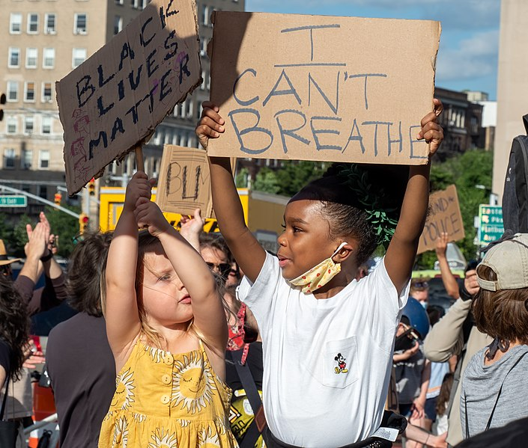
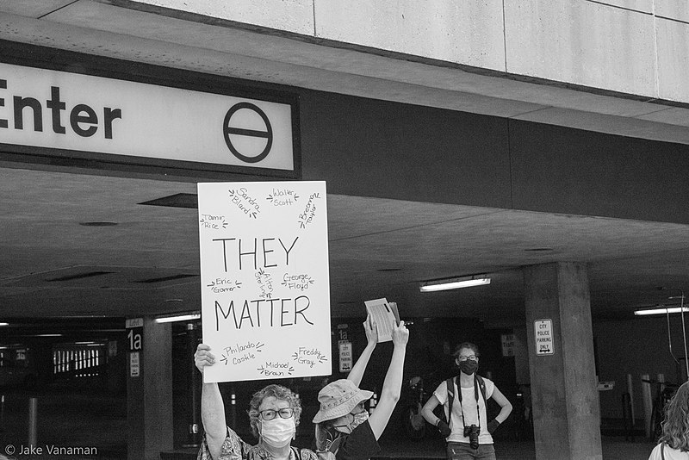
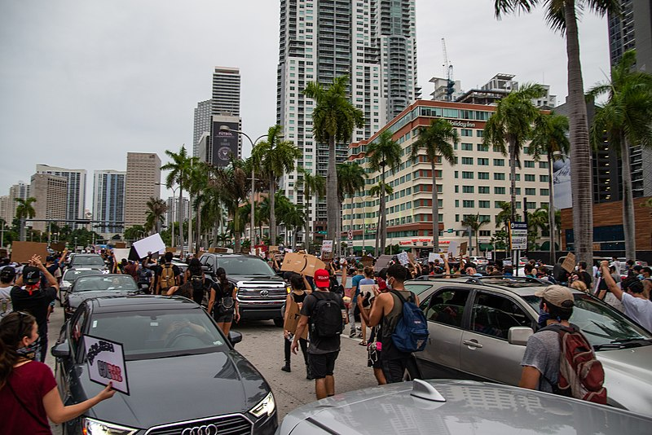
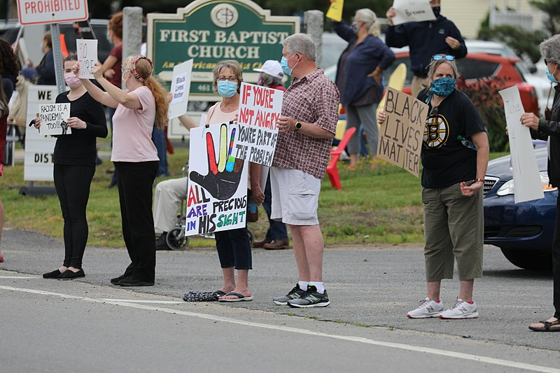
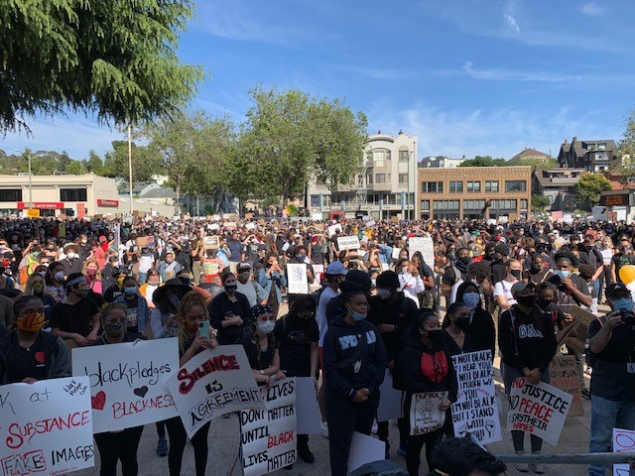
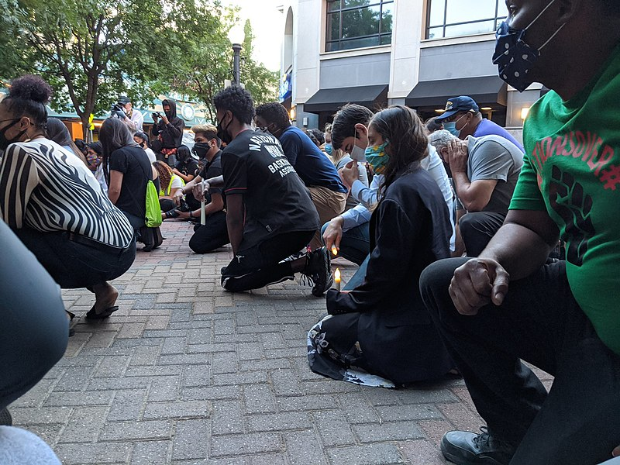
Protesting systemic racism
All images from Wikimedia Commons. Sources (clockwise from top left): Rhododendrites, Jake Vanaman, Rosa Pineda, Mike Shaheen, Guettarda, Rep. Barbara Lee, Victor Grigas, Rep. Josh Harder,

Slide 32
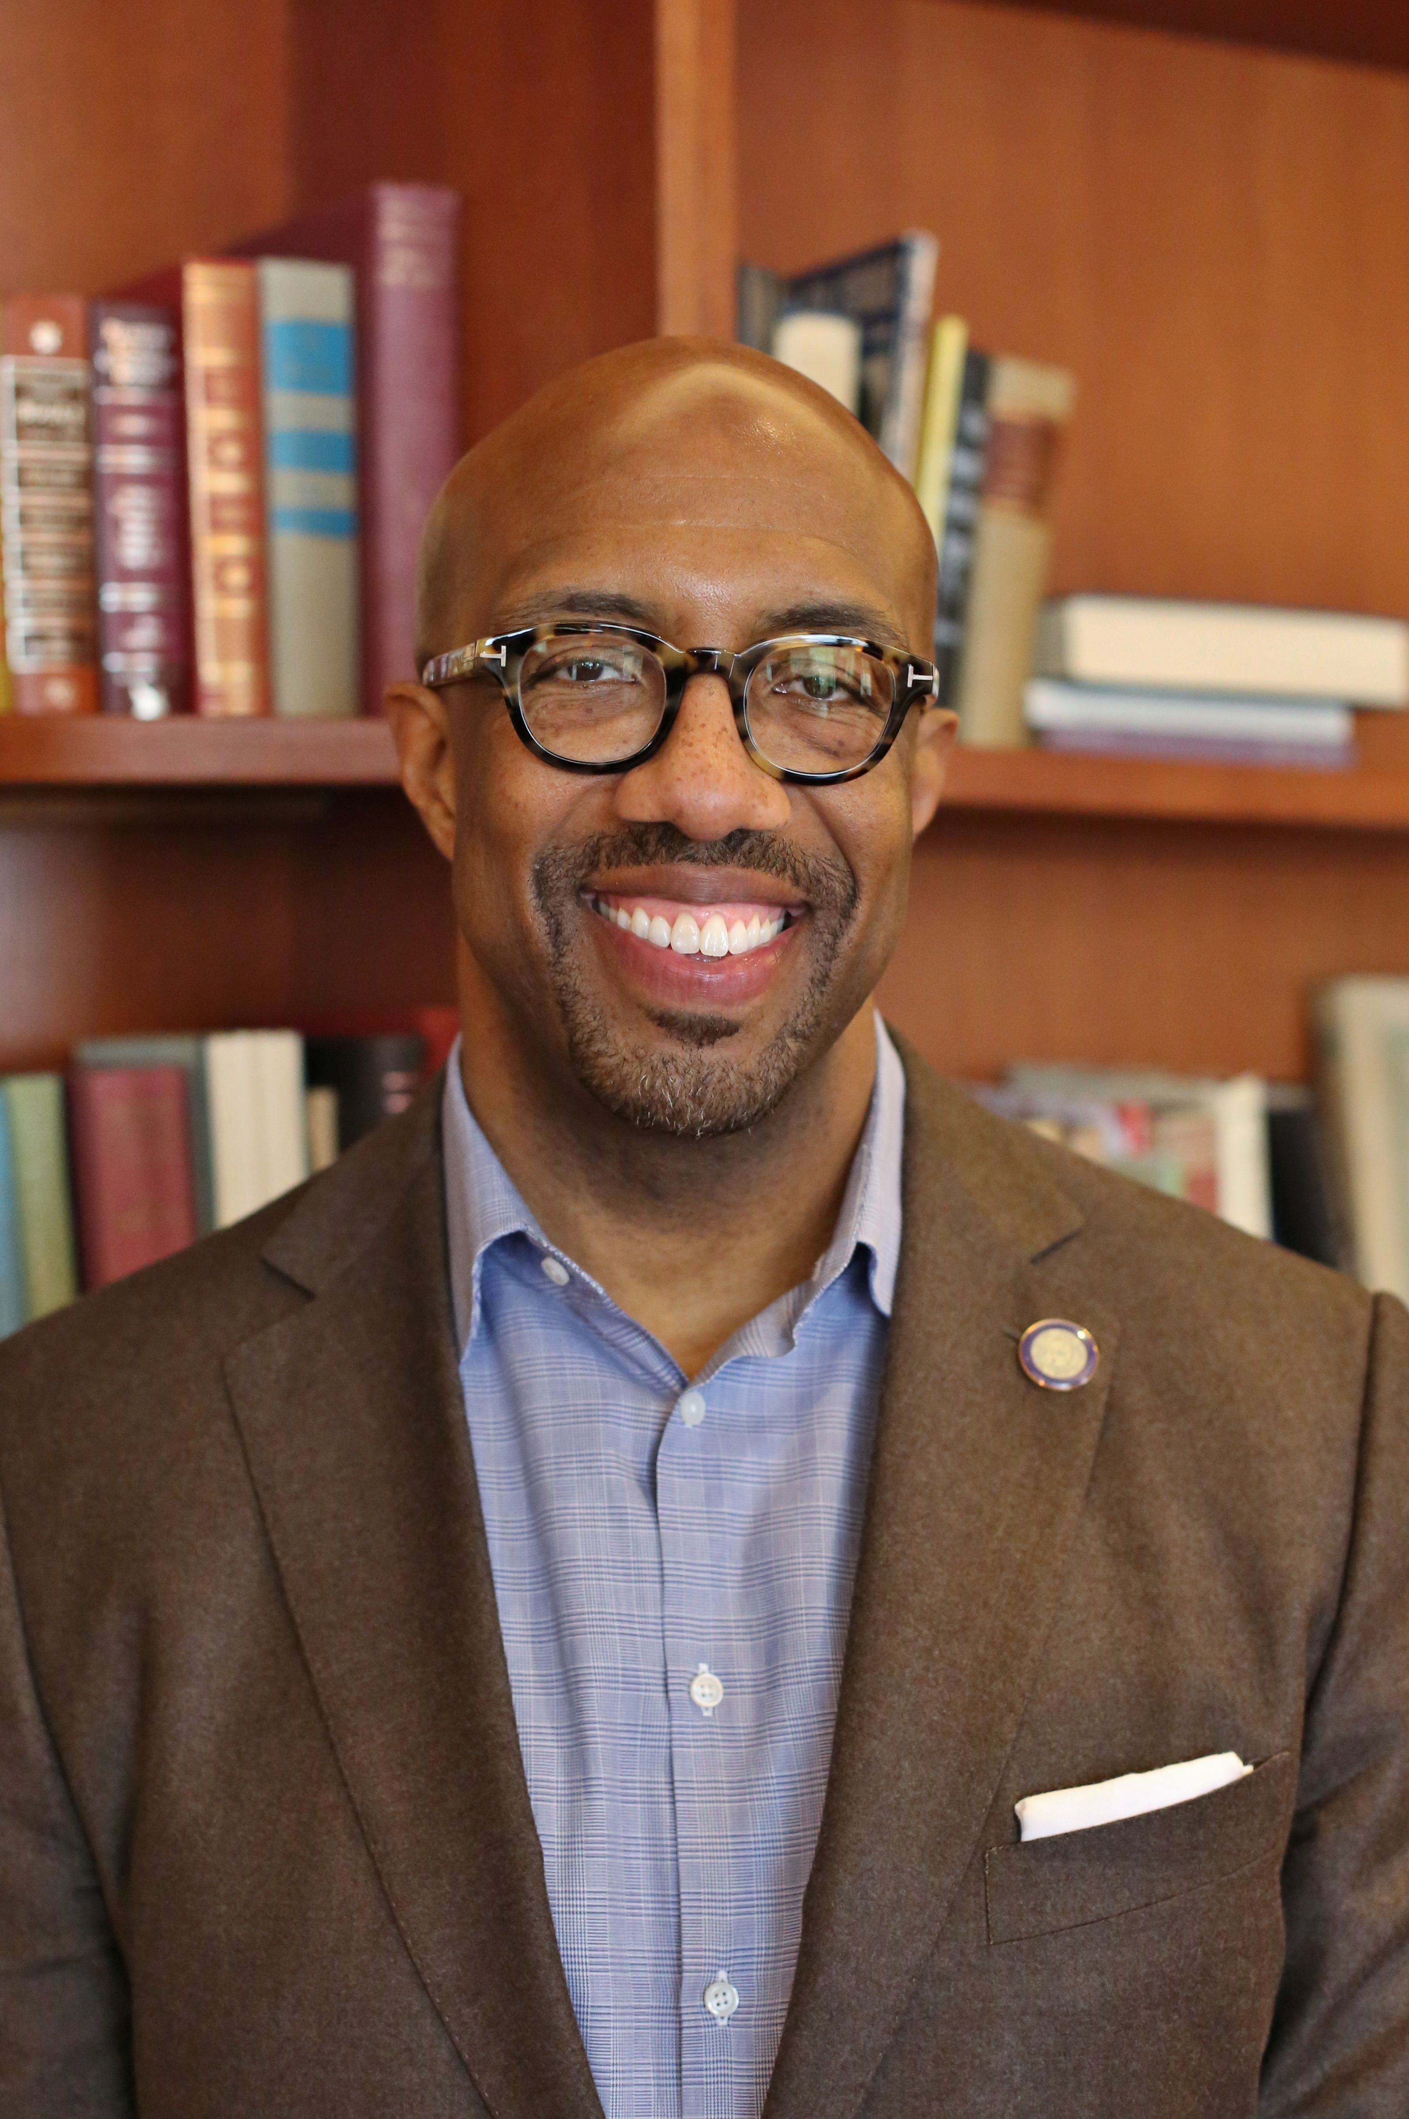
Why it matters for higher ed
“We have to hold ourselves accountable, because every single person that is responsible for this condition of society right now came through our doors.”
— Michael Sorrell, president, Paul Quinn College

Slide 33
Questions?

Slide 34
Key issues specifically for higher education operations
Continued evolution of COVID-19 pandemic
State funding for public institutions
Families’ ability to pay
Delivery methods and pedagogy
Endowments
Dormitories and housing
Enrollment
College budgets

Slide 35
Endowment returns
Brown: 12.1 percent
Dartmouth: 7.6 percent
Harvard: 7.3 percent
Yale: 6.8 percent
Penn: 3.4 percent
University of Washington: 1.1 percent
Duke: 0.7 percent

Slide 36
Dormitories and auxiliary revenue
“While colleges and universities can continue to collect tuition even if students are fully remote, albeit with pressures on pricing, they can only collect auxiliary revenue if students are present to consume services.”
— Debra Roane, vice president at Moody’s Investors Service

Slide 37
Enrollment by institution type
Source: National Student Clearinghouse Research Center

Slide 38
Enrollment by race
Source: National Student Clearinghouse Research Center

Slide 39
Enrollment by age
Source: National Student Clearinghouse Research Center

Slide 40
What don’t we know?
What the virus will do next
What the government will do
Who will win the November election
What students and families will want from colleges and universities
Where the money is coming from
How much can students and families pay
How much will the government kick in
How to best educate students

Slide 41
Your foundation
Mission
Vision
Values

Slide 42
Navigating the short-term
Focus on what you do know
Be realistic about the options available to you
Be honest about likely outcomes
Contingency planning
Broaden your circle

Slide 43
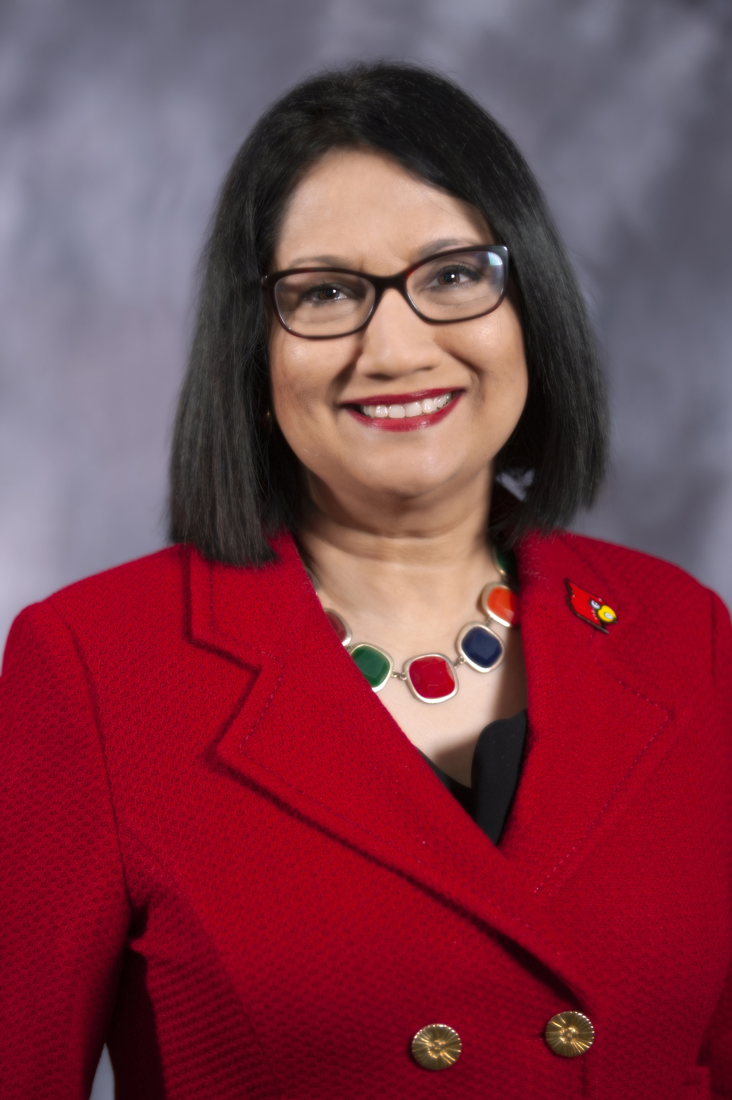
Short-term decisions feed long-term changes
“We’re forced to zoom in on the events of today and the crises of today. But if I don’t consciously carve out time to zoom out and take a look at what is happening, I think I will not be serving the university well.”
— Neeli Bendapudi, president of the University of Louisville

Slide 44
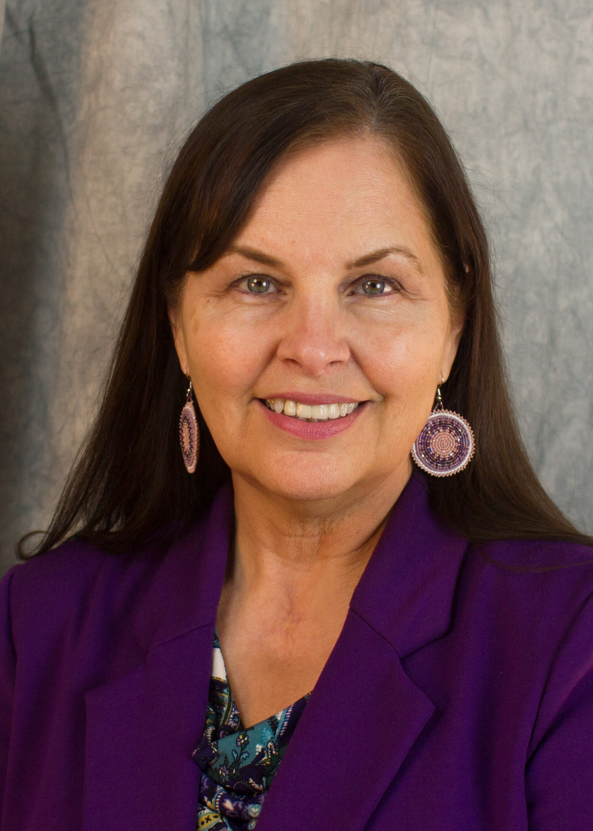
Trust
“We’re in this together. How do we protect our employees, our students and ourselves?”
—Cynthia Lindquist, president of Cankdeska Cikana Community College

Slide 45
Questions?

Slide 46
Thank you
Many thanks for listening and asking your questions.
Please consider reading the report.
Reach out with feedback or further questions: rick.seltzer@insidehighered.com

