Slide 1
Leadership in Changing Times:
Supporting Students and Institutions With Creativity and Efficiency
An Inside Higher Ed webcast
Tuesday, March 26, 2019
2 p.m. Eastern

Slide 2
Presenters
Scott Jaschik, editor, Inside Higher Ed, scott.jaschik@insidehighered.com
Doug Lederman, editor, Inside Higher Ed, doug.lederman@insidehighered.com

Slide 3
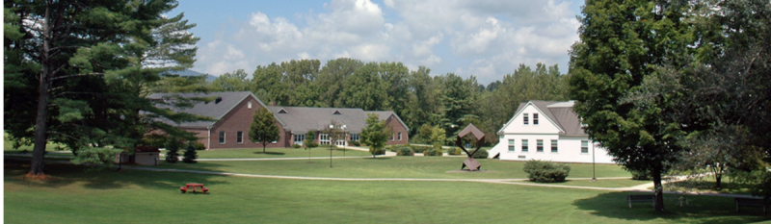

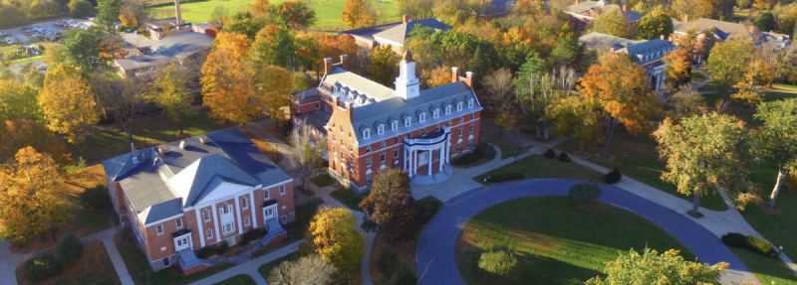
The Threat of Closure

Slide 4
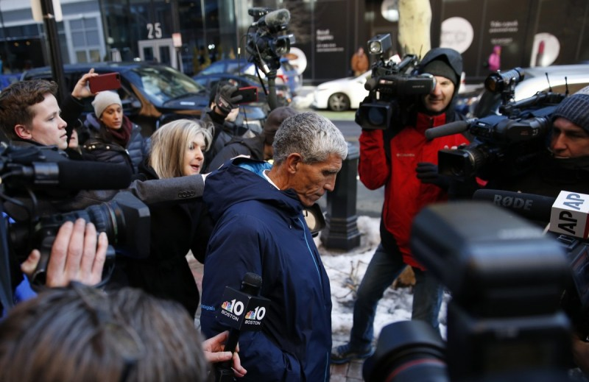
The Danger of Scandal
--Getty Images

Slide 5
Leadership in Higher Ed
The traditional model
Failings of the traditional model
The new skill set
Not just presidents and provosts
Boards
Diversity

Slide 6
Three Connected Issues
Recruitment
Retention/Completion
Pricing

Slide 7

Recruitment I: Strategic Shrinking
--Allegheny College

Slide 8
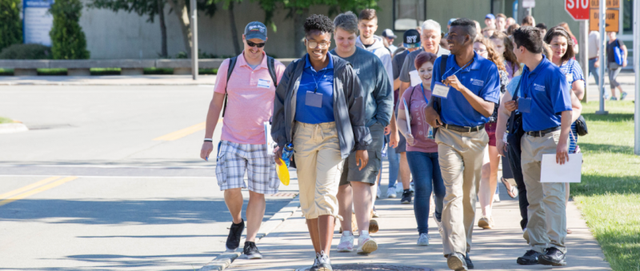
Enrollment II:
Admissions Efficiencies
--Orientation at SUNY Fredonia

Slide 9
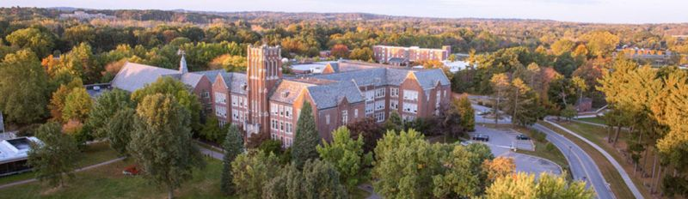
Enrollment III: A Program Focus
--Nazareth College

Slide 10

Enrollment IV:
Adjusting Aid Formulas
--Getty Images

Slide 11
Enrollment V: International
Franklin & Marshall International Admissions
 | Applications | Deposits for Fall
2018 | 2,029 | 138
2017 | 1,825 | 89
2016 | 1,731 | 102
2015 | 1,741 | 88

Slide 12
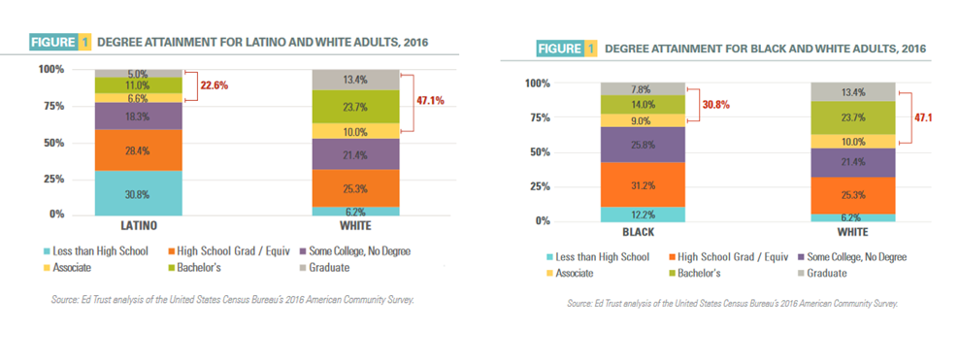
Retention/Completion I:
Confronting Equity Gaps
--Education Trust

Slide 13

Retention/Completion II:
Incentives for Completion

Slide 14
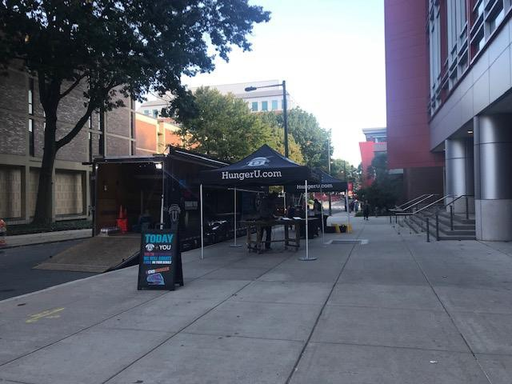
Retention/Completion III:
Focusing on Poverty

Slide 15

Retention/Completion IV:
Going After Dropouts

Slide 16

Pricing I: Free (and Faux Free)
--iStock

Slide 17
Pricing II: Beyond Tuition
Out in four
Minimizing loans
Books and materials

Slide 18
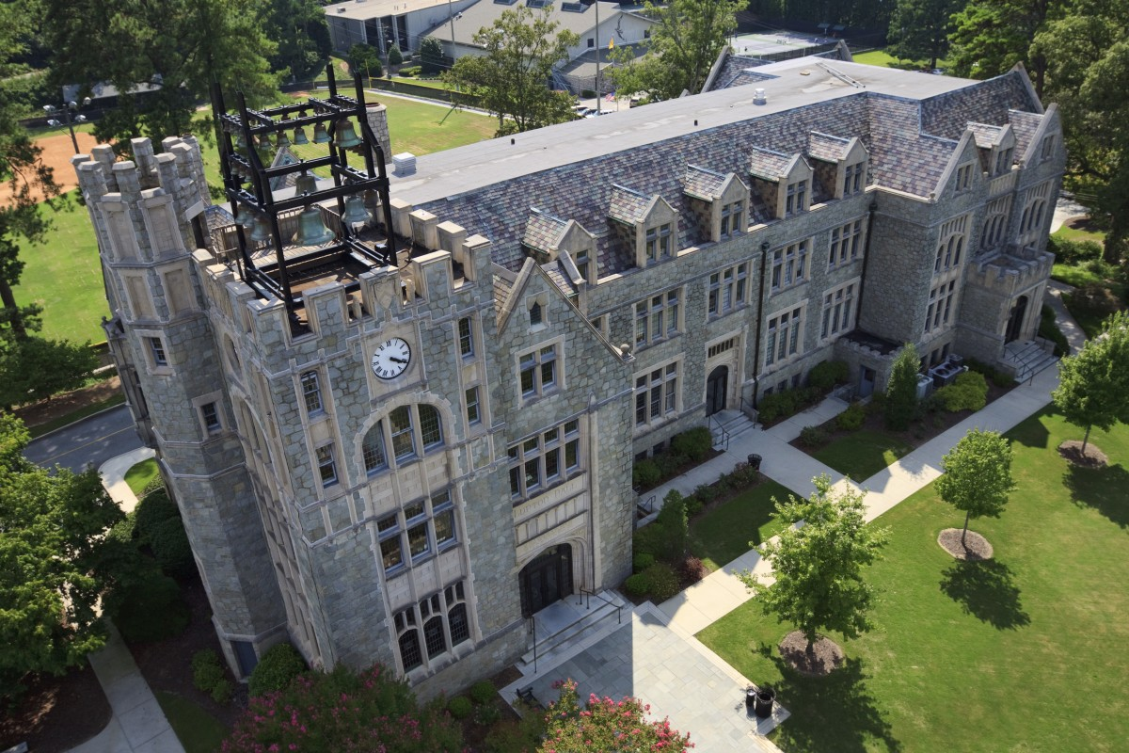
Pricing III: Matching the Publics
--Oglethorpe University

Slide 19

Pricing IV: Resets

Slide 20
Q&A
Your questions
Your ideas for future coverage

Slide 21

With Thanks ….

