Slide 1
Why Metrics Matter
An Inside Higher Ed webcast
April 23, 2019
2 p.m. Eastern

Slide 2
Presenters
Scott Jaschik, editor, Inside Higher Ed, scott.jaschik@insidehighered.com
Doug Lederman, editor, Inside Higher Ed, doug.lederman@insidehighered.com

Slide 3
Three Quotes
“What gets measured gets done.”
“Just because you can measure it doesn’t mean you should.”
“Garbage in, garbage out.”

Slide 4
How Metrics Are Used
To improve teaching and learning
To improve completion / retention
To promote accountability
To promote equity
To help students and families make informed decisions
Several of the above

Slide 5

Case Studies and Their Lessons
-- --iStock

Slide 6
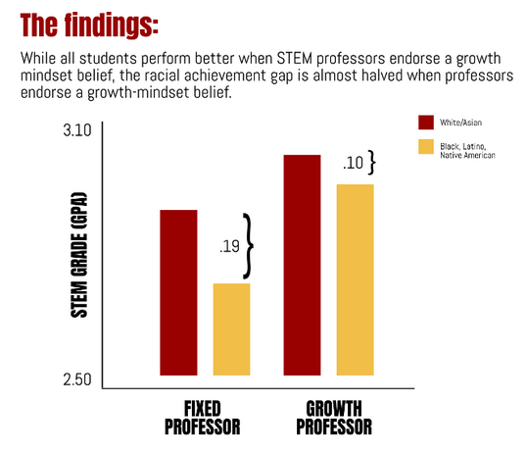
Impact of Faculty Attitudes

Slide 7
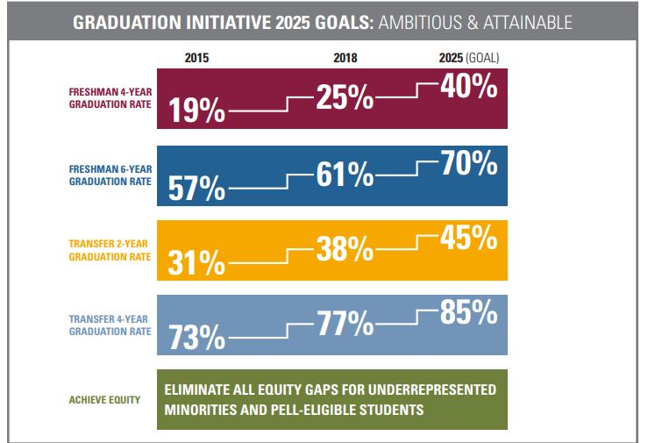
Tracking Graduation Rates: I
--California State University System

Slide 8
Tracking Graduation Rates: II
--University System of Maryland
 | 2-Year Retention | 4-Year Retention | 4-Year Graduation | 6-Year Graduation
Coppin State | 61% | 38% | 9% | 17%
Frostburg U | 76% | 56% | 27% | 47%
U Maryland College Park | 95% | 87% | 66% | 85%

Slide 9
The Federal Graduation Rate
What it is
Why everyone hates it (and yet it survives)
Alternatives

Slide 10

How to Help Part-Time Students

Slide 11
Undermatching
How the idea was discovered
How it is used in affirmative action debates
How it may have led to unintended consequences

Slide 12
The Liberal Arts and Gen Ed
Counting majors
Salaries
Life outcomes

Slide 13

Faux Social Mobility?

Slide 14
Q&A
Your questions
Your ideas for future coverage

Slide 15

With Thanks ….

