Slide 1
The Next Generation of Students
An Inside Higher Ed webcast
Tuesday, October 23 at 2 p.m. Eastern

Slide 2
Presenters
Scott Jaschik, editor, Inside Higher Ed, scott.jaschik@insidehighered.com
Doug Lederman, editor, Inside Higher Ed, doug.lederman@insidehighered.com

Slide 3
Uncertain Numbers: I
--National Student Clearinghouse

Slide 4
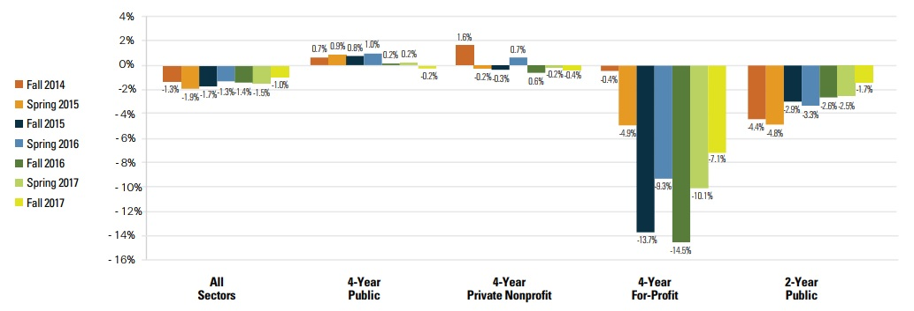
Uncertain Numbers: II
--National Student Clearinghouse

Slide 5
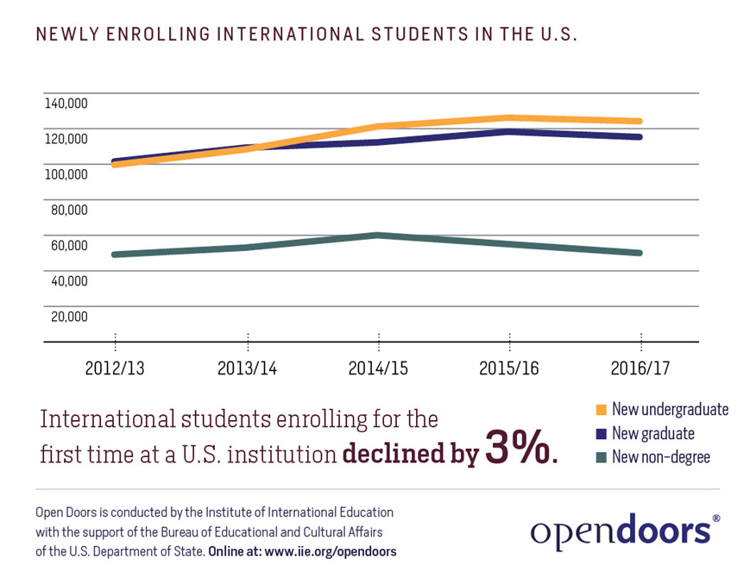
Uncertain Numbers: III
-
-Institute of International Education

Slide 6
Uncertain Numbers: IV

Slide 7
Who Are the Next Generation? How Will They Be Taught?
An important note about perspective …

Slide 8
Who Are They?
Not just white
Not just traditional age
Not just those who went to good high schools
Not just those who can afford to pay

Slide 9
How Will They Learn?
Part time
Living remotely
Learning online
Learning via competency
Not just degrees
Career focus

Slide 10
Appreciating Difference: I
--Excelencia in Education

Slide 11
Appreciating Difference: II

Slide 12
Why the Harvard Case Doesn’t Matter, and Why It Does

Slide 13
Online Options Are No Panacea

Slide 14
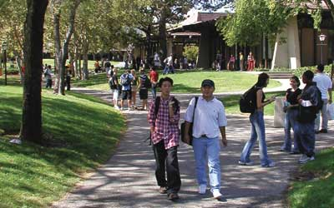
Centrality of Community Colleges
--Foothill College

Slide 15
Admissions Policies That Matter
Testing
Application fees
Where colleges recruit
Promotional strategies
Transfer

Slide 16
Avoiding Melt

Slide 17
Remediation
Placement
Before or alongside other courses
New approaches
Paying for the instruction

Slide 18
Full-Time vs. Part-Time
Why many programs focus on encouraging full-time enrollment
Why many students will never enroll that way
Strategies for part-timers

Slide 19
Summer
Regular course offerings
Strategies to use summer

Slide 20
Focusing on First Gen

Slide 21
Federal and State Policies
Aid eligibility
For-profit higher education
Work-study
Programs for parents

Slide 22
Relentless Focus on Graduation

Slide 23
Q&A
Your questions
Your ideas for future survey questions

Slide 24
With Thanks …

