Slide 1
New Strategies for Online Education
An Inside Higher Ed webcast
Tuesday, April 17
2 p.m. Eastern

Slide 2
Presenters
Scott Jaschik, editor, Inside Higher Ed, scott.jaschik@insidehighered.com
Doug Lederman, editor, Inside Higher Ed, doug.lederman@insidehighered.com

Slide 3
Evolution of Distance Education

Slide 4
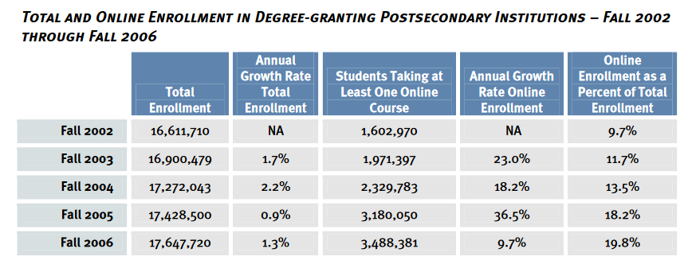
Significant Growth: Early 2000s
Source: Online Learning Consortium

Slide 5
The MOOC Diversion

Slide 6
Recent Enrollment Trends - I

Slide 7
Recent Enrollment Trends -- II

Slide 8
Recent Enrollment Trends -- III
 | 2012 | 2013 | 2014 | 2015 | 2016
All students | 20,511,849 | 20,454,336 | 20,637,987 | 20,536,231 | 20,464,608
Proportion in at least one distance course | 24.8% | 25.9% | 27.9% | 29.2% | 31%%
Enrolled exclusively in distance courses | 2,310,056 | 2,427,504 | 2,804,867 | 2,873,144 | 2,983,075

Slide 9
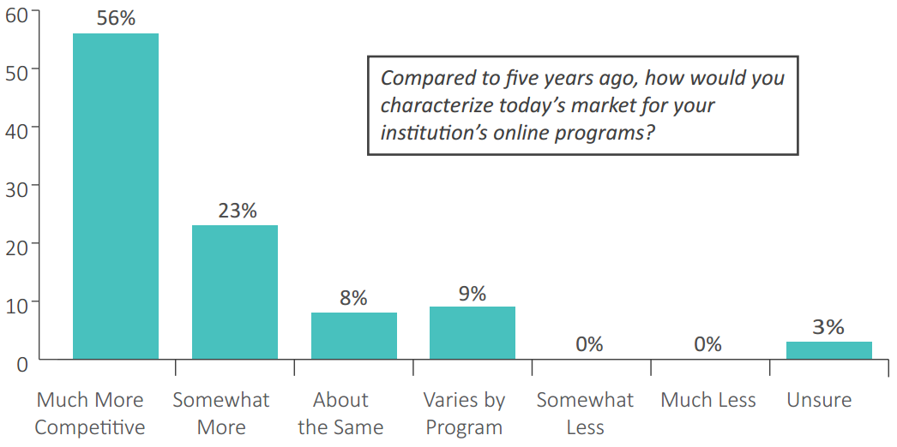
Recent Enrollment Trends -- IV
--Quality Matters

Slide 10
Some Key Distinctions
Traditional undergrad vs. everything else
For-profit vs. nonprofit
Fully online vs. hybrid
Physical location of students
Prestige vs. practicality

Slide 11
Strategy: The Niche

Slide 12
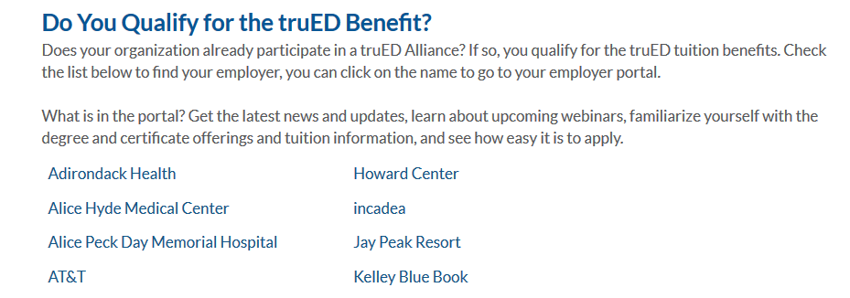
Strategy: Corporate Partners

Slide 13
Strategy: Finding Scale

Slide 14
Strategy: CBE and New Models

Slide 15
Strategy: Go Big

Slide 16
Strategy: MOOC-Inspired

Slide 17
Strategy: Close Access Gaps

Slide 18
Strategy: MicroMasters

Slide 19
Strategy: Hybrid, Hybrid, Hybrid
Courses for traditional residential students
“Low res” programs
Cohorts
Popularity of local online providers

Slide 20
Strategy: Cut Tuition Rates

Slide 21
Strategies That Don’t Work
Believing you can get rich quick
Minimizing faculty role/input
Forgetting your mission
Cutting corners
Overpromising

Slide 22
Challenge: Faculty Skepticism

Slide 23
Challenge: What Leaders Know (or Don’t Know)
Educational issues
Financial issues
Partnership issues

Slide 24
Challenge: Outdated Rules

Slide 25
Q&A
Your questions
Suggestions for future coverage

Slide 26
With Thanks….

