Slide 1
How the Economy Is Changing Higher Education Management
An Inside Higher Ed webcast Monday, March 30 2 p.m. Eastern
Notes:
Excited to welcome all of you members of our “insider” program for a special advance look at our 2020 survey of presidents…
Want to thank you very much for joining us, and more importantly for supporting Inside Higher Ed and its journalism with your membership.
This is one of the benefits – along with discounts on reports and events, among other things – that we hope make this a valuable thing to do.

Slide 2
Presenters
Scott Jaschik, editor, Inside Higher Ed, scott.jaschik@insidehighered.com
Doug Lederman, editor, Inside Higher Ed, doug.lederman@insidehighered.com
Notes:
Joined today by Scott …

Slide 3
Coronavirus

Slide 4
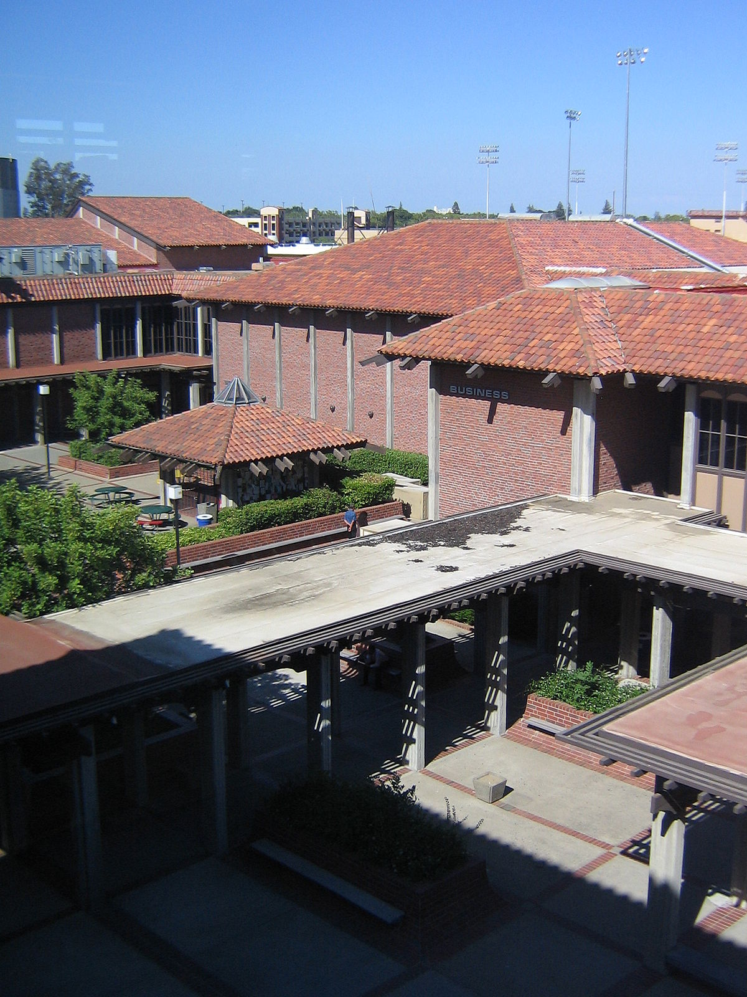
The Financial Management of Colleges and Universities - I
Community colleges
Public four-year regional colleges
Small private colleges
This Photo by Unknown Author is licensed under CC BY

Slide 5
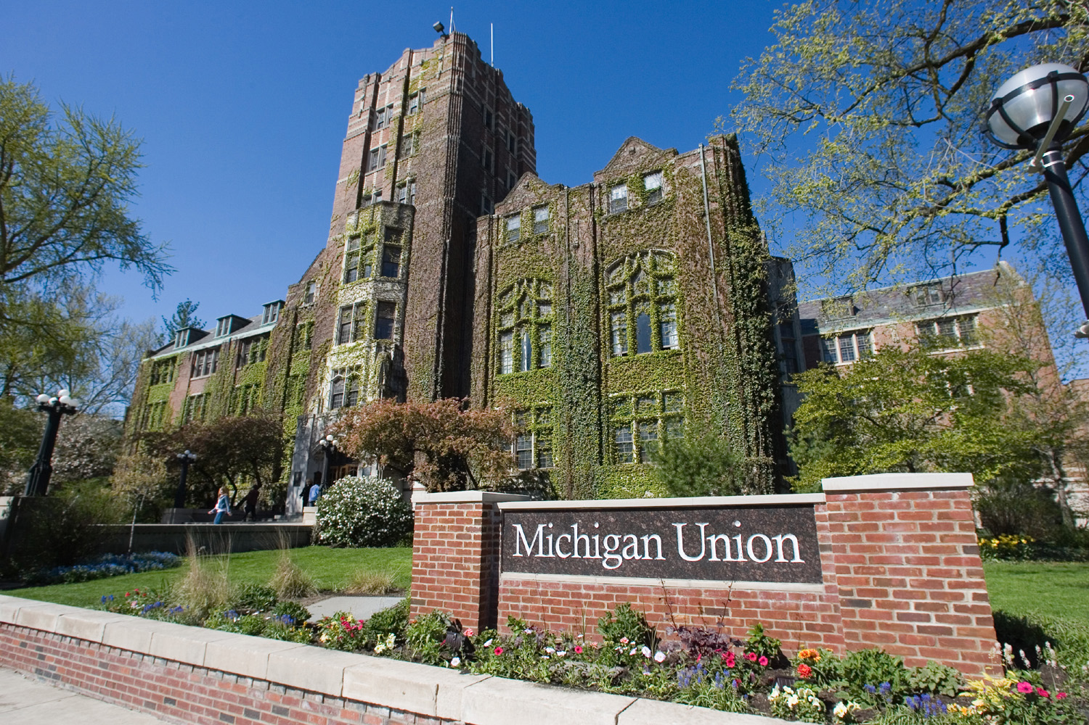
The Financial Management of Colleges and Universities -- II
Flagship public universities
Notes:
“I am confident my institution will be financially stable over the next 5/10 years,”

Slide 6
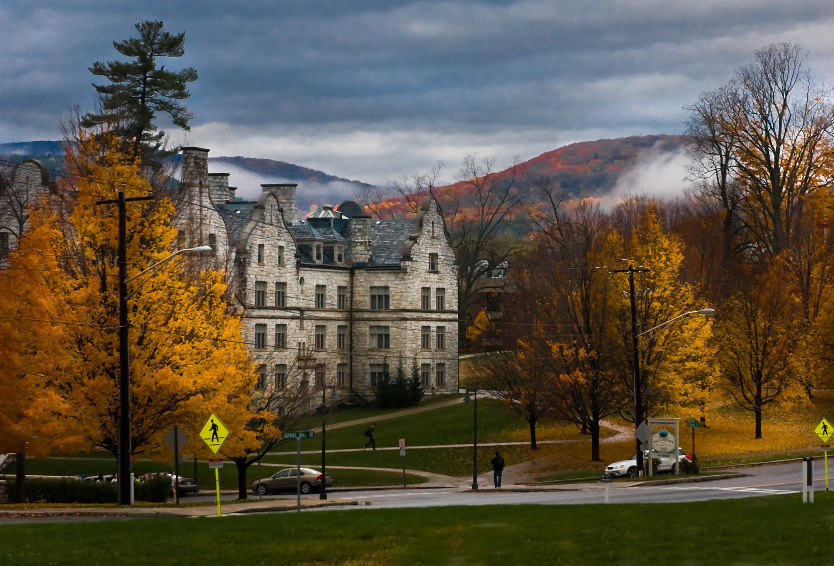
The Financial Management of Colleges and Universities -- III
Highly selective private universities
Highly selective private liberal arts colleges

Slide 7
HR
Beyond forms…
Building a creative workforce
Promoting diversity
Dealing with problems

Slide 8
Student Information Systems -- I
Admissions

Slide 9
Student Information Systems -- II
Financial aid

Slide 10
Student Information Systems -- III
Academics
The link between academics and finances

Slide 11
Questions and Answers
Your questions
Suggestions for future coverage
Notes:
Survey conducted in Jan/early Feb. – wonder if answers would be different now?

Slide 12
With Thanks

