Slide 1
Ask Me Anything
Data and AI
21 July 2021
Bob DiMaggio, Vice President of Product
Traci Roble, Director of Partner Success
Dr. Mark Voortman, Data Science Architect
Notes:
IHE – Todd Blume

Slide 2
Welcome
Notes:
IHE - Todd

Slide 3











Who is Othot?
Othot’s advanced analytics guide colleges and universities to make informed decisions throughout the entire student-to-alumni lifecycle by better understanding each individual.
Notes:
IHE - Todd

Slide 4



Today’s Speakers
Bob DiMaggio
Traci Roble
Dr. Mark Voortman
Vice President of Product, Othot
Director of Partner Success, Othot
Data Science Architect, Othot
Professor,
Point Park University
Notes:
IHE - Todd

Slide 5
It All Starts with Data

Slide 6
“Data collection is a journey: start with what you have, add as you go.”
- Dr. Mark Voortman
Notes:
Traci

Slide 7
1
Why
Data?
3
Where is
The Data?
2
Data
Mindset
Notes:
Traci discusses topics

Slide 8
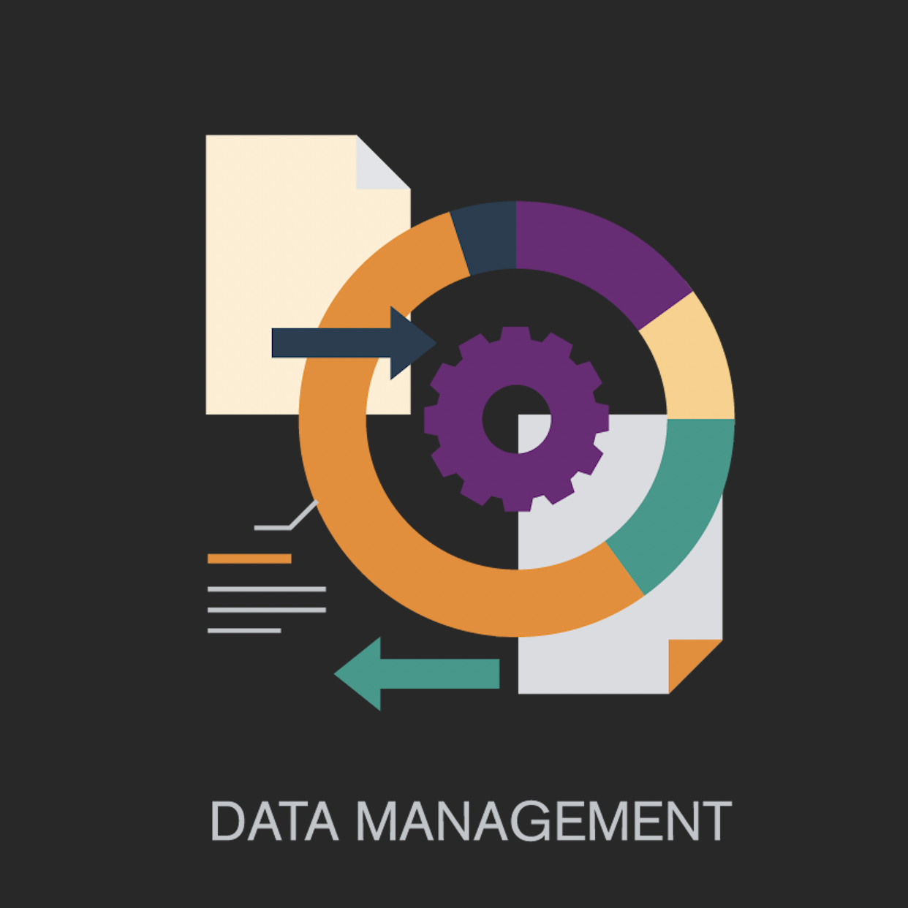
Why Data?
“Garbage-in garbage-out”
“Data is the new oil of the digital economy”
Blockbuster vs Netflix (data = asset)
Amazon product recommendations
Othot recommends student related actions
Do you have a data culture yet?
Notes:
Mark

Slide 9
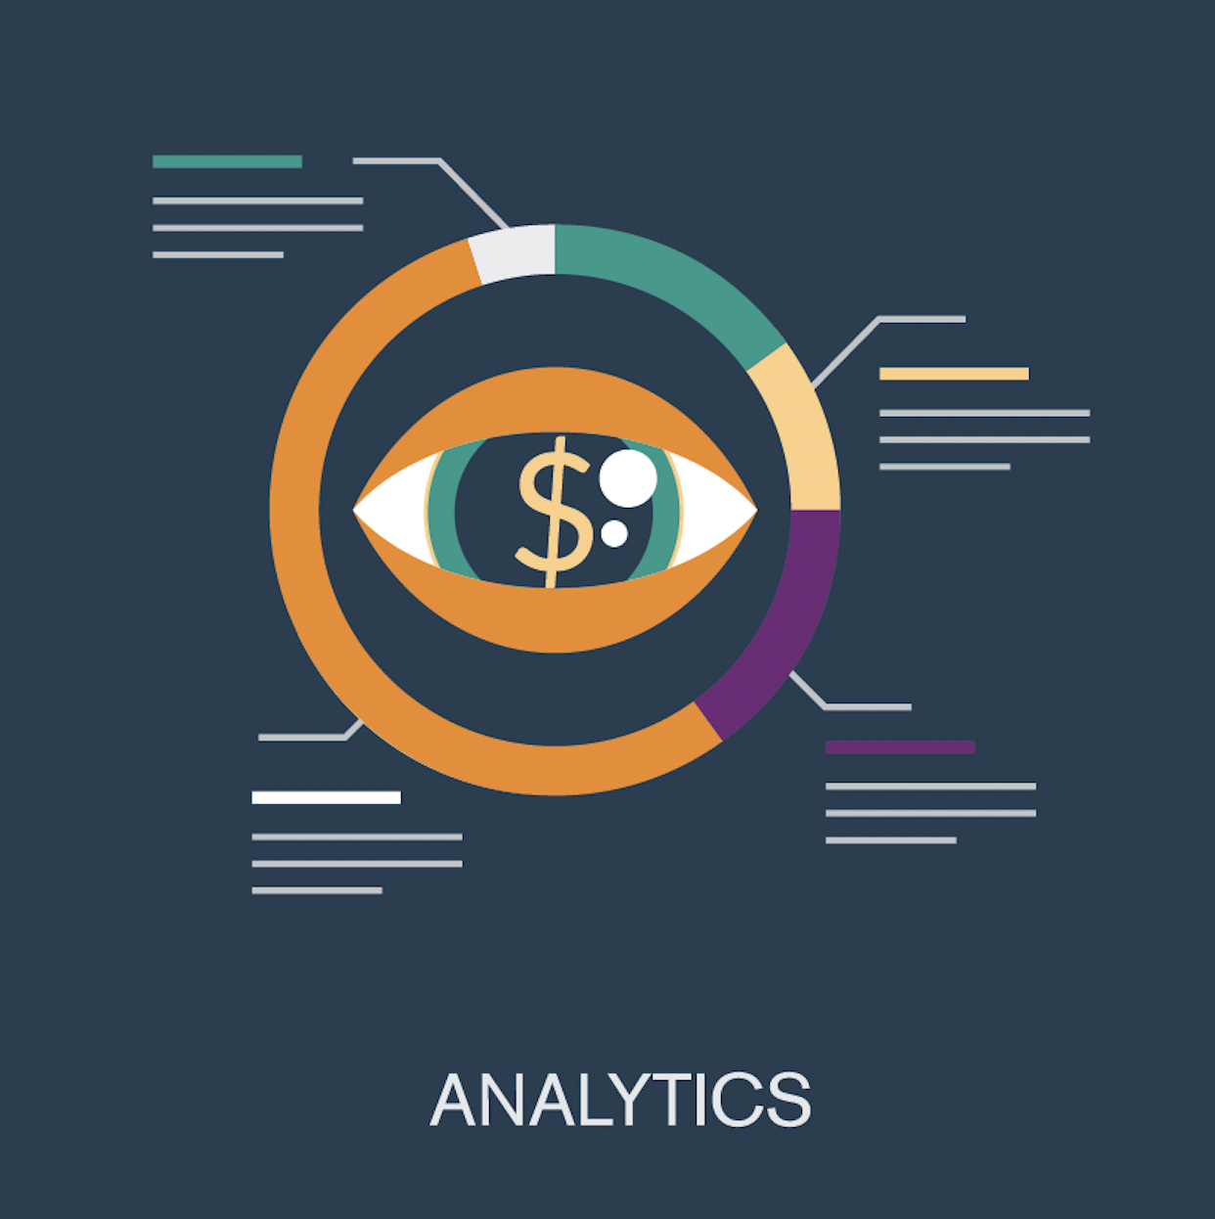

Data Drives Model Performance
BAD
BAD
BAD
Even the best models can’t fix poor data
Additional key points:
Bad or little data negatively impacts decisions
Bad or little data is usually still better than no data
Start investing in data sooner rather than later (asset)
Model centric approach => data centric approach (Andrew Ng)
Investing in data (asset)
results in better models
results in better decisions
Notes:
Mark

Slide 10
1
Why
Data?
3
Where is
the Data?
2
Data
Mindset
Notes:
Mark What we’ll be covering today

Slide 11
Look at Data as a Keystone Habit
Keystone habits can be defined as “small changes or habits that people introduce into their routines that unintentionally carry over into other aspects of their lives” [Charles Duhigg in The Power of Habit]
For example, better sleep leads to more exercise and eating healthier
Similarly, an organization focused on data will improve many processes and decisions
Some examples
  Data can be used to justify policies or investments​
  Collecting detailed data on campus visits can be used to make improvements to the process​
  It enables the use of machine learning for a variety of purposes​
  It may be possible to repurpose data for future decision making, modeling, etc.​
  Relevant data can be shared or compared more easily across the organization​
  Really, any decision process will benefit from additional data
Notes:
Mark

Slide 12
Some Investments may be Required
What data are you currently collecting?
What additional data can you collect?
What infrastructure is required to collect additional data?
Can you consolidate all the data in one place?
The payoff may not be immediate, but postponing should not be an option (asset)
Can't collect data after the fact!!
Notes:
Traci

Slide 13
Obstacles to Data Collection
It can be difficult to collect data consistently
  E.g., data entry problems: is all data entered, is the data entered in the same way, etc.
  Use systems that allow data to be exported
Sometimes transactional data is hard to obtain, even though it is preferred
  Aggregate data can be derived but the reverse is not possible
  Transactional data enables feature engineering (which can be challenging without help)
Data should not be removed or replaced in most cases
  For example, in enrollment we see partners remove aid when a students does not enroll
  This can adversely affect modeling (we have systems in place as safeguards)
It may be as much a people problem as a technical problem
  May need to create awareness about data collection policies and initiatives
Notes:
Traci

Slide 14
1
Why
Data?
2
Data
Mindset
3
Where is
the Data?
Notes:
Traci

Slide 15
After the Why, Now the What and Where of Data
What
Personal data
Demographic data
Behavioral data
Interventional data
Where
SIS
CRM
LMS
…
We can help prepare data!
Notes:
Traci

Slide 16
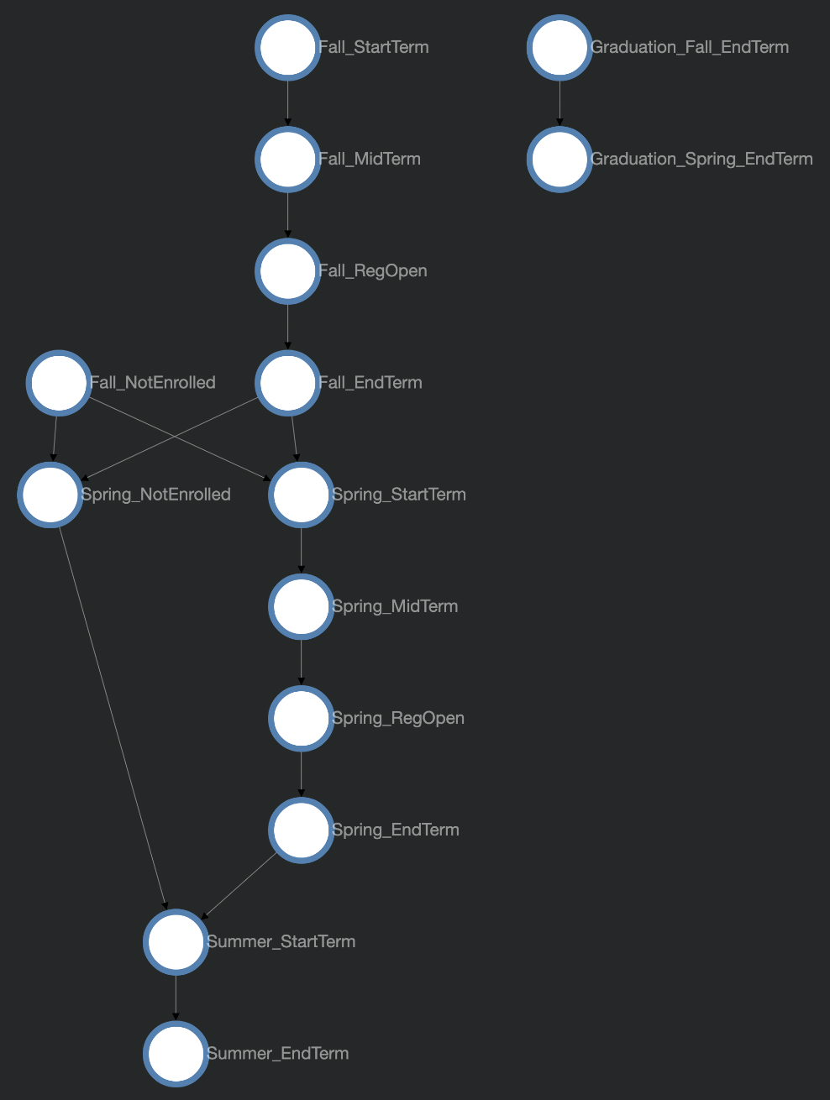
Data Lifecycle
Partner example on the right
Use different data for different points in time
  Include all relevant records at that time
  Include all relevant variables at that time
Models are tailored to data at that point
Different insights and actions may apply
Notes:
Traci

Slide 17
Categories of Data
Easy
Admissions Data
Grades and Academics
Finances
Academic Career Choices
Academic Related Behavior
Campus Engagement Behaviors
Job Success Related Behaviors
Health and Wellness related behaviors
IMPORTANT
Try to collect some data in each category
Hard
Notes:
Traci

Slide 18

Goal: Build Comprehensive Student Profiles for Advanced Analytics
Admissions Data
Academic Career Choices
Grades and Academics
Academic Related Behavior
Data-Driven Profiles
Finances
Campus Engagement Behaviors
Notes:
Traci

Slide 19
Introduction to Artificial Intelligence

Slide 20
1
What is AI?
3
How does
AI Work?
2
Why AI?
Notes:
Mark

Slide 21

Terminology (Venn Diagram to Follow)
Machine Learning (ML) is the study of computer algorithms that improve automatically through experience and by the use of data.
Artificial Intelligence (AI) leverages computers and machines to mimic the problem-solving and decision-making capabilities of the human mind.
Data Science (DS) is an interdisciplinary field that uses scientific methods, processes, algorithms and systems to extract knowledge and insights from structured and unstructured data and apply knowledge and actionable insights from data across a broad range of application domains.
Source: Wikipedia
Notes:
Mark

Slide 22
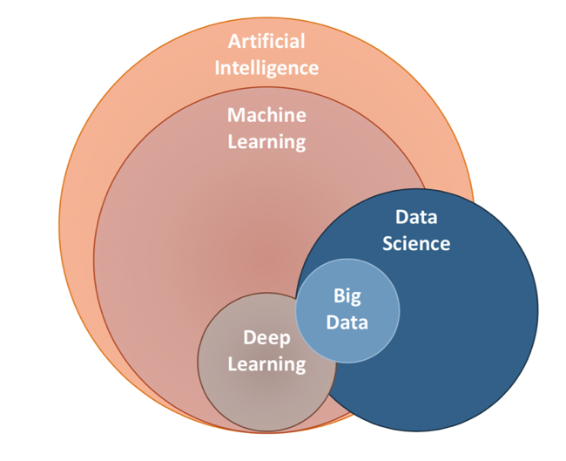
ML vs AI vs DS
Image source: https://ai.plainenglish.io/data-science-vs-artificial-intelligence-vs-machine-learning-vs-deep-learning-50d3718d51e5

Slide 23
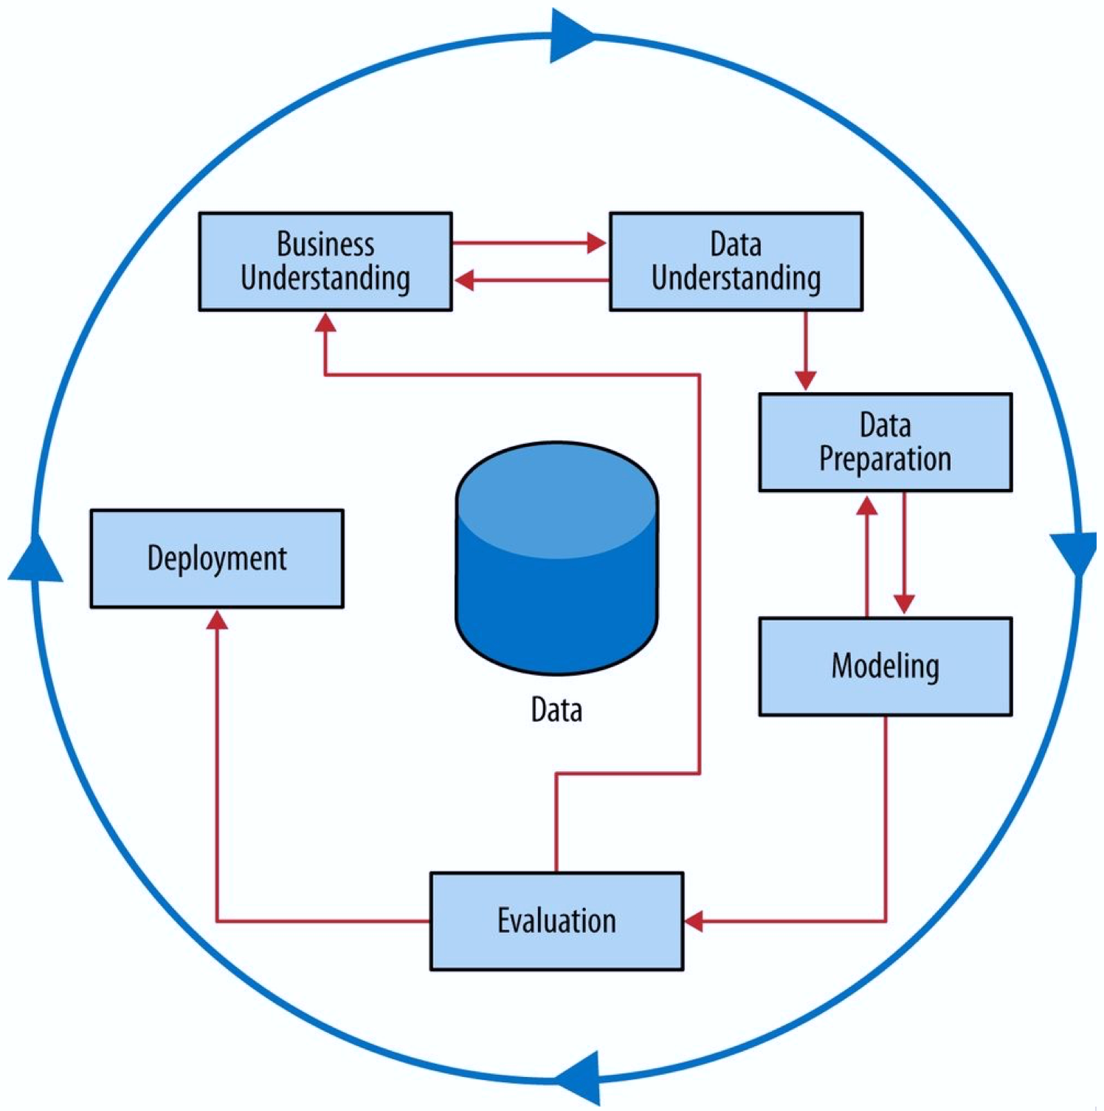
Cross-industry standard process for data mining (CRISP-DM)
There is a whole process to use AI to drive results
Data plays a critical role
All steps are important
Image source: Data Science for Business – Provost & Fawcett

Slide 24
1
What is AI?
3
How does
AI Work?
2
Why AI?
Notes:
What we’ll be covering today

Slide 25


Why Artificial Intelligence?
Enabled by technological developments
  The availability of much more computational power
  The significantly increased collection of data
Data + AI/ML allows to
  Quantify qualitative trends
  Base decision on data (evidence) instead of "gut"
  Find patterns that may otherwise be hidden or go unnoticed
  Customize predictions to the individual

Slide 26
The Power of AI and ML
Historical Data + Learning Algorithm = Predictions/Insights
Induction or generalization: the sun rose every day in the past ...
Focused on the individual (more so than statistics)
Different ways to structure problems
  Supervised (specific target variable)
    Classification: predict class from features
    Regression: predict number from features
  Unsupervised (exploratory)
    Clustering: group instances based on features

Slide 27





Types of Questions That Can be Answered
Commercial
Leaders:
How can we
make it happen?
VALUE
What will
happen?
Prescriptive
Analytics
Why did
it happen?
Predictive
Analytics
What
happened?
Diagnostic
Analytics
Descriptive
Analytics
Hindsight
Insight
Foresight
Gartner Analytics Value Escalator
www.gartner.com
DIFFICULTY

Slide 28
1
What is AI?
2
Why AI?
3
How does
AI Work?
Notes:
What we’ll be covering today

Slide 29
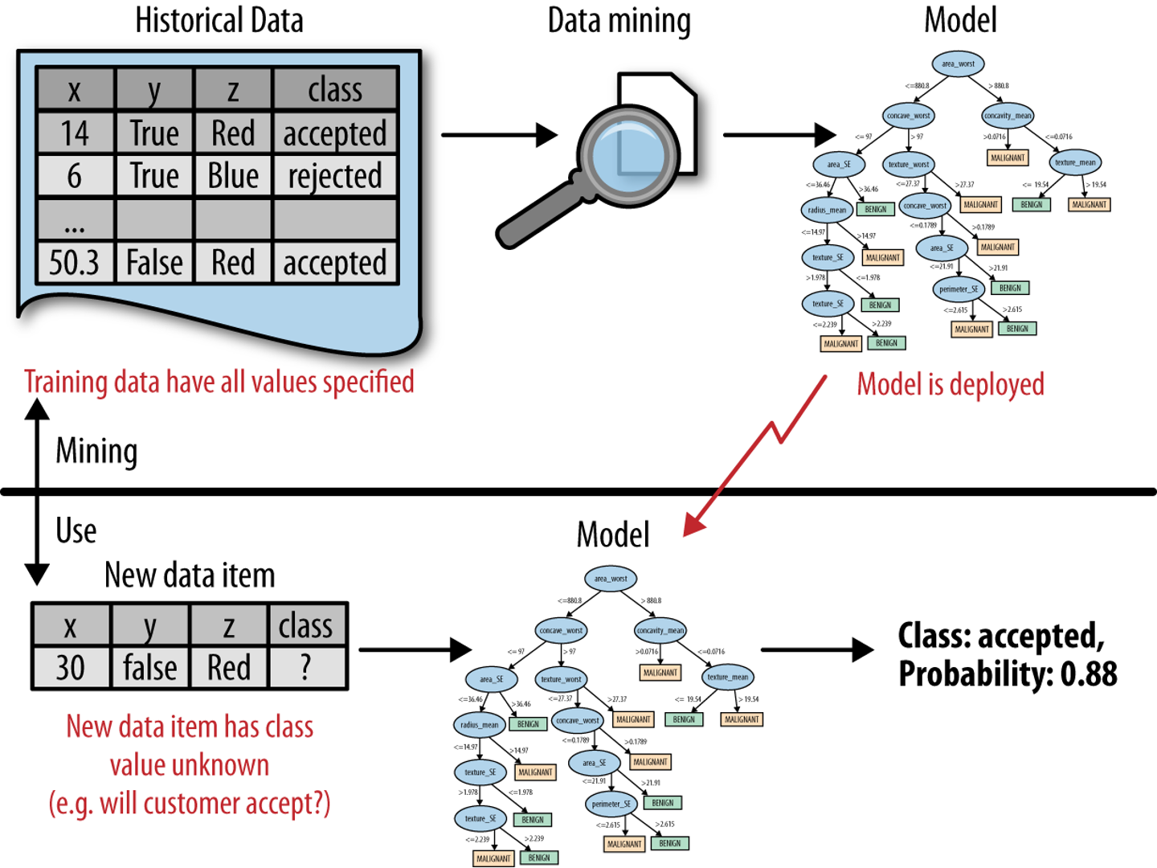
How Does AI and ML Work?
Machine Learning
Train
Predict
Original image source: Data Science for Business – Provost & Fawcett

Slide 30
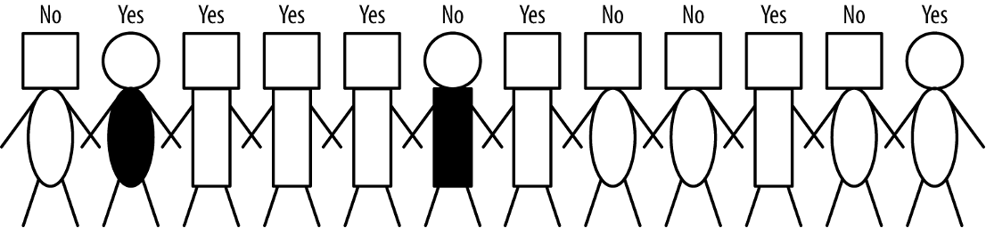
Predicting Who Will Enroll
Target Variable = what to predict: Enrollment Yes or No
Features = what to base the prediction on: head and body shapes, colors, etc.
Image source: Data Science for Business – Provost & Fawcett

Slide 31
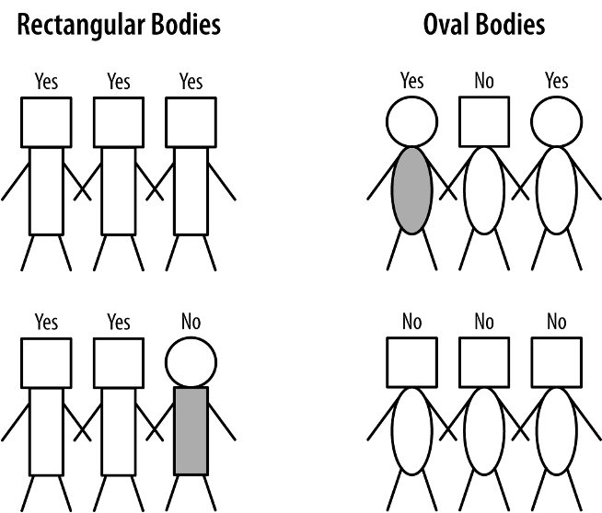
What if We Segment by Body Type?
Almost all rectangular bodies enroll
Most oval bodies do not enroll
The body type has predictive value
We can repeat this step
Machines are really good at trying all options
Image source: Data Science for Business – Provost & Fawcett

Slide 32
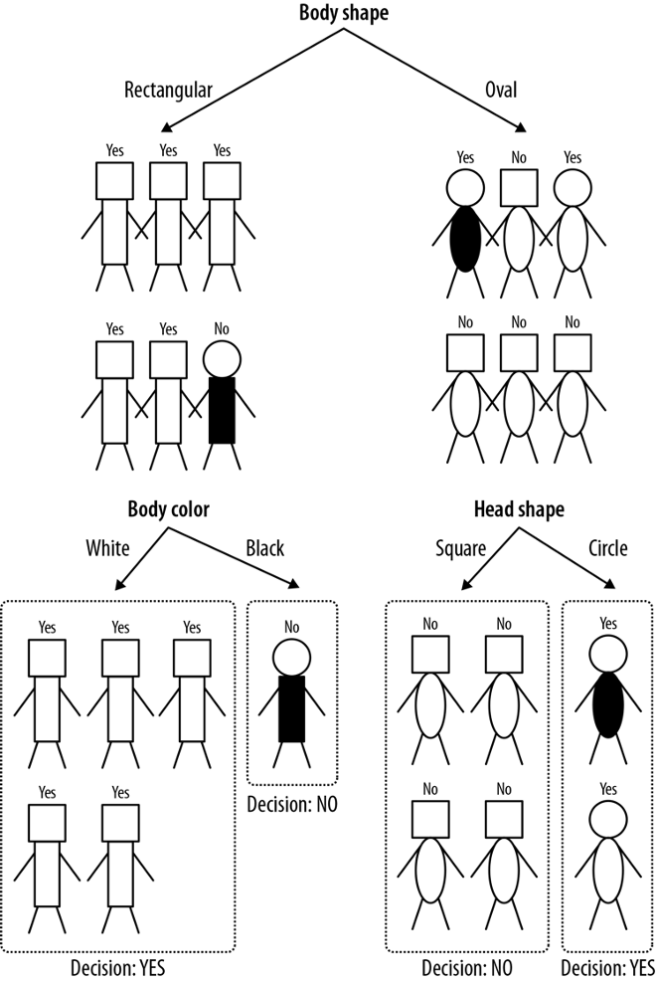
Repeating the Process ...
By repeating the process, we can get predictions that take more and more information into account by looking at smaller and smaller segments
This could result in overfitting, i.e., capturing noise instead of actual patterns
Image source: Data Science for Business – Provost & Fawcett

Slide 33
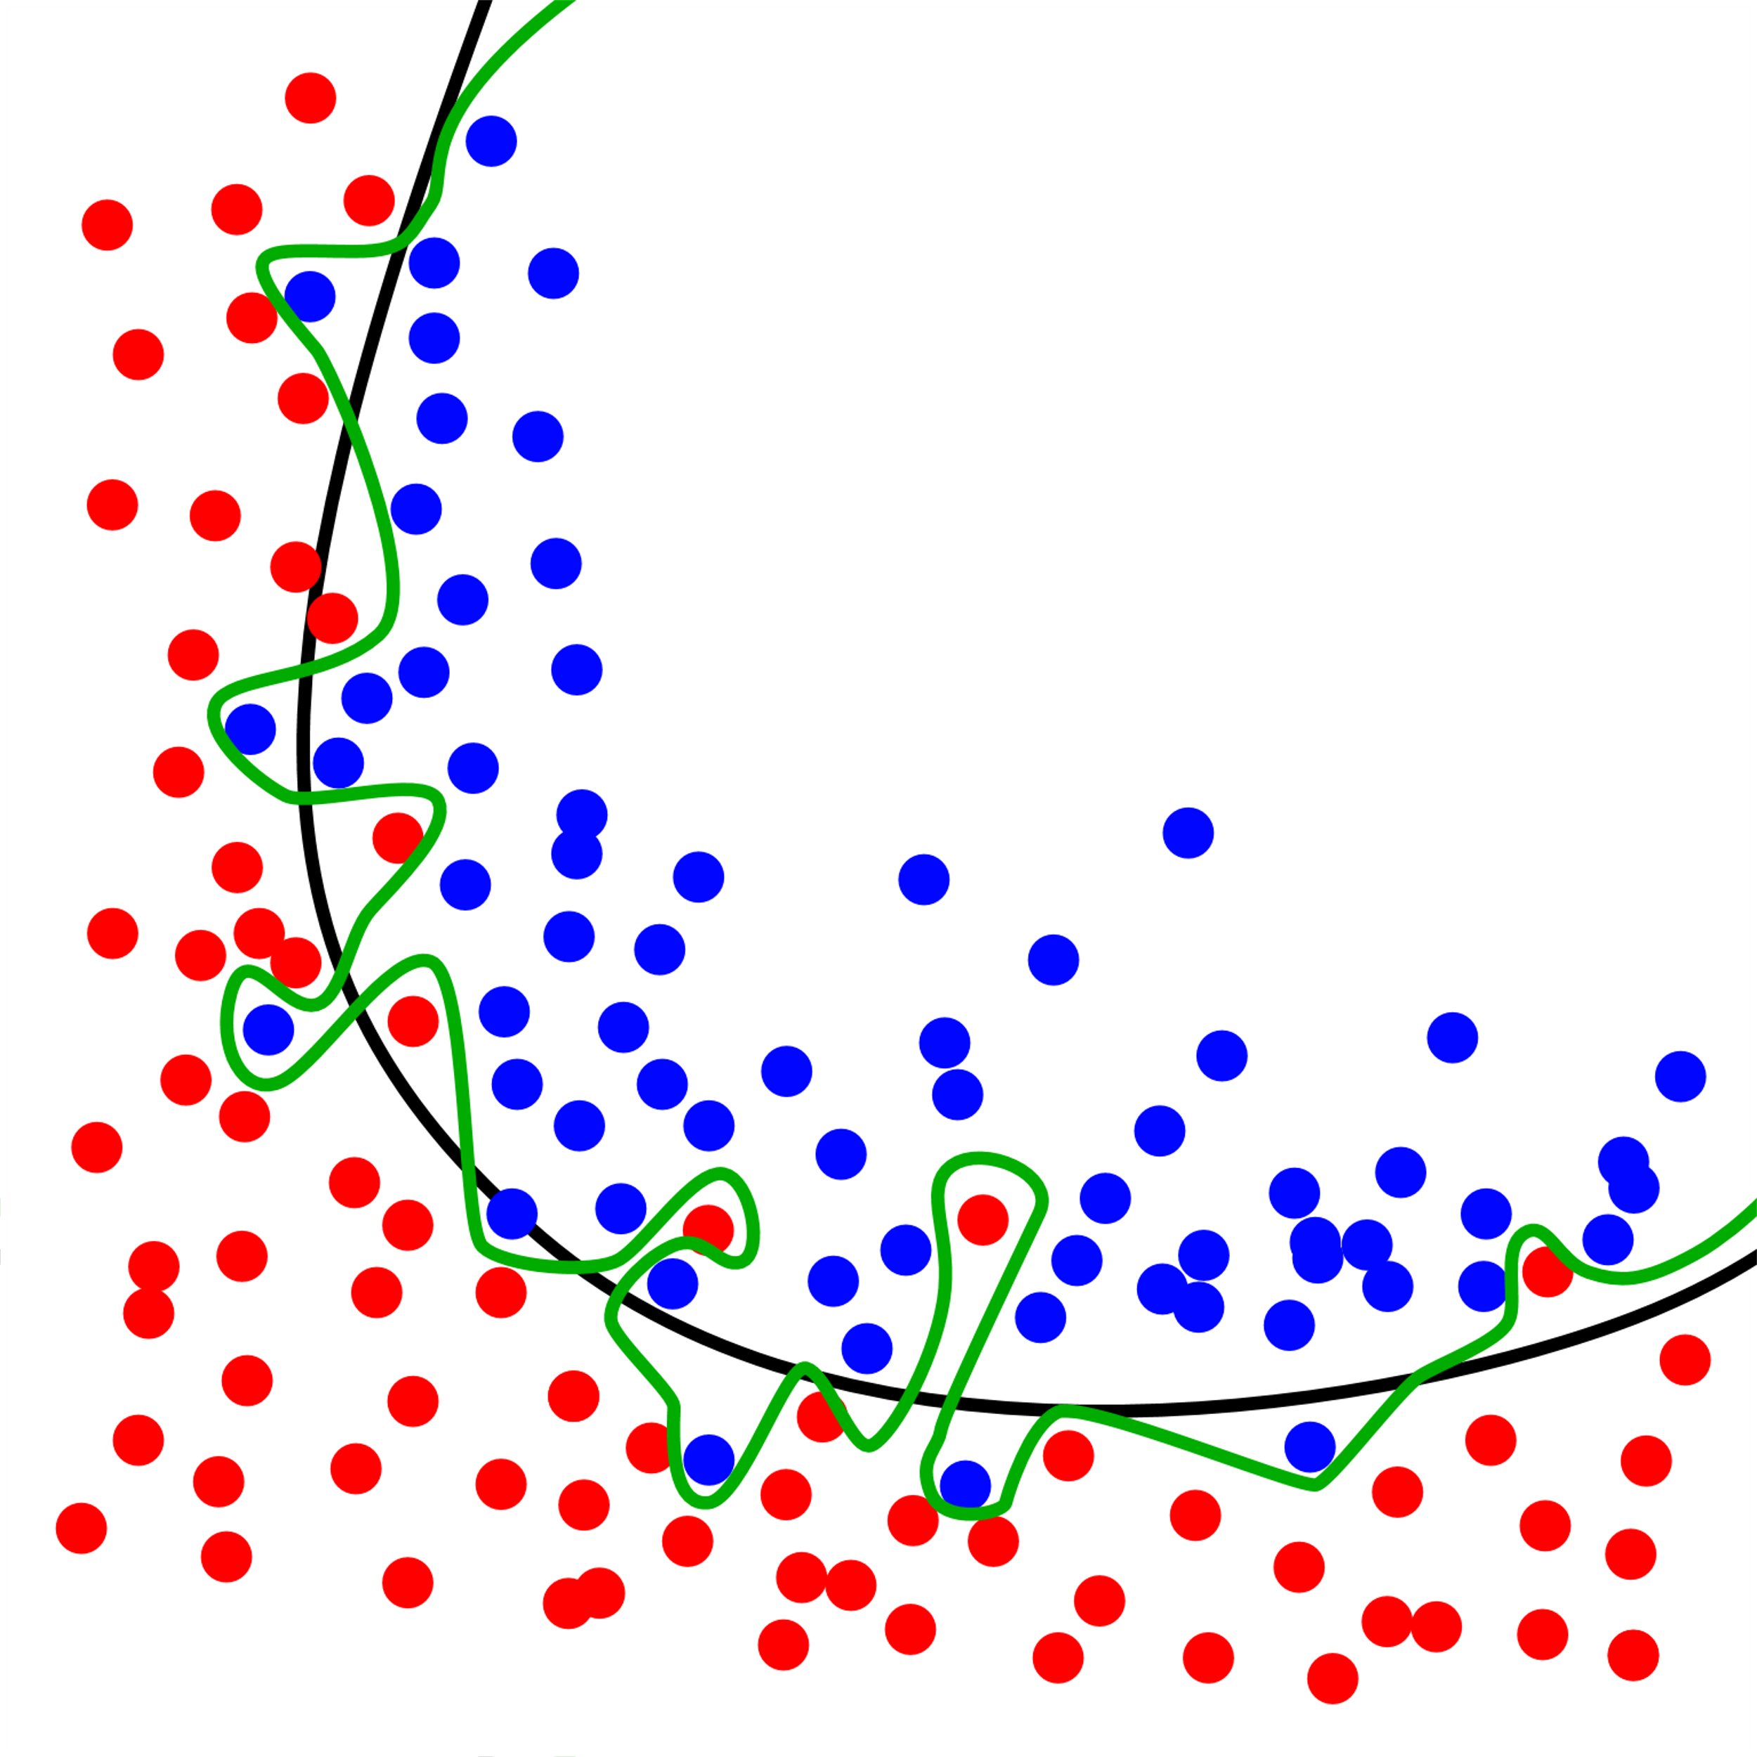
Overfitting
Green line is overfitting the train data
The green line fits the train data better, but the black line makes better predictions on new data
Try different parameters and check performance on unseen data
Cross-validation to the rescue (see next slide)​
Image source: Wikipedia

Slide 34
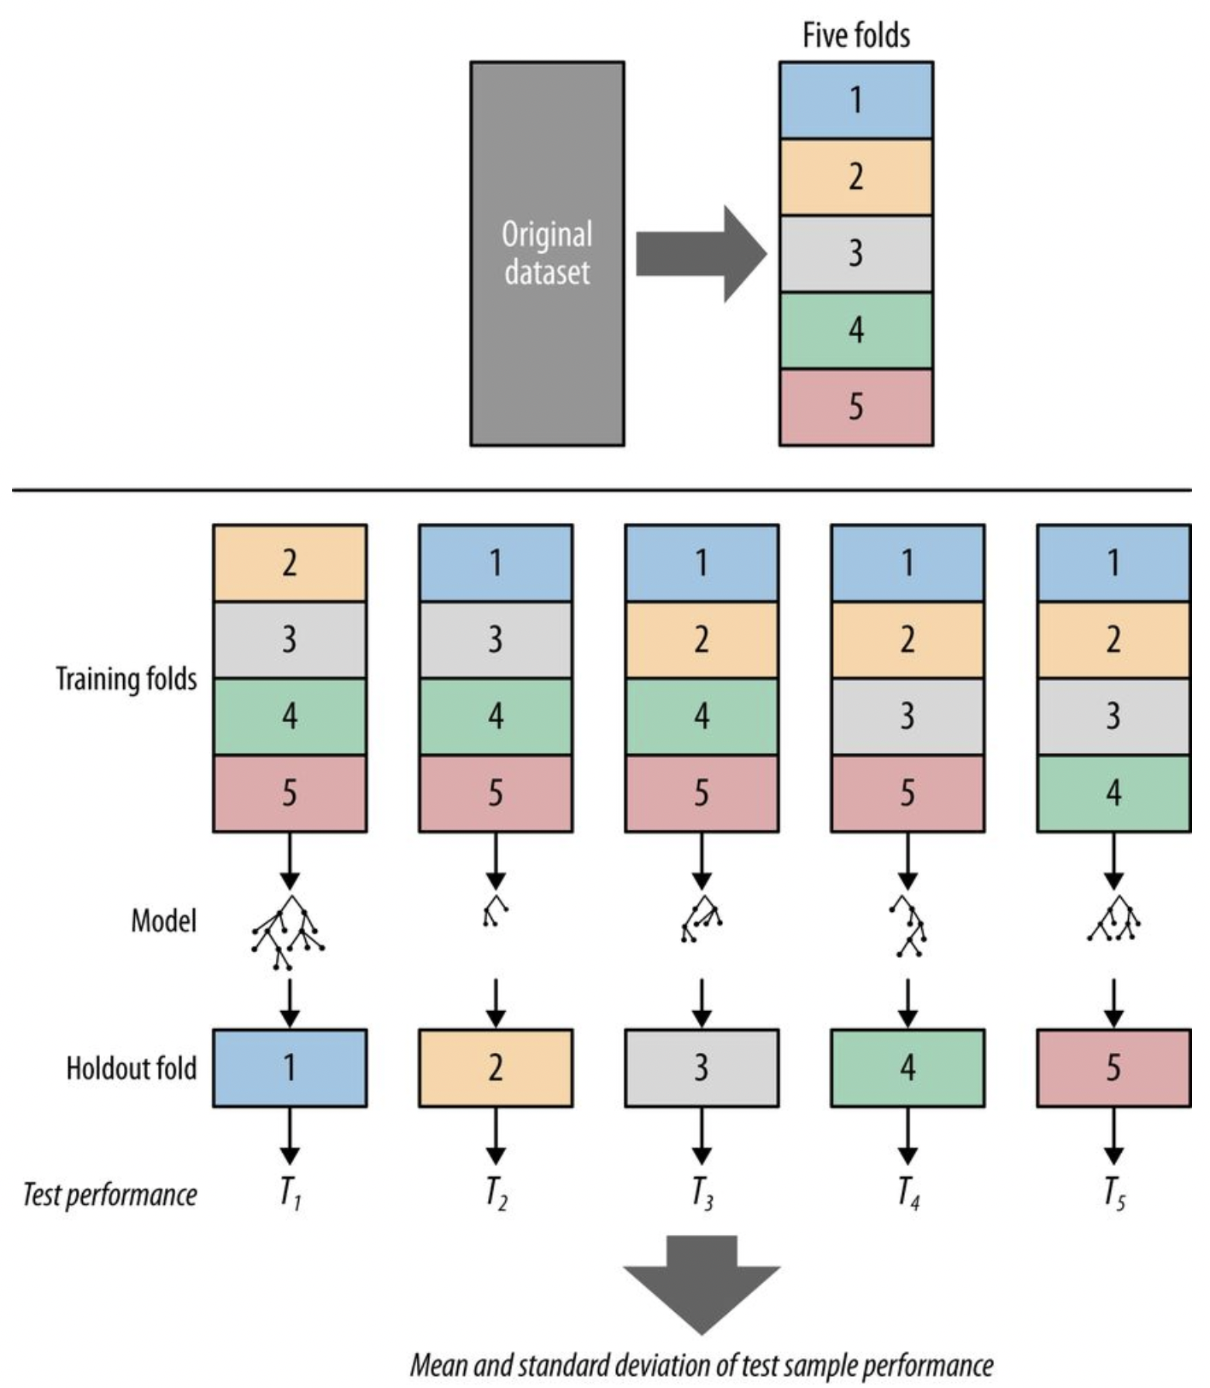
Cross-Validation: Making Sure it Works
Create 5 folds of data, use 4 folds to train a model and the 5th fold to assess the performance.
Repeat 5 times.
Image source: Data Science for Business – Provost & Fawcett

Slide 35
Closing Thoughts
Notes:
Traci

Slide 36
Where do I start?
Create an assessment of where you are and where you want to go
Utilize internal resources, e.g., speak to IT about systems, needs, and support
Create policies and build internal support by explaining the necessity of data
  Make sure you are or have a “data champion”
Utilize external vendors such as Othot to help in the process
  Guidance with data collection and best practices
  Standard data maps and comparison to other institutions
  Perform feature engineering
  Help make the data actionable through modeling/AI and the platform
Notes:
Traci
Plug the managed data checklist here.

Slide 37
Takeaways
1
Data is an important asset for many processes, including modeling
2
A data culture and mindset will help make data more readily available
3
Build comprehensive student profiles to increase chance of student success
4
AI and ML can extract patterns and insights from data otherwise not available
5
Powerful AI and ML approaches are available now and likely to accelerate
Notes:
Mark to add a few points from the AI section as key takeaways

Slide 38
Any Questions?

Slide 39
Are You Ready to Take the Next Steps in Your Data Journey?
Learn
Demo
Let's Talk
Attend our
upcoming events
Request a personalized
demo for your institution
demo@othot.com
Contact Sales
othotteam@othot.com
Notes:
We talked about a lot of different ideas and concepts today.
We're here to help you as your take steps along your data journey.
We can help you
1. Learn more by attending one of our events (next slide is Partner Experience)
2. Get a personalized demo for your institution
3. Have a one-to-one discussion with a member of our team

Slide 40
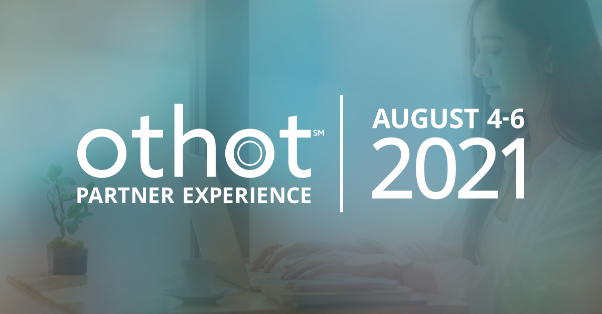
Notes:
Traci - Plug for Partner Experience. Jeff Selingo is our Keynote speaker

Slide 41
Thank you
Contact us at
othotteam@othot.com
Bob DiMaggio
Traci Roble
Dr. Mark Voortman
othot.com
412-458-4167
Notes:
Traci – Thank you for joining us. If you have any lingering questions or want to talk more about what you heard today, contact us!

Slide 42
Notes:
Traci - closing

