Slide 1
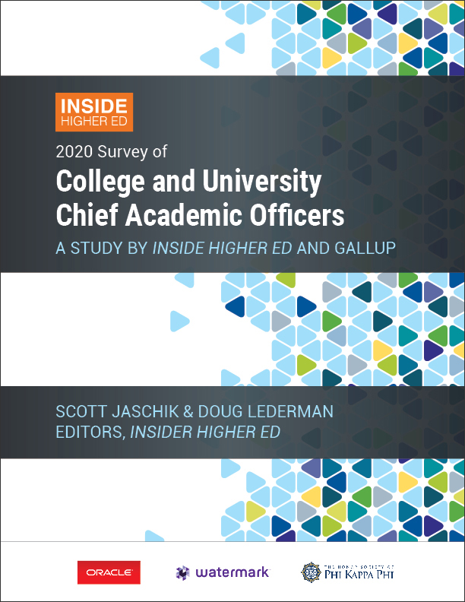
What Provosts Think
Webcast on Inside Higher Ed ‘s 2020
Survey of College and University
Chief Academic Officers
February 25, 2020
2 p.m. Eastern

Slide 2
Presenters
Scott Jaschik, editor, Inside Higher Ed, scott.jaschik@insidehighered.com
Doug Lederman, editor, Inside Higher Ed, doug.lederman@insidehighered.com

Slide 3
Methodology
Participation of 597 provosts.
Only 1 answer per institution.
Answers are completely anonymous, but coded for sector.
Survey conducted by Gallup.
Survey sponsored by Oracle, Watermark, Phi Kappa Phi and Gallup.

Slide 4
Healthy, but …
87 percent of provosts evaluate the academic health of their institutions as “excellent” or “good.”
57 percent of provosts said their institutions were very effective at providing undergraduate education; 42 percent said they were somewhat effective.

Slide 5
The Details
Category | Public % Very Effective | Private % Very Effective
Preparing students for world of work | 40% | 42%
Offering undergraduate support services | 38% | 44%
Controlling rising prices | 36% | 15%
Identifying and assessing student outcomes | 23% | 22%
Using data to aid and inform campus decision-making | 26% | 18%
Recruiting and retaining talented faculty | 17% | 30%

Slide 6
Tenure and Faculty – I
81 percent of provosts agree or strongly agree that tenure remains important and viable at their institutions.
But 63 percent of provosts said their institution will in the future be “as reliant as it is today on non-tenure track” faculty members. And 28 percent said they will be more reliant.

Slide 7
Tenure and Faculty -- II
While only a minority of provosts said that faculty members can earn tenure based on research success even if they have ineffective teaching records, 15 percent is the highest percentage ever. Between 2013 and 2018, an average of 8 percent held this view.
Provosts are more likely to say teaching (82 percent) is more important that research (5 percent) in earning tenure.

Slide 8
Tenure -- III
Sixty-two percent of provosts said they are in favor of long-term contracts as an alternative to tenure, and 38 percent are opposed.
51 percent strongly agree or agree that graduate programs are admitting more Ph.D. students than they should, given the current job market; 21 percent strongly disagree or disagree. Last year, 45 percent strongly agreed or agreed.

Slide 9
Sexual Harassment -- I
70 percent of public college provosts and 75 percent of private college provosts said higher education has tolerated sexual harassment for too long.
Only 15 percent of public college provosts, and 16 percent of private college provosts, said their institutions had done so.

Slide 10
Sexual Harassment -- II
73 percent of public college provosts and 87 percent of private college provosts said that colleges should ban all romantic relationships between faculty members and students.
Only 53 percent of public colleges and 79 percent of private colleges do so.

Slide 11
Changes in Institutional Practice
Will you do more in the next year?
Policy | % of Publics Agree | % of Privates Agree
Funding programs based on alignment with mission | 91% | 83%
Expanding online programs | 88% | 84%
Cutting underperforming academic programs | 78% | 75%
Dismissing underperforming faculty members | 71% | 61%
Increased use of part-time faculty members | 37% | 40%
Altering tenure policies | 20% | 17%
Cutting athletic programs | 4% | 9%

Slide 12
Cuts
34 percent of public college provosts and 41 percent of private college provosts report that they have cut majors or departments.
73 percent of public college provosts and 79 percent of private college provosts said that they worried about the impact the cuts are having on higher education.
About half of provosts said they were worried about the impact of cuts at their institutions.

Slide 13
The Cuts and the Liberal Arts
Statement | % of Public College Provosts Who Agree | % of Private College Provosts Who Agree
High-quality undergraduate education requires healthy departments in fields such as English, history, political science and other liberal arts fields. | 58% | 63%
Politicians and board members are prioritizing STEM and professional programs over those that support general education. | 37% | 31%
The number of majors in a program is an appropriate way to determine which departments to cut. | 5% | 6%

Slide 14
General Education
91 percent of chief academic officers strongly agree or agree that general education is a crucial part of any college degree. More than 6 in 10 strongly agree.
By 45 percent to 36 percent, they are more likely to disagree than agree that general education requirements are too expensive.
Only a quarter of provosts agree that students understand the purpose of general education.

Slide 15
Liberal Arts
83 percent of public college provosts and 91 percent of private college provosts believe that “a liberal arts education is central to undergraduate education.”
60 percent of provosts believe the number of liberal arts colleges will decline significantly in the next five years.
82 percent of public college provosts and 86 percent of those at private colleges said "the concept of a liberal arts education is not well understood in the U.S."

Slide 16
Assessment
Nearly three quarters of provosts (73 percent) say their institution makes effective use of data to measure student outcomes.
By 46 percent to 19 percent, provosts agree rather than disagree that the growth of assessment systems has improved the quality of teaching and learning at their college.
51 percent say their college regularly makes changes to curriculum, teaching practices or student services based on what it finds through assessment.

Slide 17
Your Questions
Q&A

Slide 18
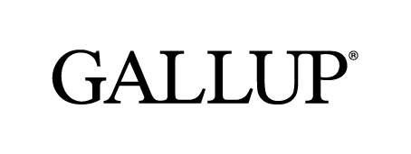


With Thanks

