Slide 1
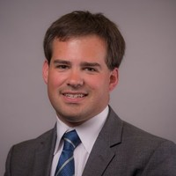
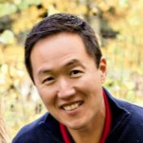
Travel Risk Management in Higher Education
The program development journey to keep faculty, staff, and students safe while traveling.
Linda Wilson Director of Finance Systems and Services | wilsonl@gonzaga.edu
Jason Grunin Asst. Vice President of Business | jason-grunin@utulsa.edu Steve Lee Principal Consultant | s.lee@sap.com
Notes:
Steve

Slide 2
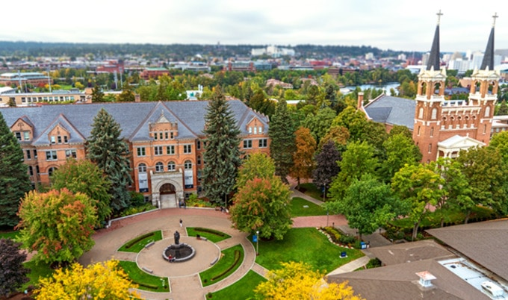
About Gonzaga
Facts about Gonzaga
Located in Spokane, Washington, with a campus in Florence Italy.
Private Jesuit institution
103 buildings on 152 acres
Pronunciation: Gone - ZAG (as in "bag") - uh
Total Enrollment: 7,566
Average GPA: 3.71
Division 1 Athletics currently ranked #2 in the nation for NCAA Men’s Basketball and Women’s Basketball #17
Mandated Travel Policy
Gonzaga University is an exemplary learning community that educates students for lives of leadership and service for the common good.
Notes:
Linda

Slide 3
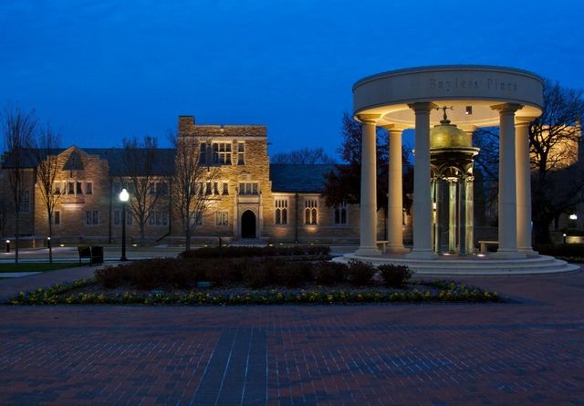
About University of Tulsa
Facts about Univ. of Tulsa
Located in Tulsa, Oklahoma, Private Institution, Not-for-Profit
FY20 Operating Budget: $216 Million
300+ Acres, 200+ Buildings,
Total Enrollment: 4597
Total Employment: 1454
3 locations – 250+ acres : 3m sq. feet
Mandated Travel Program
Division I Athletics
Complex study abroad program
The University of Tulsa is a private, independent, doctoral-degree-granting institution whose mission reflects these core values: excellence in scholarship, dedication to free inquiry, integrity of character, and commitment to humanity.
Notes:
Jason

Slide 4
Poll Question
Where does travel risk fall within your institution? (Select multiple.)
Travel
Finance
Provost
Academic Affairs
Risk Management
Campus Police
IT
HR
Legal
Other

Slide 5
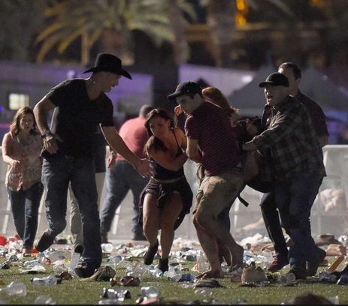
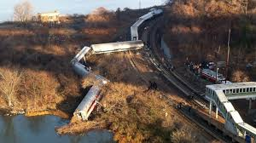
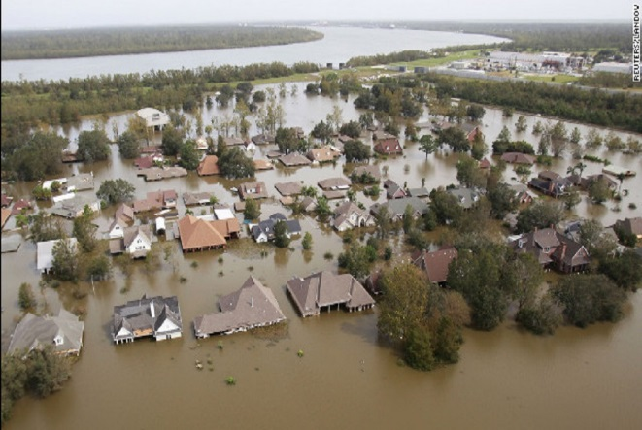
The Realities of Today
Notes:
Steve

Slide 6
What is at stake?
Organizational Risk
Reputational Risk
Financial Risk
The potential cost of doing nothing
Notes:
Steve

Slide 7
Poll Question
When was your most recent incident involving travel risk? (Choose one.)
This week
Last week
Last month
Last 12-months
More than 12 months ago
Yet to have one

Slide 8
“Hope is not a strategy. Luck is not a factor. Fear is not an option.”
James Francis Cameron - filmmaker, environmentalist, explorer, and philanthropist
Notes:
Steve

Slide 9
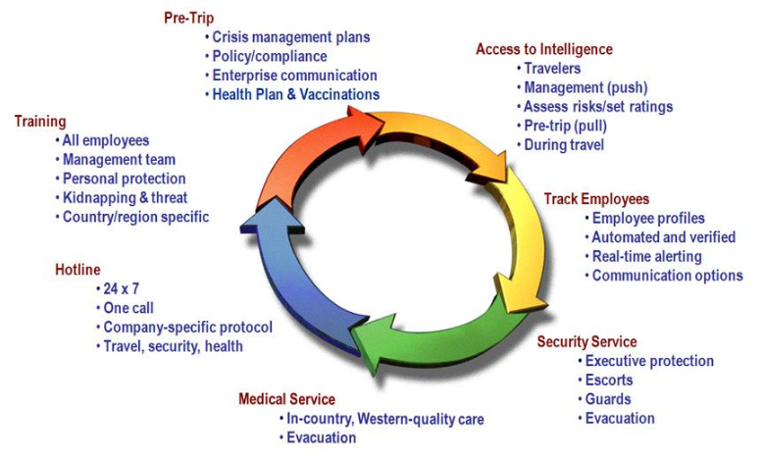
Traveler Safety Continuum Focus areas of a comprehensive travel risk management program.
Source: Global Business Travel Association (GBTA)
Notes:
Steve

Slide 10
Poll Question
How prepared is your institution to respond to a crisis? (Choose one.)
Extremely prepared (proactive, immediate response, employees know how to get help)
Moderately prepared
Slightly prepared
Not prepared at all (reactive, slow response)

Slide 11
Insight #1
What’s the challenge specific to Higher Ed?
Notes:
Travel Risk-challenges in Higher Ed
Students, student groups, staff, and faculty booking in discount booking tools of their choice
Challenges
We are spending tuition dollars so we need to be frugal
Visibility
Where they and what are was their itinerary?
Pre-trip education
Pre-trip Risk evaluation
Pre-trip insurance information
Documentation requirements
Immunization discussion

Slide 12
Insight #2
Where did you start? How did you start?
Notes:
Insight #2
Where did you start and how did you start
Cabinet level presentation on Concur Locate and received the green light
Created Travel & Expense office
Presentation with Risk Director, Insurance representative, travel stakeholders
Travel Risk Advisory Board
Created policy mandating travel booking

Slide 13
Insight #3
The use of technology in the modern travel risk management program.
Notes:
Use of technology in modern travel risk management program
Transparency – ability to know where all travelers are at a moment’s notice on a world map
Provides “know before you go” opportunities
Need to communicate?
Track both work and travel locations – Florence Italy campus

Slide 14
Where Traveler Location Data Resides Today
Travel Agency Bookings
Supplier-direct Travel Bookings
Approved Travel Requests
Location check-in’s
Study Abroad Registrations
Work & Home Addresses
Expense Data
Proprietary Application
Notes:
Linda and Jason

Slide 15
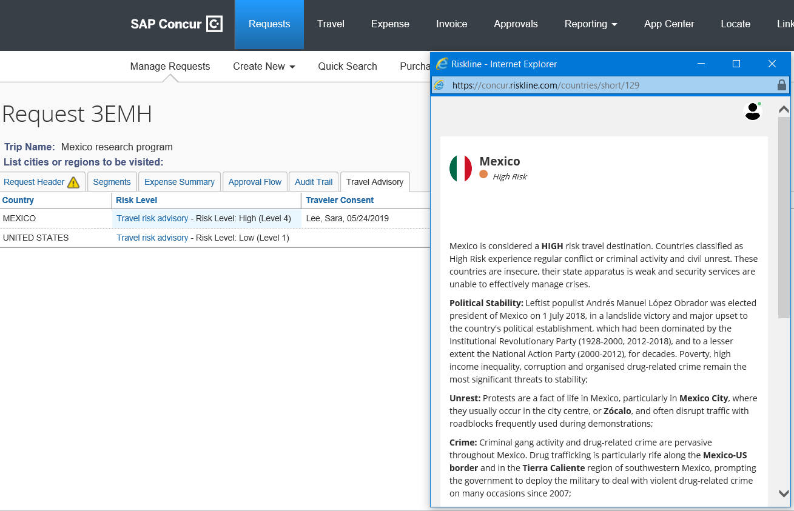
SAP Concur
Offering an intuitive UI and mobile applications Concur solutions provides faculty and staff an easy way to complete and approve expense reports whether on the road or on campus.
Notes:
Steve

Slide 16
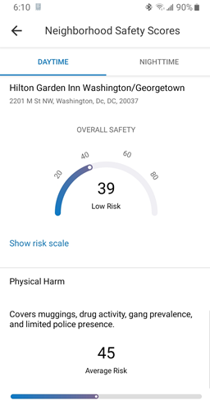
SAP Concur
Offering an intuitive UI and mobile applications Concur solutions provides faculty and staff an easy way to complete and approve expense reports whether on the road or on campus.
Notes:
Steve

Slide 17
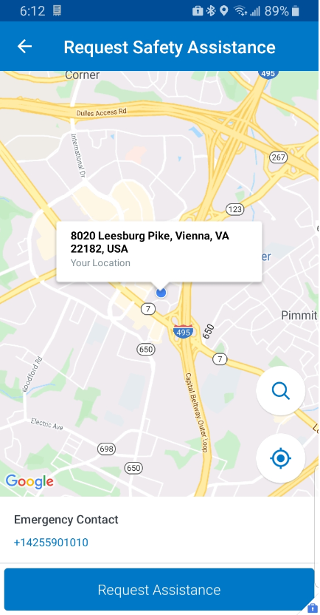
SAP Concur
Offering an intuitive UI and mobile applications Concur solutions provides faculty and staff an easy way to complete and approve expense reports whether on the road or on campus.
Notes:
Steve

Slide 18
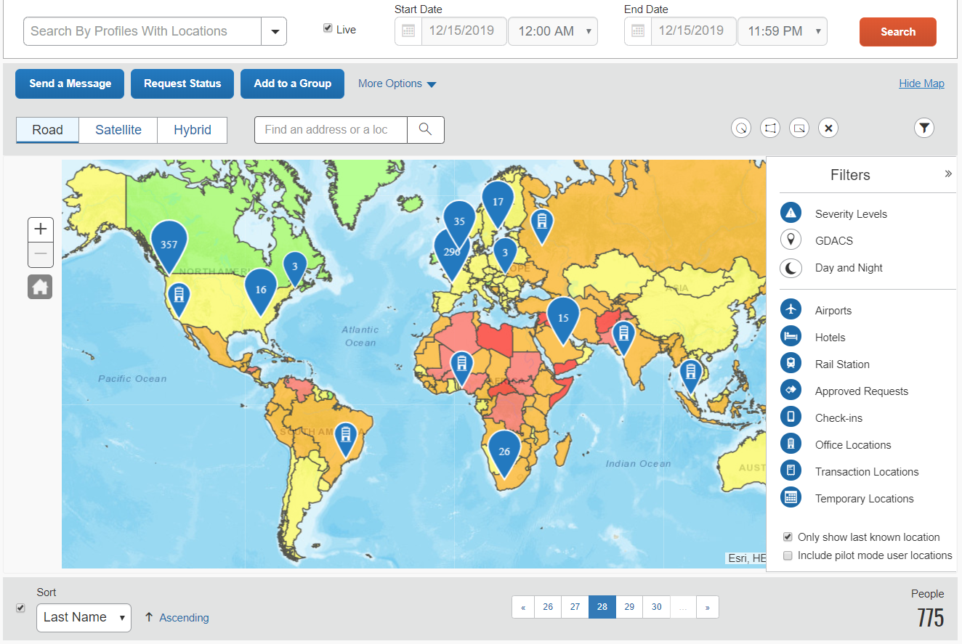
SAP Concur
Concur Locate combines location data consolidation, risk intelligence, and communication capabilities onto a single view.
Notes:
Steve

Slide 19
Recommendations and Key Takeaways
Establish a travel health, safety and security policy.
Get access to reliable travel safety and security intelligence.
Put restrictions and processes in place for travel to high risk destinations.
Know where all your people are.
Create an incident and crisis management plan
Notes:
Linda and Jason

Slide 20
Travel Risk Management in Higher Education
The program development journey to keep faculty, staff, and students safe while traveling.
Linda Wilson Director of Finance Systems and Services | wilsonl@gonzaga.edu
Jason Grunin Asst. Vice President of Business | jason-grunin@utulsa.edu Steve Lee Principal Consultant | s.lee@sap.com
Notes:
Q&A

