Slide 1
Success at Scale: Strategies to Improve Outcomes for Underserved Students An Inside Higher Ed Special Report

Slide 2
Speakers
Mikhail Zinshteyn Reporter | Author of Success at Scale
Paul Fain News Editor Inside Higher Ed paul.fain@insidehighered.com

Slide 3
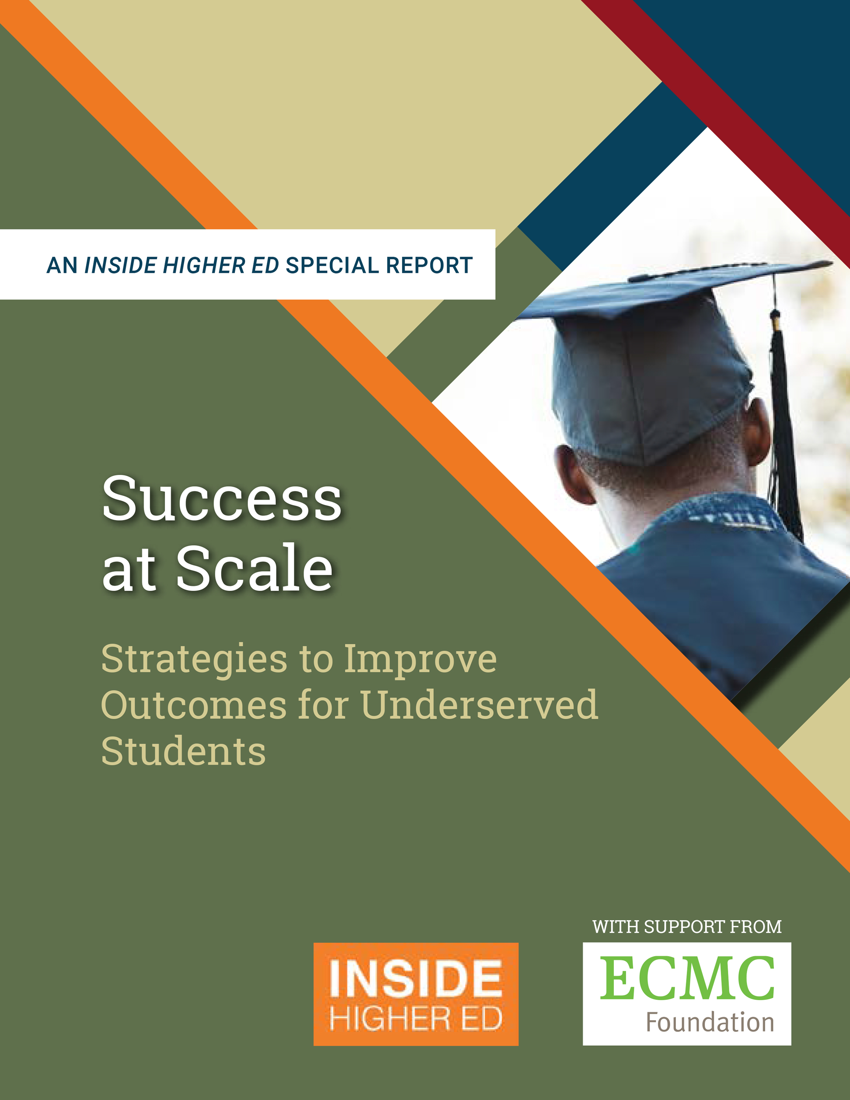
We dwell on the bad, but there have been improvements.
By one measure, the share of students who graduate from high school and immediately enter college has risen from 63 percent in 2000 to 68 percent in 2017.
By that same measure, far more Hispanic students have entered college after high school, rising from 49 to 67 percent in those years.

Slide 4
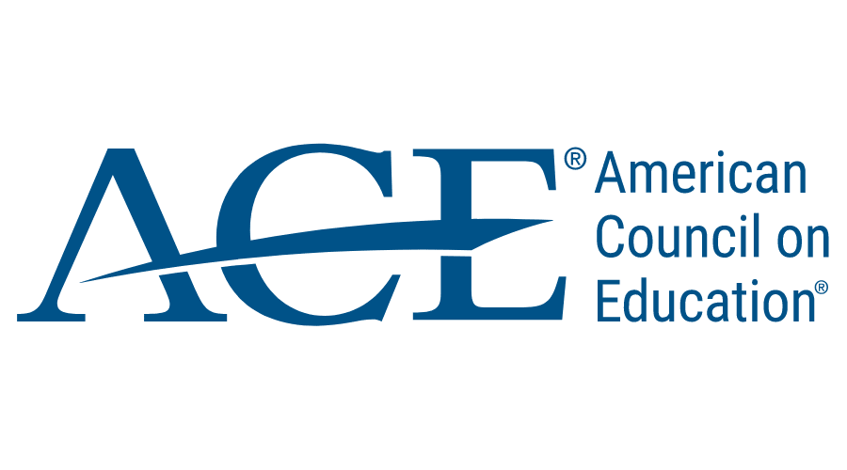
Cont.
In 2017, about 45% of adults who were at least 25 years old had earned an associate degree or higher, up from 31% in 1997
Between 2000 and 2016, the share of 18- to 24-year-olds enrolled in college jumped from 35 to 41 percent, per ACE

Slide 5
But progress is uneven.
Just over half of college students are earning their degrees in six years (National Student Clearinghouse Research Center)
More than 30 million adults have some college but no degree
A quarter of black students who earn bachelor’s degrees do so in 12 or more years—nearly double the national average and higher than the 15% for Hispanics (ACE)

Slide 6
Cont.
Of first-time students starting community college, 2012 cohort: 28% earned a certificate or associate degree; less than a third transferred to earn a bachelor’s; 13% earned a bachelor’s within six years
Silver lining: 44% of those who did transfer earned a bachelor’s in six years

Slide 7
What is working? Accelerated Study in Associate Programs
ASAP is a package of intensive student counseling, priority registration, tutoring, career development services, tuition waivers, free textbooks and public transportation passes. It leads to unparalleled student improvement.
Evidence of success? The latest evidence released in 2019, backed by the gold standard in research—the randomized-control trial—shows that ASAP caused three-year graduation rates to jump from 22% to 40%. MDRC did this study.
Impacts in New York were greater for Black students. Evidence suggests more part-time students transitioned to full-time to take advantage of the program

Slide 8
Cont.
Challenges: Implementation (it takes several years with a lot of necessary buy-in), funding (upfront costs are large but measured by spending per degree, the model is cheaper in the end), advisor training (it can take up to a year and the model proposes an advisor-student ratio of 150:1), knowing limits of scaling it (e.g., it’s for full-time students)
Reality check: ASAP “is not causing people who otherwise would not have earned a bachelor’s to earn one,” said MDRC researcher of ASAP report. “But it is causing some people to earn that degree a little bit faster than they would have.”
Reality check: After six years, ASAP’s impacts still strong, but lower. The graduation rate increased by 10 percentage points, the 2019 MDRC research found.

Slide 9
ASAP “shows quite a bit of promise for improving completion and student success,” said Maria Cormier, a senior research associate at the Community College Research Center at Columbia University’s Teachers College. “So I think it’s worth situating it in the broader conversation of community college reform and institutional change and how it can work in tandem with other efforts and interventions.”

Slide 10
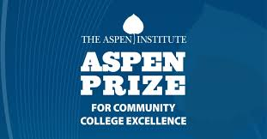
What is working? Guided Pathways
What is it? At its core, guided pathways allows students to initially pick a broad area of concentration and earn a degree or certificate with a clear understanding of the courses they need, with strategic advising throughout their time in school. It’s a whole-school model.
Signs of success: Several past and current Aspen Prize for Community College Excellence finalists are in various stages of guided pathways implementation.

Slide 11
Cont.
Early indicators, like completing gateway math and English courses in first year and share of students passing 6 or more units in their first year are up in many of the colleges adopting this, as is reduction in units acquired toward associate degree
While trends are promising, “none of this is definitive evidence that guided pathways is effective,” said researcher on guided pathways reform at CCRC at Columbia University

Slide 12
Cont.
Challenges: Implementation can take 5+ years. Colleges must create clear course maps to guide students along pathway toward degree or certificate
Challenges: Changing remediation policy to speed up time it takes for student to pass a gateway course
Challenges: Purchasing software that allows students to enroll and track their progress toward educational milestones, down to the semester-by-semester level
Challenges: Relying on software to guide students because few schools can hire enough academic advisors

Slide 13
Cont.
Challenges: Dashboards that show typical jobs and common employers, plus average pay, per degree and area of concentration. The display requires few clicks, and links to financial aid and information sessions line the course sequence material.
Mindset changes: professors learn students’ names, shake hands after class to say “I’ll see you tomorrow”; do reforms at guided pathways only benefit transfer-bound students or CTE students, too?
Mindset changes: Doing away with the distinction between part-time and full-time students. “We are looking at students as being on-path and off-path,” one college dean said.
Capacity issues: Is there enough space in nearby universities to take in possible surge of students who are transfer-ready because of guided pathways?

Slide 14
A balanced “schedule means students can access the courses they need, at the times they need them. The schedule is no longer a barrier to their pathway to graduation”

Slide 15
What is working: Transfer reform
Big ideas and challenges:
Improving articulation agreements so that transferable courses count not just as electives, but as major requirements, too.
This requires a lot of consultation between faculty at community colleges and bachelor’s-issuing institutions. Problems could include a university’s refusal to accept a gateway math course that had a corequisite component
Developing a core curriculum so that courses students take in one college count in another college, and that those courses are accepted by the institutions students are transferring into

Slide 16
Cont.
Improving articulation agreements so that the university encourages students to earn associate degrees (Governors State University)
Universities should recruit from multiple community colleges and simplify transfer agreements to overcome demographic headwinds
Universities should offer a transfer promise to students and fund-raise for additional scholarships
Partner with more universities and nonprofits, like Institute for Higher Education Policy, to create reverse-transfer plans and other strategies to award credit to students with some credit but no degree so that they can at least have an associate degree

Slide 17
“To me this just means that, as institutions are facing increasing pressure with the completion crisis around the country, it makes a lot of sense to help students [earn the degrees they were pursuing all along].”
Julie Ajinkya,
Vice president of applied research Institute for Higher Education Policy

Slide 18
Improving grad rates at a large university system
Big ideas and challenges:
Completion grants or tuition waivers to allow students with some unpaid debt to school to return to class and finish a degree
Reform remediation policy (beware of faculty pushback)
Have a grand vision at the most senior level that trickles down to every middle manager and faculty member

Slide 19
Cont.
Make that vision achievable but also bold by comparing yourself to like-institutions and seeing what their graduation rates are (Cal State University did this to inform its graduation goal)
Open more sections for popular courses (this requires money)
Course-sequencing software
Avoid the temptation of increasing admissions standards and monitor this

Slide 20
“We need to invest more in these types of wraparound services programs to help individuals who need assistance to complete certificates and degrees.”
Michael Scuello,
Senior associate at Metis Associates

Slide 21
Other promising trends
Open-educational resource textbooks (they save students money and early research suggests the quality of these textbooks leads to no difference in grades than commercial textbooks
Student housing at community colleges. It could create a sense of community and belonging and offer relief for students who are housing insecure. Trick is to keep costs low so that Pell or other aid can cover the rent
Taking advantage of federal and nonprofit funds to improve STEM pathways for community college students. Look for opportunities to pair students with research professors to do lab work and receive mentoring

Slide 22
Cont.
Encourage faculty to list on course syllabi information to access emergency aid and other student services, like a campus nurse practitioner or mental health expert; partner with third-party organizations who can manage available emergency aid and distribute it fairly quickly to students in need.
Expanding the role of financial aid offices to connect students with federal food stamps and housing-assistance programs is another example of smarter use of available funds.
Emulate the Arkansas Career Pathways Initiative: The program is seen as a solution for addressing the inequities students who are parents confront. Student services include hands-on advising and career planning, financial support for childcare and transportation services, textbook support, and assistance with résumé writing and job interview preparation.

Slide 23
Final thoughts – reform is expensive, but savings are possible
One community college estimated it needed an extra $2 million a year to hire enough counselors and advisors to implement guided pathways. The money, even in California, isn’t there, but the hope is that software that visualizes what courses students need along program maps will take the load off advisors so that they can offer more targeted guidance for students.
Another community college disbanded four of its intercollegiate sports teams to save on $2.6 million that it wanted to re-invest in student success. That figure doesn’t include maintenance upkeep.

Slide 24
Final thoughts cont.
Yes, ASAP at the City University of New York required an initial investment of more than $4,600 per student, but because so many more students earned their associate degrees under ASAP, the cost per degree for CUNY ended up being more affordable for an ASAP student than for someone who didn’t take part in the program.
One analysis found that ASAP reduced the cost to the college of providing a degree by 15%.
Grants to support the writing of open-resource textbooks so that students save money down the line and keep upkeep on curriculum material in-house.

Slide 25
Speakers
Mikhail Zinshteyn Reporter | Author of Success at Scale
Paul Fain News Editor Inside Higher Ed paul.fain@insidehighered.com

Slide 26
Q&A

Slide 27
With thanks

