Slide 1
STEM Teaching and Learning
An Inside Higher Ed webcast
Wednesday, August 26, 2020
2 p.m. Eastern

Slide 2
Presenters
Scott Jaschik, editor, Inside Higher Ed, scott.jaschik@insidehighered.com
Doug Lederman, editor, Inside Higher Ed, doug.lederman@insidehighered.com

Slide 3
The Coronavirus Pandemic

Slide 4
Momentum in Physics Education
Beginning with energy, not forces and vector mathematics.
Students are asked to do calculus themselves.

Slide 5
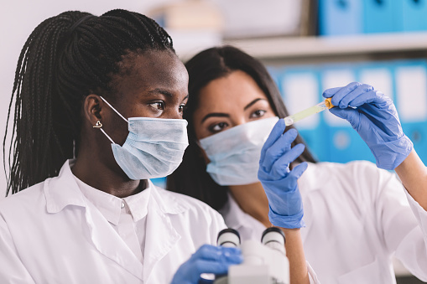
The General Reforms of Science Education
--Getty Images

Slide 6
Much Ado About Class Size
--Pexels.com

Slide 7
Community College Transfers

Slide 8
Remotely Hands-On

Slide 9
Not All Online Experiences Are the Same
With apologies to Rob Weir
--Establish hard and fast expectations.
--Think asynchronously.
--Get technical.
--Reimagine your role.
--Set dates for closing comments.

Slide 10
What Worked in the Spring? -- I

Slide 11
What Worked in the Spring? -- II

Slide 12
Q&A
Your questions
Your suggestions for future coverage

Slide 13
With Thanks …

