Slide 1
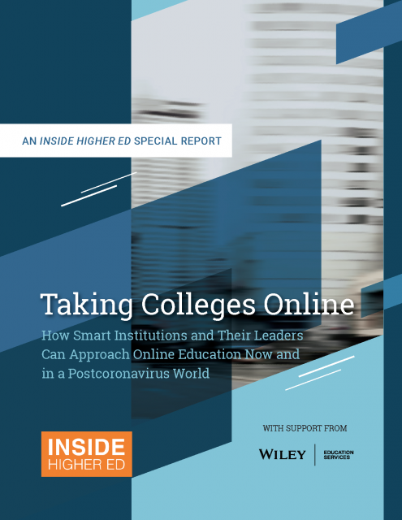
Taking Colleges Online: How Smart Institutions and Their Leaders Can Approach Online Education Now and in a Post-Coronavirus World
An Inside Higher Ed webcast Wednesday, July 15, 2020 2 p.m. Eastern

Slide 2
Presenters
Lindsay McKenzie, technology reporter, Inside Higher Ed, lindsay.mckenzie@insidehighered.com
Doug Lederman, co-editor and co-founder, Inside Higher Ed, doug.lederman@insidehighered.com

Slide 3
Report Summary
The state of digital learning before COVID-19
Different models for going online: build, buy or hybrid
Selecting and working with online program management companies (OPMs)
Key institutional considerations before going online
What it takes to deliver high-quality online education

Slide 4
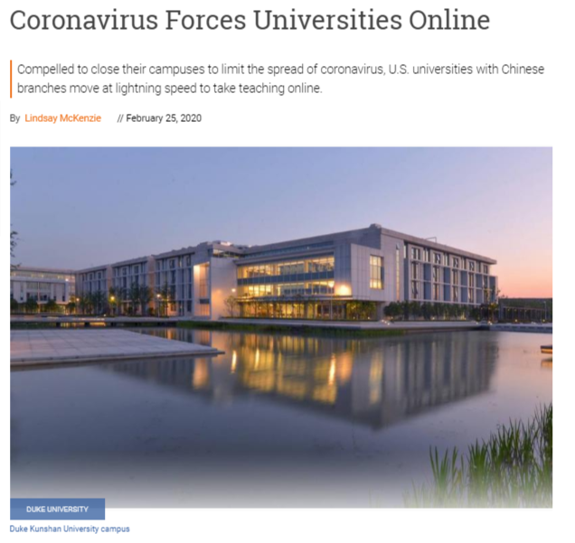
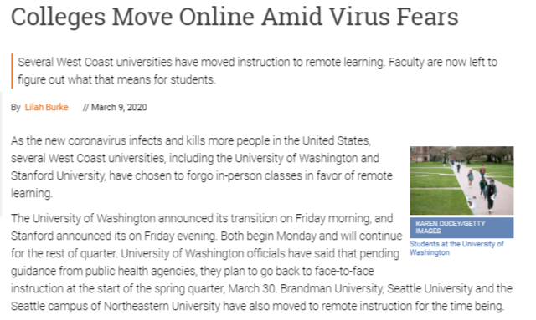
A Rapid Transition

Slide 5
Motivations to Move Online
Boost enrollment and revenue
Cater to nontraditional students
Future-proof your institution
Does your motivation for scaling your college’s online presence align with your institutional mission?

Slide 6
Different Approaches
Build: develop and manage your online programs with in-house expertise
Buy: work with a company to manage all or part of an online program
Share: award college credit for online courses taught elsewhere
Your budget, ambition and core values will guide the approach your institution takes.

Slide 7
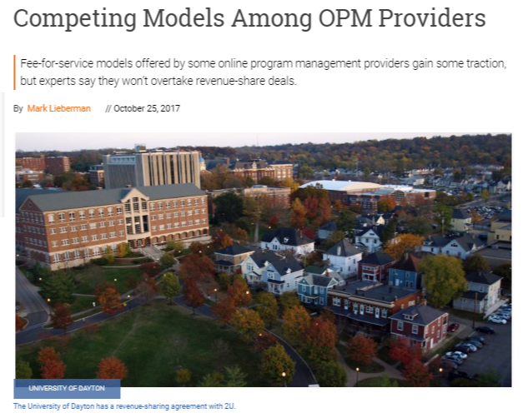
Online Program Management
Financial models:
Revenue-share for
bundled services
Fee-for-service for
unbundled services
Hybrid

Slide 8
Scrutiny of Online Instruction
Instructors have become more accepting of online instruction over time, but concerns about quality linger for many of them.
The U.S. Department of Education has temporarily relaxed several regulations relating to online education due to the pandemic.
Student and faculty impressions of online learning will be shaped by their experience of remote learning in 2020.

Slide 9
Back to Normal?
University business officers want to pursue transformation, not a return to the status quo.
Respondents to this year’s Survey of College and University Business Officers show greater confidence in long-term financial stability than short-term.
Inside Higher Ed survey of college presidents about COVID-19 crisis reveals leaders do not plan to reverse investment in online learning resources.

Slide 10
Coronavirus Concerns
Supporting low-income students is one of college presidents’ biggest concerns.
Under financial pressure, some institutions have been forced to lay off staff members.
Still a lot of uncertainty about the fall semester.

Slide 11
Q&A
Your questions
Your ideas for future coverage?

Slide 12
With Thanks …

