Slide 1
Back to School?
What adults without degrees say about
pursuing additional education and training
October 10, 2019

Slide 2
Moderator
Carol D’Amico
Executive Vice President,
National Engagement and Philanthropy

Slide 3
Research Team
Dave Clayton, Ph.D. Senior Vice President,
Consumer Insights
Nichole Torpey-Saboe, Ph.D. Director of Research
Consumer Insights

Slide 4
The Power of Listening
Education Consumer Survey
Random sample telephone survey, nationally representative
340,000+ responses
Ages 18-65
All postsecondary pathways
All demographics
All states & DC
Largest metro regions

Slide 5
The Opportunity

Slide 6
120 million adults without a college degree

Slide 7
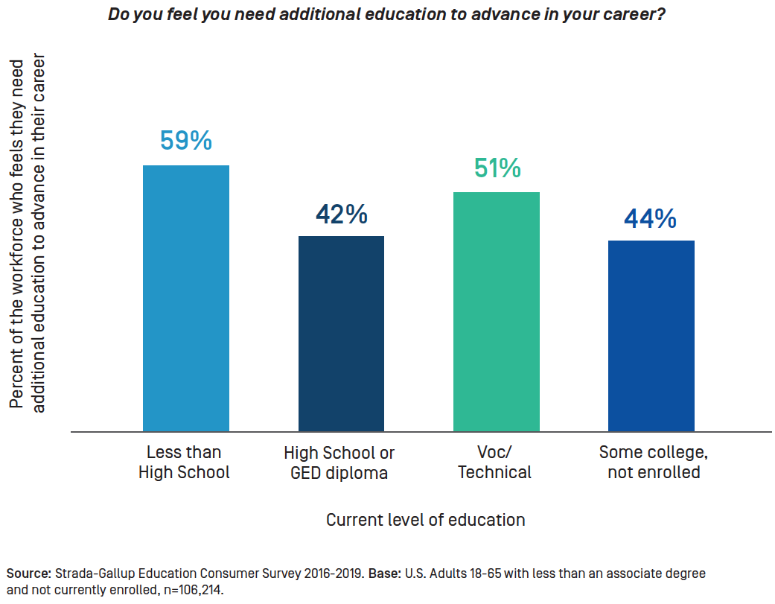
55 million adults without degrees feel they need more education

Slide 8
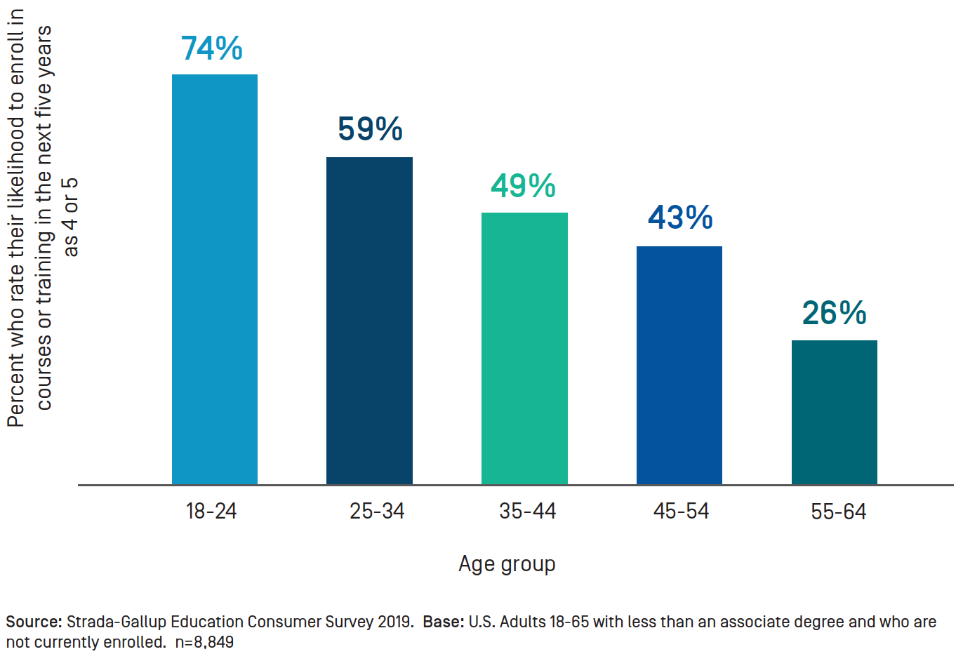
60 million adults without degrees likely to enroll within 5 years

Slide 9
The Disconnect

Slide 10
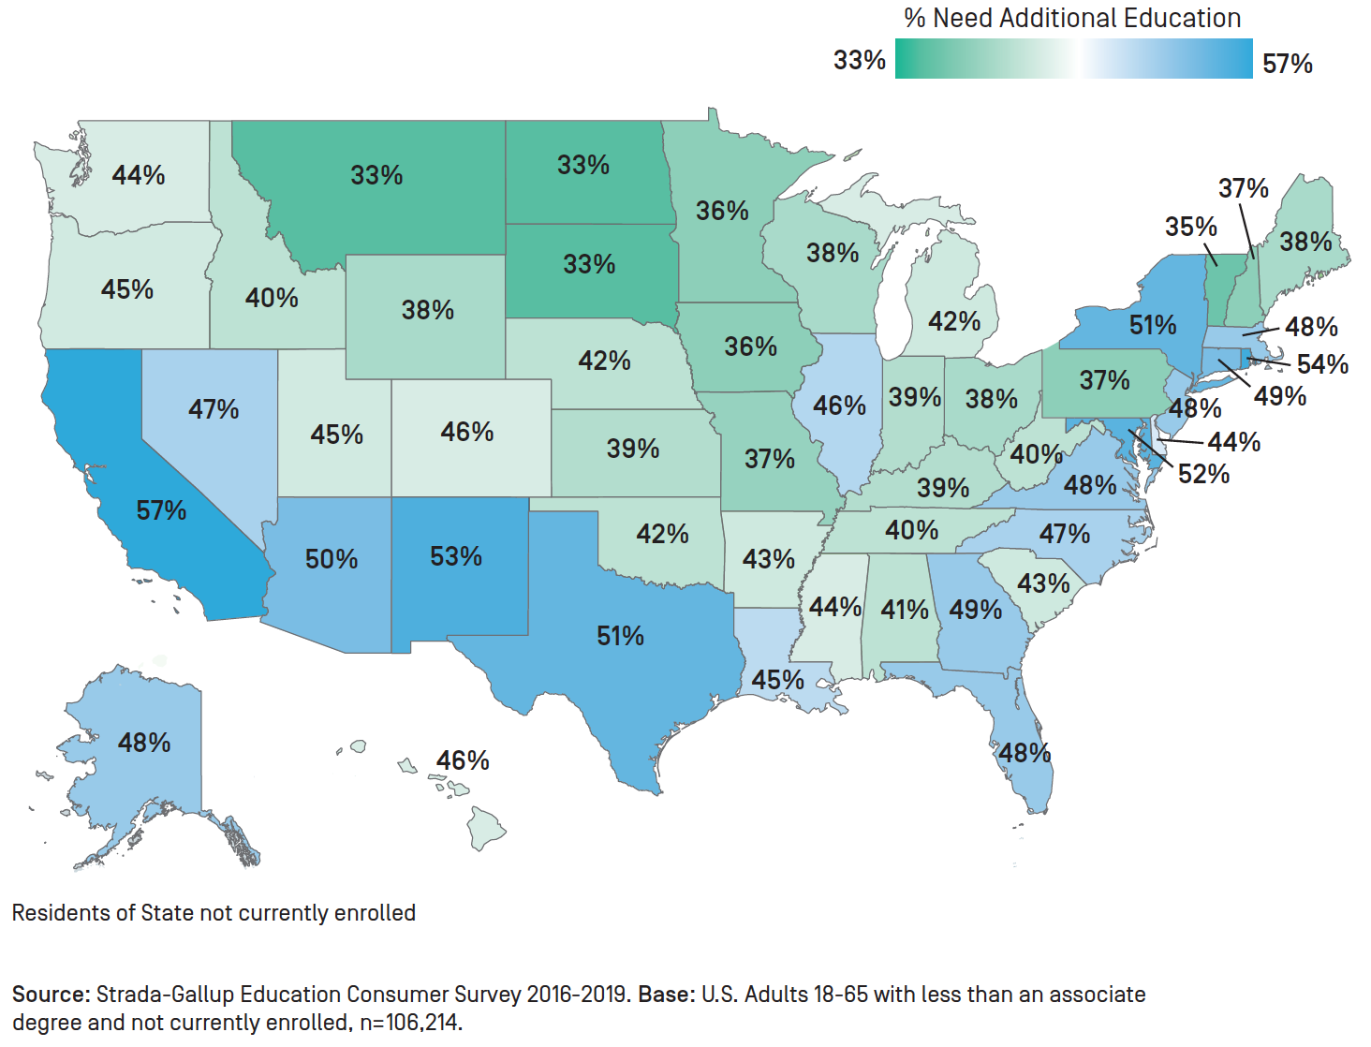
Recognize regional and local differences

Slide 11
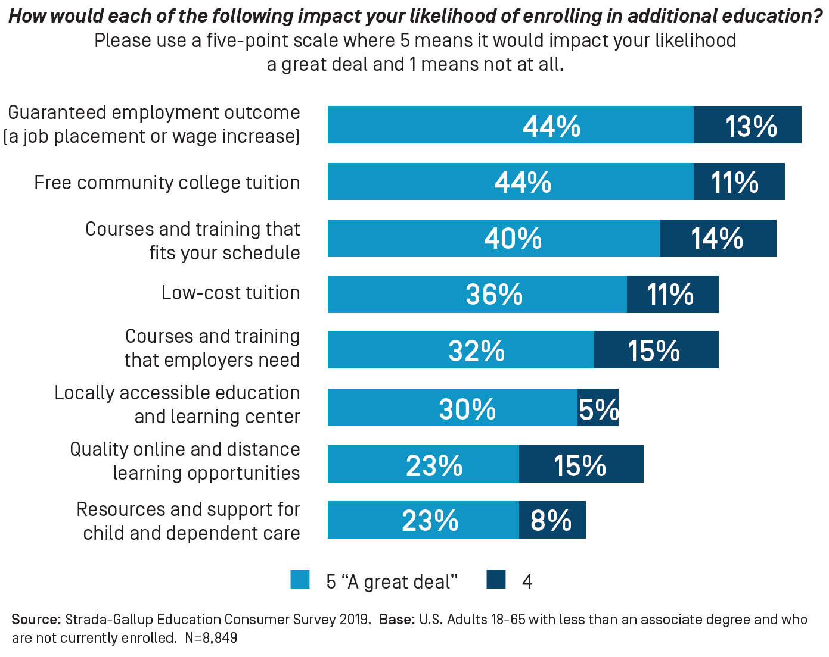
Make employment outcomes clear

Slide 12
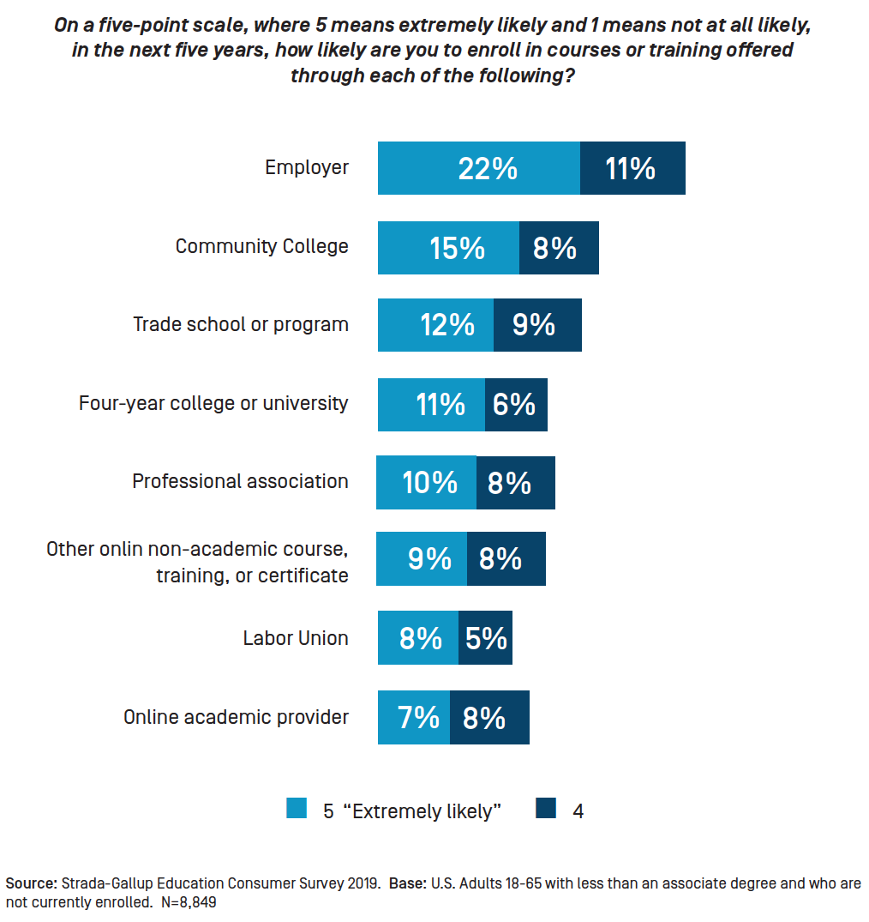
Partner with employers

Slide 13
What are adults telling us about post-secondary education?
They feel the need for more.
Work outcomes motivate them.
Employer participation is expected.

Slide 15
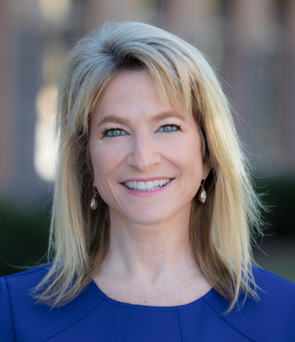
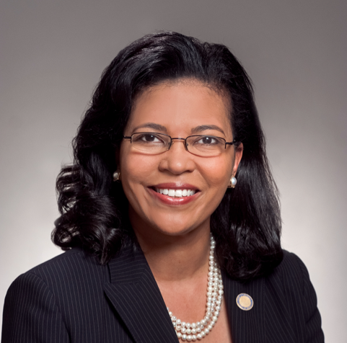
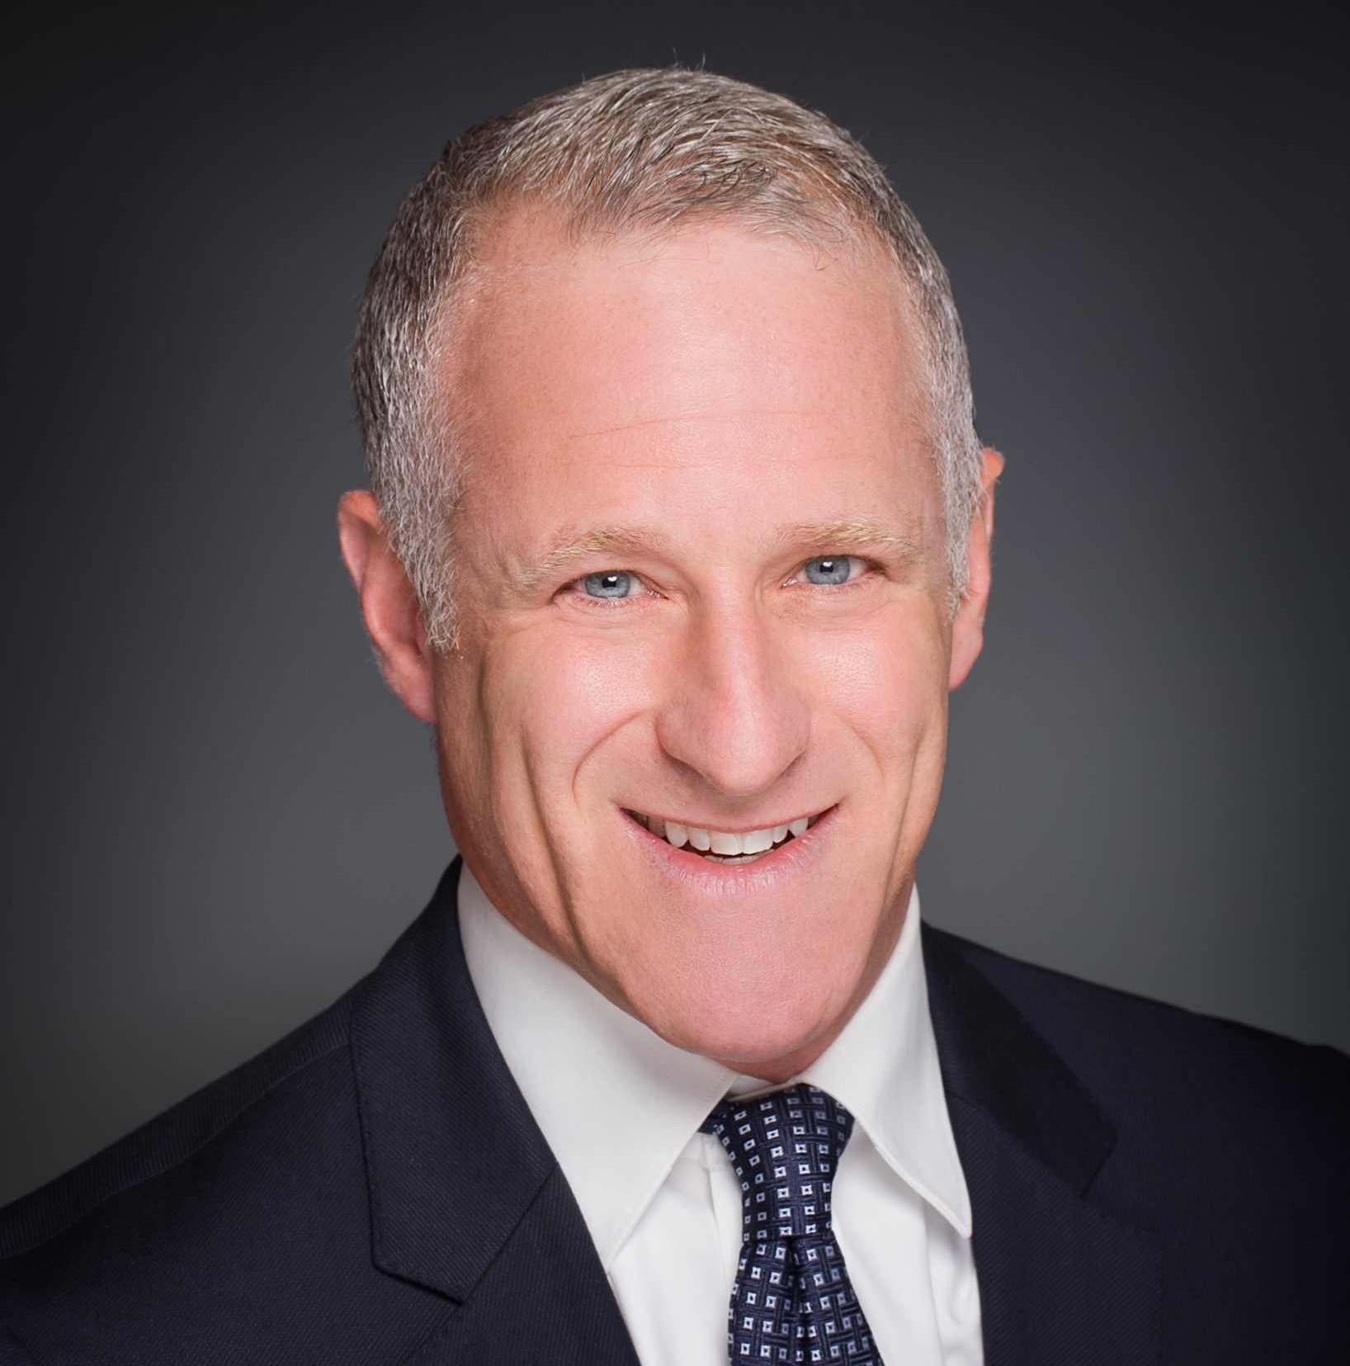
Panel
Michelle Marks, Ph.D. Vice President for Academic Innovation & New Ventures, George Mason University
Kim Hunter Reed, Ph.D. Commissioner of Higher Education, State of Louisiana
Ken Eisner Director, Worldwide Education Programs & Global Lead, AWS Educate, Amazon Web Services

Slide 16
Read the full report at stradaeducation.org/report/back-to-school/ Learn more about the nation’s largest dataset of consumer perspectives on the value of education at https://www.stradaeducation.org/network/consumer-insights/
Resources

