Slide 1
Smart, Succinct and Agile: Strategic Planning in an Age of Uncertainty
An Inside Higher Ed webcast
Thursday, January 24, 2019
2 p.m. Eastern

Slide 2
Presenters
Rick Seltzer, senior reporter, Inside Higher Ed, rick.seltzer@insidehighered.com
Scott Jaschik, editor, Inside Higher Ed, scott.jaschik@insidehighered.com

Slide 3
What is Strategic Planning?
Remarkably varied in form
As practiced today, strategic plans:
Chart a path forward
Help institutions respond to external change
Tie together other forms of planning
Take up a tremendous amount of time and energy

Slide 4
A Very Brief History
Formally adopted by colleges and universities in the 1970s and 1980s
Have become better-known and much more widely adopted since then

Slide 5
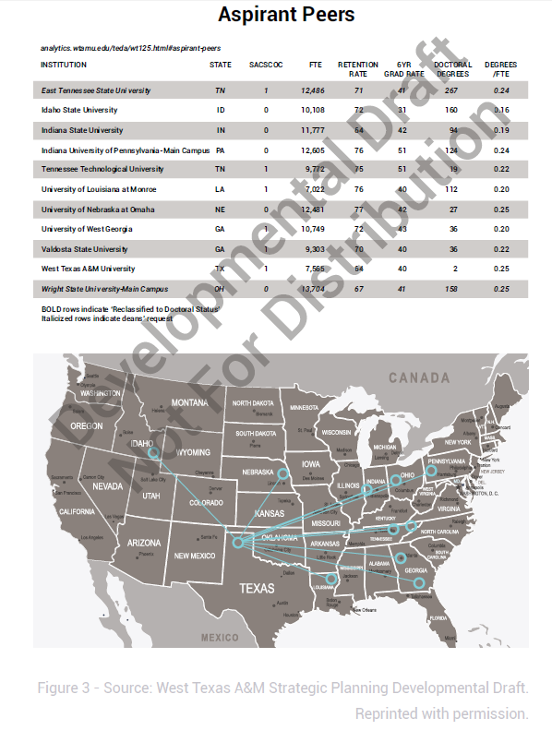
40 Years Ago vs. Today
Source: Wikimedia Commons/Al Costanzo
West Texas A&M Strategic Planning Developmental Draft (Reprinted with permission)

Slide 6
Criticism
“Strategy making is not an isolated process. It does not happen just because a meeting is held with that label.”
-Henry Mintzberg, Harvard Business Review, 1994

Slide 7
Gathering Dust on a Shelf
Wikimedia Commons/Bibliothek Wissenschaftspark Albert Einstein

Slide 8
Skepticism on Campus

Slide 9
Why Plan?
You have little choice
The world is changing
It really can help — even some skeptics have been won over

Slide 10
Understanding Some Problems

Slide 11
One Size Doesn’t Fit All
Context matters
Planning that’s too top-down doesn’t mesh with strong faculty
Planning that’s too bottom-up risks getting nothing done or being scattershot

Slide 12
Taking Stock
What role must this plan fill at this moment in time – and for the next several years
Establish identity and long-term direction
Make hard choices
Win support from key constituencies
Provide political cover
External relations
Coordinate other moving pieces
Emphasize easily overlooked areas – like inclusion and equity
Meet accreditation requirements

Slide 13
Where Do You Go Next?

Slide 14
Key Components
Preplanning
Information Gathering
Drafting
Execution
Measurement and evaluation

Slide 15
Pick the Right Measurements

Slide 16
Who Sits at the Table?
Wikimedia Commons/Fairfax County Chamber of Commerce

Slide 17
Format
Keep it simple
Keep it short
Consider more specificity in an implementation plan

Slide 18
Vision, Mission and Values
Wikimedia Commons/Col André Kritzinger

Slide 19
Rich vs. Poor
Wealthy institutions have the luxury of more flexibility and control over their planning processes
They can also afford to be constantly evaluating
More money can mean being pulled in more directions

Slide 20
Public vs. Private
Public institutions have politicians and taxpayers to worry about
Two-year colleges, four-year colleges and flagships also have their differences
Context remains key

Slide 21
Remember
“Culture eats strategy for breakfast.”
-Peter Drucker

Slide 22
Trends Today
Best practices: Think action, integrated planning
Shorter plans
More tracking
Open to modification

Slide 23
Q&A
Your questions
Your ideas for future coverage

Slide 24
With Thanks ….

