Slide 1
A Survey of Student Affairs Officers
An Inside Higher Ed webcast
Tuesday, April 28, 2020
2 p.m. Eastern

Slide 2
Presenters
Scott Jaschik, editor, Inside Higher Ed, scott.jaschik@insidehighered.com
Doug Lederman, editor, Inside Higher Ed, doug.lederman@insidehighered.com

Slide 3
Methodology
Survey conducted January 16-February 12, before the spread of COVID-19 in the U.S.
Responses from 506 officials.
Survey conducted by Gallup, with questions prepared by Inside Higher Ed.
Complete anonymity in survey results, but answers were coded by sector.

Slide 4
What They Spend Their Time On
Topic | Public | Private
Student mental health | 93% | 96%
Student well-being | 89% | 94%
Hunger and homelessness | 73% | 31%
Race relations | 46% | 57%
Substance abuse | 40% | 38%
Interpersonal violence | 32% | 36%
Free expression on campus | 33% | 28%
Greek life | 19% | 21%

Slide 5
Mental Health -- I
Half of student affairs leaders say they worry about students’ mental health ”a great deal.”
Asked to rate the mental health of students, only 1 percent said that it was excellent, 34 percent said that it was good, 58 percent fair and 8 percent poor.
37 percent said they were very concerned about the impact of student mental health issues on the mental health of those who treat them, and 45 percent were somewhat concerned.

Slide 6
Mental Health – II
Volume of Visits to Mental Health Professionals
 | Public | Private
Increased a lot | 76% | 81%
Increased a little | 22% | 18%
Didn’t increase | 2% | <1%

Slide 7
Mental Health – III
Volume of Students Receiving Prescriptions for Mental Health
 | Public | Private
Increased a lot | 63% | 62%
Increased a little | 35% | 38%
Not increased | 2% | 0%

Slide 8
Race Relations – I
How Are Race Relations on Your Campus?
 | Student Affairs Officers | Presidents
Excellent | 6% | 14%
Good | 48% | 63%
Fair | 39% | 21%
Poor | 7% | 2%

Slide 9
Race Relations – II
How Are Race Relations in Higher Education?
 | Student Affairs Officers | Presidents
Excellent | 0% | 1%
Good | 15% | 18%
Fair | 67% | 66%
Poor | 19% | 15%

Slide 10
Who Is Treated Well on Campus?
The top three: white students, male students, Christian students
The bottom three: LGBTQ students, Muslim students, black students

Slide 11
Campuses and Free Speech - I
 | Strongly Agree | Agree | Neutral | Disagree | Strongly Disagree
Students on my campus generally respect free speech rights. | 15% | 53% | 25% | 6% | 1%
My campus hosts speakers with a variety of views. | 14% | 27% | 32% | 16% | 11%
Conservative speakers are treated with respect. | 22% | 46% | 23% | 7% | 2%
Liberal speakers are treated with respect. | 35% | 48% | 14% | 2% | 1%

Slide 12
Campuses and Free Speech -- II
 | Strongly agree | Agree | Neutral | Disagree | Strongly disagree
Students understand why free speech is important in academe. | 6% | 23% | 37% | 26% | 8%
Colleges should remove those who disrupt speeches from the venue. | 14% | 36% | 33% | 11% | 7%
Colleges should punish those who disrupt speeches. | 6% | 21% | 41% | 22% | 11%

Slide 13
Sexual Assault
 | Strongly agree | Agree | Neutral | Disagree | Strongly disagree
Colleges must improve the way they respond to allegations of sexual assault. | 36% | 38% | 19% | 5% | 3%
My institution handles sexual assault allegations appropriately. | 47% | 41% | 9% | 2% | 1%
Allegations of sexual assault are best handled by local police, not colleges. | 11% | 16% | 23% | 24% | 26%

Slide 14
Homeless and Hungry Students
 | Less Than 5% | 5%-<10% | 10%-<15% | 15%-<20% | 20% or More
What share of your students are homeless | 56% | 26% | 9% | 4% | 5%
What share of you students are food insecure? | 16% | 22% | 14% | 8% | 41%

Slide 15
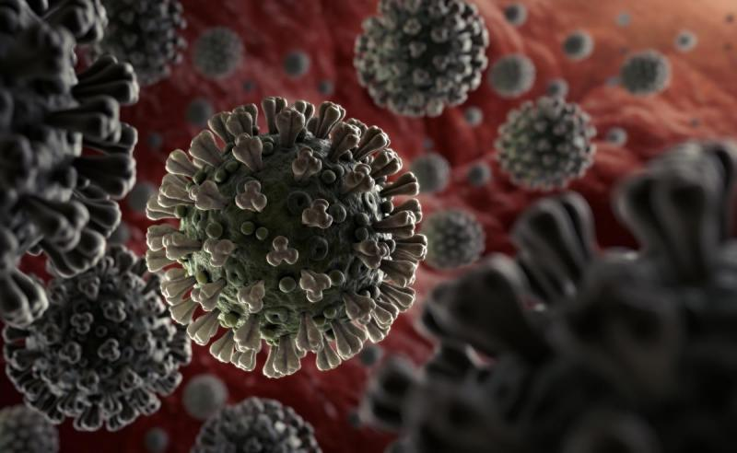
Student Affairs and COVID-19

Slide 16


With Thanks …

Slide 17
Your Questions

