Slide 1
Student Success for Life
An Inside Higher Ed webcast
Thursday, June 20
2 p.m. Eastern

Slide 2
Presenters
Scott Jaschik, editor, Inside Higher Ed, scott.jaschik@insidehighered.com
Doug Lederman, editor, Inside Higher Ed, doug.lederman@insidehighered.com

Slide 3
Interrelated Success Efforts

Slide 4
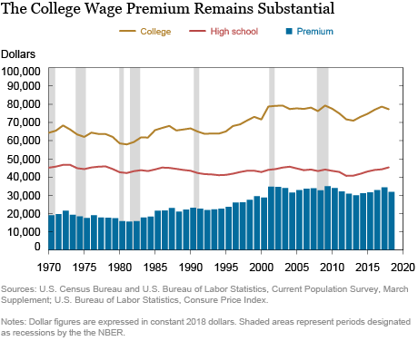
The Economic Value of College
--Federal Reserve Bank of New York

Slide 5
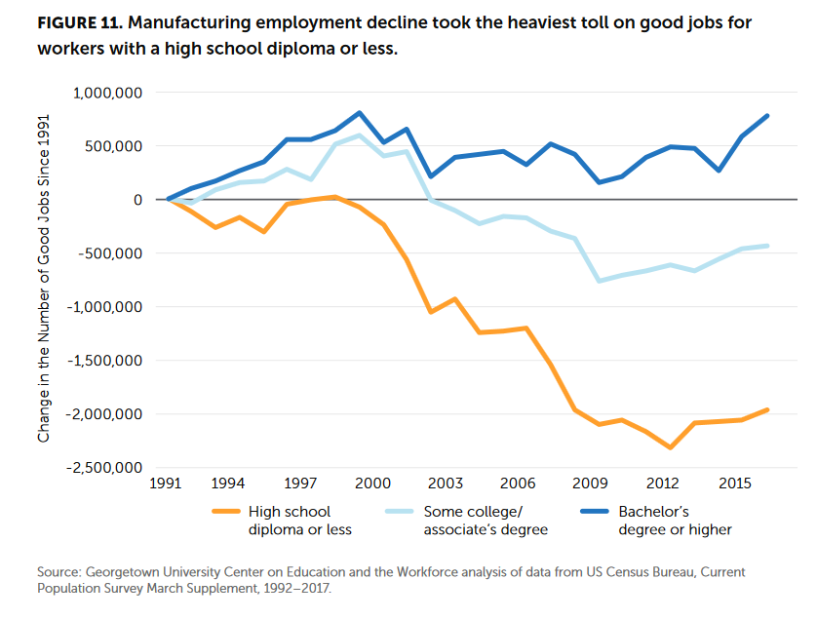
The Loss of Manufacturing Jobs
--Georgetown U Center on Education and the Workforce

Slide 6
If Evidence Is Clear, Why Don’t More People Seek Training?
Fear of student debt
Lack of awareness of “middle skills” jobs
Lack of interest from many male students in growth health professions jobs
Economy with low unemployment, but not necessarily with good jobs
Changing job patterns
False narratives
Racial and ethnic gaps

Slide 7
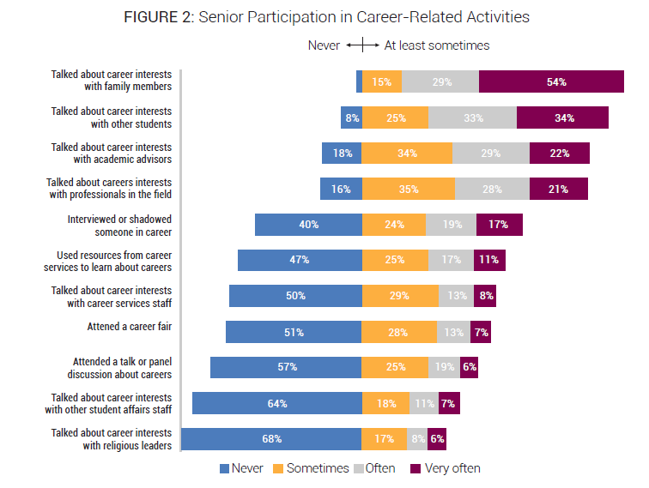
Problems Extend to 4-Year Students
--National Survey of Student Engagement

Slide 8
Assertive Advising – on Academics and Life
Types of programs
Why course selection matters
Completion, debt and careers

Slide 9
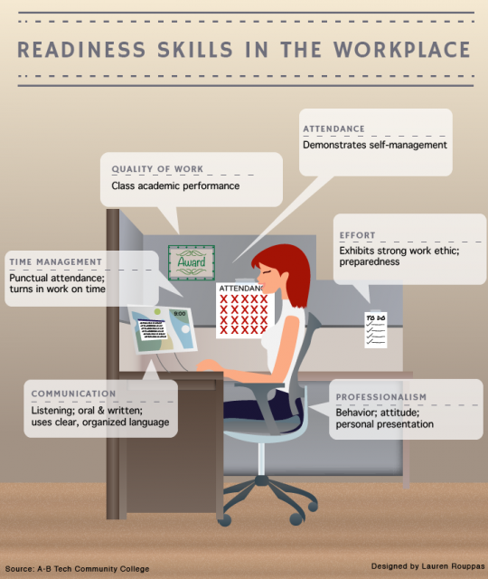
Mixing Soft Skills and Academics
--Asheville-Buncombe Technical Community College

Slide 10
Ending False Divides on Liberal Arts and Gen Ed
-- --iStock

Slide 11
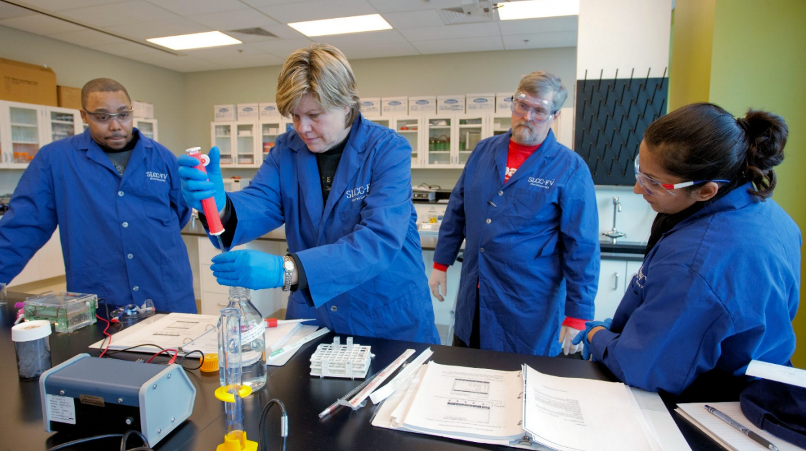
Monitoring Local Labor Markets
--St. Louis Community College

Slide 12
The Work-Study Debates
Is program about helping students earn money, or to prepare for careers?
Is money distributed equitably?

Slide 13
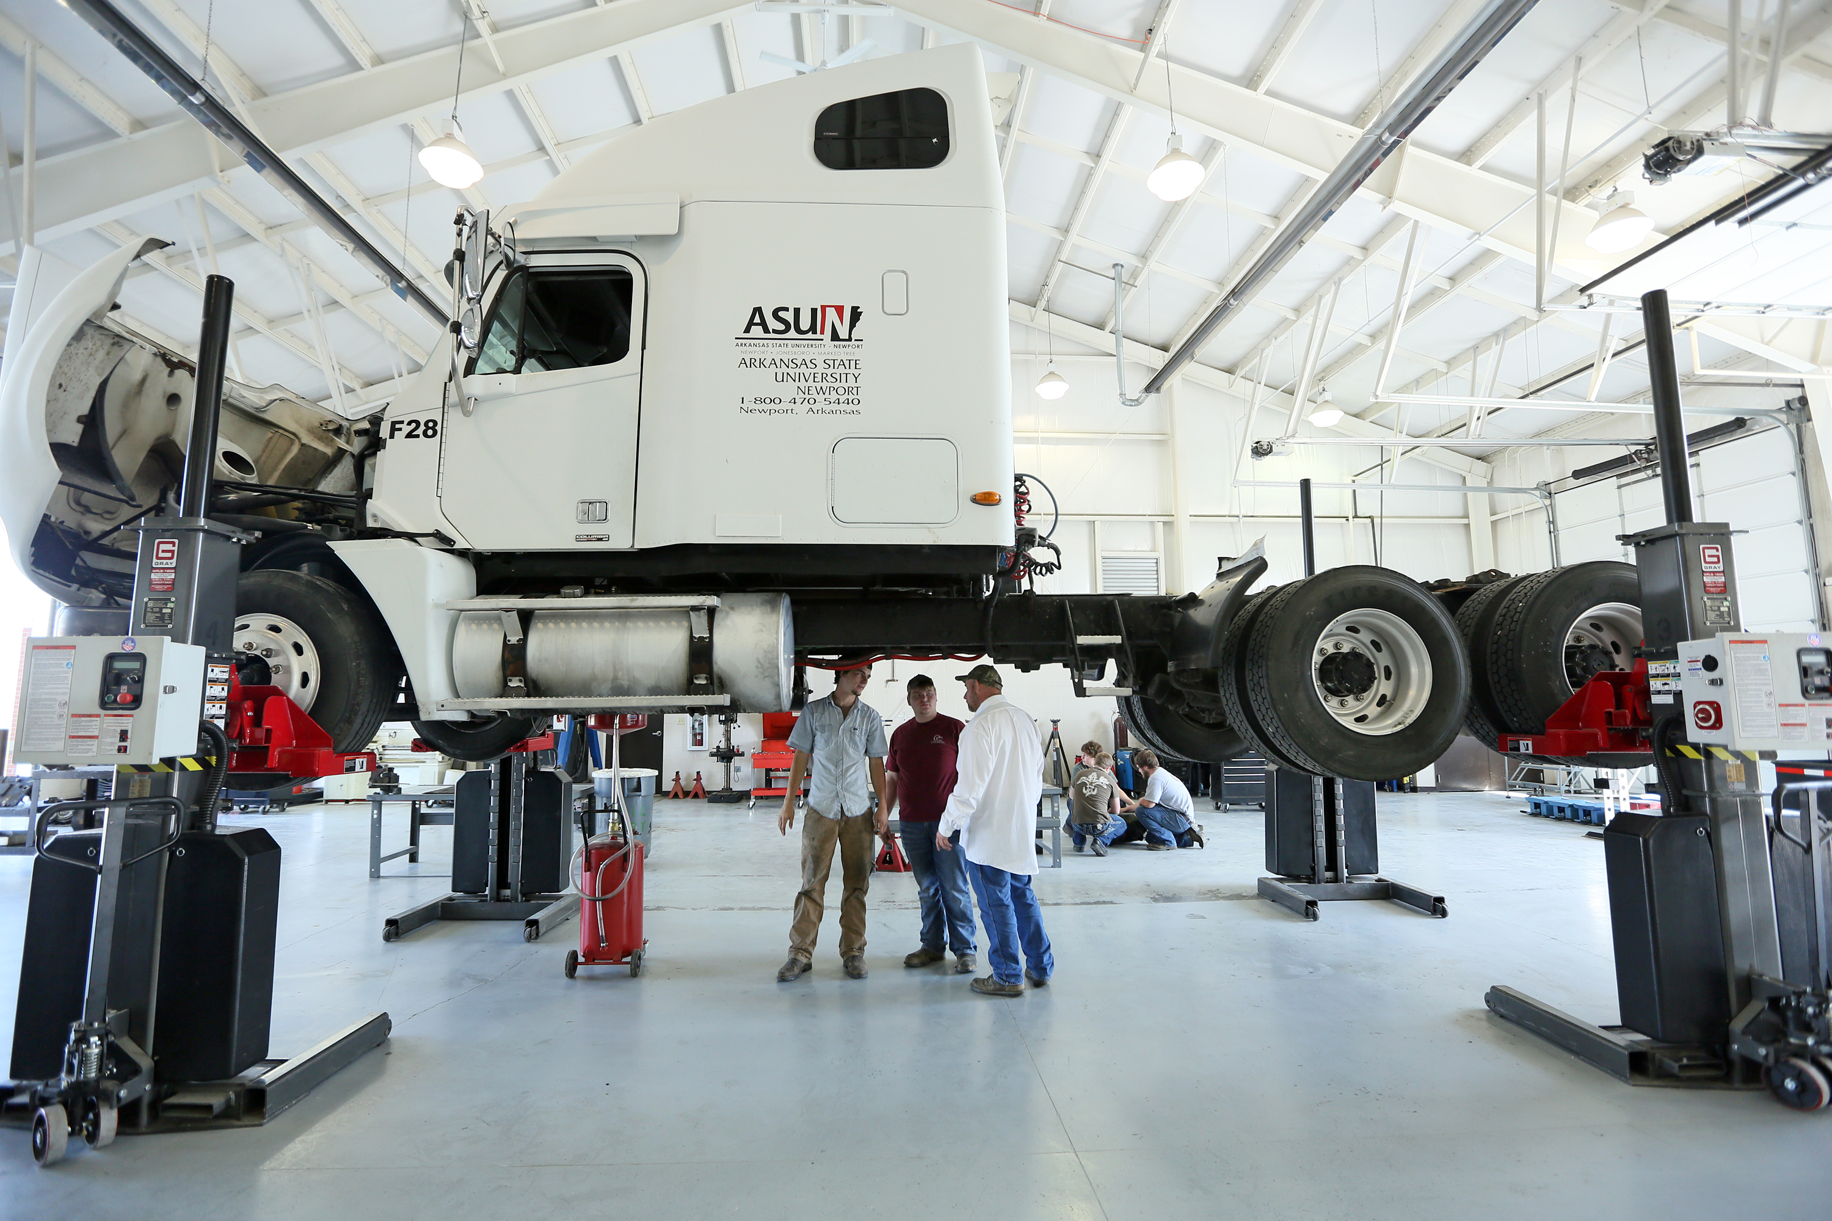
Short-Term Training
Why it matters
Federal aid issues
Public awareness issues

Slide 14
Competency-Based Education
Link to careers
Link to on-and-off approach to learning and career advancement
Ideal academic programs

Slide 15
Pulling It All Together
Recruiting students from out of state
Designing custom programs
Producing graduates ready for good jobs

Slide 16
Q&A
Your questions
Suggestions for future coverage

Slide 17
With Thanks….

