Slide 2
Agenda
Background: The Annual State of Continuing Education Study
Identifying and Defining the Modern Learner Engagement Gap
PANEL DISCUSSION
Understanding Senior Leadership Support
Delivering a Modern Customer Experience in Higher Ed
Q&A

Slide 3
Why We Conduct the State of Continuing Education Survey
Create Visibility
Support Our Community
Identify Trends and Challenges
Notes:
https://moderncampus.com/research-paper/state-of-continuing-education-2021.html

Slide 4
Three Drivers: The Modern Learner Engagement Gap
Modern students think and act like customers
Traditional models don’t prioritize engagement
Disengagement and program misalignment impact enrollment and retention
Notes:
https://moderncampus.com/blog/4-signs-that-you-have-a-modern-learner-engagement-gap.html

Slide 5
Notes:
https://moderncampus.com/why-modern-campus.html

Slide 6
Panel Discussion| Senior Leadership Support
POLL: Do you have leadership buy-in to scale and expand non-degree education at your institution?

Slide 7
Understanding Senior Leadership Support
Do you have senior leadership support to scale and grow non-degree education?
What are the greatest obstacles to scaling non-degree education?
Administrative Burden
Launch Costs
Main Campus Acceptance/Support
Budget/Financial Support
Technology Gaps
Notes:
https://moderncampus.com/whitepaper/how-to-increase-continuing-ed-revenue-with-a-modern-ecommerce-experience.html

Slide 8
Panel Discussion | Modernizing the Customer Experience
POLL: What role should your institutional website play in engaging modern learners?

Slide 9
Words & Actions: The Digital Experience
73%
say digital experience should play a leading role in in student enrollment and retention
10%
Agree that their school’s digital experience is effective today
Notes:
https://moderncampus.com/whitepaper/pathways-and-personalization.html

Slide 10
Does your institution have the technological capacity to deliver the experience non-degree students expect?
Notes:
https://moderncampus.com/whitepaper/why-a-seamless-digital-experience-matters.html

Slide 11
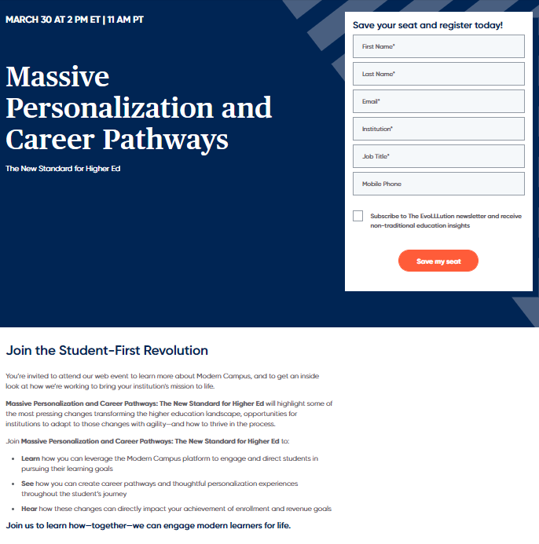
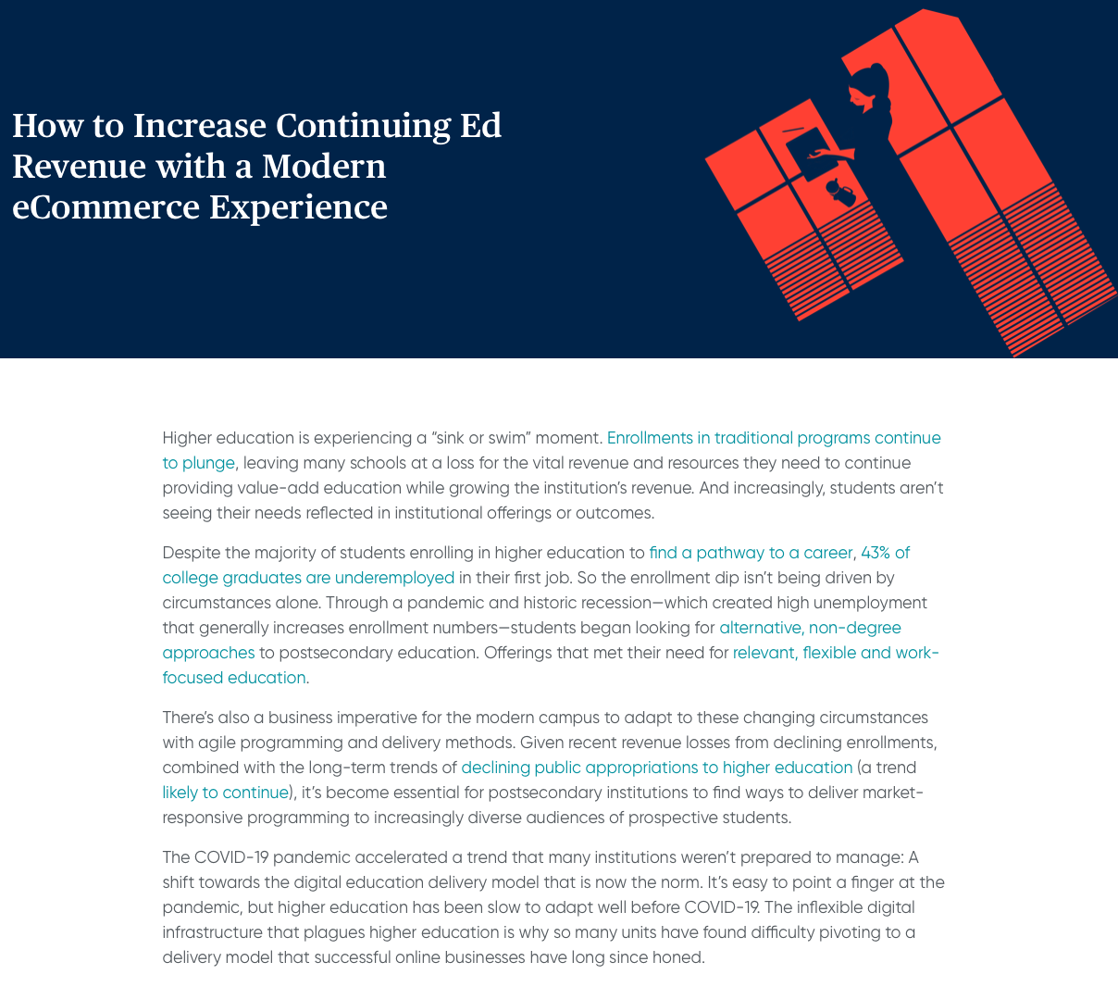
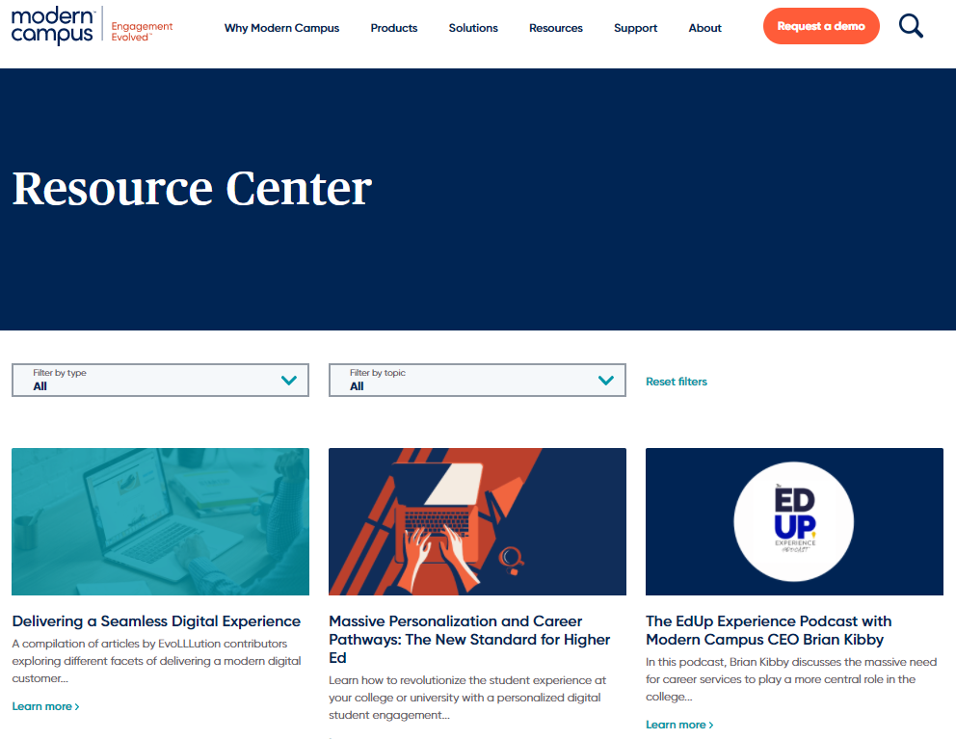
Additional Resources
Massive Personalization & Career Pathways
March 30 Web Event
How to Increase CE Revenue with a Modern eCommerce Experience
Whitepaper
ModernCampus.com
Resource Center
Notes:
https://moderncampus.com/events/modern-campus-orientation-march30.html

Slide 12
Learn how to address the Engagement Gap:
Massive Personalization and Career Pathways: The New Standard for Higher Ed
moderncampus.com/NewStandard
Amrit Ahluwalia
Editor-in-Chief of The EvoLLLution: A Modern Campus Illumination
aahluwalia@evoLLLution.com
Notes:
https://moderncampus.com/events/modern-campus-orientation-march30.html

