Slide 1
Making the Tough Decisions: Critical Business and Enrollment Strategies
An Inside Higher Ed webcast
Tuesday, February 6
2 p.m. Eastern

Slide 2
Presenters
Scott Jaschik, editor, Inside Higher Ed, scott.jaschik@insidehighered.com
Doug Lederman, editor, Inside Higher Ed, doug.lederman@insidehighered.com

Slide 3
When Institutions Don’t Make Tough Decisions
Southern Illinois U jobs for chancellor’s daughter and son-in-law
Unexpected enrollment at Irvine
Michigan State scandal

Slide 4
When Institutions Try (and Fail) to Make Tough Decisions
Sweet Briar’s death and rebirth
Alabama-Birmingham football’s death and rebirth

Slide 5
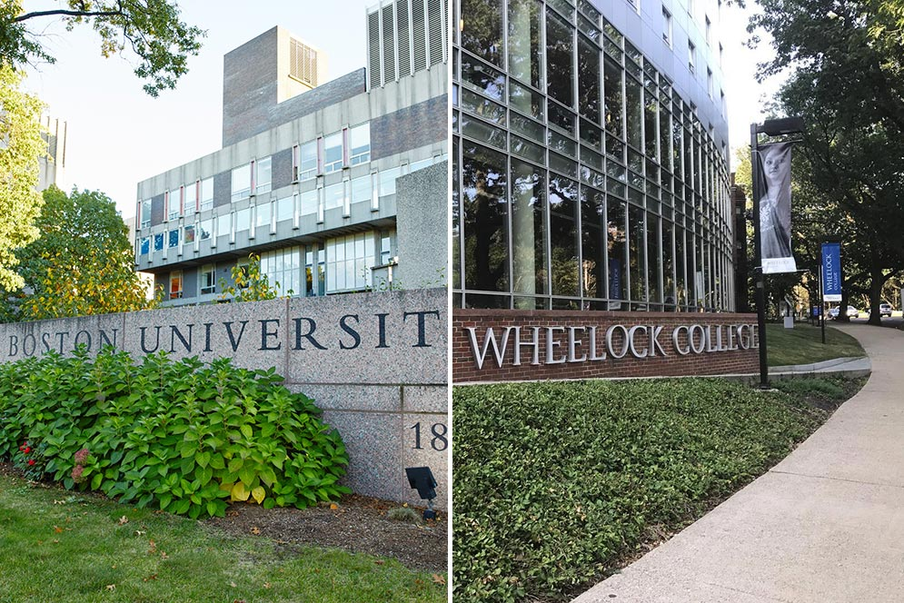
Tough Decision: To Merge
Wheelock-BU
Shimer-North Central

Slide 6
Tough Decision: Not Selling Business School Name

Slide 7
Tough Decision: Keeping Net Tuition Stable for Each Class
(And contrast with tuition “resets”)

Slide 8
Tough Decisions: Making Enrollment Rebound at Regional Publics
SUNY Fredonia
Lake Superior State

Slide 9
Tough Decisions: Facing the Competition by Changing Strategy

Slide 10
Tough Decision: Getting Smaller
Saint Michael’s College
Trinity College

Slide 11
Tough Decision: Giving Up Application Fee Funds
Why colleges are doing it
How colleges are doing it
The payoff (beyond money)

Slide 12
Tough Decision: Closing a Law School

Slide 13
Tough Decision: Going Big Without a Lengthy ‘Quiet Phase’

Slide 14
Tough Decision: Involve the Faculty by Sharing Budget Info
--iStock

Slide 15
Tough Decision: Balancing Mission and Money

Slide 16
Tough Decision: Facing History During Your Honeymoon

Slide 17
The Quandary of Shared Governance
College leaders regularly complain that they are prevented from making tough decisions because various constituents will object.
Faculty members, alumni, students and political leaders regularly reject bold changes because they were never consulted.

Slide 18
Qualities Behind Success
A well defined question/problem
Genuine communication with faculty members and others
Realistic goals and timetables
Leaders who accept not everyone will agree
Alignment with mission

Slide 19
Q&A
Your questions
Suggestions for future coverage

Slide 20
With Thanks …

