Slide 1
Migrating Your ERP to the Cloud
The University of Arizona Experience
December 12, 2017

Slide 2

Introductions
Derek Masseth
Chief Technology Officer
dmasseth@email.arizona.edu

Slide 3
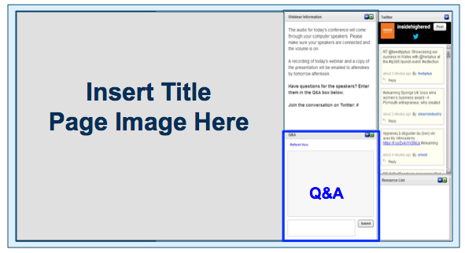
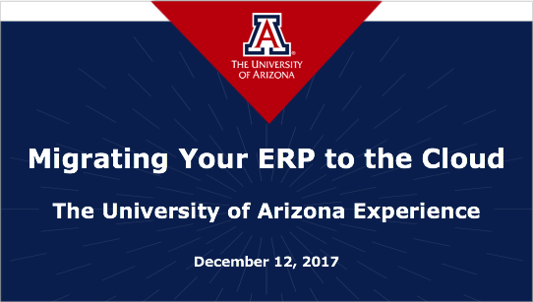
Before We Begin
We are using On24 for today’s webinar. Please enter questions in the text field at the bottom of the Q&A Window.
We are monitoring the discussion and will try to bring the Q&A comments into the conversation.
We are recording the webinar, and will send a follow-up email tomorrow that provides the URL to access the presentation and the slides.
Enter Questions
Here

Slide 4
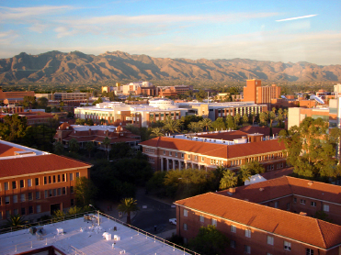
The University of Arizona
Land-grant university
Two medical schools
42,000+ students
Across 300+ majors
13,000+ employees

Slide 5
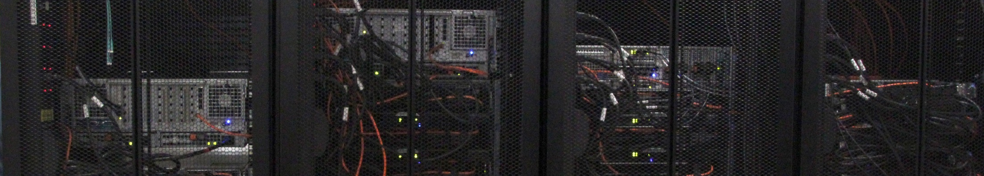
Our Challenge
Constrained on premise infrastructure capacity
Lengthy time to build
Disaster Recovery (DR) testing challenges
Default position of “NO”
Aging hardware

Slide 6
Why Cloud?
High availability & resiliency
Pay only for usage
Peak usage scalability
Agility and responsiveness
Uptime during testing
Reduced risk
Enhanced security

Slide 7
Why AWS?
Pace of innovation
Fixation on customer needs
Attention to security
Enables us to innovate

Slide 8
The Journey to Cloud ERP
RFP
Pilot Projects
Proof of Concept
Staff Training
Leadership Commitment

Slide 9
ERP Roadmap

Slide 10
Why Amazon RDS?
Built-in automation
Building and destroying database instances is a breeze
Backup/recovery is simple, powerful, and fast
Automatic application of patches and CPUs
Built-in encryption
Built-in high availability

Slide 11
Components for Success
People
Building community
Training
Career paths
Accidental exp.
Process
Strategy
Governance
Concrete Project
Communicate
Product
Technology
Cost
Security
Tagging

Slide 12
Measuring Success
Agility, Efficiency & Innovation
Customers & IT have the ability to quickly spin up environments for “What if” scenarios
Close to immediate provisioning of environments
Revolutionizing the software development lifecycle—spin up demo
Opportunity
With the regulations around grant funding, architecting securely in AWS GovCloud gives UA the opportunity to even apply
Availability
No service downtime during disaster recovery testing
Services remain available in the event of campus infrastructure failures

Slide 13
Resources and References
University of Arizona Cloudaprise Site
  https://it.arizona.edu/cloudaprise
AWS: Cloud Adoption Framework
  https://aws.amazon.com/professional-services/CAF/
AWS: Enterprise Cloud Computing on AWS
  https://aws.amazon.com/enterprise/
AWS: Security Best Practices
  https://aws.amazon.com/whitepapers/aws-security-best-practices/

Slide 14

Questions?

Slide 15
Contact
Derek Masseth
Chief Technology Officer
dmasseth@email.arizona.edu

Slide 16
THANK YOU!

Slide 17
Best Practices
Security
Automation
Account Strategy
Tagging Policy
Financial Model—
Forecasting & Cost Management

