Slide 1
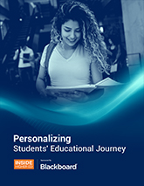
Personalizing Students’ Educational Journey
An Inside Higher Ed webcast Wednesday, July 28, 2021 2:30 p.m. Eastern
Notes:
Hello, and welcome to today’s webcast, “Personalizing Students’ Educational Journey.”
My name is Doug Lederman, editor and co-founder of Inside Higher Ed, and I want to thank you for taking time out of your busy days to join us for this event.

Slide 2
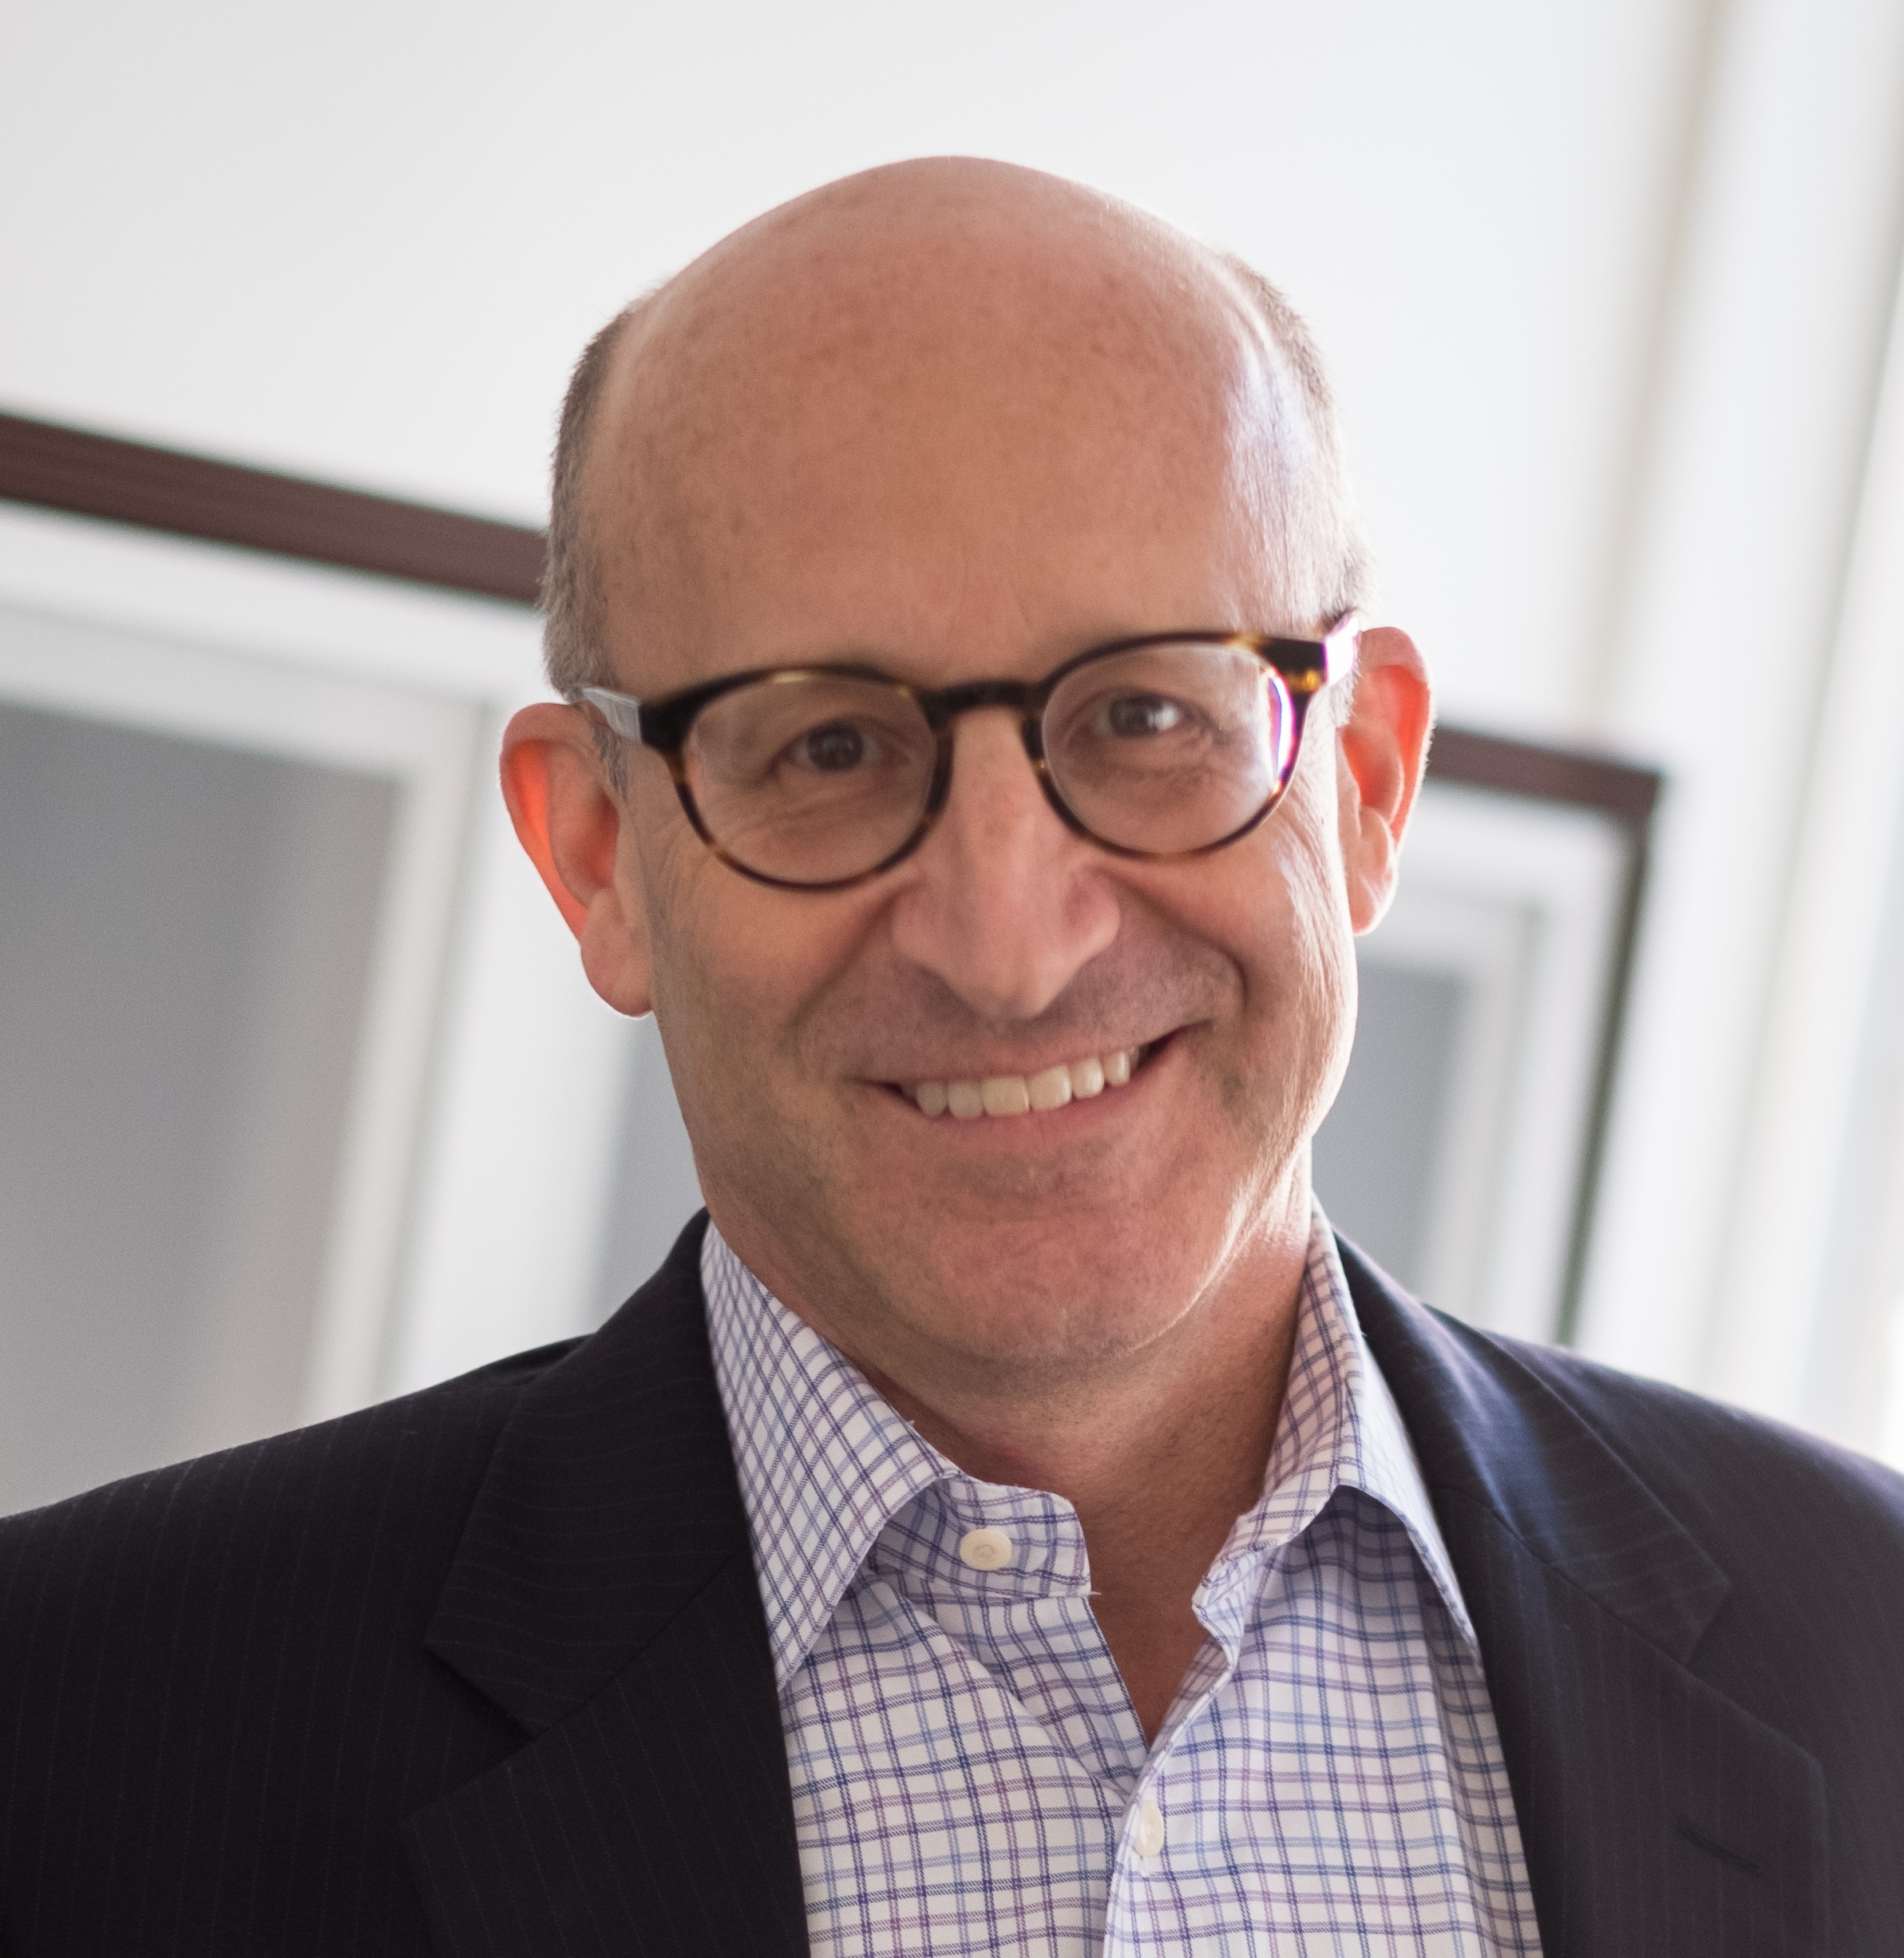
Presenters
Doug Lederman Editor and co-founder, Inside Higher Ed doug.lederman@insidehighered.com
Scott Jaschik Editor and co-founder, Inside Higher Ed scott.jaschik@insidehighered.com
Notes:
Joined today by my co-editor and co-founder, Scott Jaschik.
In the first half hour or so, Scott and I are going to run through a presentation about what we mean by the student journey, why personalization is important, and some of the different ways that colleges, systems and others are going about incorporating personalization into their learning experiences.
IN the second part of the presentation, Scott and I will respond to your questions and comments.
You don’t have to wait until then, though, and we encourage you to start submitting any questions as soon as they occur to you. You can do that in the Q&A field next to the presentation box on your screen. You’ll only see the questions that you submit. We won’t read your name or institution unless you specifically want us to – please include your name or institution, or institution type, in your question if you think that information will help us answer your question more effectively.
Couple other housekeeping items:
Encourage you to tweet about today’s webcast … hashtag is #IHE
Before we begin, I wanted to offer a note of thanks to AWS, whose advertising support has made this webcast possible. AWS has numerous tools for cloud computing for colleges and universities, and we very much appreciate its support.

Slide 3
Evolution in Perception of the Institution’s Role
Access
Completion
Student Success
Lifelong Learning
Notes:
Want to start with some background thoughts to put the discussion about personalization in content, starting with a discussion about how the thinking about a college education has evolved.
From early days … and by that I mean well into past,
college for the few, you’re lucky to be here to soak up the knowledge we’re going to impart to you …
steady expansion of view of higher education as a public good (from land grants to GI Bill to Pell Grant) for which greater access was the goal …
In last couple of decades, Increasing pressure on colleges (amid mounting tuition/debt, public doubts), from accountability standpoint and because it was “right thing to do”) to ensure that the students they enrolled completed their educational program; not just students’ responsibility whether they complete …
We’ve refined that language in the last few years to being about “student success,” which recognizes that completion of a credential (almost always defined as a degree) may not be a learner’s only goal, and that more granular indicators of student progress and growth were needed. And that it was an institution’s obligation to help students get there. (striking, related to one of the articles in the booklet on which this webcast is based, that Biden admin’s American Families Plan would include sizable pot of $$ ($62B) to help institutions that enroll signif numbers of low-income students support persistence and completion … probably biggest investment ever in “student success” … )
Additional reality: given the pace at which economy (and jobs) are changing, most people will need to continue to learn new skills and accumulate new knowledge to keep pace. So less about finishing one credential or segment of learning and more about regular growth, ideally always contextualized in what has come before (and what might follow).

Slide 4
No Single ‘Journey’
Aelitta/iStock/Getty Images
Notes:
Another reality is that as higher education has become much more diverse over time, it’s become more and more obvious just how different learners’ backgrounds, preparation, goals and the like can be.
The matrix of possibilities is almost limitless now – variations based on demographic traits such as gender, age, race and ethnicity, first gen status, socioeconomic background; situational questions such as intensity of study, whether they work; online vs. in-person (and along that continuum); program of study, academic strengths and weaknesses;
Many of those can affect a learner’s success in various ways …
so institutions need to understand how different types of students fare; so question of “what do we do well? And not” is far too simplistic a question if institutions are going to be held responsible for how their students do collectively …

Slide 5
The COVID-19 Impact
This Photo by Unknown Author is licensed under CC BY-SA
Notes:
So many ways that pandemic and recession affected higher education – some it’s probably too early for us to know for sure.
Among those that are most relevant to this presentation, including the ways in which the pandemic may have changed institutions’ view about how they deliver their educations … as well as student expectations.
Most significant may be renewed/expanded appreciation for students as people, and how different their situations and experiences are. Quite literally got a view inside students’ lives – issues that mattered pre-pandemic but became front and center during it. Do they have decent technology? Safe/comfortable places to study? Balance school and work and life?
Heightened awareness of the unlevel playing field makes even more important (per the last slide) a greater recognition of just how many different paths they may want to take, and the need to get a clearer, more granular sense of who our students are, how different types of them are faring, and – ultimately and perhaps ideally – a greater ability to give each of them the experience they individually want or need.
That may remain aspirational to some extent, but at least moving in that direction is also becoming an imperative … and rest of webcast will talk about some of the prerequisites for personalizing students’ learning paths …
Also a reality (setting up next slide) that the increased use of virtual/remote learning may have opened up a lot of faculty eyes (and perhaps administrative ones, too) to how much more we (CAN, MIGHT, if not DO) learn about students through virtual interactions – a lot more information is captured … (segueway to next slide)

Slide 6
The Data Imperative
Metamorworks/iStock/Getty Images
Notes:
All the reasons why institutions need to have a better sense of how different groups of students fare … as granular as possible.
--From start of journey – which students typically thrive at the institution; for those who don’t, why not; how to get better? Who should be admitted?
--how do institutions decide what a student’s needs are as they enter? And decide what kind of supports to provide to students based on their educational (and other) needs?
--continues all the way through the student’s journey:
in helping them understand which programs of study might be best for them
Getting alerted (and reaching out to the students) when they stumble
Understanding how they learn best (in what modes, etc.)
All the way through to careers …
Any thoughtful strategy of using data to help students on their educational paths has to take seriously issues of privacy and student awareness of how their data are being used … that’s another webcast altogether, but would be remiss not to mention it …
Now going to shift to some of the other topics explored in the booklet …

Slide 7
Student Expectations for How They Learn
Notes:
Have always had some students who determine (and probably more who would like to determine) how and when they learn …
But particularly for a lot of traditional-age undergrads, they’ve often been limited in their options – this is when this course is, this is how we’re teaching it, take it or not.
Pandemic blew that up … and while many students yearn to return to campus, don’t think institutions can comfortably assume that their expectations for how they learn will remain as they were.
Don’t think we’re going to see millions more students flock to online only study – but may see many more students wanting the flexibility that many of them experienced (some for the first time) during pandemic’s remote learning. How will institutions fare with that – will they let students truly choose, giving them more control over their learning environments and experiences? Or try to force them back into what works best for the institution (and faculty)?
Speaking of: not sure we know how FACULTY will respond, either. Lots of professors enjoyed their newfound flexibility, too …

Slide 8
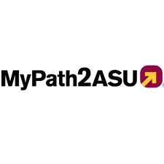
The Role of Technology
“Technology tools can also give students more control over their academic and career pathways. Many higher education professionals take pride in guiding students through the higher education system, but our goal should be to make the system transparent and easy to navigate. We need to put the right information into the hands of students at the right time so that they have the agency and autonomy to do what is in their best interests.”
--Maria Hesse and Cheryl Hyman, Arizona State U
Notes:
Technology often overpromises … and critics often assume that technology produces a lowest-common-denominator result, taking out the human element of unpredictability and choice.
But of course all depends on how it’s employed ….
Nuanced discussions about the role of technology – all too rare in today’s ever-politicized environment – avoid suggesting that technology is going to improve on the work of learning professionals (be they faculty or staff) and instead focus on the ways that giving those professionals more tools with which to do their work is going to help them serve students better.
Various ways it can do that:
--extending their reach by creating interactions with students at times and in places that people can’t (or that institutions historically don’t)
--letting technology perform functions (typically lower level ones) so that the human beings can focus on the things that people do best (or sorting
--
Pandemic forced student services areas that hadn’t necessarily been easily accessible to change … tutoring, etc. (story in there about new providers. ..)
Story about software Arizona State has built to help transfer students maneuver into and through the massive university.
Software does many things, including helping an individual student determine how many credits he or she will be able to transfer into the university, and to match those credits to the university’s programs so a student knows how far along she will be in the various majors she’s interested in.
Also allows for much greater personalization of advising. This is one of those areas where, theoretically, technology might be seen as replacing a whole cadre of tutors that a community college or four-year university might hire.
But as Maria Hesse and Cheryl Hyman write, “For years, people have proposed increasing the number of advisers at community colleges and universities, to help students make informed choices about their career goals, select an academic program and support their progress toward a degree. But the reality is that budget constraints do not allow most institutions to add significant numbers of new positions that would bring down advising caseloads to more manageable sizes. Further, no one adviser can or should be expected to know all there is to know about the hundreds
So in this case technology isn’t replacing people – it’s providing support that wouldn’t necessarily get provided at all …

Slide 9
Nudging’s Promise (and Limits)
“Is text message-based nudging a magic bullet that can solve all of the issues facing higher education during this challenging period? No. But it can be an effective, scalable and efficient way to engage, support and encourage college students in this unprecedented time.” --John M. Burdick and Emily Peeler
Notes:
(reminder about questions)
In booklet … two examples of institutional experiments (nyu and duke) with various kinds of nudging …
different “nudges” work differently … and not a panacea
Nudging should be considered when the goal is to create small, incremental changes in student choices, not effect large behavior changes.
Difference between “nudges” and nags: (“no one likes being nagged”)
Not just reminders to do things …
Georgia State University found that offering customized messages, instead of form letters, reminding students of pre-matriculation tasks reduced the number of enrolled students who never showed up on campus by 21 percent. Several other universities found that slightly reducing the size of dorm rooms while offering expanded common spaces increased student retention and collaboration.

Slide 10
The Secret Weapon: The Faculty
Notes:
Talked earlier in the slide about how pandemic may have changed faculty members’ roles – making them the true front-line worker in higher ed, not just on the “learning” that happens in their classrooms but also many of the supplemental ways that institutions support students … profs as main conduit to academic services and the face of the institution as lots of other interactions were stripped away …
Probably laid bare for many faculty members how much their staff colleagues in academic and student support services do for students, and how essential they are, in ways that might help us move closer to the idea of education as a team sport.
But also increased awareness among college leaders about the importance of teaching and how important it is for them to make sure faculty members are prepared to be effective classroom leaders … saw a lot more professional development (mostly around online education, of course -- )

Slide 11
Your Questions? And Thanks …

