Slide 1
Technology’s Role in Returning to Campus Safely: The University of South Florida’s COVID-19 Journey

Slide 2
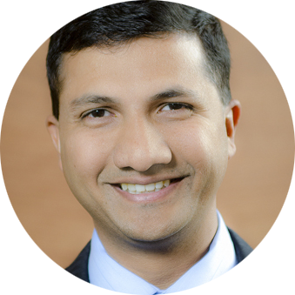
Webinar Speakers
Dr. Donna Petersen
Dean of College of Public Health and COVID-19 Task Force Chair
University of South Florida
Alice Wei
Senior Director of Transformation & Innovation University of South Florida
Sidney Fernandes
Vice President of Technology and CIO University of South Florida
Michael Beckley
Chief Technology Officer and Chief Customer Officer
Appian

Slide 3
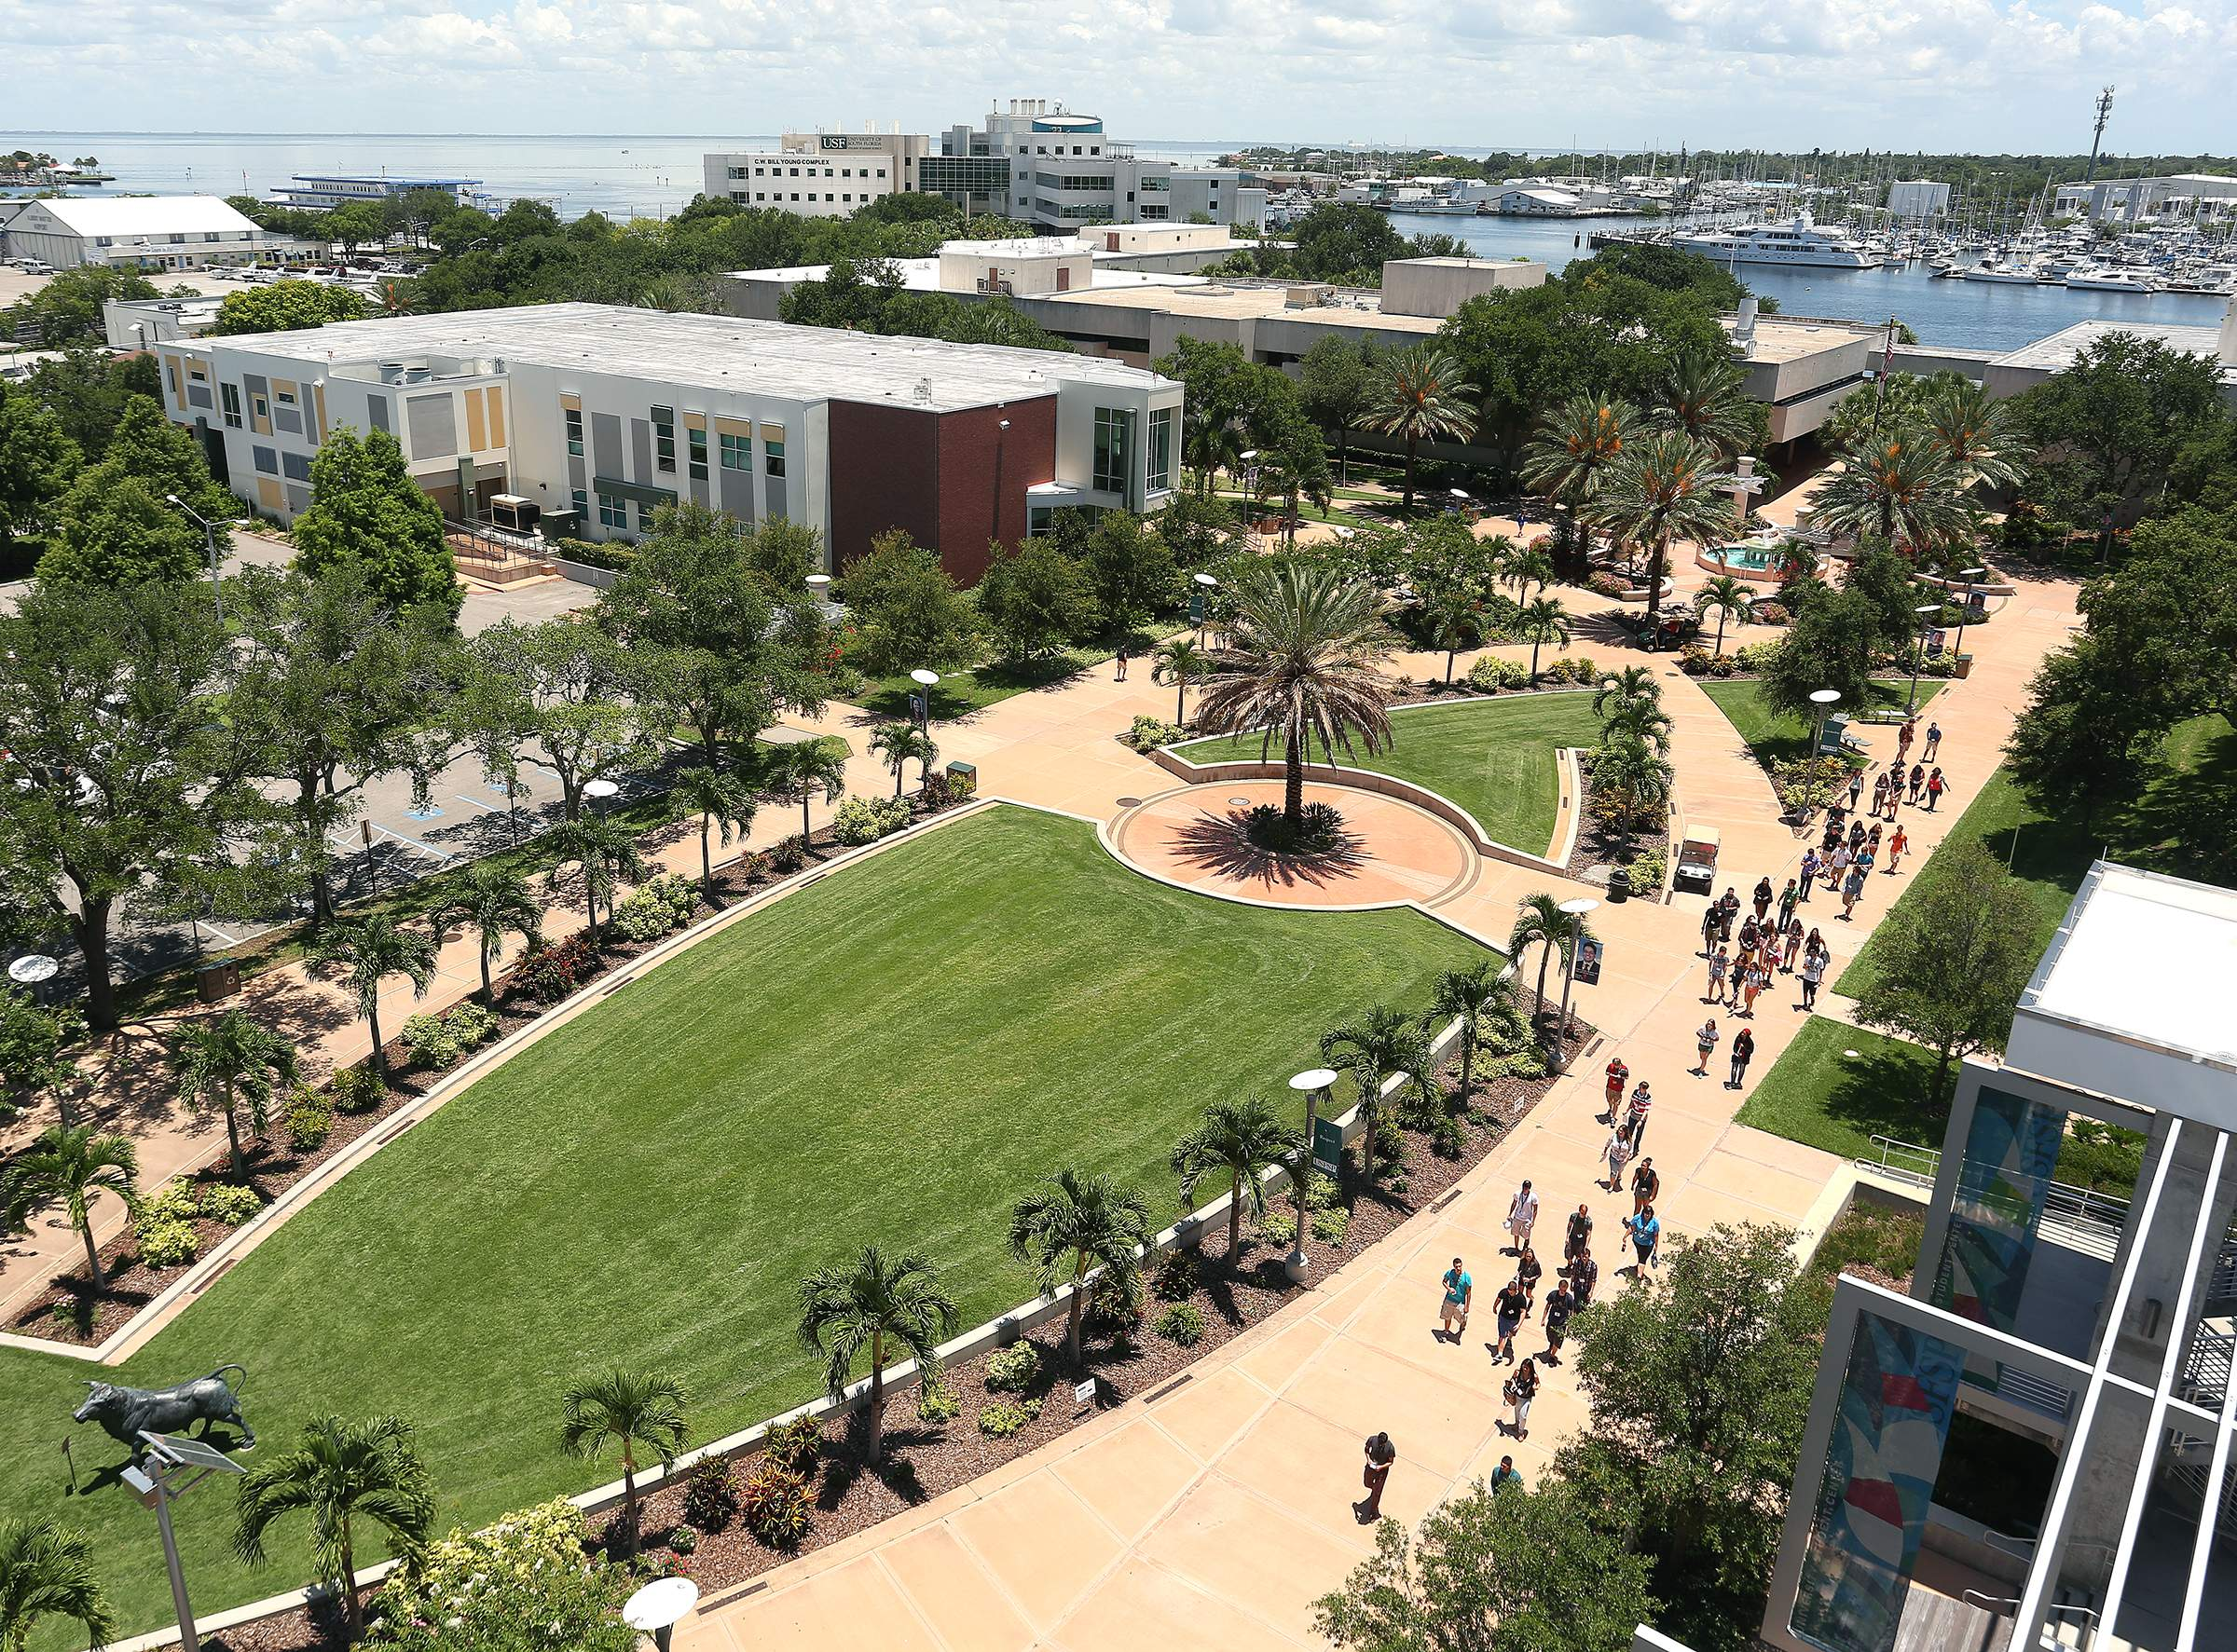
COVID-19 safety management for 50,000+ students, faculty, researchers, staff, and vendors. Coordinate and communicate across all stakeholders with one platform.
Notes:
The University of South Florida - an Appian customer since 2015 - sought a solution to coordinate the safe return of their academic community, which includes roughly 100,000 students, faculty, and staff members to their 5 campuses across the state of Florida, amid the COVID-19 pandemic.
They assessed the existing return-to-the-workplace solutions on the market and found that they fell short. Higher education institutions’ have unique needs, such as the size of their populations and on-campus residential living. As a result, USF and Appian partnered to develop CampusPass, enabling the university to safely coordinate and communicate with all their constituents.
USF is initially focusing on 3 unique populations: students, faculty, and staff. They’re conducting two different health screening surveys. One is a detailed, role-based “intake” survey with 70 questions to determine who is eligible for consideration to return to campus. Once on-campus access is authorized, then a brief, daily health check-in survey will be conducted to ensure that on-campus access should continue to be authorized.
The Intake phase of the CampusPass solution launched July 1st to a pilot group of 600 users, and will go live to the entire USF population at the end of July. The daily check-in phase, with automated return-to-campus authorization via Mobile Pass, will roll out as their community begins returning to campus in August. USF is planning to randomly test 10% of its population every few days. If at that time, they discover an on-campus COVID-19 exposure, they will leverage the CampusPass contact tracing and isolation processing functionality.

Slide 4
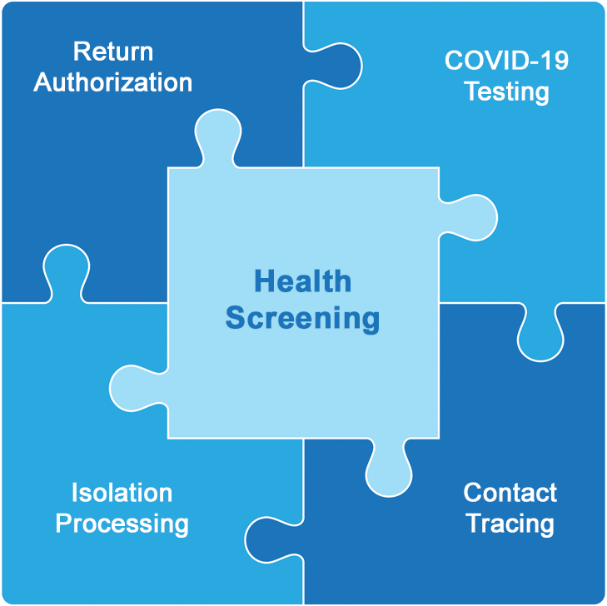
Key Components for Return to Campus and Beyond
Intra-Institutional Collaboration
Governance
Security & Compliance
Notes:
One of the key learnings from speaking with academic institutions is that all the processes and activities required to return communities safely back to campus must be fully integrated. If these capabilities operate in silos, speed and efficiency is lost, increasing the risk of an on-campus virus exposure spreading. We believe these 5 capabilities are integral to a successful, safe return to campus.
Health Screening - It begins with the health screening of everyone. Most institutions are planning on doing this on a daily basis. This will generate mountains of data that will need to be reviewed.
Return Authorization - For those populations that need to return to campus there then needs to be a return authorization. Doing this in a scalable manner is important.
Contact Tracing - We hope it doesn’t happen, but at some point there will be an on-campus COVID-19 exposure. The speed at which it is detected, traced and managed will determine the success of any campus reopening.
Isolation Processing [Only applies to universities with students living on-campus] - Unfortunately, at some point an on-campus residential student may also become sick or exposed to COVID-19. Ensuring that the student gets isolated quickly is critical. We’ve learned that universities are considering designating a COVID-19 dorm, to isolate on-campus students and staff as needed.
Virus Testing - Testing is a key component. Many institutions are planning for random testing of a percentage of their population every few days. In addition, unhealthy results to a check-in survey may also result in testing.
[Build slide] All of this has to seamlessly work together to be effective. To be successful it needs to be underpinned by:
Intra-institutional collaboration so that all internal stakeholders are working together
Governance that provides a common set of standards, policies, enforcement, reporting, and audit trails
Security & compliance to ensure that all personal data and sensitive health data is protected (FERPA, HIPAA, HiTRUST, GDPR)

Slide 5
Key Components for Return to Campus and Beyond
Intra-Institutional Collaboration
Governance
Security & Compliance
Notes:
One of the key learnings from speaking with academic institutions is that all the processes and activities required to return communities safely back to campus must be fully integrated. If these capabilities operate in silos, speed and efficiency is lost, increasing the risk of an on-campus virus exposure spreading. We believe these 5 capabilities are integral to a successful, safe return to campus.
Health Screening - It begins with the health screening of everyone. Most institutions are planning on doing this on a daily basis. This will generate mountains of data that will need to be reviewed.
Return Authorization - For those populations that need to return to campus there then needs to be a return authorization. Doing this in a scalable manner is important.
Contact Tracing - We hope it doesn’t happen, but at some point there will be an on-campus COVID-19 exposure. The speed at which it is detected, traced and managed will determine the success of any campus reopening.
Isolation Processing [Only applies to universities with students living on-campus] - Unfortunately, at some point an on-campus residential student may also become sick or exposed to COVID-19. Ensuring that the student gets isolated quickly is critical. We’ve learned that universities are considering designating a COVID-19 dorm, to isolate on-campus students and staff as needed.
Virus Testing - Testing is a key component. Many institutions are planning for random testing of a percentage of their population every few days. In addition, unhealthy results to a check-in survey may also result in testing.
[Build slide] All of this has to seamlessly work together to be effective. To be successful it needs to be underpinned by:
Intra-institutional collaboration so that all internal stakeholders are working together
Governance that provides a common set of standards, policies, enforcement, reporting, and audit trails
Security & compliance to ensure that all personal data and sensitive health data is protected (FERPA, HIPAA, HiTRUST, GDPR)

Slide 6
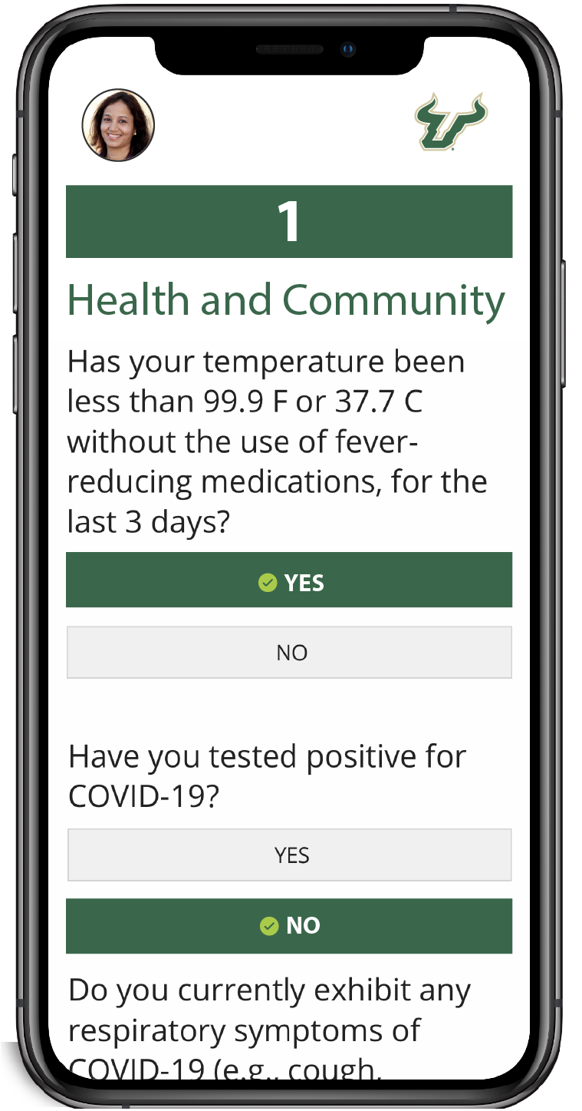
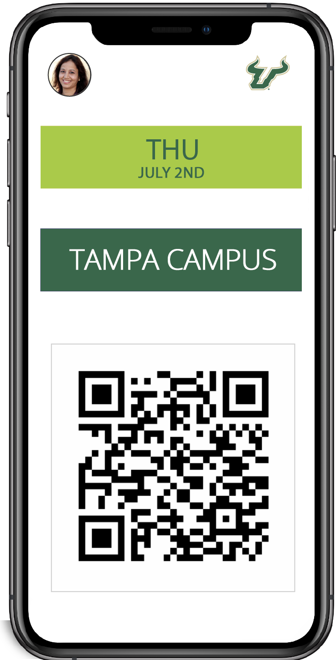
Safely Return with Appian CampusPassTM
Holistic Solution
Centralize and automate all key components to return to campus.
Easily Configured
Technical skills and integrations not required.
Quickly Deployed
Get up and running in hours. Deploy in days.
Secure and Safe
Health data stored in certified HIPAA-compliant and HITRUST certified cloud. Enables FERPA and GDPR compliance.

Slide 7
Thank You
CampusPass@appian.com
appian.com/campuspass

