Slide 1
Enrollment Concerns
An Inside Higher Ed webcast
Wednesday, June 17, 2020
2 p.m. Eastern

Slide 2
Presenters
Scott Jaschik, editor, Inside Higher Ed, scott.jaschik@insidehighered.com
Doug Lederman, editor, Inside Higher Ed, doug.lederman@insidehighered.com

Slide 3
Before COVID-19
Competitive private colleges
Public research universities
Regional state universities
Liberal arts colleges
Community colleges

Slide 4
What the Surveys Said…
Students weren’t going to come.
Students would stay close to home.
Concerns over health and finances were ruling the day.

Slide 5
Why Is the Reality Different?
Colleges have announced their plans, and many of those plans involve re-opening.
Most students believe they will be healthy.

Slide 6
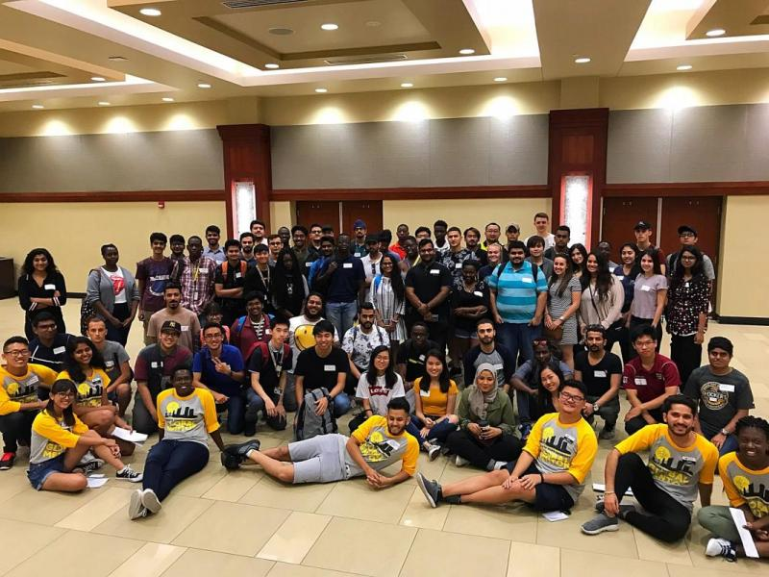
International Students
--Wichita State University

Slide 7
Very Competitive Colleges
--Yale University

Slide 8
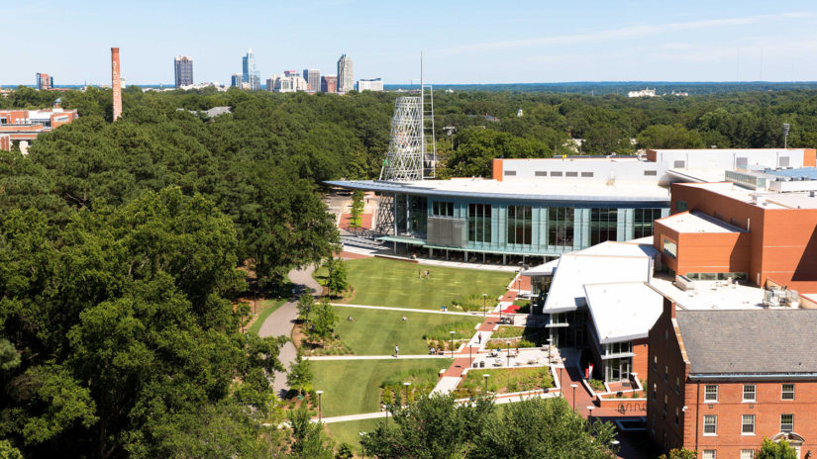
Public Research Universities
--North Carolina State University

Slide 9
Regional State Universities
No clear trend

Slide 10
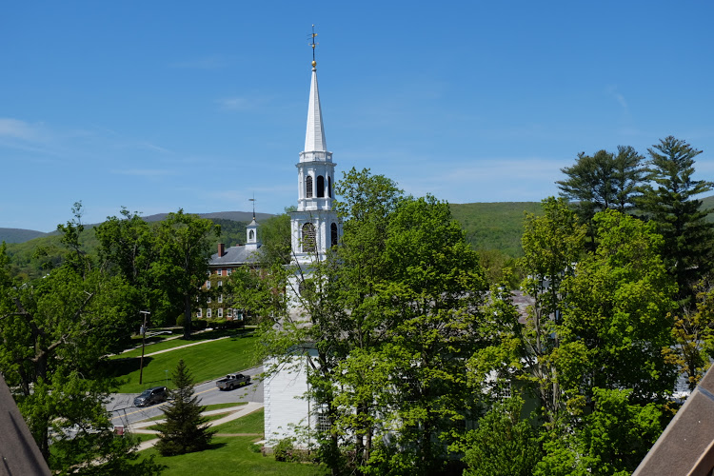
Liberal Arts Colleges
--Williams College

Slide 11
Community Colleges
--Florida Community College

Slide 12
The Big Ifs
How much summer melt?
How will the health situation change?
Finances

Slide 13
Getting Back to Normal
Will students embrace alternative providers?
Will students embrace (or reject) online learning?
Who will gain students from colleges that close?

Slide 14
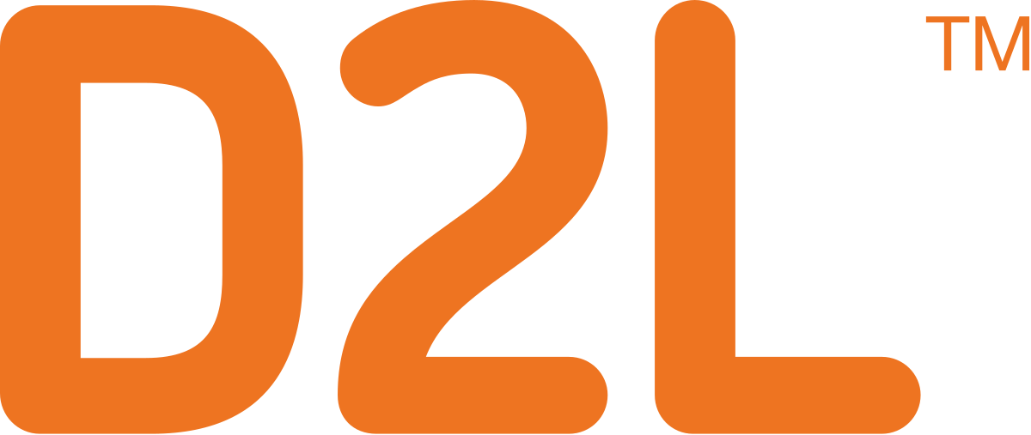
With Thanks …

Slide 15
Your Questions

