Slide 1
Evolving Faculty Careers
An Inside Higher Ed webcast
Thursday, April 12
2 p.m. Eastern

Slide 2
Presenters
Scott Jaschik, editor, Inside Higher Ed, scott.jaschik@insidehighered.com
Doug Lederman, editor, Inside Higher Ed, doug.lederman@insidehighered.com

Slide 3
The Evolving Ph.D. (or the Insufficiently Evolved Ph.D.)
Who should earn a Ph.D.?
Transparency (time to degree, debt, careers)
Disciplinary expectations
Learning to teach

Slide 4
The Job Market

Slide 5
The Skills That Matter

Slide 6
The New Job Interview

Slide 7
Leaving Academe

Slide 8
Adjunct Careers
Continued challenges in pay, benefits, job security
Impact of being in the majority at many campuses
The union movement
New models that break out of tenure-track/non-tenure track binary

Slide 9
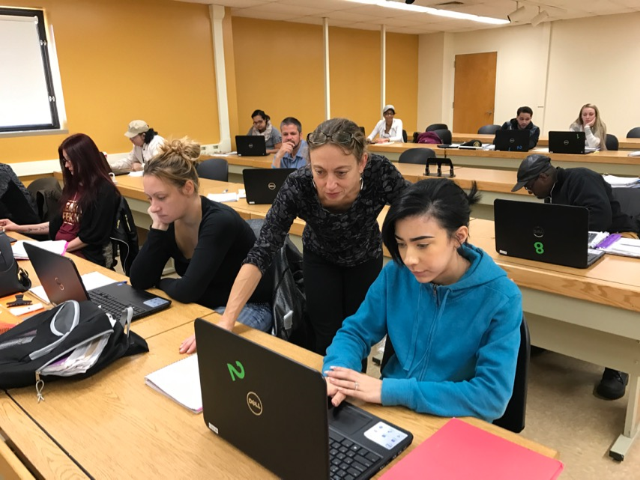
Where the Jobs Are: Community Colleges

Slide 10
Where the Jobs Are: Online

Slide 11
The New Skills
Fund-raising prowess
Program management
Attracting students
Teaching developmental courses
Career advice for students
Interdisciplinarity and disciplinarity
… and defending what matters

Slide 12
Old School Skill That Still Counts

Slide 13
Old School Skill That Still Counts

Slide 14
Old School Skill That Still Matters

Slide 15
Q&A
Your questions
Ideas for coverage

Slide 16
With Thanks …

